Slide 1
Project Presentation of Co-Op Project at Industry (Module-2) (22CS421)
On
Lintellect: Code Review Agent
Sneha Sharma
2210992392
Supervised By
Dr. Monika Aggarwal
Department of Computer Science and Engineering,
Chitkara University, Punjab

Slide 2
Introduction
Background and Motivation: In the fast-paced world of modern software development, the Pull Request (PR) review process is often the biggest bottleneck in the CI/CD pipeline. Human reviewers are frequently overwhelmed by high-volume code changes, leading to two common failures: "rubber-stamping" PRs without deep scrutiny or focusing exclusively on superficial style nits while missing critical logical flaws.
Objectives:
Centralized AI-Driven Review Platform: Develop a FastAPI-based agent that automatically detects programming languages and provides context-aware reviews for diverse codebases (Python, JS/TS, Go, Java, etc.).
Multi-Stage Reasoning Workflow: Implement a StateGraph architecture to decompose the review process into four distinct phases: initial analysis, issue discovery, false-positive validation, and executive reporting.
Seamless Pipeline Integration: Provide a secure, CORS-enabled API designed to trigger automatically during GitLab/GitHub pipeline runs, delivering actionable feedback.
2

Slide 3
Abstract
In modern software engineering, the code review process is frequently the primary bottleneck in the delivery lifecycle. While automated linters handle syntax and formatting, they lack the contextual reasoning required to identify complex logical flaws, leaving human reviewers burdened with high-volume, repetitive tasks. Lintellect is an automated code review agent designed to bridge this gap. Utilizing a multi-stage StateGraph architecture, it simulates a senior developer’s reasoning to provide deep-logic analysis directly within the CI/CD pipeline.

Slide 4
Scope of the Project
Overview: Lintellect is an intelligent, agentic code review platform designed to act as a helper within the CI/CD pipeline. When a developer pushes code to GitLab or GitHub, Lintellect automatically intercepts the diff, detects the programming language, and executes a four-node analysis graph: Analyzer, Issue Finder, Validator, and Report Generator
Features:
Multi-Agent Reasoning Graph
Automated Language Detection
Seamless Pipeline Integration
Future Enhancements:
Cross-File Contextual Awareness
Automated "Fix-It" Suggestions
4

Slide 5
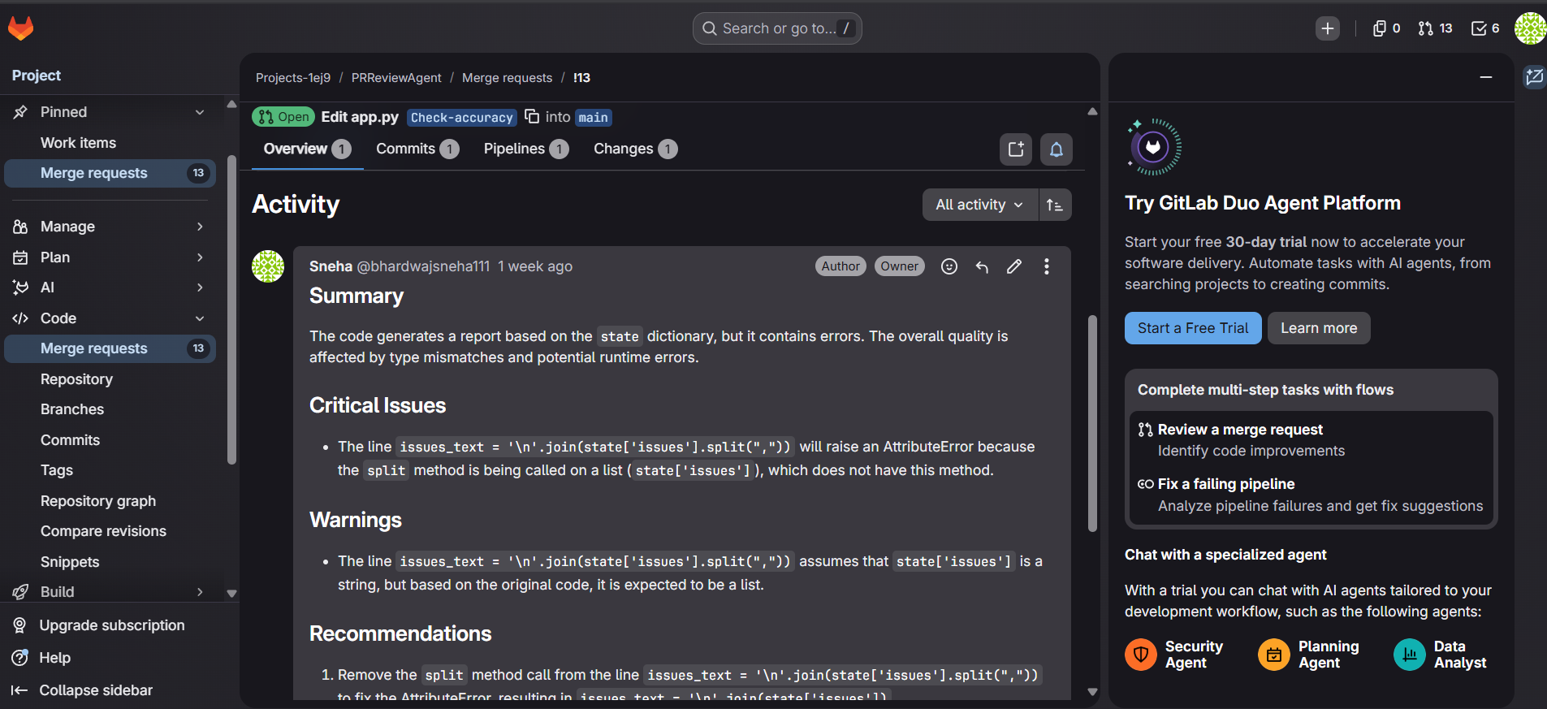
Sample Review

Slide 6
Methodology
System Design: The architecture follows a modular, asynchronous Service-Oriented Architecture (SOA), leveraging a stateful graph-based logic engine to process code reviews. By utilizing RESTful APIs for communication
Backend:
FastAPI
LangChain
LangGraph
6

Slide 7
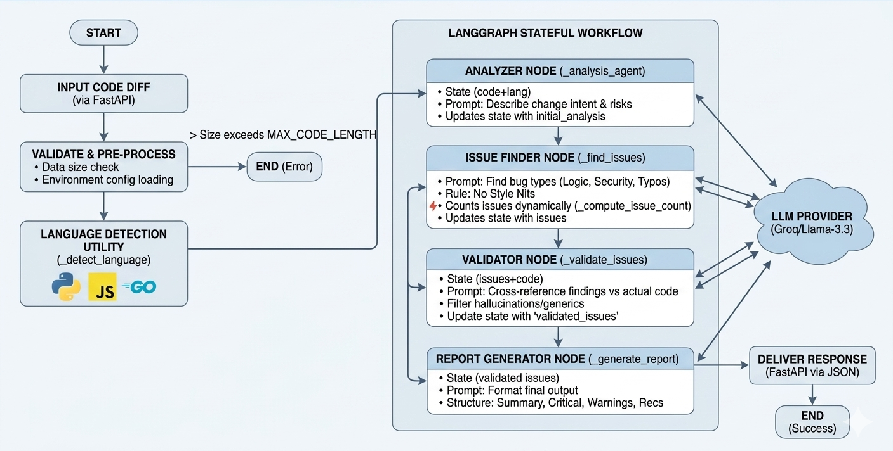
Workflow

Slide 8
Tools and Technologies
Frontend:
React.js
Tailwind CSS
Backend:
Spring Boot
Docker Compose
Database:
PostgreSQL
Prisma ORM
Supporting Tools:
Docker, Render, GitHub, Postman
8

Slide 9
Expected Outcomes
Reduced Pull Request Lead Time: By automating the initial review pass, the agent eliminates the idle time where a PR sits waiting for a human reviewer.
Enhanced Code Reliability and Security
Unlike human reviews, which can vary based on the reviewer’s mood or workload, Lintellect provides a consistent, objective baseline for every PR.
Future Prospects:
Integration with Knowledge Graphs and RAG
Code (Auto-Fix Capabilities) Future iterations will transition from identifying issues to proposing solutions.
9

Slide 10
References
FastAPI Documentation
LangChain Documentation
LangGraph Documentation
10

Slide 11
Thank You
11

