Slide 1


Corien Gruppen & Pim de Weijer

Slide 2
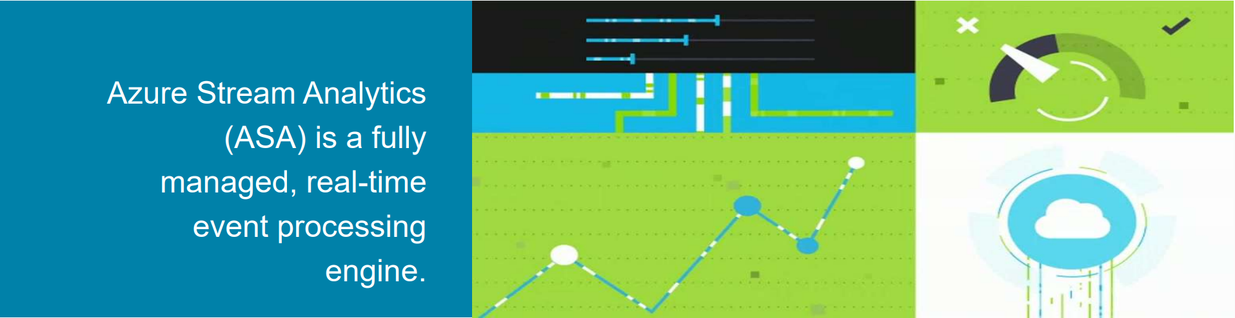
Source: https://www.slideshare.net/vkokaev/introduction-to-azure-stream-analytics

Slide 3




Source: https://www.slideshare.net/vkokaev/introduction-to-azure-stream-analytics

Slide 4


Source: https://www.slideshare.net/vkokaev/introduction-to-azure-stream-analytics

Slide 5




Source: https://www.slideshare.net/vkokaev/introduction-to-azure-stream-analytics

Slide 6



Source: https://www.slideshare.net/vkokaev/introduction-to-azure-stream-analytics

Slide 7



Source: https://www.slideshare.net/vkokaev/introduction-to-azure-stream-analytics

Slide 8



Source: https://www.slideshare.net/vkokaev/introduction-to-azure-stream-analytics

Slide 9
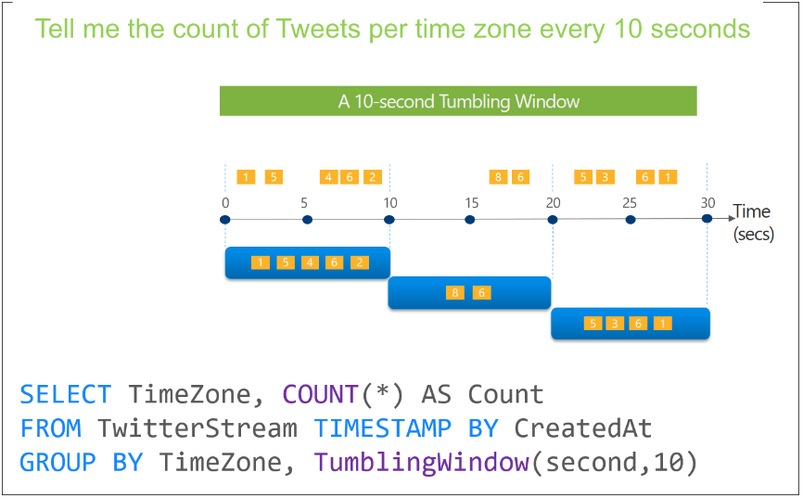



Source: https://learn.microsoft.com/en-us/azure/stream-analytics/stream-analytics-window-functions

Slide 10
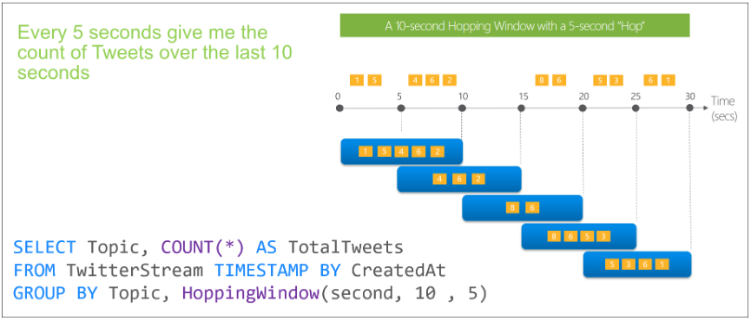
Source: https://learn.microsoft.com/en-us/azure/stream-analytics/stream-analytics-window-functions

Slide 11
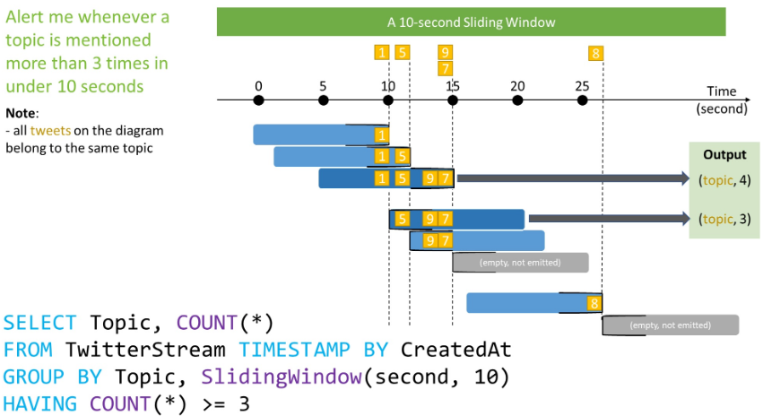
Source: https://learn.microsoft.com/en-us/azure/stream-analytics/stream-analytics-window-functions

Slide 12

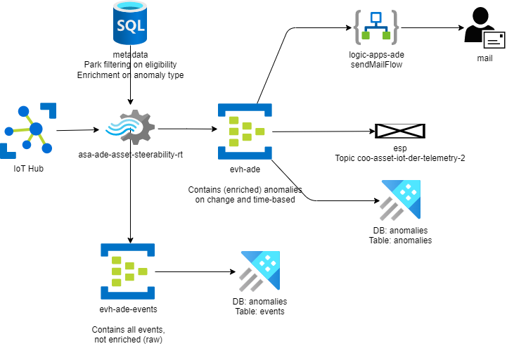

Slide 14
GIT repository with slides, assignments and solutions:
https://github.com/PimdeWeijer/SiGAzureStreamAnalytics

