Slide 1
QA IMS PROJECT
Andy Pimlott
July 2022

Slide 2
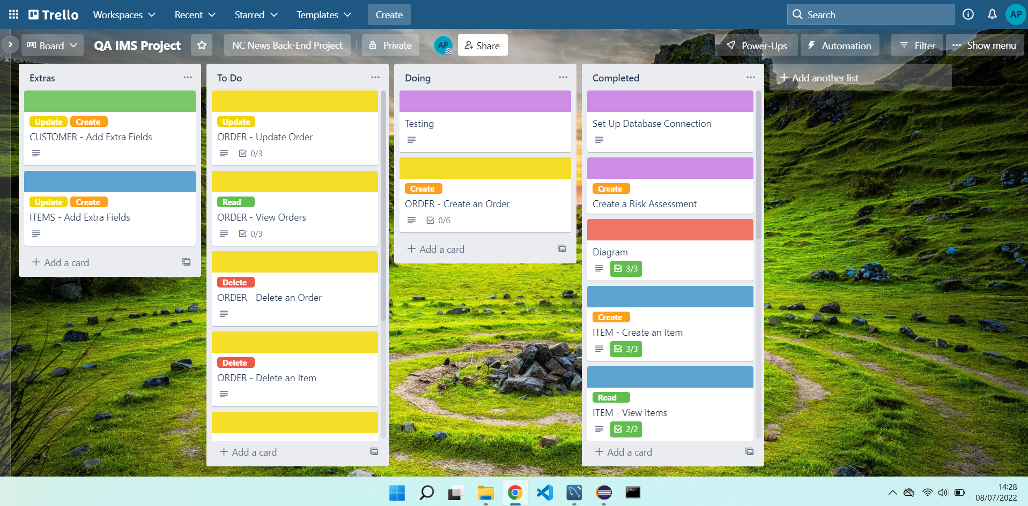
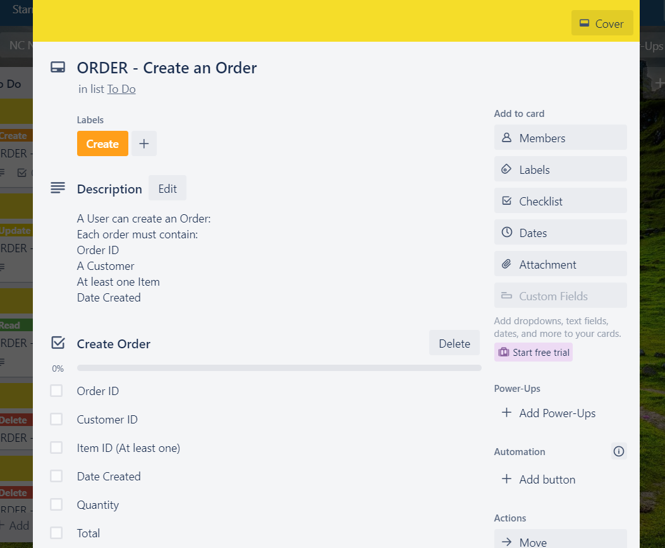
Approach
Take MVP and Break it Down in to User Stories

Slide 3
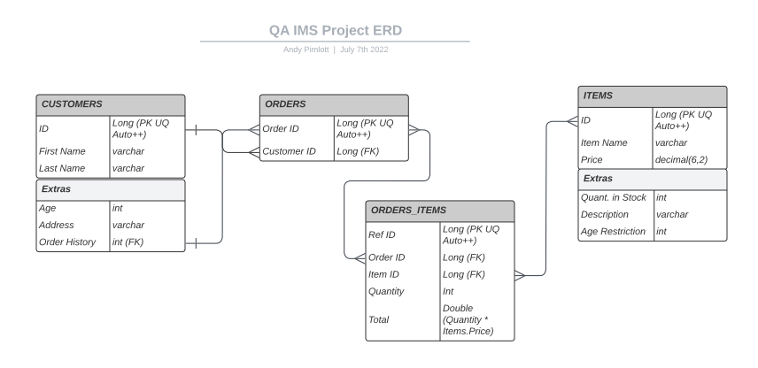
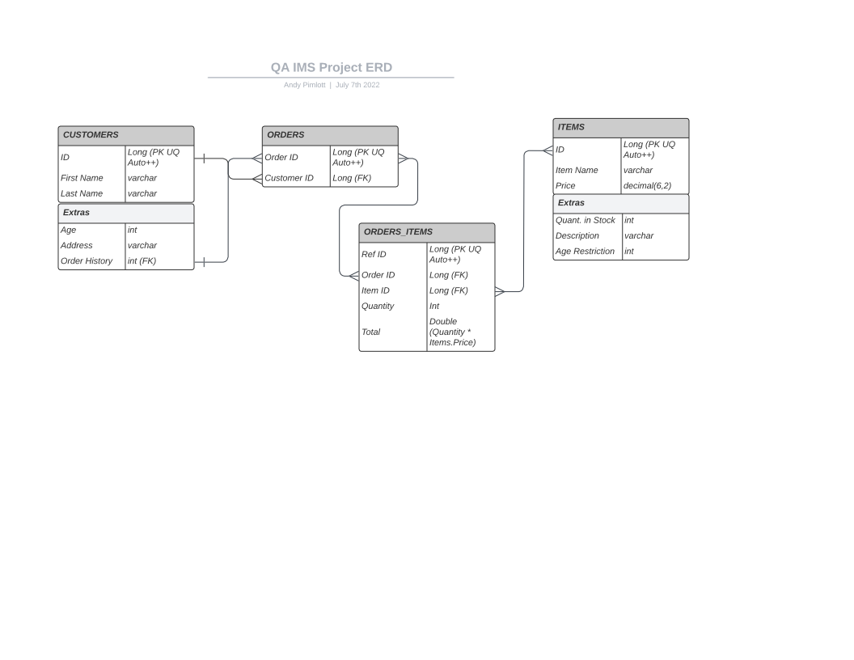
Approach
Using the MVP and User Stories to Create a Visual Flow
Of the Project

Slide 4







Technology Used

Slide 5
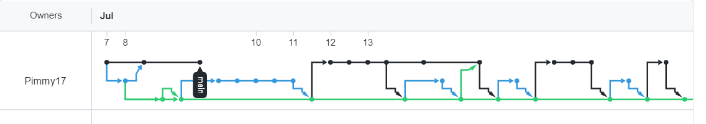
Version Control
Use a ‘dev’ branch (Green line in Network)
‘Main’ branch for final working project
Each User Story was a new branch – Merged with ‘dev’ when completed

Slide 6
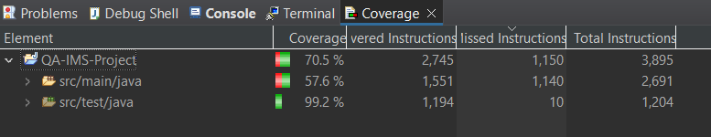
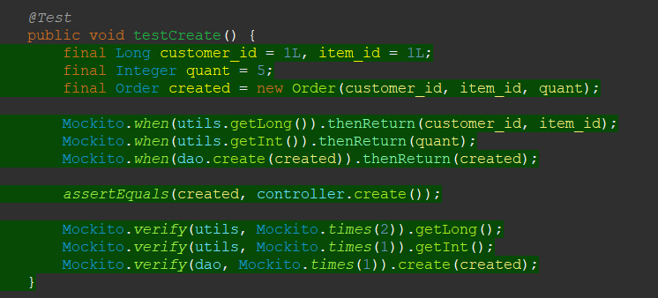
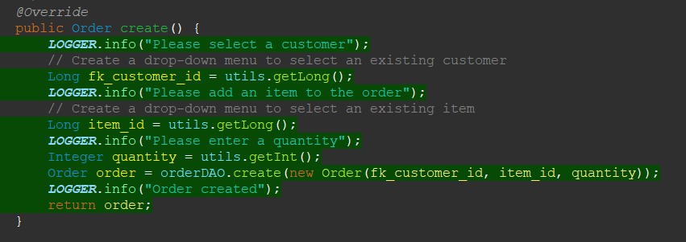
Testing
Coverage 57.6% for src/main/java
Order testing minimal due to constant error:
  Table "orders" not found; SQL statement: INSERT INTO orders (fk_customer_id) VALUES (?); [42102-200]
Example:

Slide 7
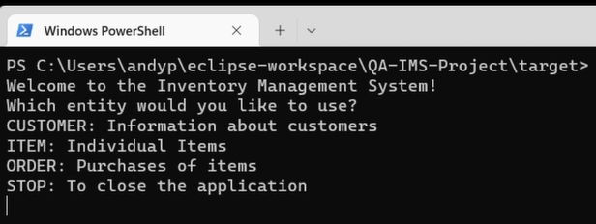
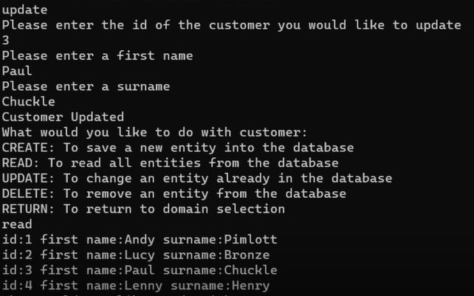
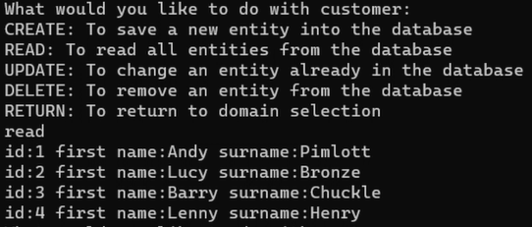
Run-Through of Project

Slide 8
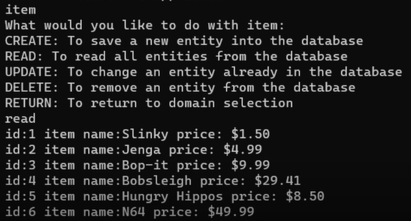
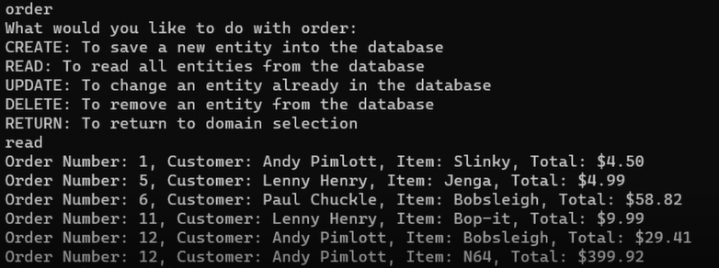
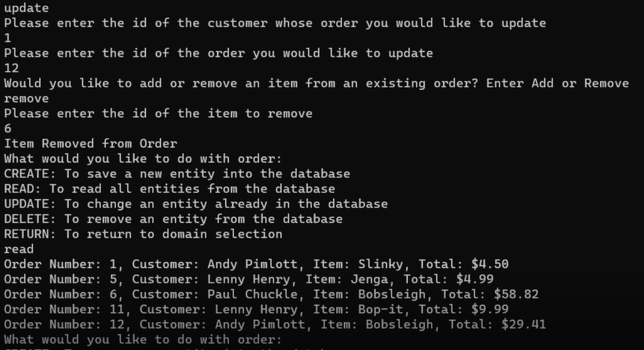
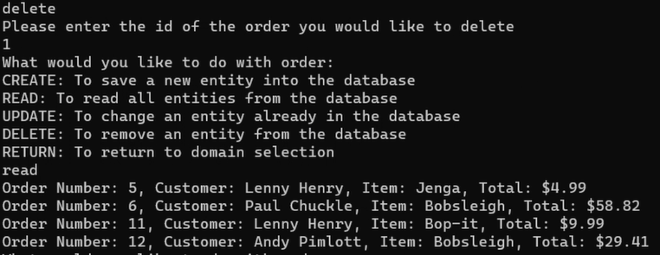
Run-Through of Project

Slide 9
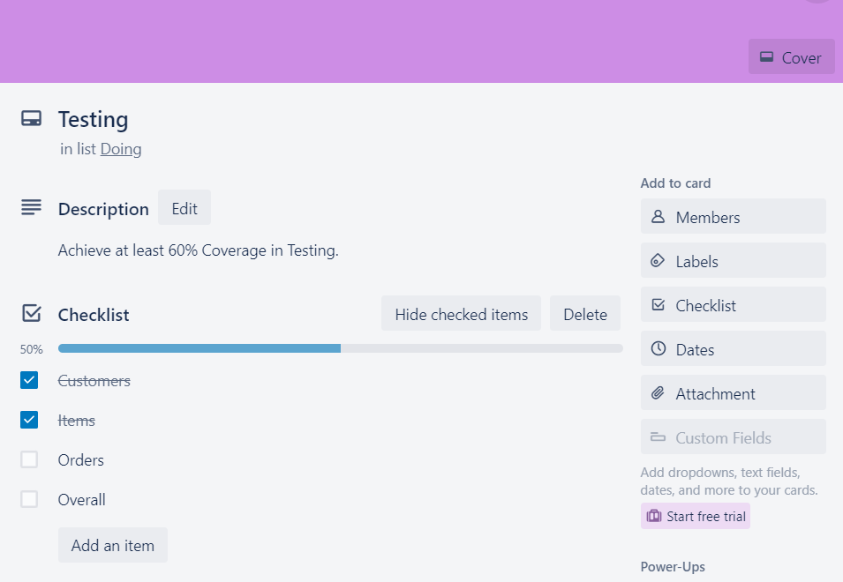
Sprint Review & Retrospective
What Went Well?
  Created a Working Project
  Learned 6 new Techs
To Be Completed:
  Orders Testing
  Display Final Order Total
Areas to Improve:
  Testing (Mockito and JUnit)
  Better Understanding of New Tech

Slide 10
Thank You for Listening!

