Slide 1
QA FULL STACK
API PROJECT
Andy Pimlott
August 2022

Slide 2
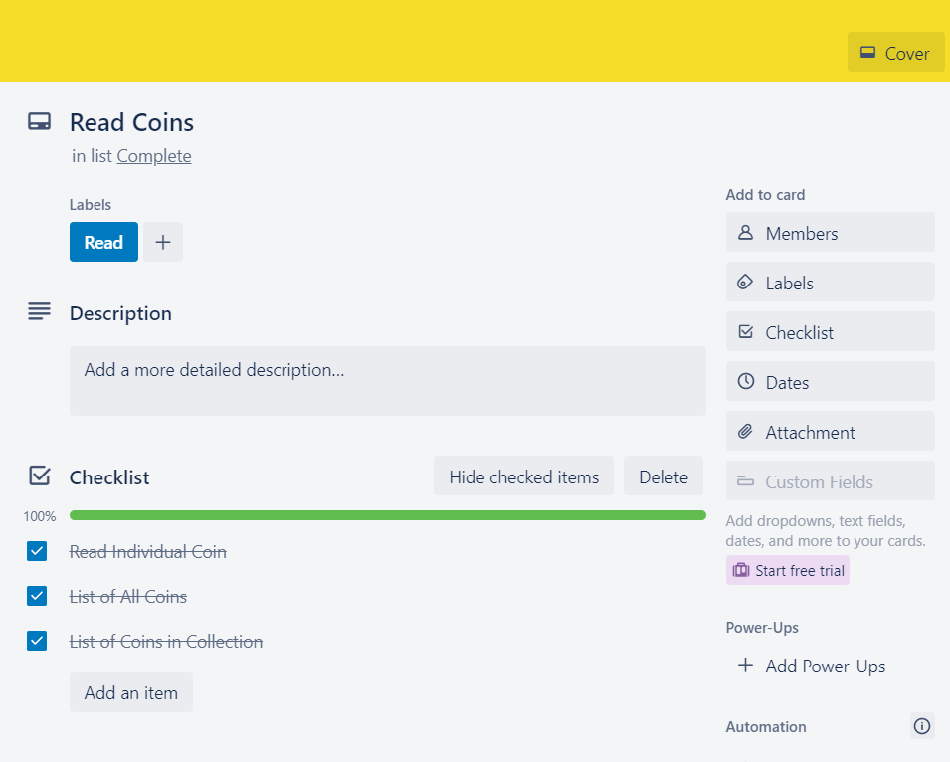
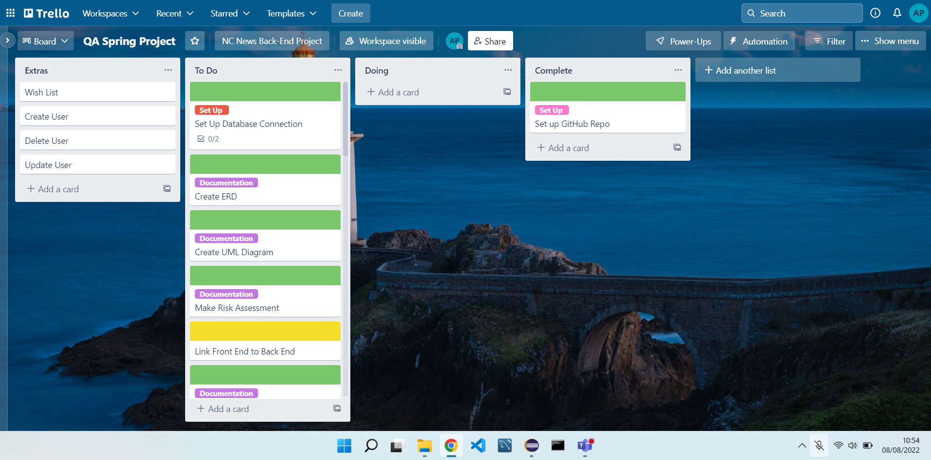
Approach
Given a specification, with an example of a project
Convert to User Stories
Colour co-ordinated (Yellow = BE)

Slide 3
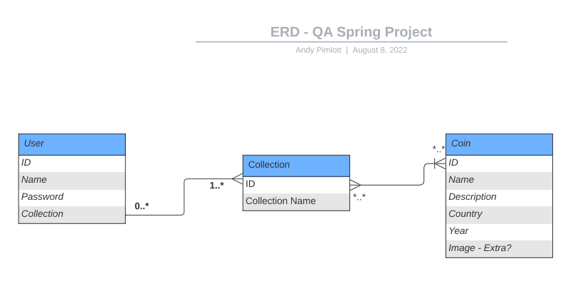
Approach
Using the MVP and User Stories to Create a Visual Flow
Of the Project – Coins part of MVP. Collection and Users were additional if I had time.

Slide 4










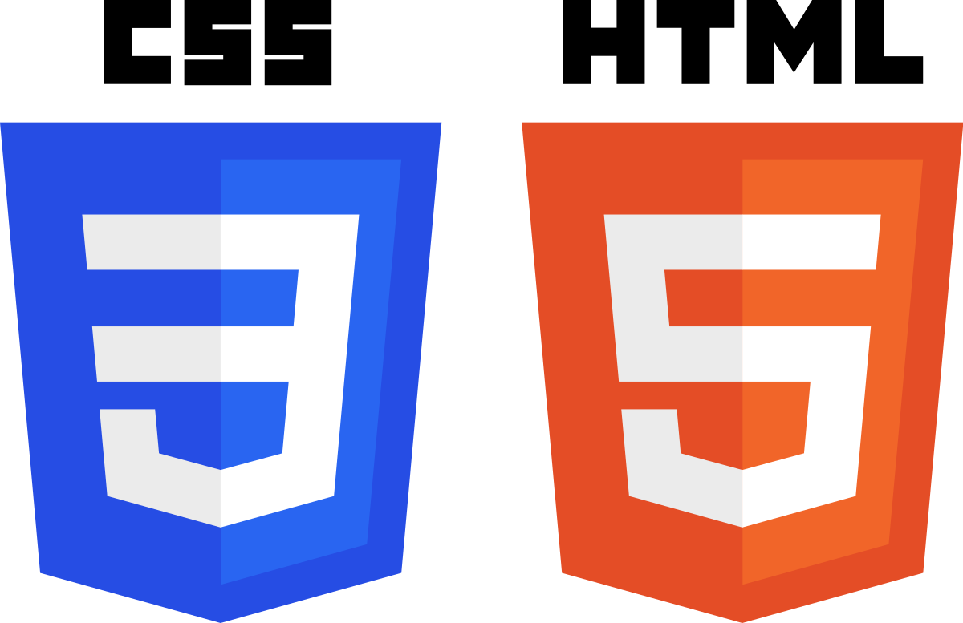

Technology Used

Slide 5
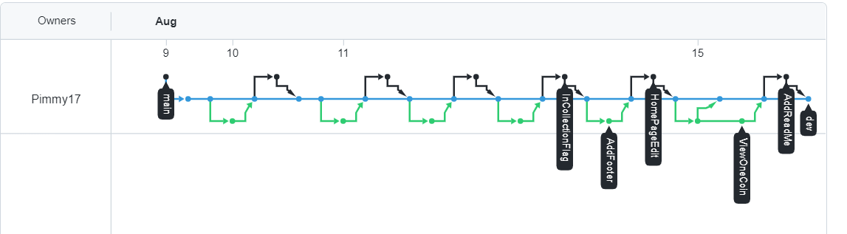
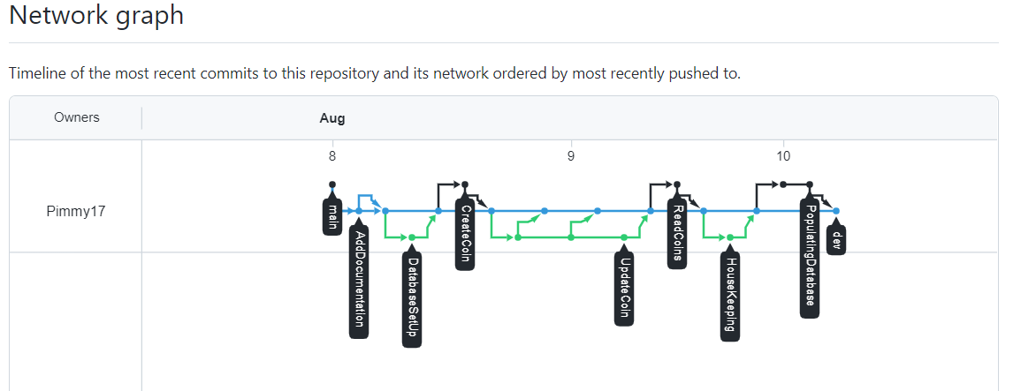
Version Control
Use a ‘dev’ branch (Blue/Middle line in Network)
‘Main’ branch for final working project
Each User Story was a new branch – Merged with ‘dev’ when completed

Slide 6
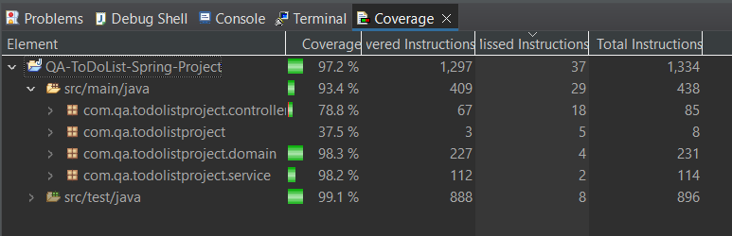
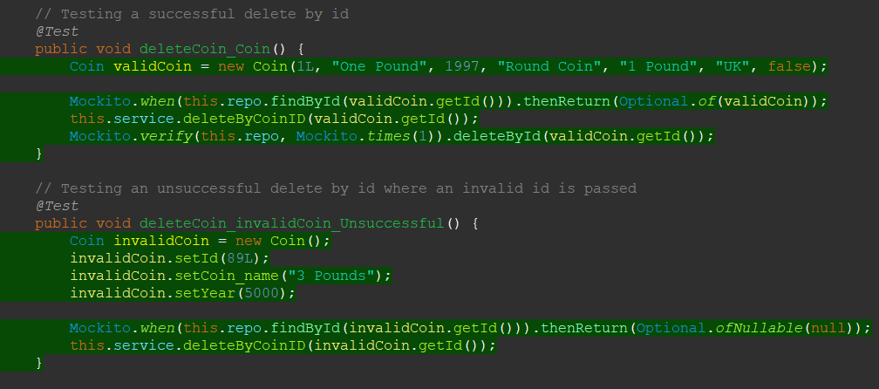
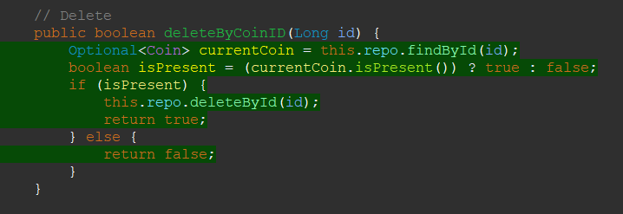
Testing
Coverage 93.4% for src/main/java
Testing Successful &
Unsuccessful examples

Slide 7
Run-Through of Project

Slide 8
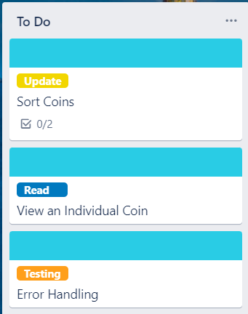
Sprint Review & Retrospective
What Went Well?
  Created a Working Project
  Better understand of Java Testing
To Be Completed:
  Sorting Features (Not working FE)
  View Individual Coin (Has More Details)
  Error Handling
Areas to Improve:
  Knowing the limitations of the tech
  How to pre-load a database

Slide 9
Thank You for Listening!

