Slide 1
Rails framework
1. Go to desktop
cd C://Users/Admin/Desktop
2. rails new kingsong

Slide 2
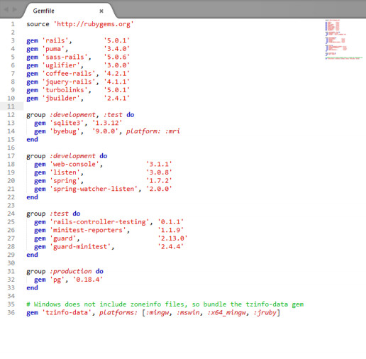
3. change Gemfile

Slide 3
4. cd kingsong
5. gem sources –a http://rubygems.org
6. answer y
7. gem install bundler
8. bundle install --without production
9. bundle show
10. bundle update
11.open cmd run rails server
12.open localhost:3000 will see welcome rails

Slide 4
13.create repo at github
14.git config --global user.name "your username"
15.git config --global user.email "your email"
16.git init
17.git add –A
18.git status
19.git commit –m “create project kingsong”
20. git remote add origin “git repo”
21. git push -u origin master

Slide 5
22.heroku login
23. heroku create
24.git push heroku master
25. git checkout -b static-pages
26. rails generate controller StaticPages home kingsong1 kingsong2 kingsong3

Slide 6
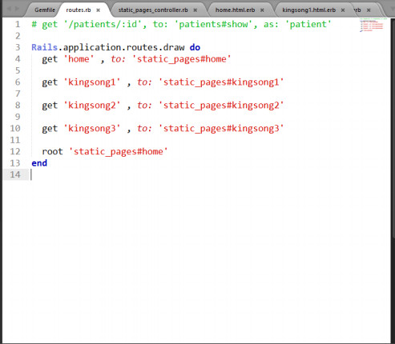
27. edit config/routes

Slide 7
28.Look localhost:3000
29.Edit app/views/static_pages/home.html.erb
30.Edit app/views/static_pages/kingsong1.html.erb
31.Edit app/views/static_pages/ kingsong2.html.erb
32.Edit app/views/static_pages/ kingsong3.html.erb
33.Edit Readme

Slide 8
34.git add –A
35.git commit -m "Finish static pages"
36.git checkout master
37.git merge static-pages
38. git push
39.git push heroku
40.git checkout –b presentation
41.create powerpoint
42.edit powerpoint and save as presentation.ppt

Slide 9
43.git add –A
44.git commit -m "Finish presentation"
45.git checkout master
46.git merge presentation
47.git push

