Slide 1
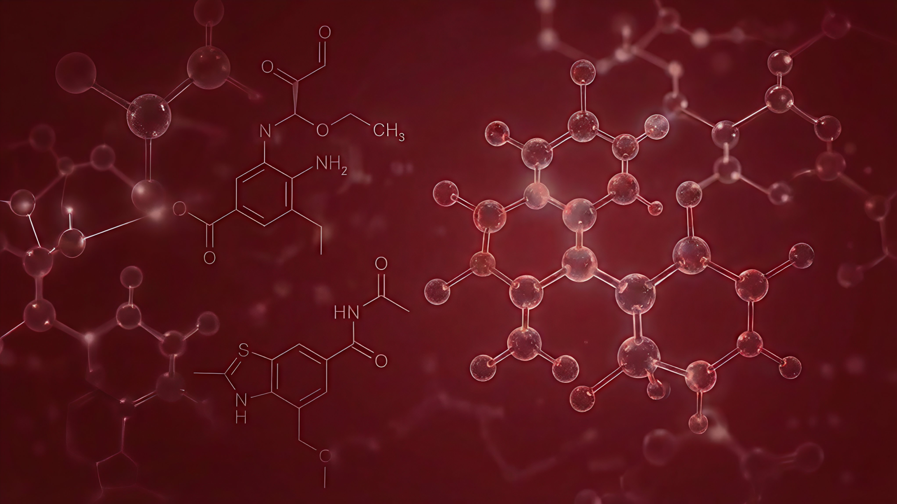

Molecular SSINet: Applying Self-Supervised Discovering of Interpretable Features to Molecule Generation
Pimpinelli Francesco 2214340
REINFORCEMENT LEARNING A.A 25/26

Slide 2

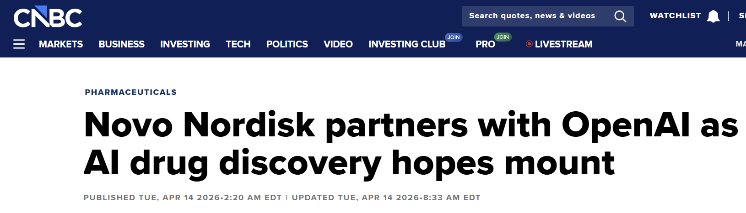

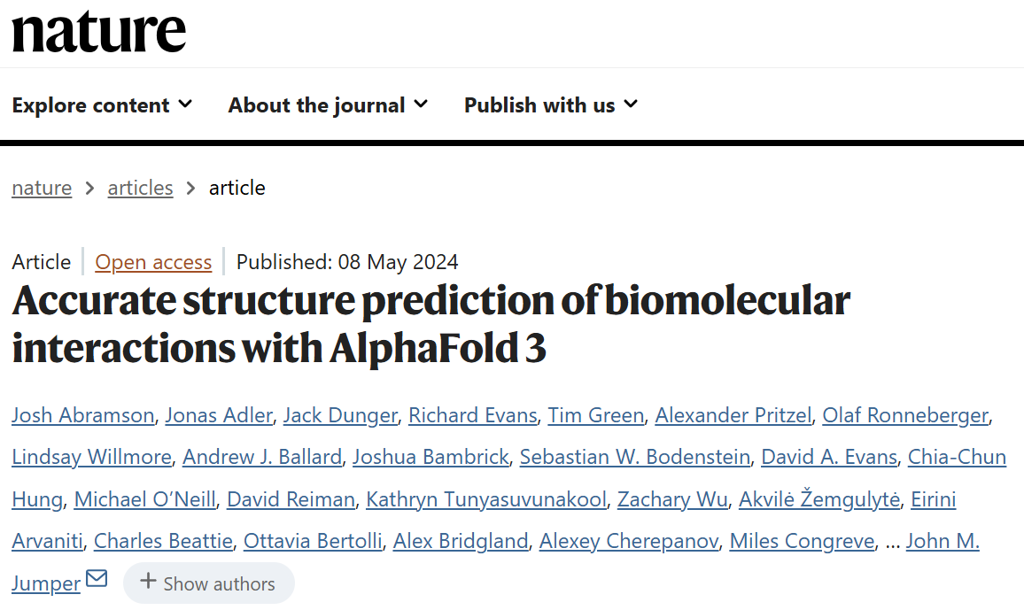
🔎The Context
Pimpinelli Francesco
2
Notes:
The Reinforcement Learning opened a lot of new frontiers in the biological and medical field. In 2024 AlphaFold3 by Google DeepMind mapped all the molecules in the nature

Slide 3

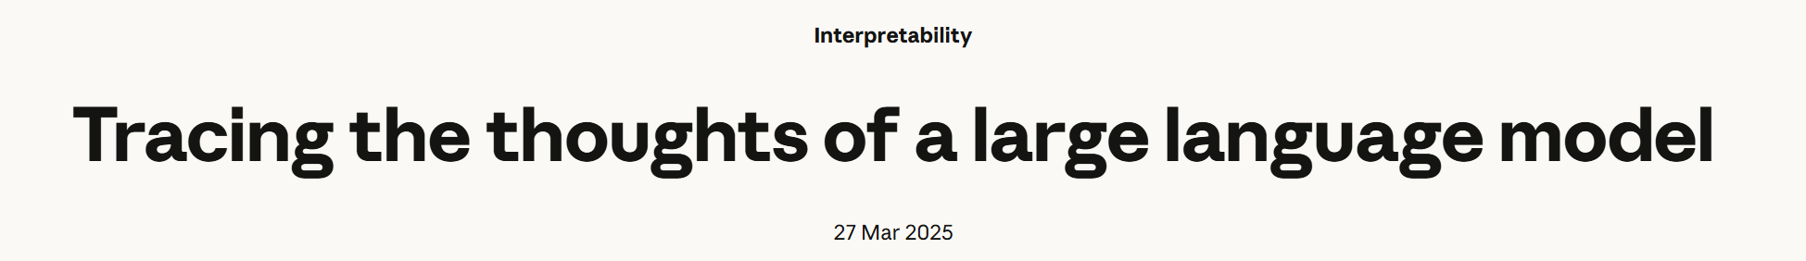
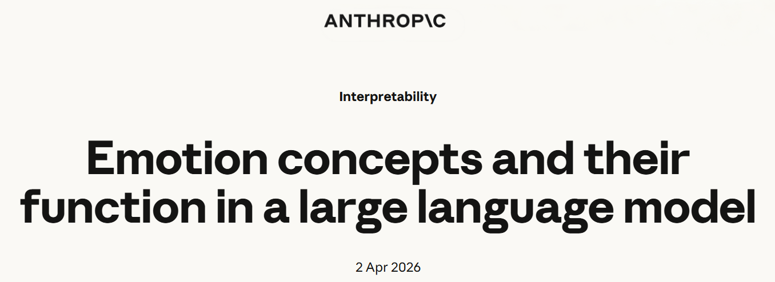
🔎The Context: 👀Interpretability
“Better understanding of the
decision-making processes”
Pimpinelli Francesco
3
Notes:
Prior saliency methods produce coarse maps with little quantitative grounding.
Understandable also to non-experts

Slide 4
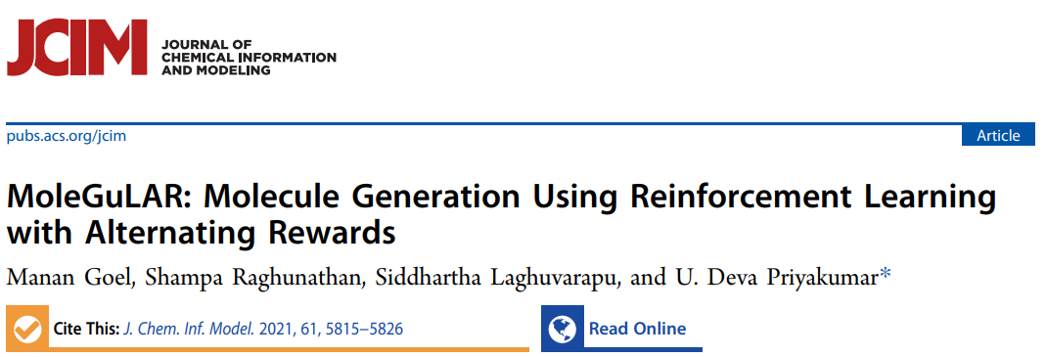
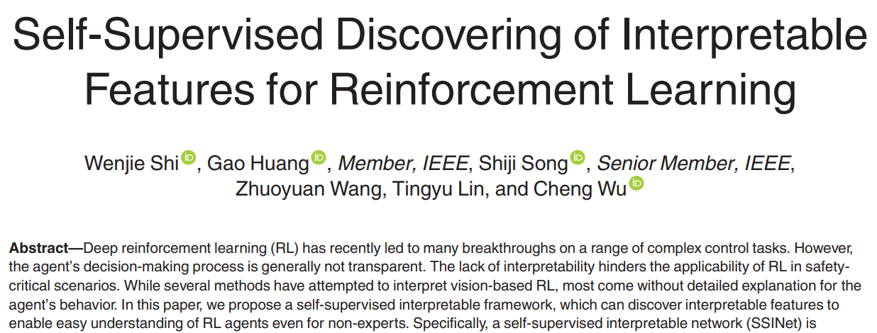
🔎The Context: 🧬 MoleGuLAR & 🖥️ SSINet
Pimpinelli Francesco
4
Notes:
The Reinforcement Learning opened a lot of new frontiers in the biological and medical field. In 2024 AlphaFold3 by Google DeepMind mapped all the molecules in the nature

Slide 5
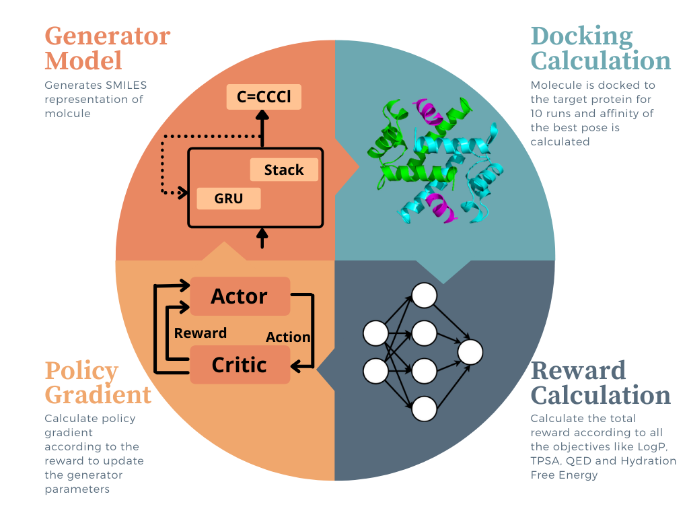
🧬MoleGuLAR: The Pipeline
Pimpinelli Francesco
5

Slide 6
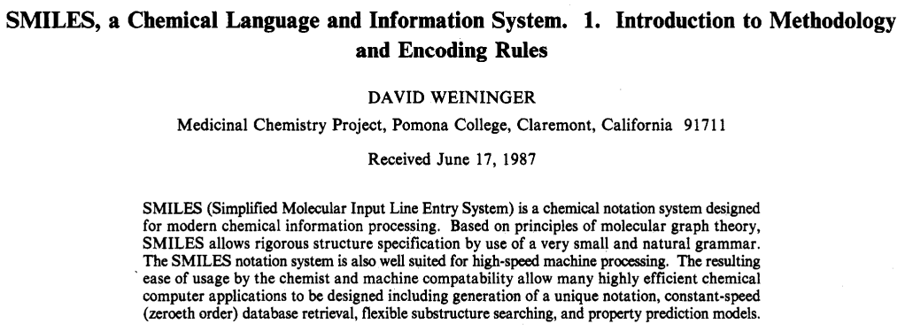

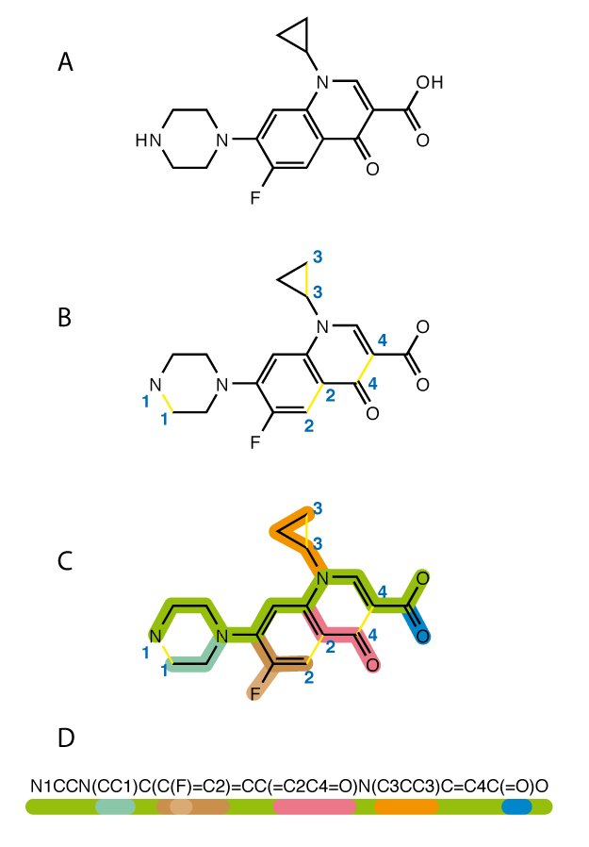
🧬MoleGuLAR: 🙂 SMILES
Pimpinelli Francesco
6

Slide 7


🧬MoleGuLAR: 📄Data & 🎯Target Proteins
$$SARS−CoV−2 M_{pro}$$
Protein essential for the viral transcription and replication of the COVID-19 virus.
Pre-Trained on
ChEMBL
TTBK1
Target protein for treating some neurodegenerative diseases, such as Alzheimer’s.
Pimpinelli Francesco
7
Notes:
Main Protease

Slide 8
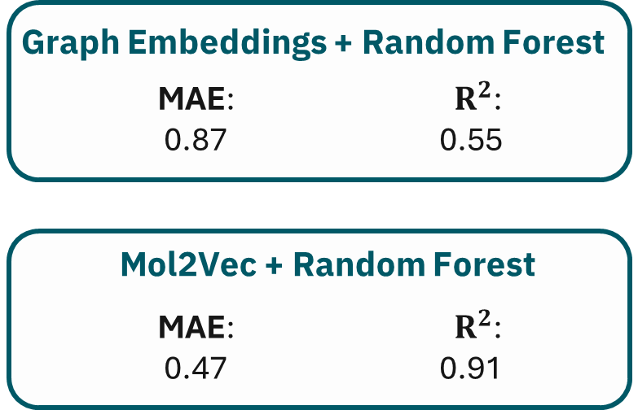
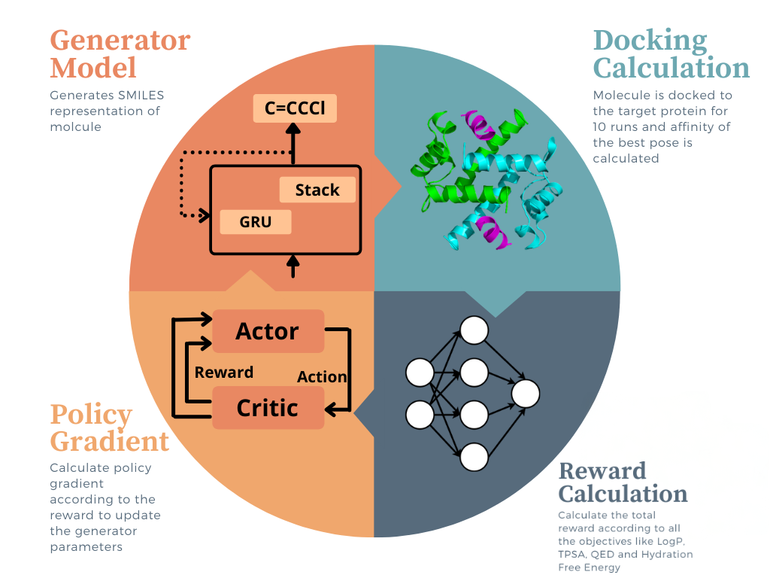

🧬MoleGuLAR: BA Estimation
Graph Isomorphism Network (GIN)
Pimpinelli Francesco
8

Slide 9
🤝BA Estimation: Chosen Architecture
Graph Isomorphism Network (GIN)
Pimpinelli Francesco
9

Slide 10
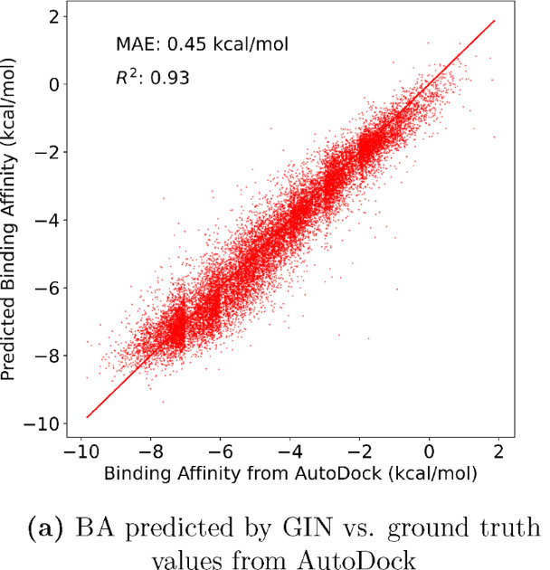
🤝BA Estimation: Chosen Architecture
Graph Isomorphism Network (GIN)
Pimpinelli Francesco
10

Slide 11
MoleGuLAR: 🎯 Desired Properties
Binding Affinity
LogP
Strength of the non-covalent interaction between two molecules
Measures a molecule's lipophilicity, how well it dissolves in fats vs water
TPSA
Surface sum over all polar atoms or molecules, including their attached hydrogen atoms
QED
Hydration Free Energy
A 0-to-1 scoring method to map resemblance to known oral drugs
The amount of energy released when one mole of ions undergoes solvation
Pimpinelli Francesco
11

Slide 12
MoleGuLAR: 🎯 Desired Properties
Binding Affinity
LogP
Strength of the non-covalent interaction between two molecules
Measures a molecule's lipophilicity, how well it dissolves in fats vs water
TPSA
Surface sum over all polar atoms or molecules, including their attached hydrogen atoms
QED
Hydration Free Energy
A 0-to-1 scoring method to map resemblance to known oral drugs
The amount of energy released when one mole of ions undergoes solvation
Pimpinelli Francesco
12

Slide 13
MoleGuLAR: 🏆Reward Strategies
Exponential
Linear
Strong push toward low binding energy
Constant gradient based on the score minus a threshold
Logarithmic
Squared
Gentle at first but becomes aggressive as scores approach zero
Heavily punishes low-quality molecules
Pimpinelli Francesco
13

Slide 14
MoleGuLAR: 🏆Reward Strategies
Weighted Sum
Rewards
Alternating Rewards
Among all the Desired Properties, with fixed weights
All weights are set to 0 except for one specific property, which is cycled at regular intervals
Pimpinelli Francesco
14

Slide 15
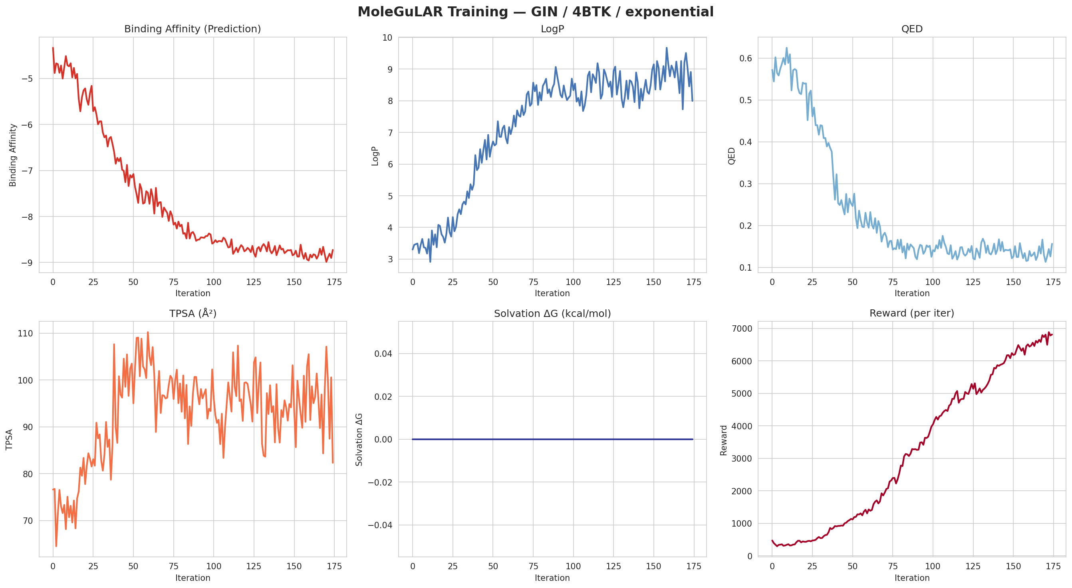
MoleGuLAR: 🏆Reward Strategies
Alternating Rewards
Weighted Sum
Rewards
All weights are set to 0 except for one specific property, which is cycled at regular intervals
Among all the Desired Properties, with fixed weights
Pimpinelli Francesco
15

Slide 16
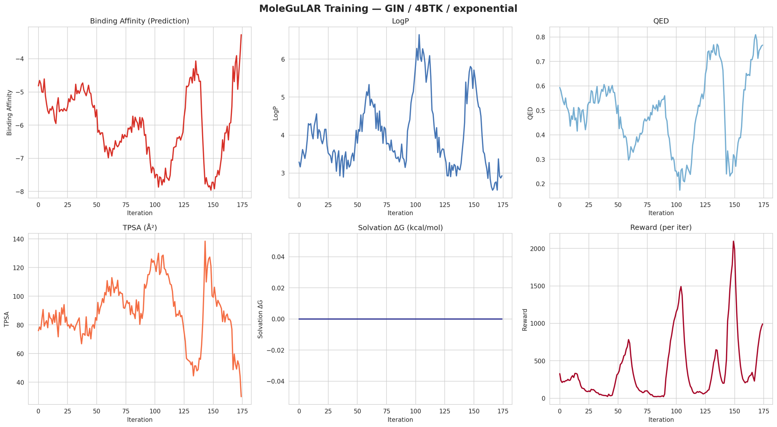
MoleGuLAR: 🏆Reward Strategies
Weighted Sum
Rewards
Alternating Rewards
Among all the Desired Properties, with fixed weights
All weights are set to 0 except for one specific property, which is cycled at regular intervals
Pimpinelli Francesco
16

Slide 17
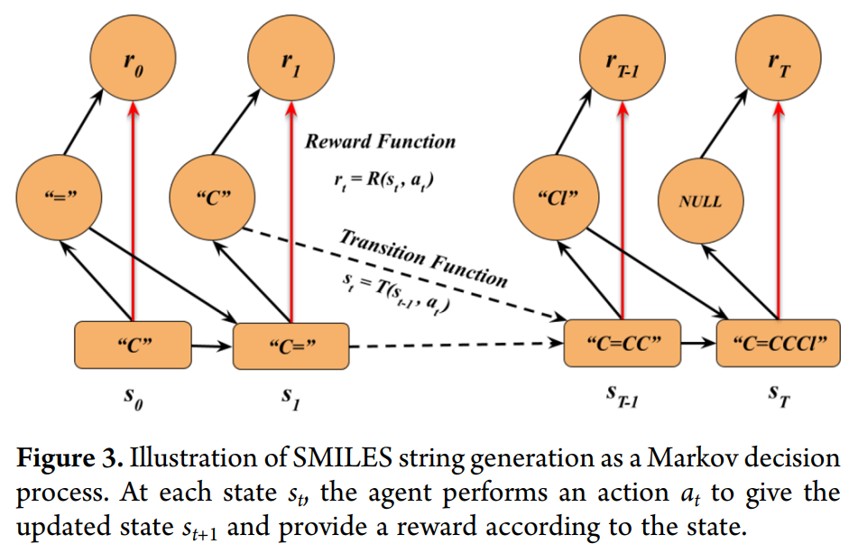
🧬MoleGuLAR: 🤖The RL Model
Pimpinelli Francesco
17

Slide 18
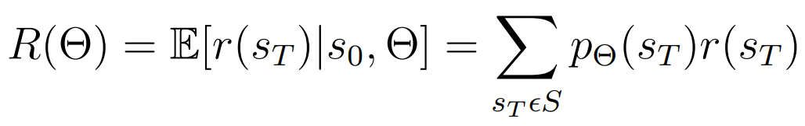
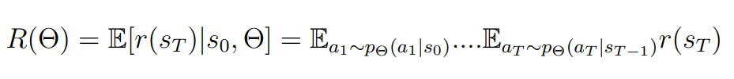

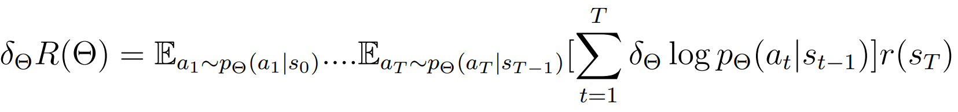
🤖The RL Model : 💪REINFORCE
Expected Reward Function
S has exponential size
Differentiation Rule
Gradient
Pimpinelli Francesco
18
Notes:
The set S containing all terminal states of length T is exponential in size and hence, needs to be approximated as a mathematical expectation. To maximize R(Θ) we need to calculate its gradient which can be done using the REINFORCE algorithm1 and the following differentiation rule

Slide 19
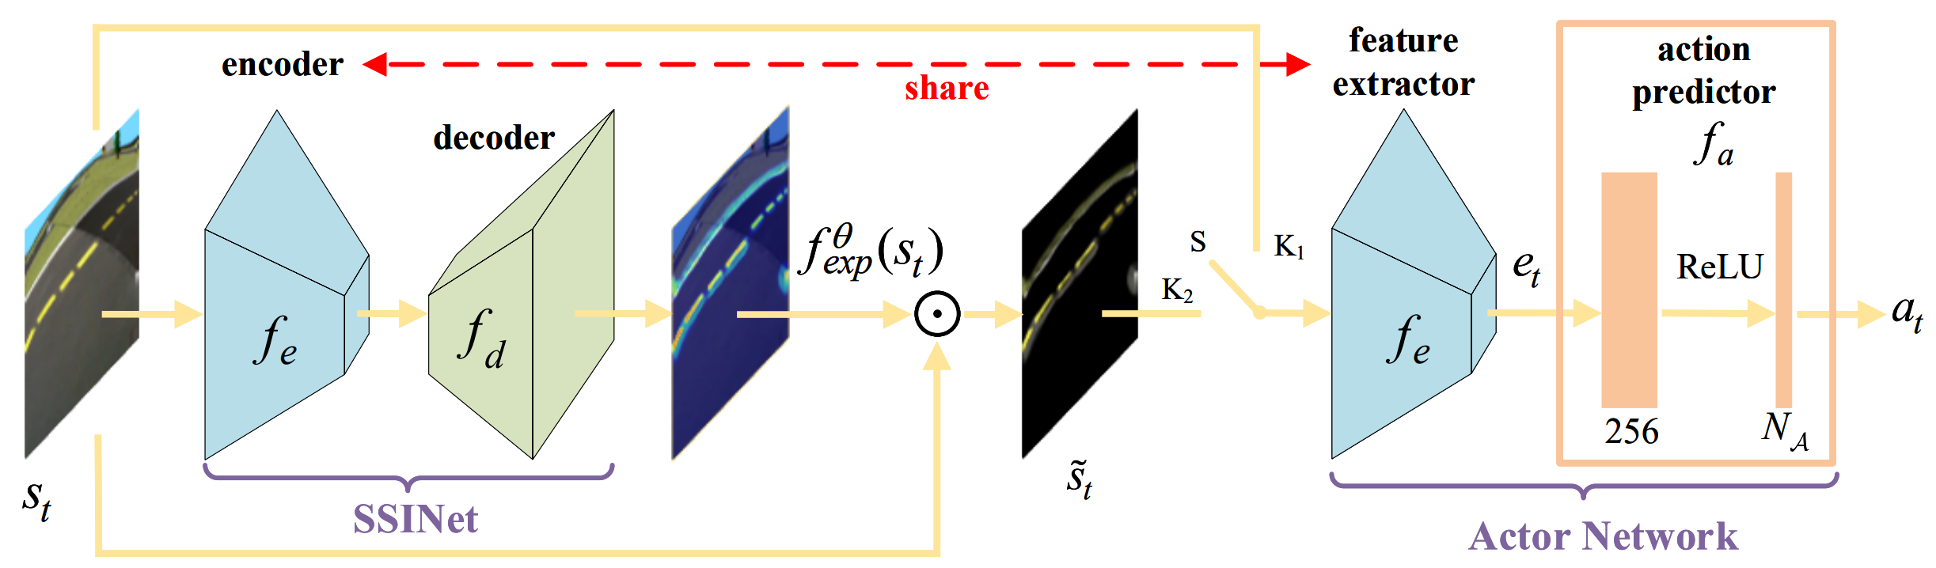
🖥️ SSINet: 🏗️The Architecture
Pimpinelli Francesco
19
Notes:
Fig. 1: Architecture diagram of our self-supervised interpretable framework, which includes two stages. In the first stage, we switch S to K1 and jointly pretrain the feature extractor fe and action predictor fa with RL. In the second stage, we switch S to K2 and train the decoder fd while freezing fe and fa. The encoder is shared from the feature extractor and also denoted by fe. NA is the dimension of action space.

Slide 20


🏋️ The Training: Stage 1🎭 The Actor Network
Trained end-to-end with PPO
Pimpinelli Francesco
20
Notes:
These two components are trained end-to-end with PPO. The agent interacts with the environment, collects experience, and updates its weights to maximize cumulative reward. Nothing unusual here — this is just standard deep RL training.
Once the agent has converged to a good policy, it is called the expert policy π_e. It is then frozen and used to collect a dataset of M = 50,000 state-action pairs {(s_i, a_i)} by rolling it out in the environment. Each pair records a state the agent visited and the action it chose. This dataset is the only "supervision" that SSINet will ever receive

Slide 21
🖥️ SSINet: 🏋️The Training (Self-Supervised)
After convergence becomes the expert policy to collect the state-action pairs from the environment
Pimpinelli Francesco
21
Notes:
Prior saliency methods produce coarse maps with little quantitative grounding.
Understandable also to non-experts

Slide 22
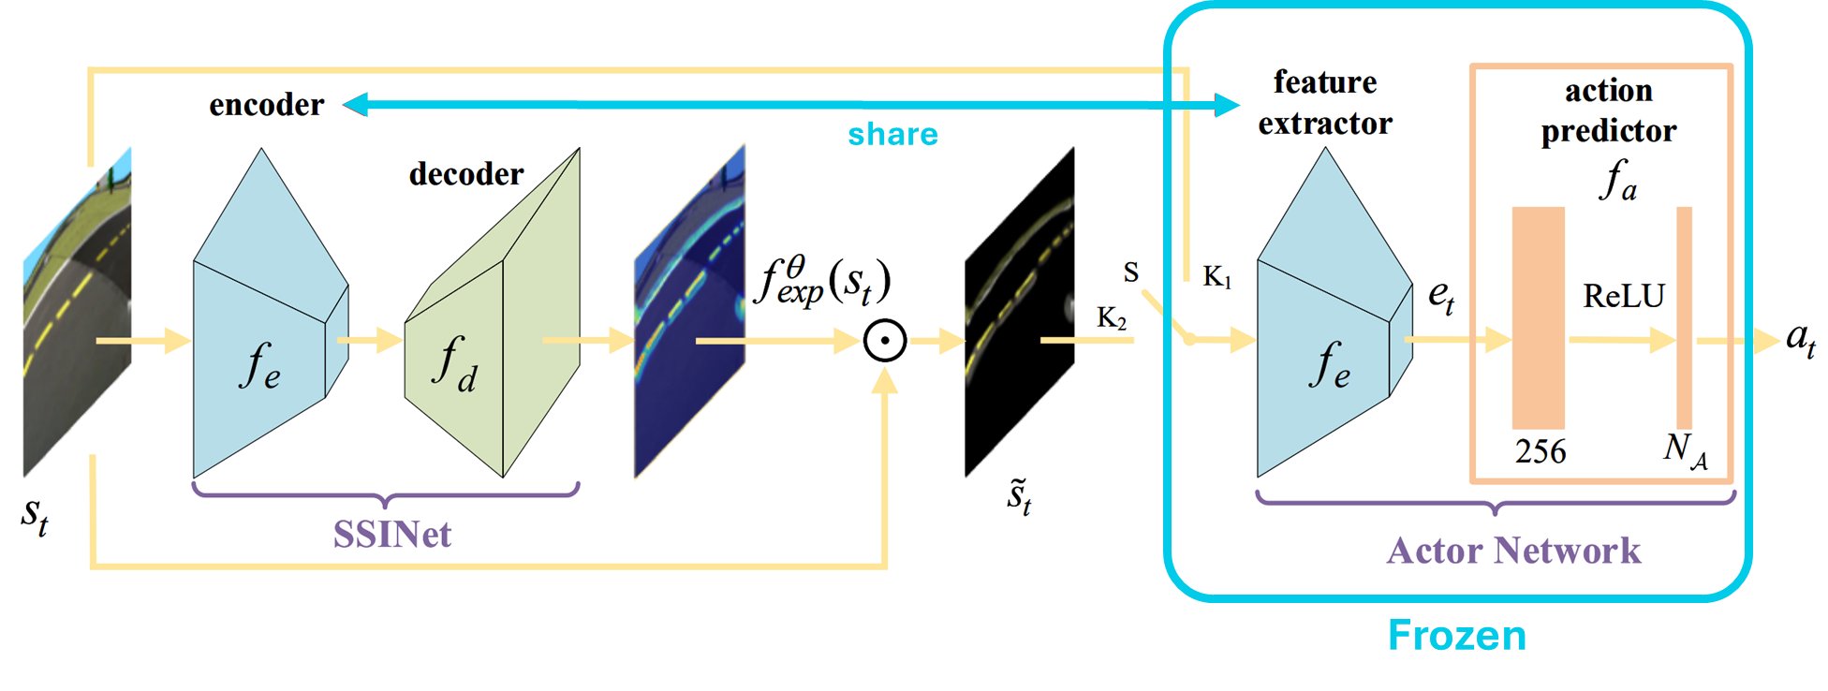
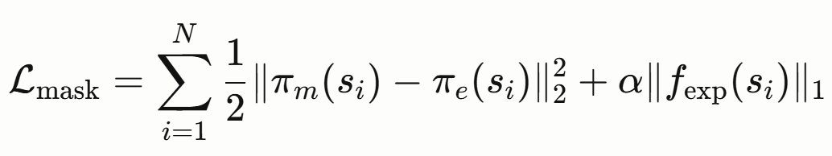
🏋️ The Training: Stage 2 🔎 The SSINet
Pimpinelli Francesco
22
Notes:
Prior saliency methods produce coarse maps with little quantitative grounding.
Understandable also to non-experts

Slide 23
🏋️ The Training: Stage 2 🔎 The SSINet
share
Weight Update
Frozen
Pimpinelli Francesco
23
Notes:
Prior saliency methods produce coarse maps with little quantitative grounding.
Understandable also to non-experts

Slide 24
🖥️ SSINet: 2️⃣Two Core Properties
Maximum Behavior Resemblance
Minimum Region Retaining
The masked state must yield (almost) the same action as the original state
The mask should retain as little of the image as possible.
Pimpinelli Francesco
24
6
Pimpinelli Francesco
Notes:
MRR – sharpens the

Slide 25
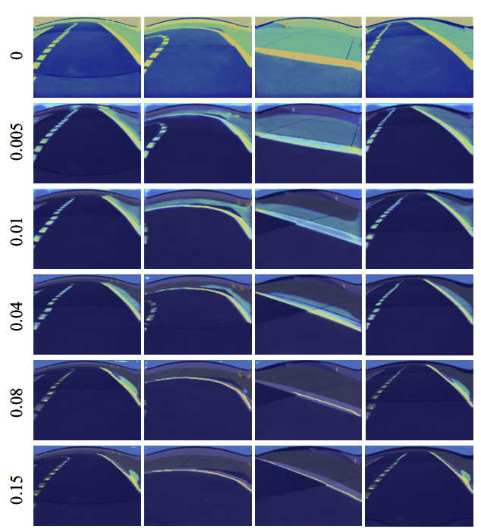
🖥️ SSINet: 2️⃣Two Core Properties
Minimum Region Retaining
The mask should retain as little of the image as possible.
Pimpinelli Francesco
25
6
Pimpinelli Francesco
Notes:
MRR – sharpens the

Slide 26
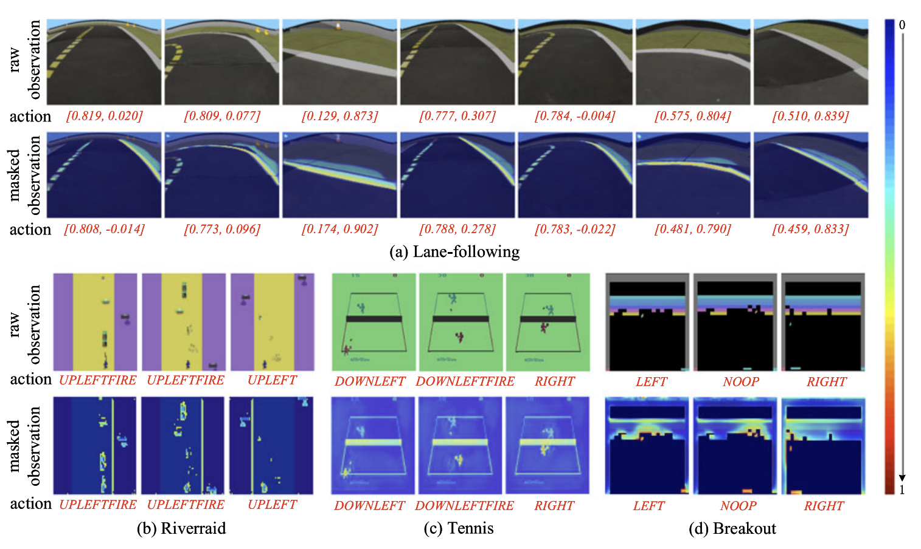
🖥️ SSINet: 🔚The Output
Pimpinelli Francesco
26
Notes:
Prior saliency methods produce coarse maps with little quantitative grounding.
Understandable also to non-experts

Slide 27
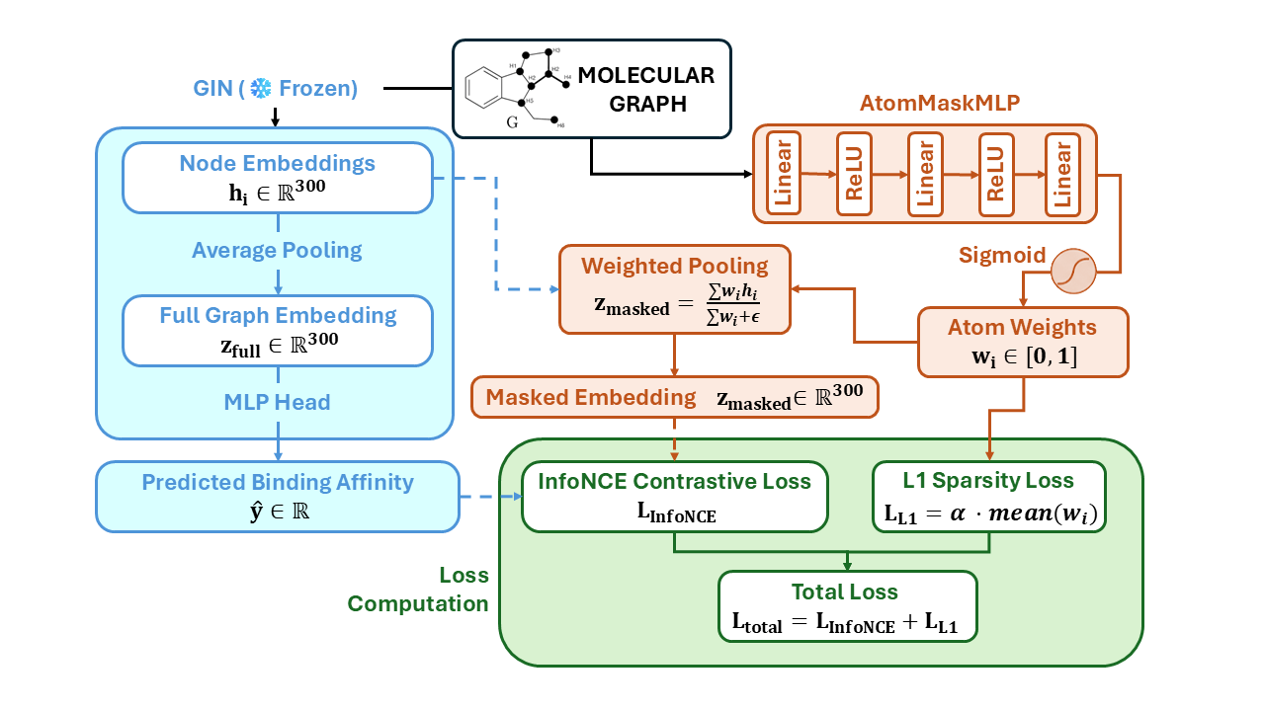
🆕The novelty: 🧬Molecular SSINet
Pimpinelli Francesco
27

Slide 28
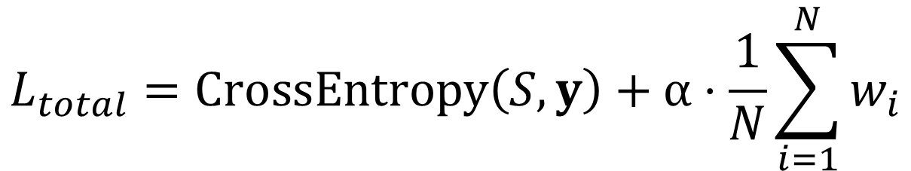
🆕The novelty: 🧬Molecular SSINet
$$L_{total}=CrossEntropy\left(S,y\right)+α⋅\frac{1}{N}\sum_{i=1}^{N}{w_{i}}$$
Maximum Behavior Resemblance
Minimum Region Retaining
The masked state must yield (almost) the same action as the original state
The mask should retain as little of the image as possible.
Pimpinelli Francesco
28
Notes:
InfoNCE contrastive loss, trains the AtomMaskMLP to produce a masked graph embedding — obtained via importance-weighted atom pooling — that remains indistinguishable from the full GIN embedding of the same molecule, while being distinguishable from the embeddings of all other molecules in the batch; this enforces Property 1 (Maximum Behavior Resemblance).
L1 sparsity penalty that directly minimizes the mean atom importance weight, pushing the mask to highlight as few atoms as possible and enforcing Property 2 (Minimum Region Retaining).
Gradients flow exclusively through the AtomMaskMLP; the GIN encoder remains fully frozen throughout.

Slide 29
🆕The novelty: 🧬Molecular SSINet
Pimpinelli Francesco
29

Slide 30
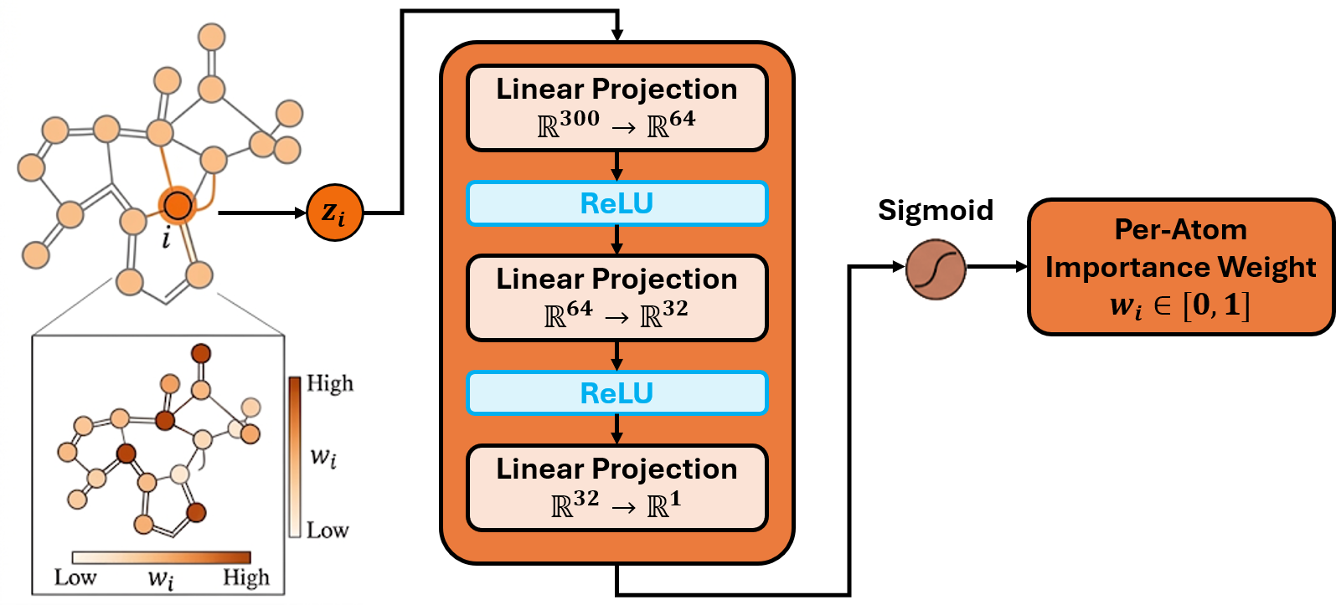
🧬Molecular SSINet : 🏋️Training The Mask
Pimpinelli Francesco
30

Slide 31
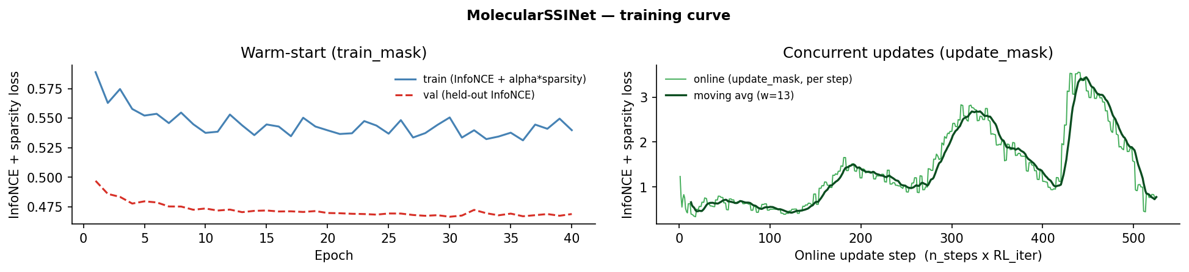
🧬Molecular SSINet : 🏋️Training The Mask
Warm-Start
First training on pretraining molecules to ensure convergence
Pimpinelli Francesco
31
Notes:
Our implementation of SSINet departs from the original formulation by initializing the structured sparsity mask through a warm start—deriving an initial mask from a brief pretraining phase rather than a random or uniform prior—and subsequently refining it via an online update that recomputes mask saliency throughout training rather than fixing it after a single offline calibration pass. The canonical SSINet, designed for image domains, exploits the continuous, grid-structured locality of pixels, where a statically computed mask remains valid because spatial correlations are stationary across the input manifold. Molecular graphs, however, present discrete, permutation-invariant topological relationships whose connectivity-induced feature distributions shift substantially across batches, rendering a fixed mask unstable. The warm start preserves the original convergence trajectory, while the online update tracks the non-stationary graph statistics, jointly reproducing Sinte's intended gradient dynamics and regularization behavior under the domain transfer from pixels to molecules.

Slide 32
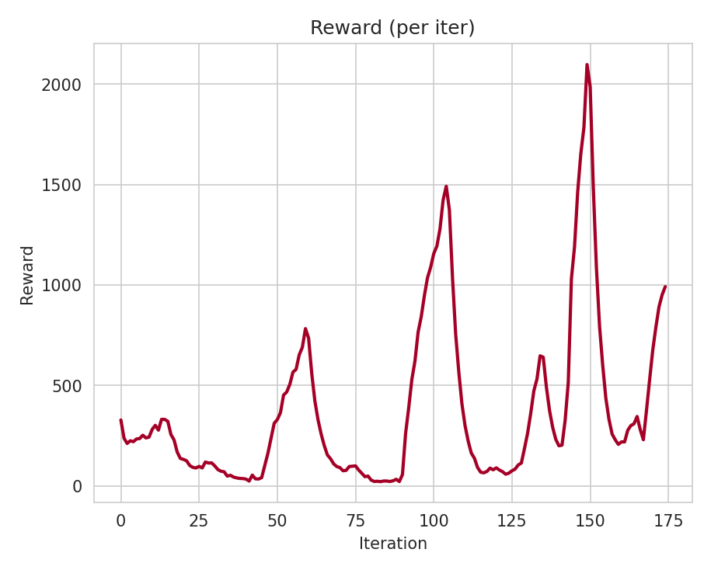
🧬Molecular SSINet : 🏋️Training The Mask
Update
Concurrent Update
Three-steps-alignment after each generator iteration
Same Trend: Good Adaptation
Quality is training dependent
Pimpinelli Francesco
32
Notes:
Our implementation of SsiNet departs from the original formulation by initializing the structured sparsity mask through a warm start—deriving an initial mask from a brief pretraining phase rather than a random or uniform prior—and subsequently refining it via an online update that recomputes mask saliency throughout training rather than fixing it after a single offline calibration pass. The canonical SsiNet, designed for image domains, exploits the continuous, grid-structured locality of pixels, where a statically computed mask remains valid because spatial correlations are stationary across the input manifold. Molecular graphs, however, present discrete, permutation-invariant topological relationships whose connectivity-induced feature distributions shift substantially across batches, rendering a fixed mask unstable. The warm start preserves the original convergence trajectory, while the online update tracks the non-stationary graph statistics, jointly reproducing SsiNet's intended gradient dynamics and regularization behavior under the domain transfer from pixels to molecules.

Slide 33
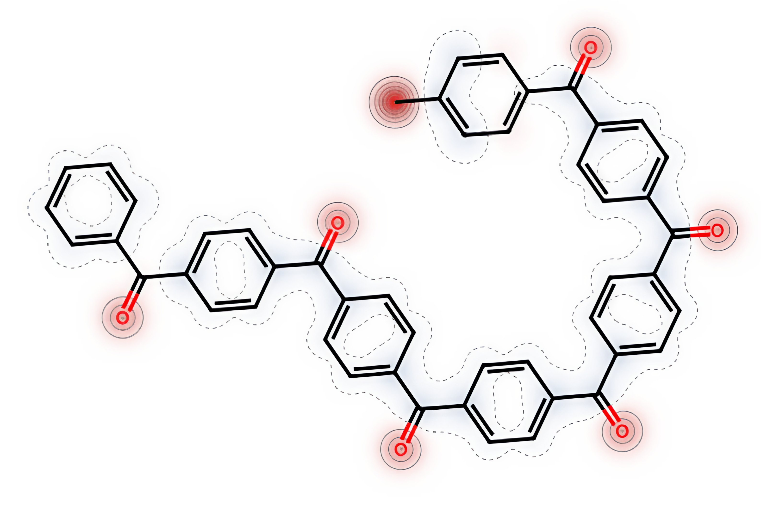
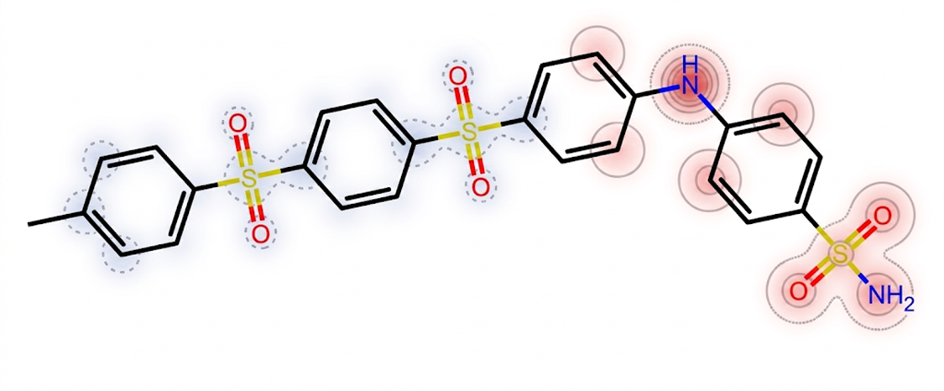
🧩The Adaptation: 📂Results
Pimpinelli Francesco
33

Slide 34

🧩The Adaptation: ➕Weighted Sum
Reward Hacking
Greater aromatic surface area
More hydrophobic interactions
Higher Binding Affinity
Cc1ccc(C(=O)c2ccc(C(=O)c3ccc(C(=O)c4ccc(C(=O)c5ccc(C(=O)c6ccc(C(=O)c7c…))
Useless as a Drug
The Mask is Confused
Does not have an H-bond donor to make Hinge Contact with the target protein, still are detected important atoms
Having a lot of aromatic rings, it detect as important anything that is different
Pimpinelli Francesco
34
Notes:
A chain of seven (or more) para-substituted phenyl rings linked by aromatic ketones, with a 4-tolyl cap and a phenyl tail. There is no nitrogen anywhere in the molecule. There is no sulfur. There is no H-bond donor. From a kinase-inhibitor standpoint this molecule cannot make hinge contacts — it has nothing to donate.

Slide 35
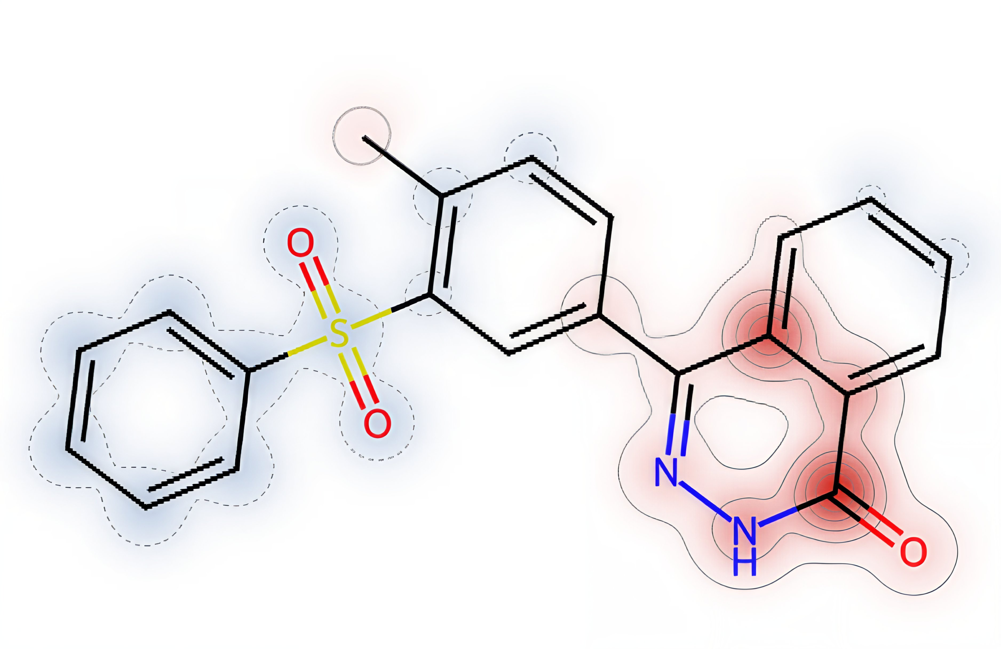
🧩The Adaptation: 🔄️Alternating Rewards (35)
Linear oligomer of
para-phenylene sulfone
The alternating reward allowed the compound to incorporate a primary sulfonamide group at the end.
It is the responsible of the hinge bond that that inhibits the effects of the target protein.
Cc1ccc(S(=O)(=O)c2ccc(S(=O)(=O)c3ccc(Nc4ccc(S(N)(=O)=O)cc4)cc3)cc2)cc1
The Mask is Right!
Correctly detects the N-H molecule that broke the previous malicious pattern.
Pimpinelli Francesco
35
Notes:
Pharmacophorically, this molecule is a textbook aryl-sulfonamide kinase warhead, the same chemotype family as celecoxib (COX-2), pazopanib and sorafenib (RTKs), apatinib (VEGFR), and a long line of CK1/TTBK preclinical leads. The primary sulfonamide is recognised by kinase ATP-pocket hinges through a stereotyped triple H-bond pattern: the sulfonamide N–H donates to the hinge backbone carbonyl, one of the sulfonyl oxygens accepts from the next-residue backbone N–H, and the second sulfonyl oxygen accepts a water-mediated H-bond from the catalytic lysine. This is exactly the geometry seen in 4BTK co-crystal structures with sulfonamide ligands.

Slide 36
🧩The Adaptation: 🔄️Alternating Rewards (15)
The phthalazinone fused-ring system,
acts as the core pharmacophore providing the necessary H-bond contacts to establish the hinge binding with TTBK1.
More structurally suitable and resistant than the sulfonyle warhead seen before, thanks to the presence of Carbon and Nitrogen.
Cc1ccc(C2=NNC(=O)c3ccccc32)cc1S(=O)(=O)c1ccccc1
Good Adaptation
Pimpinelli Francesco
36
Notes:
In this case, the phthalazinone fused-ring system, acts as the core pharmacophore providing the necessary H-bond contacts to establish the hinge binding with TTBK1, being more structurally suitable and resistant than the sulfonyle warhead seen before, thanks to the presence of Carbon and Nitrogen.
The model correctly highlight this situation, showing that it didn’t memorize the sulfonyle warhead as a generally suitable pharmacore, but it can evaluate correctly for each molecule.

Slide 37

💯 Final Evaluation: ⚖️Pros vs Cons
The mask demonstrated a good level of generalization
The quality of the mask is training dependent
Around 3h of training with the chosen configuration
The importance is a per-molecule min-max norm, forcing every molecule to have important atoms
Good level of visual interpretability achieved for
non-experts in the field
All the chemical evaluations were carried out using Claude Opus, instructed to act as a “Chemist in the Loop”
The properties of SSINet have been faithfully replicated
Pimpinelli Francesco
37

Slide 38
🔜 Future Works
Move the interpretation module during the per-token SMILES generation
Improve the reliability of the mask, relaxing appropriately the loss constraints
Improve the pipeline embedding the same visualization also for 3D molecules
Validate against a baseline computed on AudoDock-GPU
Pimpinelli Francesco
38

Slide 39
THANKS FOR YOUR
ATTENTION!
Pimpinelli Francesco 2214340
REINFORCEMENT LEARNING A.A 25/26

