Slide 1
Team Name: Locuz

Slide 2
Context
Impact investment firms(Venture Capitals, and Private Equities included) are beginning to filter their investment portfolios with sustainability in mind.
While not all firms are willing to invest in green(companies that build green products/services) companies, the general consensus among firms is to ensure sustainability within operations regardless of the theme of their portfolio companies.
A few VC/PE firms that are either based or operate in India, are currently demanding their portfolio start-ups/companies to build sustainability reports:
Aavishkaar Group
Ankur Capital
Omidyar Network India

Slide 3
Challenges
Opportunities
Since ESG movement into the VC/PE firms are in its nascent stages. There is a limited availability of tools & services to monitor and help in ESG reporting.
There are a limited number of standards that can be applicable for ESG reporting with start-ups because of dynamic materiality.
In FY 2022, India invested about $7.9 billion through VC/PE firms in ESG based investing; according to the Annual India Private Equity Report 2023 by Bain & Company
VC/PE’s are seeking centralized oversight of their portfolio companies’ ESG performance to keep better track of their investments.

Slide 4
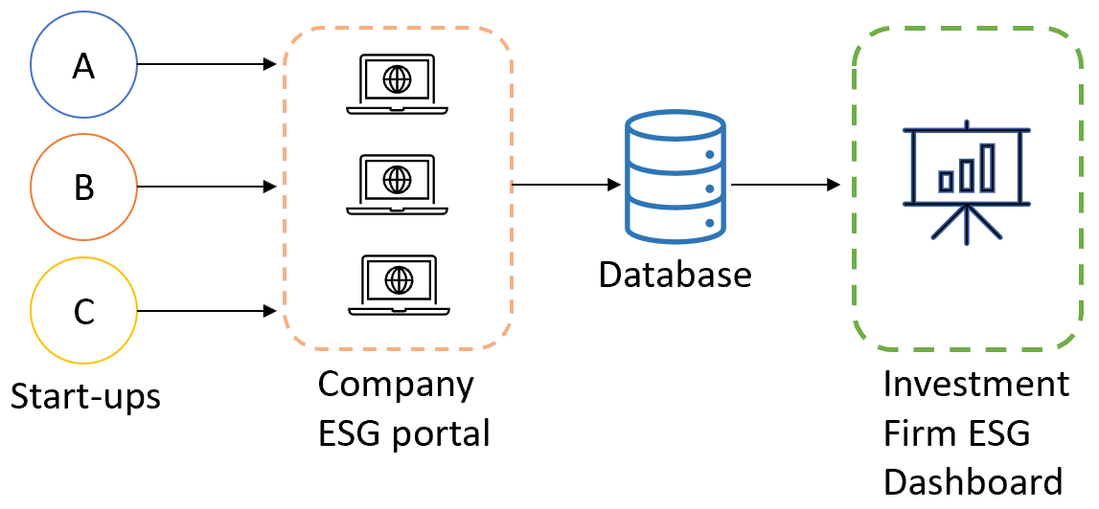
Product: ESG dashboard for Investment Portfolio
The dashboarding tool is a two part system:
Dashboard console that takes data from all portfolio companies to collate the information and provide a single-view console for investors. Thereby, providing ESG performance overview across the portfolio.
Reporting console available to portfolio companies that request ESG-based survey(s) periodically – which eventually reflects on the investor’s ESG dashboard.

Slide 5
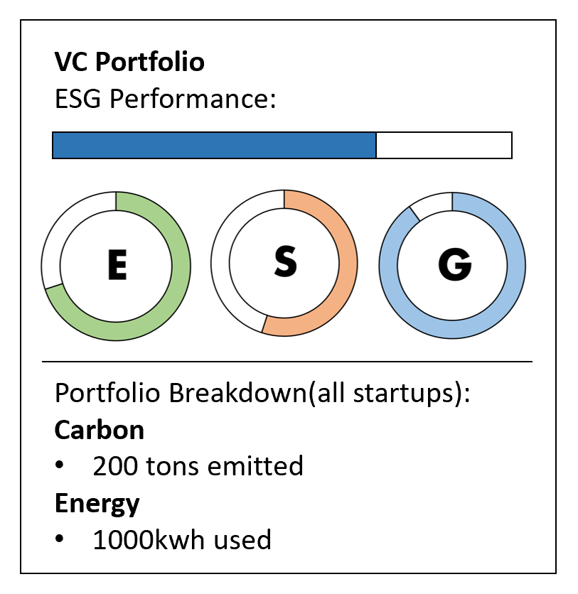

Product:
Reporting company perspective:
The reporting company will provide all ESG based data through an app. The app will be built to periodically(monthly, quarterly) request data based on the materiality assessment.
In order to ease reporting, all questions will be based on themes/categories requested by from MSCI. Thereby easing the data pipeline between the company and the investment firm.
VC/PE perspective:
The firm will have access to the dashboard which will collate all ESG data from all reporting companies and summarize.
The tool will also provide breakdowns per theme/metric/company so the firm has access to better oversight.
The firm and company will have to, together strategize on their materiality and customize survey questions accordingly.

Slide 6
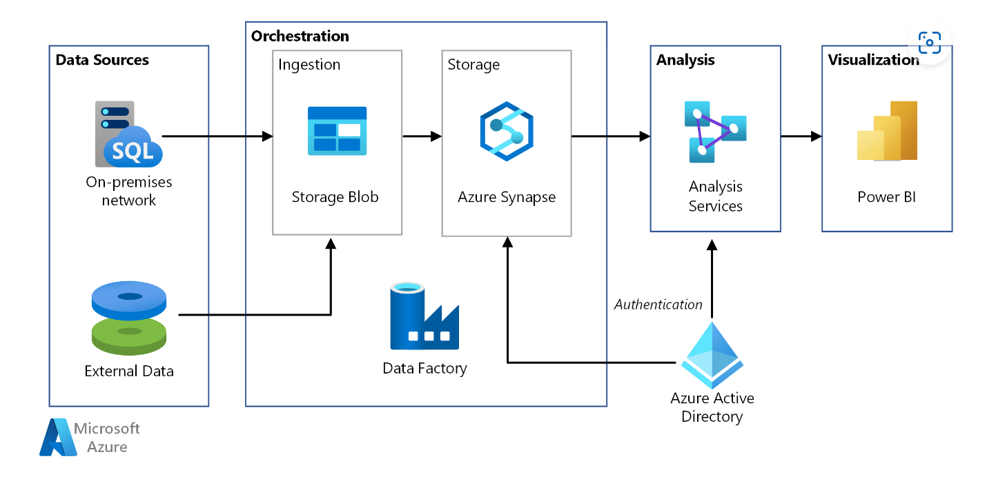






Architecture
Survey App

Slide 7
Importance
Currently, VC/PE firms are requesting individual data from their portfolio companies, and analyzing this data in siloes which is inefficient, sub-optimal, and time-consuming. Firms can largely benefit from using a similar tool to breakdown siloes and make improved and efficient use of their investor expertise.
This tool is crucial for investment firms that are about to begin building their ESG strategies, and impact investment arms. A dashboard that is able to pool in data used for ESG reporting will help enable investor-investee relationships in the following ways:
Automate data collection process between investor and investee.
Reduce longer-term risk associated with growth-stage companies. Improved risk management with the use of ESG standards will help companies anticipate regulatory changes in their own business areas in a constantly changing regulatory environment.
Increased oversight from investors from an ESG perspective.
Teams will be able to quickly build and change ESG strategies with easily accessible, and original data from investee companies themselves.
Firms will be able to analyse and position themselves as leaders of impact investing; thereby opening up more sustainability-based investment opportunities.

