Slide 1


NEXT GEN EMPLOYABILITY PROGRAM
CREATING A FUTURE-READY WORKFORCE
Student Name:
PRATISHTHA NARULA
Student ID:
STU65c53081930c11707421825
Mobile No:
9250045053
Mail ID:
pratishthanarula10@gmail.com
College Name :
Netaji Subhas University of Technology, Delhi

Slide 2
CAPSTONE PROJECT SHOWCASE
Project Title: HEALTHCARE DATA DRIVEN DECISIONS USING POWER BI
Abstract | Problem Statement | Project Overview | Proposed Solution | Technology Used | Modelling & Results | Conclusion | Q&A

Slide 3
Abstract
1
Healthcare data management faces significant challenges: The healthcare sector generates immense volumes of data from various sources including patient records, medical devices, and administrative systems. But, its management is complex.
2
Decision-making inefficiency: Decision-makers often struggle to extract relevant insights from large datasets, leading to delays and suboptimal decisions.
3
Utilizing Power BI for streamlined processes: We employ Power BI to simplify data cleaning, analysis, and visualization, facilitating easier access to actionable insights for healthcare professionals.
4
Improving patient care and operational efficiency: Our goal is to empower healthcare organizations with data-driven insights to enhance patient care outcomes and optimize resource allocation, ultimately improving overall healthcare delivery.

Slide 4


Problem Statement
The healthcare industry operates within an ecosystem characterized by an abundance of data stemming from diverse sources such as electronic health records (EHRs), medical imaging, diagnostic tests, administrative records, and wearable health monitoring devices. However, the sheer volume and complexity of this data pose significant challenges for healthcare organizations. Often, decision-makers within these organizations find themselves inundated with data, struggling to extract actionable insights in a timely manner. This inefficiency in decision-making can lead to suboptimal patient outcomes and inefficient allocation of resources. Our project recognizes these challenges and aims to provide a solution by focusing on streamlining data processes and harnessing the power of comprehensive analytics

Slide 5

Project Overview
Week 1: Data Cleaning
Importing and preprocessing admission and patient data
Standardizing data types and formatting
Selecting relevant columns for analysis
Week 2: Data Analysis Expression (DAX)
Creating new columns for analysis, including duration of stay, smoking/alcohol habits, presence of specific medical conditions, etc.
Calculating age groups and other relevant metrics
Generating new measures for patient demographics and trends
Week 3: Visualization and Dashboard
Designing visualizations to explore relationships between diseases and lifestyle habits
Creating dynamic dashboards for easy data interpretation
Implementing slicers for interactive filtering
Week 4: Formatting and Testing
Finalizing formatting for presentation and usability
Conducting testing to ensure accuracy and functionality
Preparing for deployment and dissemination of findings

Slide 6
Proposed Solution
Our solution centers on leveraging Power BI, a robust business intelligence tool, to convert raw healthcare data into actionable insights. Through the application of advanced analytics techniques and intuitive visualization tools, we empower healthcare professionals to make well-informed decisions and enhance patient outcomes. By harnessing Power BI's capabilities, we streamline the data analysis process, enabling healthcare organizations to unlock valuable insights from complex datasets efficiently. This approach facilitates proactive decision-making, optimizing resource allocation and ultimately improving the quality of care delivered to patients.

Slide 7
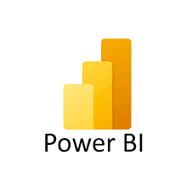
Technology used
Power BI emerges as the cornerstone of our project, offering a user-friendly interface coupled with powerful analytical capabilities. Key features utilized include data modeling, DAX expressions for complex calculations, interactive visualizations, and seamless dashboard creation.

Slide 8
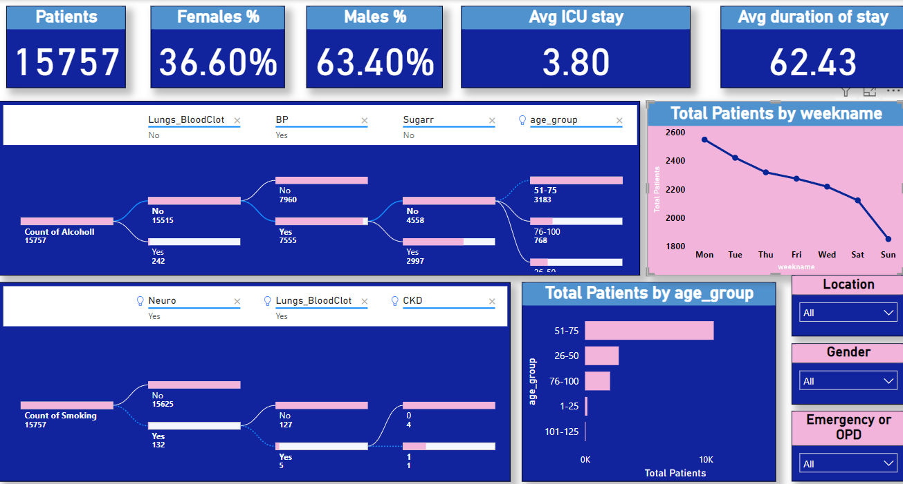
Modelling & Result

Slide 9
Modelling & Result
We employed various techniques to structure and analyze healthcare data effectively. This involved creating data models within Power BI to organize and manipulate the datasets for meaningful insights extraction. Initially, we focused on data preparation, which included tasks such as importing data from multiple sources (e.g., admission data, patient data), checking data types, and transforming data to ensure consistency and accuracy. We carefully selected relevant variables and cleaned the data to remove any inconsistencies or errors that could impact the analysis.
Subsequently, we utilized Power BI's data modeling capabilities to establish relationships between different tables within the dataset. This enabled us to perform complex analyses and calculations across multiple data dimensions seamlessly. By defining relationships and creating calculated columns and measures using Data Analysis Expressions (DAX), we enhanced the depth and sophistication of our analyses.

Slide 10
Modelling & Result
Key Results from Analysis:
Gender Distribution: Approximately 64% of the total patients are male, while the remaining 36% are female.
Average Duration of Stay: The average duration of a patient's stay in the Intensive Care Unit (ICU) is 4 days, whereas the average duration of stay in the hospital overall is 63 days.
Urban vs. Rural Distribution: Patients residing in urban areas outnumber those in rural areas, indicating a higher concentration of healthcare demand in urban settings.
Age Distribution: Patients aged 50 or older represent the largest demographic group, suggesting a higher incidence of healthcare needs among older individuals.
Type of Admission: Outpatient Department (OPD) cases outnumber emergency admissions, indicating a higher volume of non-emergency healthcare visits compared to emergencies.

Slide 11

Conclusion
In conclusion, our project highlights the transformative impact of data-driven decision-making within the healthcare landscape. Through the utilization of Power BI, we have successfully unearthed invaluable insights poised to revolutionize various facets of healthcare delivery. By harnessing the analytical capabilities of Power BI, we've navigated through complex datasets, extracting actionable intelligence that can significantly enhance operational efficiencies and resource management within healthcare organizations.

Slide 12


Notes:
Thank You !!

