Slide 1
Topic-“Simon Game”
PRESTIGE INSTITUTE OF MANAGEMENT AND RESEARCH BHOPAL (MADHYA PRADESH)
DEPARTMENT OF COMPUTER SCIENCE AND ENGINEERING
B.Tech Computer Science and Engineering
Presented By:
1. Rahul jatav
(0198CS211078)
2. Gaurav jharbade
(019CS211036)
3. Pooja kumari
(0198CS223D13)
4.Mayank thakre
(0198CS223D11)
HOD:
Prof. Nilesh jain
(Professor, Dept. of CSE, P.I.M.R, Bhopal)
Guidance:
Prof. (Professor, Dept.of CSE,
P.I.M.R., Bhopal)
1

Slide 2
Presention Flow:
Introduction
Technology used
Working of Game
ER diagram.
Hardware software requirement .
DFD diagram.
Advantage
References
Conclusion

Slide 3
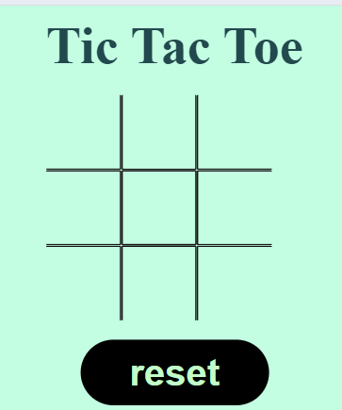
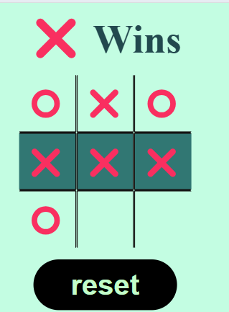
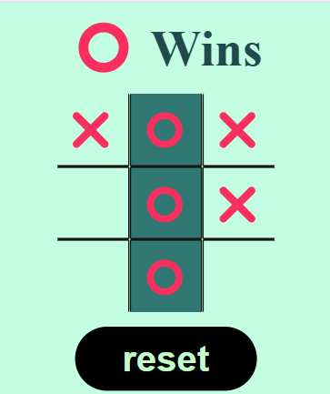
The game is traditionally played on a 3x3 grid. Two players take turns marking the spaces in the grid, one using Xs and the other Os. The objective is to be the first to align three of your marks in a horizontal, vertical, or diagonal row. If all nine squares are filled without any player achieving this, the game ends in a draw.
Introduction:

Slide 4
Technology used:
1.Html:- for basic structure and layout of the game.
File: index.html
2.Css:- Css use for the desining of game and other elments of the game.
File: style.css
3.javascript:- for the functionality or working of game we use javascript Language .
File: index.js

Slide 5
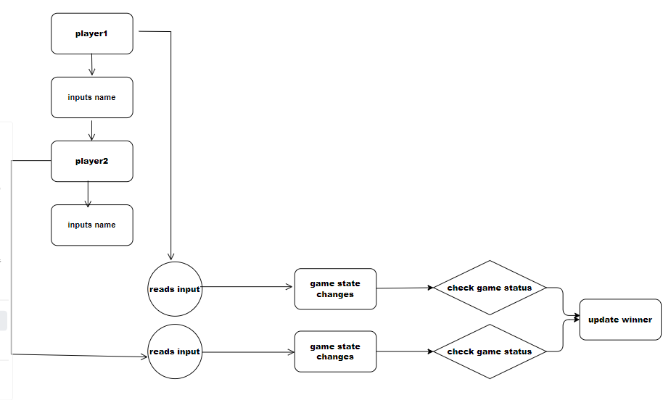
DFD DIAGRAM

Slide 6
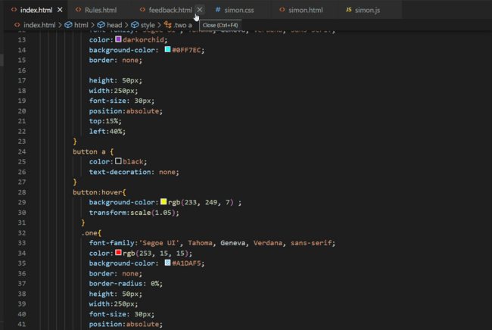
Demo video :

Slide 7
Steps For play Game:
Click start button.
focus on flashing lights.
Click same flash lights.
Follow the sequence.
Click wrong flash lights.
Game over.
Restart.

Slide 8
Advantages:
It helps develop cognitive skills.
It helps develop concentration, and memory.
Can be played with friends.
It also helps to improve focused.

Slide 9
Software & Hardware requirment :
software Requirment :
Hardware requirment:
1.processor: i3,(minimum)
2.Cpu:Intel,platinum.
3.Minimum 4GB Ram.
4.Minimum256GB Storage.
1.Editor: Vs code(visual studio).
2.os:any(window,linux,unix)
3.Supportive browser like -chrome ,firefox.

Slide 10
REFFERNCES:
1. Stack Overflow:- use for the coding languages and other tech information .
2. Mdn: mozzila : mozzila developer network for make some functionality in the game

Slide 11
Limitations:
it is the web browser based game.
it required more focus .
Acknowledgement of rules .

Slide 12
Conclusion:
“In conclusion, Simon is not just any ordinary electronic memory game. It has established itself as an iconic and captivating game that has stood the test of time. With its unique combination of lights and sounds, Simon has managed to engage and entertain players of all ages for decades.From its humble beginnings in the 1970s to its modern-day iterations.
Simon has become a beloved classic in the world of electronic games. Its simple yet challenging gameplay, along with its ability to improve memory and concentration skills, has made it a favorite among players of all skill levels.”

Slide 13
Thank you !

