Slide 1


SP BUYS, E COMMERCE FRAUD DETECTION
FRAUD DETECTION
By Caleb, Adam, Huiqin, PinPin (Group 1)

Slide 2

TABLE OF CONTENTS
Advanced Data Processing
Feature Engineering & Feature Selection
Outlier Detection
Handling Imbalanced Classes
Model Development
Pipeline Creation
MLFlow - Track and Monitor ML Models
Dask
Model Selection Process
Model Optimization
Hyperparameter Tuning - RandomForestClassifier
Hyperparameter Tuning -decisiontreeclassifier
Export Final Model - decisiontree
Graphical User Interface

Slide 3
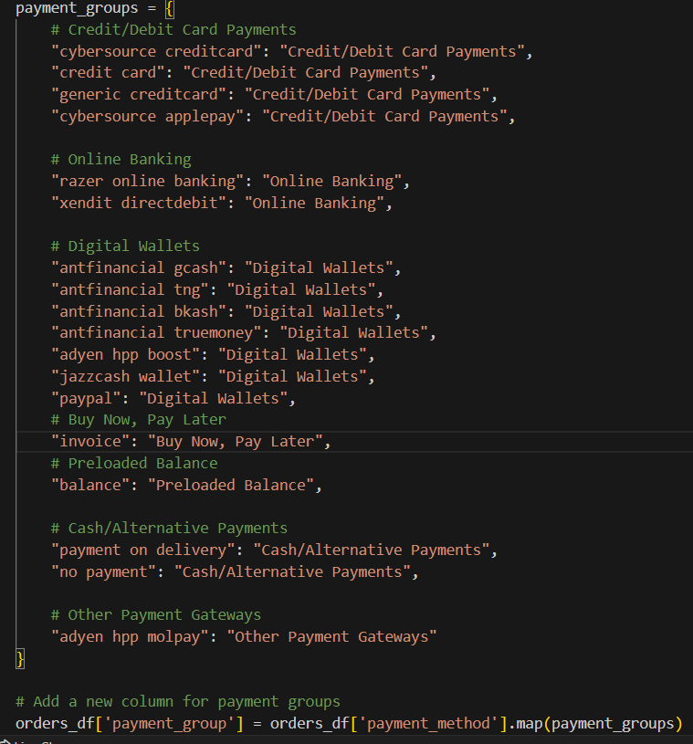
Advanced Data Processing: Feature Engineering
Group Categories:
The payment methods are grouped into several categories such as "Credit/Debit Card Payments", "Online Banking", "Digital Wallets", "Buy Now, Pay Later", "Preloaded Balance", "Cash/Alternative Payments", and "Other Payment Gateways".
DataFrame Column Creation:
A new column payment_group is added to the orders_df DataFrame by mapping the existing payment_method column through the payment_groups dictionary.

Slide 4
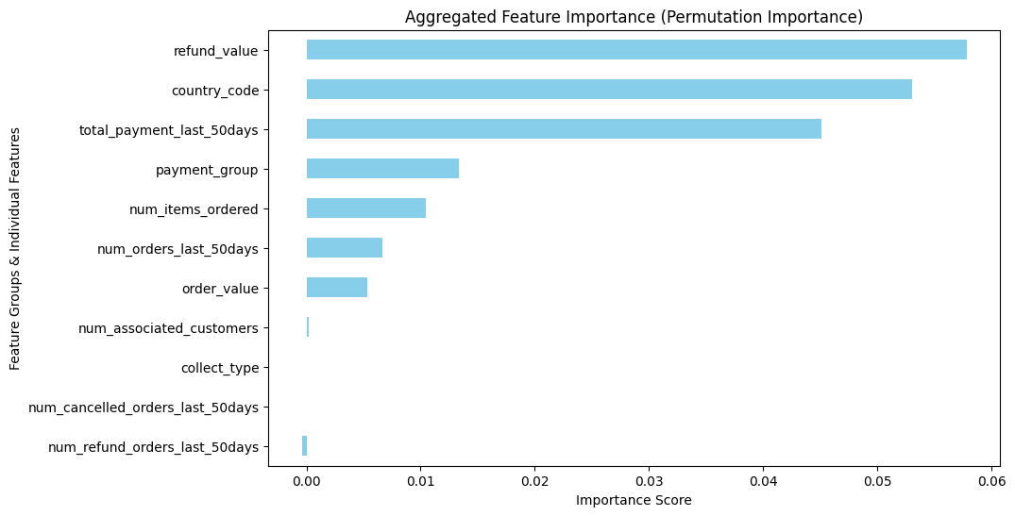
Advanced Data Processing: Feature Selection
This chart shows the important features with refund value being the most importantly, followed by country code and lastly total payment last 50 days.

Slide 5
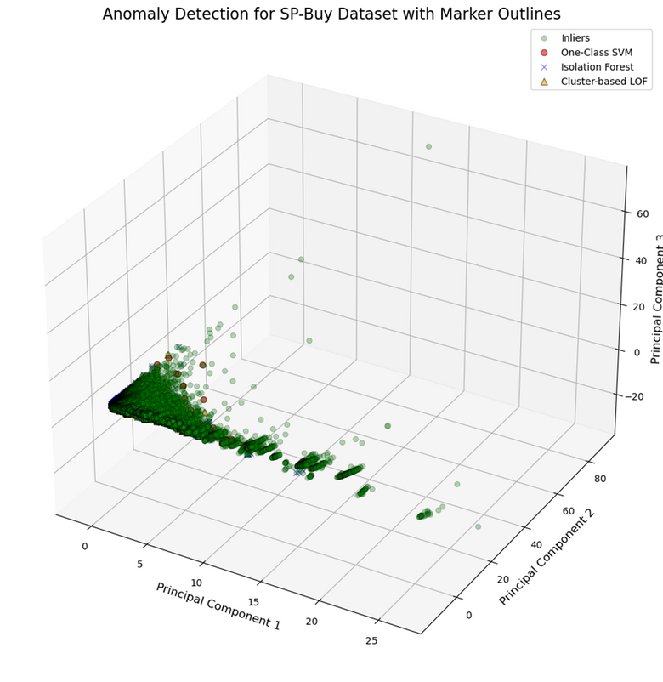
Advanced Data Processing: Outlier Detection
Among Isolation Forest, One-Class SVM, and Cluster-based LOF, Isolation Forest is the best choice for large-scale fraud detection. It is highly scalable, efficiently handles high-dimensional data, and detects anomalies based on their separation from normal patterns. Additionally, it does not require labeled training data, making it ideal for big data scenarios.

Slide 6
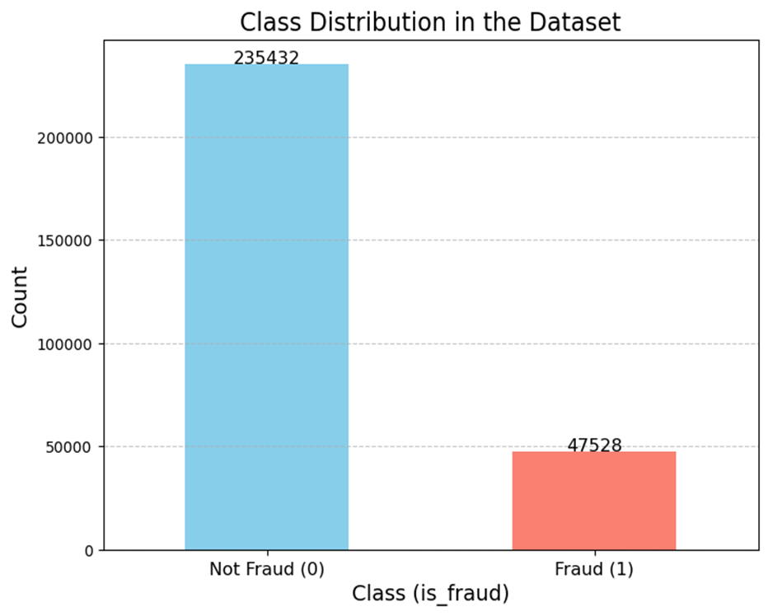
Advanced Data Processing: Class Imbalance
To address class imbalance, we used Data-Level, Algorithm-Level, and Hybrid Methods. Data-Level techniques balanced the dataset through oversampling (SMOTE, ADASYN) and undersampling (Random Undersampling, Tomek Links). Algorithm-Level methods improved model handling via Cost-Sensitive Learning, XGBoost’s Scale-Pos-Weight, and Class Prior Modification. Hybrid approaches, like SMOTEENN, combined oversampling and data cleaning for better generalization. These techniques reduced bias and enhanced fraud detection accuracy.

Slide 7
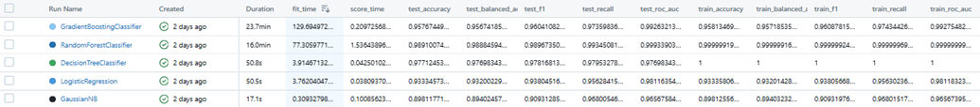
MLFlow - Track and Monitor ML Models
Benefits of using MLFlow
keep and track your model experiments including parameters, results, model names
Easy to compare and choose the best model as every information is in one location,
saving us time while analyzing each model.

Slide 8
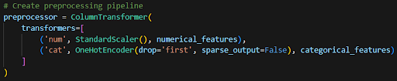
Pipeline Creation
Why Standard Scaler:
Standard Scaler centers the distribution of the features around zero, which makes the data more interpretable and easier to work with
Standard Scaler is robust to outliers in the data, as it only considers the mean and standard deviation, which are not strongly influenced by outliers.
Benefits of using Pipeline
Streamline process of building, training and evaluating of the model
Ensure consistency
Time Efficiency
Automate Process

Slide 9
MLFlow - Track and Monitor ML Models
Benefits of using MLFlow
keep and track your model experiments including parameters, results, model names
Easy to compare and choose the best model as every information is in one location,
saving us time while analyzing each model.

Slide 10
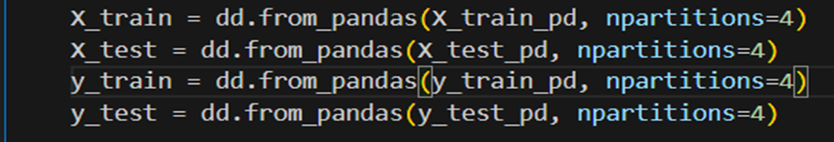
Dask
Dask is a parallel computing library in python. Allows you to scale computations in parallelism and work with larger dataset in a single machine.
Benefits of using Dask
Easy to use - built around Numpy, Pandas and Scikit-learn
Performance - achieve high performance by utilizing all resources
Scalability - able to process larger dataset and complex computations

Slide 11
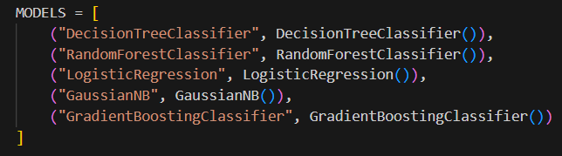
Model Selection - Models
In our model selection process, we will train and experiment with 5 distinct binary classification models.

Slide 12
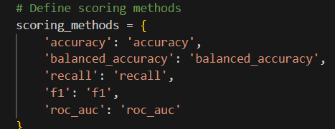
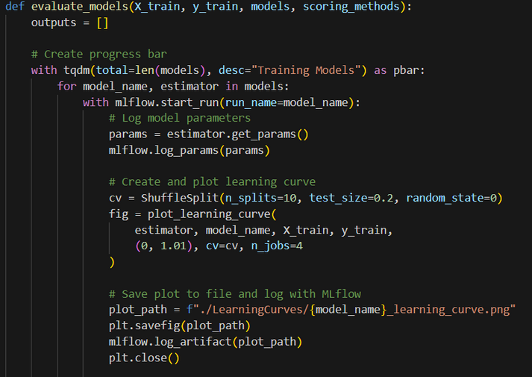
Model Selection - Modelling Process
MLflow Tracking:
Start an MLflow run and log the model's hyperparameters.
Learning Curve Plotting:
Use a ShuffleSplit CV to generate and save a learning curve plot.
Log the plot as an MLflow artifact.
Cross-Validation Evaluation:
Evaluate the model with cross-validation using multiple scoring methods.
Calculate mean scores for each metric and log them.
Error Handling & Progress Update:
Handle errors gracefully and update the progress bar.
Results Compilation & Styling:
Combine mean scores into a DataFrame.
Style the DataFrame to highlight the best and worst scores.

Slide 13
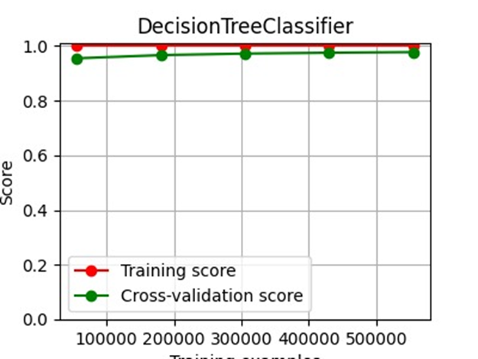
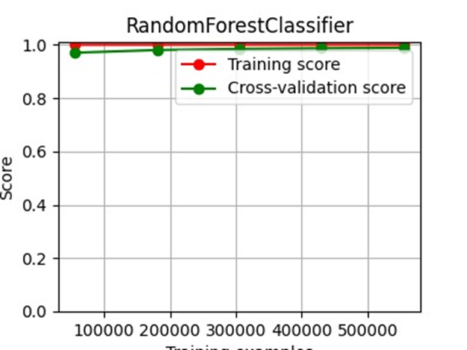
Model Selection - MLFlow Experiment Tracking

Slide 14
Model Selection - Model Experiment Remarks
Model | Fit Time | Test F1 Score | Test Recall | Other Metrics | Remarks
Decision Tree Classifier | Short | High | High | High Accuracy | Fast fitting time. Train scores are 1, indicating perfect fit and potential overfitting. Needs regularization if deploying to production.
Random Forest Classifier | Med | Highest | High | Highest Accuracy, ROC | Excellent performance across all metrics. Possibly the best balance and a good choice of model. Train scores are near-perfect, watch out for overfitting.
Logistic Regression | Short | Low | Decent | Low Accuracy, ROC | Lowest performance compared to other models.
Gaussian Naive Bayes | Very Short | Low | Decent | Lowest Accuracy, ROC | Fast fitting time, but poor performance.
Gradient Boosting Classifier | Long | High | High | Good Accuracy, ROC | Good performance, similar to Random Forest but takes considerably more time to fit. Check if time is a deal-breaker or if you're ok with a longer turn around for potentially better results

Slide 15
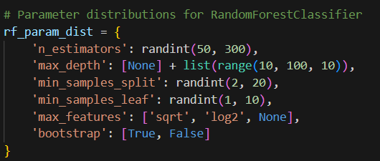
Hyperparameter Tuning - RandomForestClassifier
Reasons for Tuning Hyperparameters
max_depth:
Prevents overfitting by limiting tree complexity, reducing memorization of noise.
min_samples_split & min_samples_leaf:
Controls tree growth, balancing bias and variance. Higher values regularize the model to avoid overly specific branches.
n_estimators:
Avoids unnecessary complexity and long training times while ensuring performance improvement.
max_features:
Reduces feature correlation, preventing overfitting and improving generalization.
bootstrap:
Adds randomness, lowers variance, and enhances model stability by training each tree on different data subsets.

Slide 16
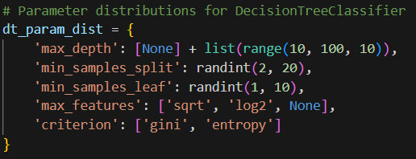
Hyperparameter Tuning - Decision Tree Classifier
Reasons for Tuning Hyperparameters
max_depth:
Prevents overfitting by limiting tree complexity, balancing model performance and generalization.
min_samples_split:
Controls tree growth; higher values promote regularization and reduce variance.
min_samples_leaf:
Prevents overfitting by ensuring leaf nodes have enough samples to generalize patterns.
max_features:
Reduces correlation between splits, improving generalization and preventing overfitting.
criterion:
Determines split quality (gini for purity, entropy for information gain), optimizing model performance.

Slide 17
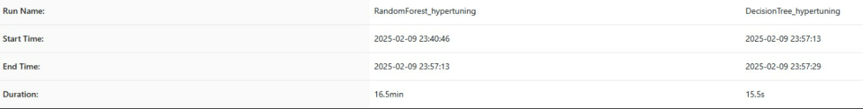
Hyperparameter Tuning - Comparison
We compared hypertuned models and found RandomForestClassifier excels in detecting fraud, but DecisionTreeClassifier is close behind. Since inference speed is crucial for deployment in a GUI, we prioritize efficiency. Despite its strength, RandomForestClassifier may slow down processing, so we choose the more lightweight DecisionTreeClassifier for deployment.

Slide 18
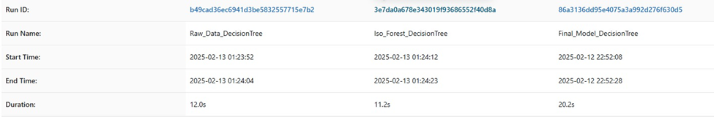
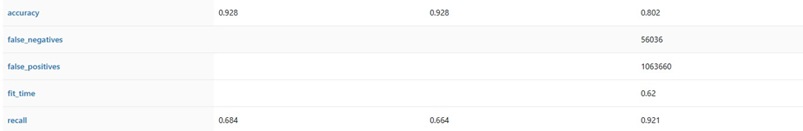
Selecting the best model
While the first two models achieved an accuracy of 92.8%, the final model performed lower at 80.2%. However, the recall of the final model (0.921) significantly outperforms the others, indicating a better ability to detect fraudulent transactions at the cost of more false positives (1,063,660). The choice of Isolation Forest as an outlier detection method contributed to these results, balancing anomaly detection and fraud classification

Slide 19
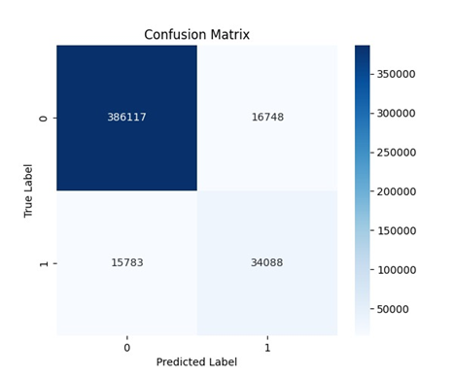
Selecting the best model
Raw data Decision Tree model:
True Negatives (TN): 386,117 (correctly identified non-fraud)
False Positives (FP): 16,748 (non-fraud misclassified as fraud)
False Negatives (FN): 15,783 (fraud misclassified as non-fraud)
True Positives (TP): 34,088 (correctly identified fraud)
The Decision Tree model, trained on an imbalanced dataset, struggles with fraud detection. Class imbalance skews predictions toward non-fraud, increasing false negatives.
High false negatives reduce recall, indicating difficulty in detecting fraudulent transactions.

Slide 20

Selecting the best model
Isolation Forest Decision Tree model:
True Negatives (TN): 369,195 (lower due to anomaly removal)
False Positives (FP): 15,701 (slightly reduced misclassified non-fraud cases)
False Negatives (FN): 15,192 (fewer missed fraud cases)
True Positives (TP): 30,012 (slightly lower, likely due to some fraud cases being removed as anomalies)
Isolation Forest was used for outlier detection before training the Decision Tree model, leading to slightly better fraud detection. False negatives decreased, improving fraud identification, but false positives persist.
While fraud detection improved, some actual fraud cases may have been removed as anomalies, slightly reducing the total detected fraud cases.

Slide 21
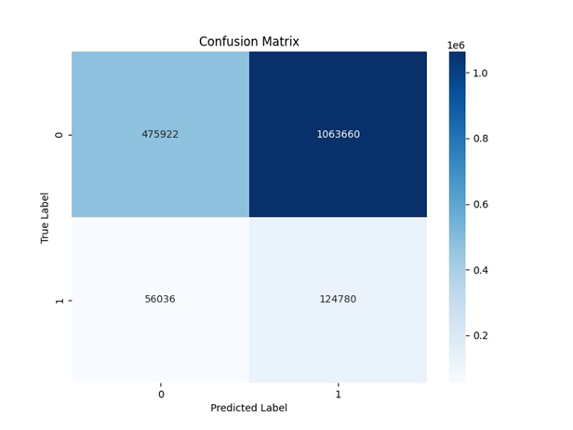
Selecting the best model
Final Model Decision Tree model:
True Negatives (TN): 475,922 (more non-fraud cases correctly classified)
False Positives (FP): 1,063,660 (massive increase, many non-fraud cases misclassified)
False Negatives (FN): 56,036 (higher than before, meaning some fraud cases are still missed)
True Positives (TP): 124,780 (significant increase, detecting more fraud attempts)
The model combined class imbalance handling and Isolation Forest, improving fraud detection but increasing false positives. Higher true positives (TP) indicate improved recall, but false positives (FP) surged, reflecting a trade-off between fraud detection and precision.

Slide 22
Selecting the best model
The final model that we have chosen is the decision tree model that combines class imbalance handling and Isolation Forest -> Final Model Decision Tree
The model prioritizes high recall, detecting more fraud but at the cost of increased false positives, requiring a balance between fraud prevention and accuracy. However, we want to detect frauds at all costs as we lose more money from false negative. Therefore, we will not prioritize those false positive.

Slide 23
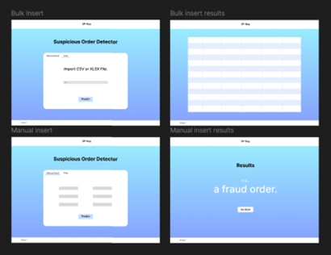
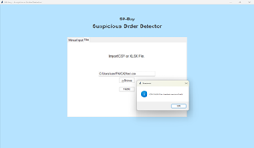
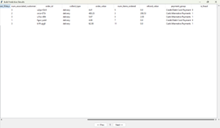
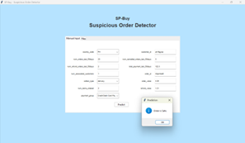
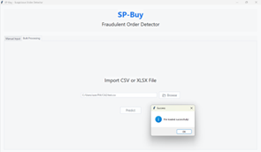
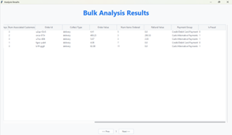
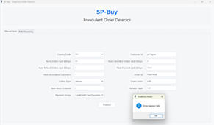
User Interface - Tkinter
Draft 1:
Created the first draft to match the wireframe, opting for a blue background due to Tkinter’s limitations with gradients. Real-time results were shown in a message box for simplicity, and pagination was added for larger file uploads.
Wireframe
Bulk Insert (Batch Mode)
Bulk Insert (Batch Mode) - results
Manual Insert (Real-time Mode) & result
Draft 2 (Final):
Added error handling, included a table title, and removed the blue background for a cleaner design. The title was updated to "Fraudulent Order Detector" for professionalism. We also enlarged the input box and added an “Export Results” button for saving the data.
Bulk Insert (Batch Mode)
Bulk Insert (Batch Mode) - results
Manual Insert (Real-time Mode) & result
Batch Mode – Allows bulk input, with results displayed in a table.
Real-Time Mode – Allows manual input, displaying results one at a time.

Slide 24
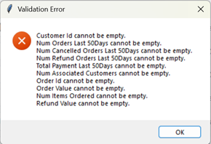
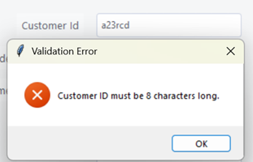
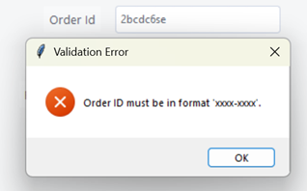
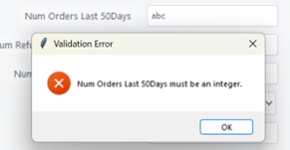
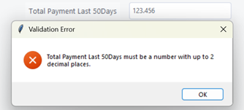
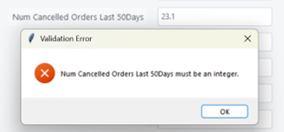
User Interface - Tkinter
Error handling in a program is essential to ensure that the application can gracefully handle unexpected or invalid inputs and provide clear feedback to users.
Here are the error handling we did:
Empty Inputs
Format Checks
Format Checks
Input type checks
Input type checks
Input type checks

Slide 25
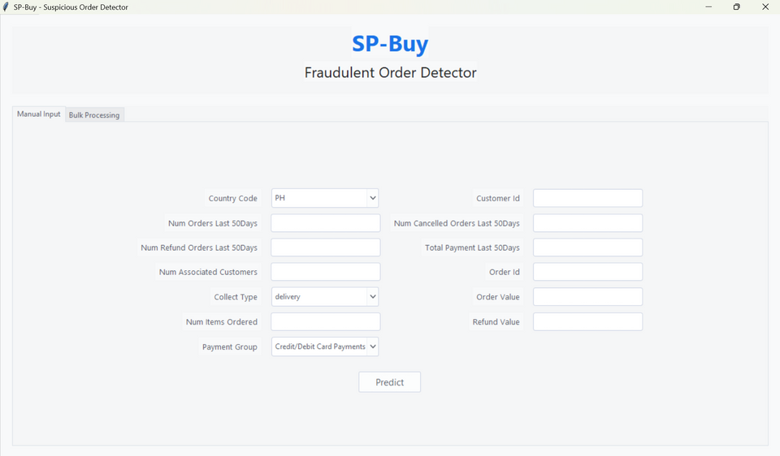
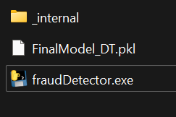
Deployment
We deployed the Python script as a standalone executable using PyInstaller, which packages all dependencies into a folder containing the executable.
Here's the process:
Install PyInstaller: python -m pip install pyinstaller
Run: python -O -m PyInstaller --hidden-import=sklearn fraudDetector.py
Go to the “Dist” folder.
Open the “fraudDetector” folder.
Copy the model pickle file into the folder.
Double-click fraudDetector.exe.
Wait for the application to load.

