Slide 1






DATA ANALYSIS
Electric Vehicles
PinPin
DAAA/FT/1B/07
P2317623
Presented by:

Slide 2



Table of Contents
Problem Statement
Dataset Analysis
Conclusion
& Pitch

Slide 3

Introduction
Mr Lee is in Ministry of Transport and is given the task of fulfilling GreenPlan 2030. He gave an idea of citizens driving Electric Vehicles. However, his colleges mocks him saying they actually will emit more gases and are better just driving on gas.
GreenPlan 2030
Singapore needs to reduce domestic greenhouse gas emissions by at least 3 million tonnes per year by 2030

Slide 4
Mr Lee’s Mission
Find out if Electric Vehicles are better for the environment or not emitting greenhouse gases
Pitch a solution after the research so GreenPlan’s target can be fulfulled
Problem Statement
Singapore’s Greenhouse emission is too high and we need a way to lower it before 2030.

Slide 5


Datasets Used
1
AirPollutant (CO) https://beta.data.gov.sg/collections/1365/view
2
AirPollutant (NO2) https://beta.data.gov.sg/collections/1366/view
3
Electric Vehicles (EV) https://github.com/OSkrk/Electric-vehicles-EV-Database/blob/main/Data/EVs_data_base.csv
4
Vehicles in Europe: https://co2cars.apps.eea.europa.eu/?source=%7B"track_total_hits"%3Atrue%2C"query"%3A%7B"bool"%3A%7B"must"%3A%5B%7B"constant_score"%3A%7B"filter"%3A%7B"bool"%3A%7B"must"%3A%5B%7B"bool"%3A%7B"should"%3A%5B%7B"term"%3A%7B"year"%3A-1%7D%7D%5D%7D%7D%2C%7B"bool"%3A%7B"should"%3A%5B%7B"term"%3A%7B"scStatus"%3A"Provisional"%7D%7D%5D%7D%7D%5D%7D%7D%7D%7D%5D%7D%7D%2C"display_type"%3A"tabular"%7D

Slide 6

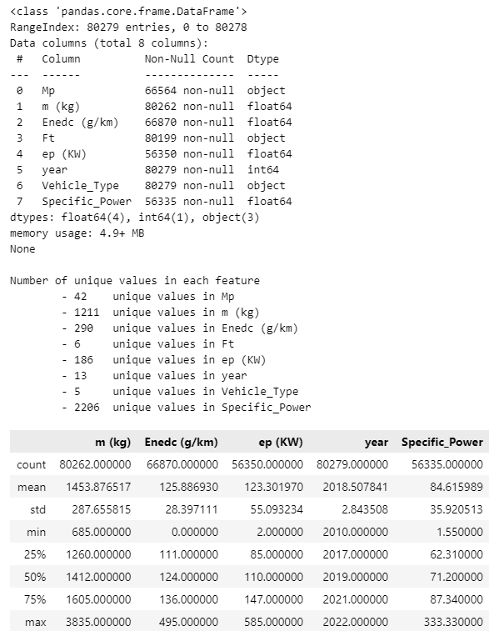
EUROPE
Code
Output

Slide 7
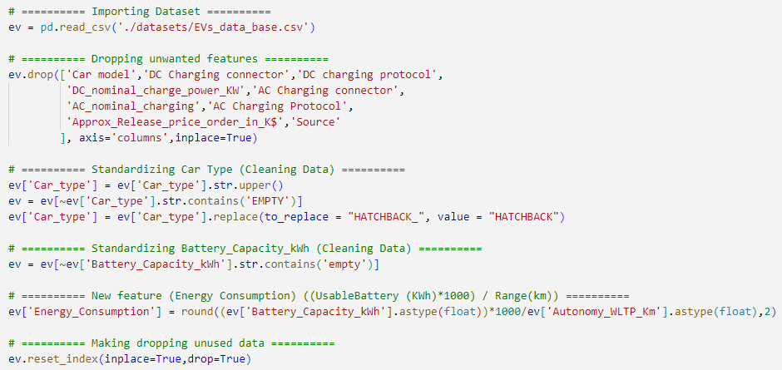
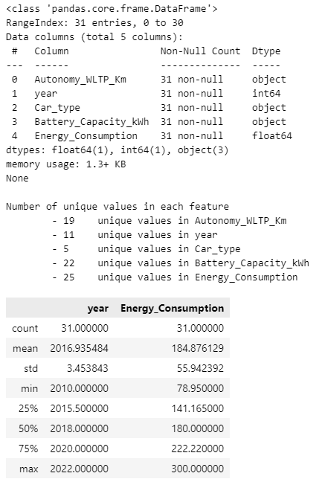

EV
Code
Output

Slide 8
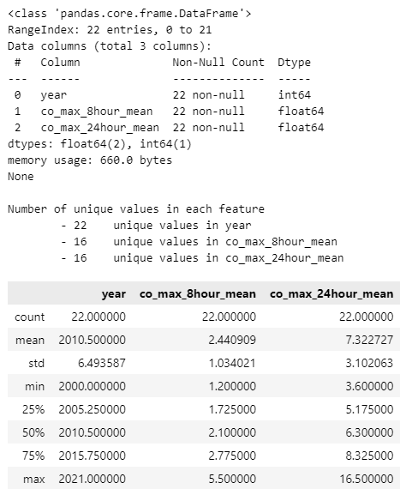

CO
Code
Output

Slide 9
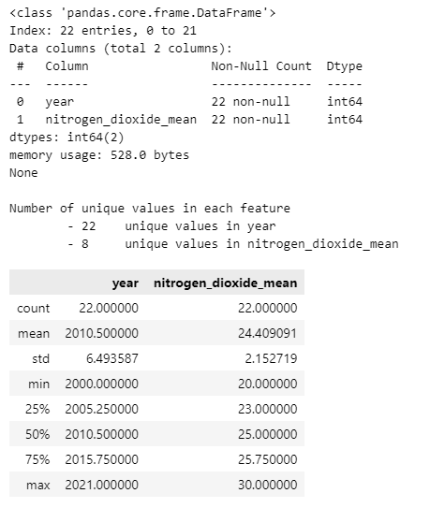

NO2
Code
Output

Slide 10
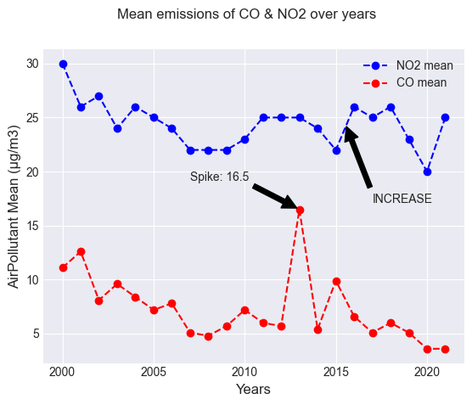
Line graph
Air Pollutants (NO2 & CO) vs Years
In General
NO2 keeps fluctuating
CO has a slow decline
CO actually has a High Spike of more than 300%. However, after research, it is due to the 2013 Southeast Asian Haze from Indonesia.
Take a closer look NO2 at 2015 with that sudden spike. We will later find out what affected it
Source: https://en.wikipedia.org/wiki/2013_Southeast_Asian_haze
Line Graph:
To to track Air Pollutants over a periods of time

Slide 11
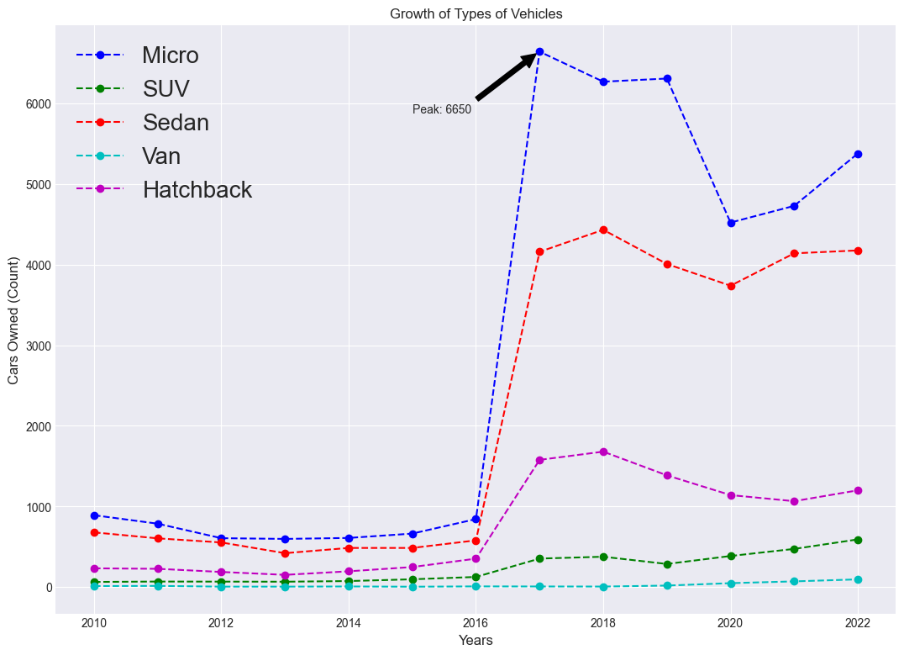
Line graph
Growth of the Types of Vehicles
In General
Every Type was constantly under 1000 but had all rose at 2017. Except for Vans
Due to the production of such Vehicles ,before 2016, which releases many harmful gases, one being NO2. This caused the sudden spike in NO2 levels.
Hence, We can deduce that the production of Vehicles are harmful for the environment
Line Graph:
To to track Owned Cars over a periods of time
Source: https://www.azocleantech.com/article.aspx?ArticleID=1736

Slide 12
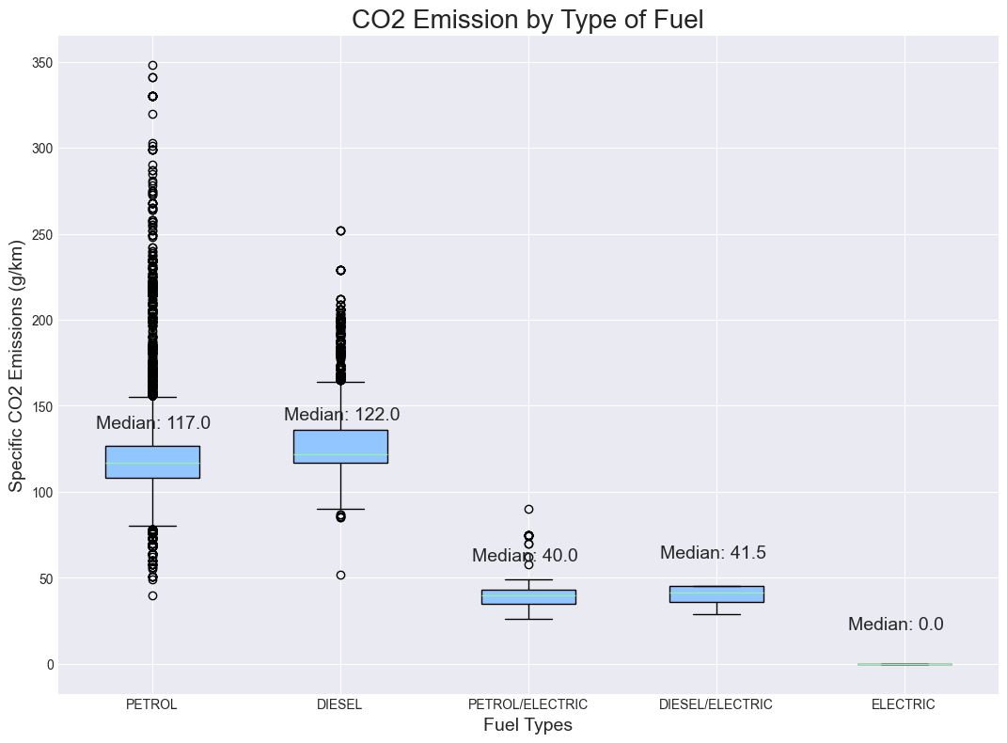
Box Plot
CO2 Emission by Type of Fuel
In General,
Petrol and Diesel have similar IQRs
The Hybrids also have similar IQRs
Electric doesn’t produce any CO2 Emission.
Those with similar IQR and Medians means they are similar in Emitting CO2
Electric Vehicles have a Zero CO2 Emissions which is good for the environment in the long run.
Petrol also has much more outliers compared to the rest
Box plot:
To compare distribution of the type of Fuel

Slide 13
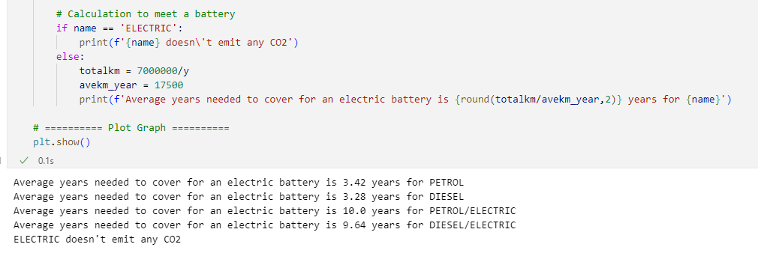
Box Plot
Calculations
The Average distance traveled by a car in Singapore is 17,500km annually
The Average Electric Battery Emits 7 tonnes of CO2.
This shows that Petrol and diesel produce as much CO2 as roughly 3EV batteries.
Source:
www.budgetdirect.com.sg/car-insurance/research/car-running-costs-singapore

Slide 14
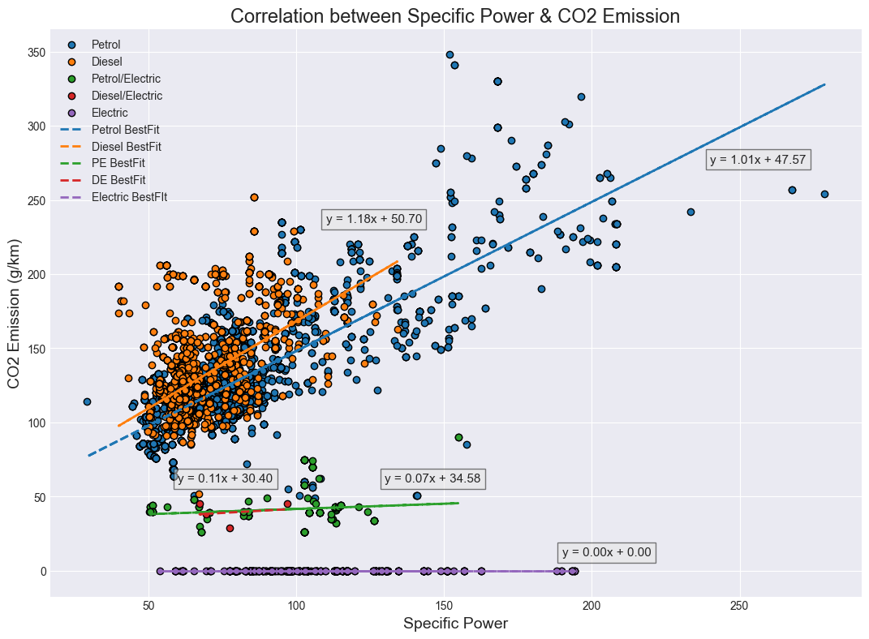
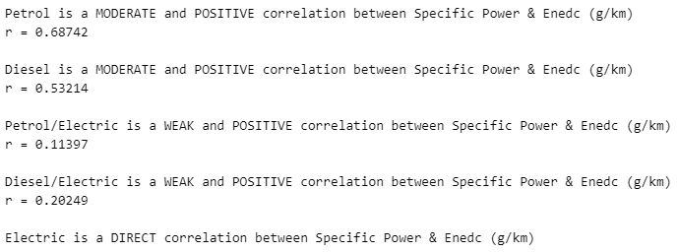
Scatter Plot
Correlation Between
Specific Power & CO2 Emissions
Specific Power is
(Power of Engine (W)/Mass of Vehicle)
Its used to determine the acceleration rate.
This will show us how Powerful the engine is.
Scatter Plot:
To show relationship between
Specific Power and CO2 Emissions
Source:
https://codinghero.ai/difference-between-hatchback-sedan-and-suv/
Power of Engines
Hatchback < Sedan < SUV

Slide 15
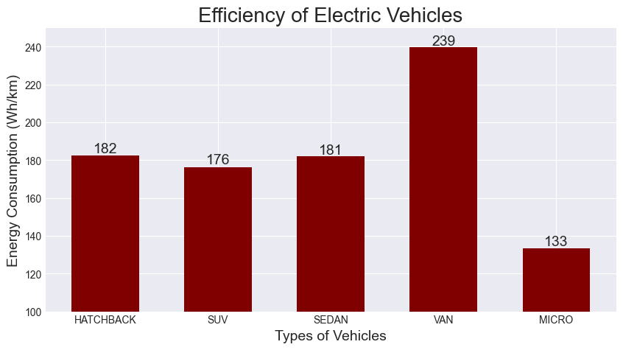
Bar Graph
Growth of the Types of Vehicles
In General
Van has the worst battery efficiency as it consumes 239Wh/km
Micro is the most efficient with 133Wh/km
The rest are between 185 to 175Wh/km
This shows that Micro Electric Vehicles are the most eco-friendly Electric Vehicle
Bar Graph:
To compare the frequency of multiple categories
Source:
https://www.smalltownbikeco.com/blogs/news/environmental-benefits-of-electric-bikes

Slide 16
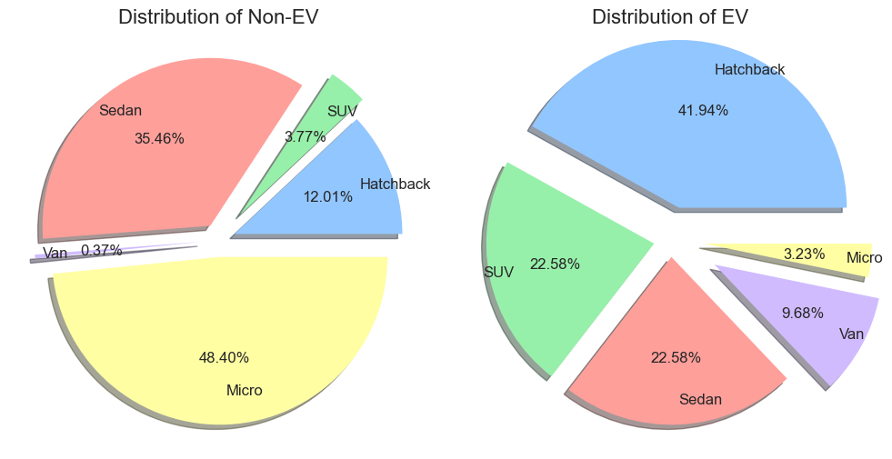
Pie Chart
Growth of the Types of Vehicles
Overall,
Non-EV
Micro Vehicles at almost 50%
Van being the lowest
EV
Micro Vehicles are now the lowest
Hatchback is the highest
Although Micro Vehicles has the most efficient batteries, it is still the lowest portion of the EVs produced
The Van also takes up over 9% of the overall EVs produced which is bad for the environment
Pie Chart:
To show percentage population of the Type of Vehicles

Slide 17

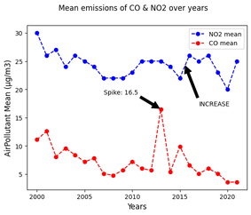
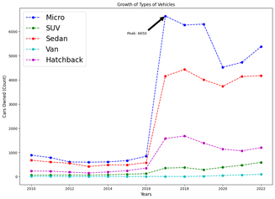
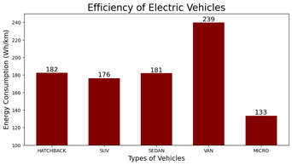
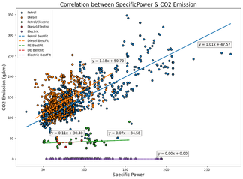
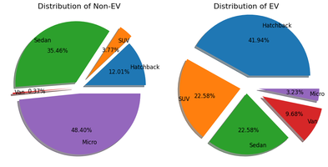
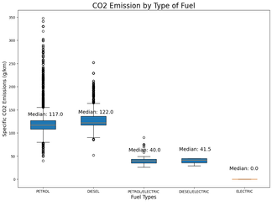
Conclusion
Line Graphs
Manufacturing of EVs are Costly.
Bar Graph
Most efficient batteries Micro Vehicles
Scatter Plot
Powerful Engines Emit More CO2
Pie Chart
There are too little Micro Vehicles
Boxplot
Electric Vehicles are an Investment

Slide 18

Pitch
1
Have a Discount For Micro EVs
To encourage the purchase of the most eco-friendly vehicle instead of others
2
More Funds into EV Technology
To have a future with EVs running on Constant clean energy. Such as Solar Energy or Regenerative Braking

