Slide 1

Area Filtering & Connected Components
Ali Hussain & Pina Cammisano

Slide 2
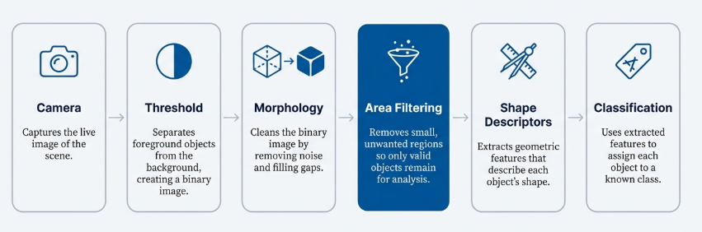
Pipeline
Camera → Threshold → Morphology → Area Filtering → Shape Descriptors → Classification
Camera: Captures the live image of the scene to be processed.
Threshold: Separates foreground objects from the background by converting the image to binary.
Morphology: Cleans the binary image by removing noise and filling gaps in objects.
Area Filtering: Removes small connected regions so only valid objects remain.
Even after Morphology, the image can still contain multiple regions, some of which are noise. ]
Shape Descriptors: Extracts geometric features that describe each object’s shape.
Classification: Uses the extracted features to assign each object to a known class.
Area filtering removes these unwanted regions so only real objects are used for shape analysis and classification!

Slide 3
What is Connected Component Analysis and Why is it important?
- Segmentation produces multiple foreground regions
- Each region consists of connected pixels
-These regions may represent real objects or noise
- Connected component analysis identifies each region as a separate object
-This prepares those regions for area-based filtering

Slide 4

Connected Components with Stats
Sample code:
num_labels, labels, stats, centroids = cv2.connectedComponentsWithStats(binary, connectivity=8)
Finds all connected regions in the binary image
Assigns a unique label to each region (label 0 = background)
Computes statistics for each region, including area and bounding box
Provides the data needed to perform area filtering in later steps

Slide 5
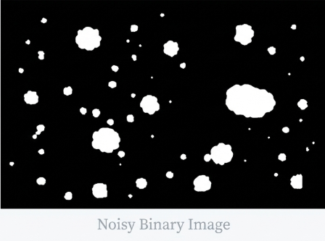
Area Filtering
Each connected component has a measurable pixel area
Area is computed directly from the labeled component
A minimum area threshold (MIN_AREA) is defined
Decision rule:
area < MIN_AREA → discard region
area ≥ MIN_AREA → keep region
This converts a set of regions into a validated object list
which can be sent to the Shape Descriptor step.

Slide 6

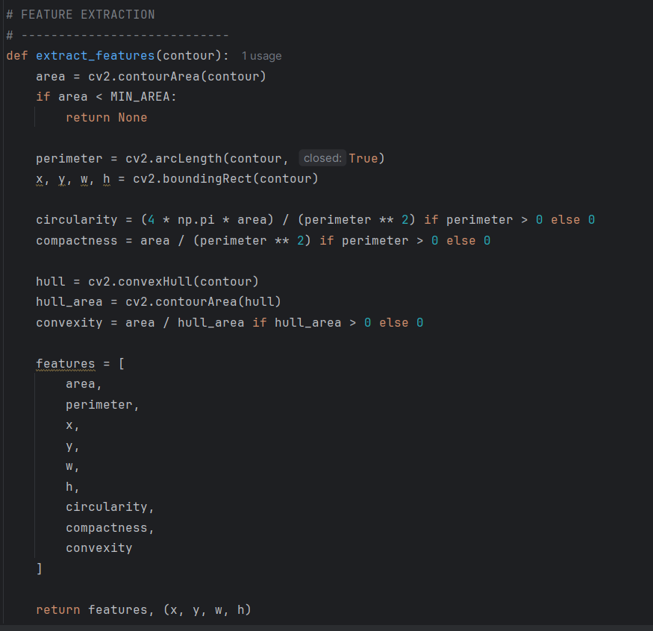

Area Filtering Code
Area Thresholding:
MIN_AREA is tuned based on the expected physical size of the objects and the camera resolution, so that noise regions are consistently smaller than the threshold.
If statement ensures objects less than MIN_AREA do not move onto the next step
Perimeter:
Perimeter measures boundary length of the object
Bounding box provides object location and size
Circularity, Convexity, Compactness:
All used to help with labelling the shapes

Slide 7













Connectivity: 4 vs 8
4-Connectivity:
Pixels connect only up, down, left, right
Diagonal pixels are not connected
Can split objects into multiple parts
Leads to incorrect area measurements
8-Connectivity:
Pixels connect including diagonals
Objects stay fully connected
More accurate for real-world shapes
For the project 8-connectivity was used because:
Prevents objects from breaking apart
Preserves true object shape
Improves area filtering and classification accuracy
$$↖$$
$$↗$$
$$↑$$
$$↑$$
$$←$$
$$→$$
$$←$$
$$→$$
$$↓$$
$$↙$$
$$↘$$
$$↓$$
4-Connectivity
8-Ccoonectivity

Slide 8
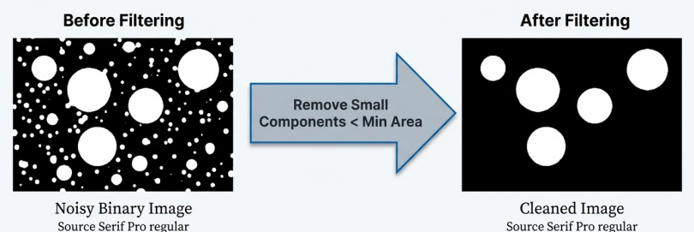
Why Area Filtering Improves Results
Noise usually appears as small isolated regions
Real objects have a larger pixel area
Area filtering removes components below a minimum area
This eliminates noise and false detections
Remaining objects are cleaner and more accurate

Slide 9

Thank you!

