Slide 1
Student Management System
Name : Pinal Pratap Dandgavhal
Course Name: Full Stack Java Developer

Slide 2
Project Abstract
Student Management System is simple console application without graphics, developed using core java language and mysql database.
This mini project utilizes various aspects of the java language such as, functions,inheritance,interface .

Slide 3
Technology Uses:
Hardware Requirments:
Processor : Intel core 2.30Ghz
RAM: 1024Mb
Hard Drive : 1 GB or more
Software Requirements:
Operating System: WindowsXP?8/8.1/10
Data Base : MYSQL
Language : Java
Framework: Java Frame work

Slide 4
Development Tools & Technology
Technology Used:
JDK(Java Development Kit)
JDBC (Java Database Connectivity)
Development Tools
Eclipse IDE
MYsql

Slide 5
Data Base Table Design
SR.NO | Field Name | Data Type
1 | First Name | Varchar
2 | Last Name | varchar
3 | Location | varchar
4 | Username | varchar
5 | Password | varchar
6 | Mobile Number | varchar

Slide 6
Sr.No | Field Name | Data Type
1 | Student ID | int
2 | Student Name | varchar
3 | Student Phone Number | varchar
4 | Student Location | varchar

Slide 7
User Model
Using Username and Password user can login to the student management system.
User can view all information
User can update only his/her some specific information.

Slide 8
School Management System Modules
Registration module: In this module, the users of the system have to register themselves with all their personal details and after that, they can log in to the system Login module: This module page allows different types of login details for student, admin, teacher, and staff. Add module: This allows to add new users to the system database. Save module: This allows to save the records in a database. Delete module: It deleted the student records from a database. View profile module: This module displays information according to the type of user. The admin can view all the details while the other users can only view their own details.

Slide 9
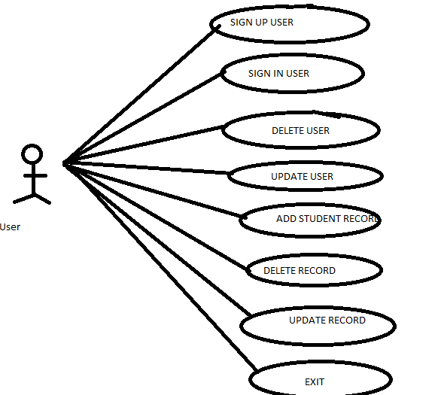
Use Case Diagram

Slide 10
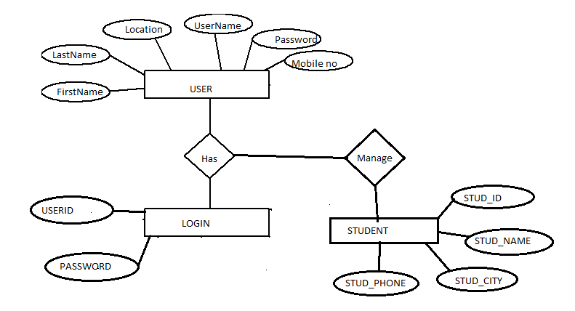
ER-DIAGRAM

Slide 11
Advantages
The student management will be automated the traditional system.
There is no need to use paper and pen.
Checking student data is very easy.
Adding new student details is very simple.
Deleting existing record if in case user enter
wrong details of student is easy.
Updating record is also easy.

Slide 12
CONCLUSION
This system is aimed at total user-friendly as well as efficient management of varied tasks. These tasks may range from registering new students, updating student and user record easily to all the essential features necessary for making the administrative division of school effective

