Slide 1
CAPSTONEPROJECT(SHOPFORHOME)
PRESENTED BY:
Pinal Kamal Patidar
Shruthi Pingili
Ravindra Kumar Parasa
Neeraj Reddy
Vasavi Ponnam
JAVA &AWS C1 GROUP-7
MENTOR:MR.NEERAJ KUMAR KHERIA

Slide 2
INTRODUCTION
Problem Statement: ShopForHome is a popular Store in the market for shopping the home décor stuff . Due to Covid 19 all the offline shopping stopped. So, the store wants to move to the cloud platforms and wants their own web application.
There are 2 users on the application: -
1. User
2. Admin

Slide 3
TECHNOLOGIES USED:
Angular
Spring Boot
SQL
Softwares Used:
Eclipse IDE
Visual Studio code
MySQL

Slide 4
Sprint I Objectives
1.Create git repository
2.Create database schema (all tables along with their relationships)
3.Create entities in Spring
4.Create Microservice based structure
5.CRUD on User and Products
6.Create an eCommerce Template in Angular (Static only) to hold images and products lists
7.Develop Search Functionality in Angular
8.Bulk upload implementation

Slide 5
Sprint II Objectives
1.Cart option
2.Stock and Sales reports
3.Create Data Transfer objects
4.Create repository
5Create Service layer logic
6.Create Controller to direct rest api
7.Create Discount Microservice

Slide 6
GIT REPOSITRY
https://github.com/PinalPatidar/ShopForHome

Slide 7
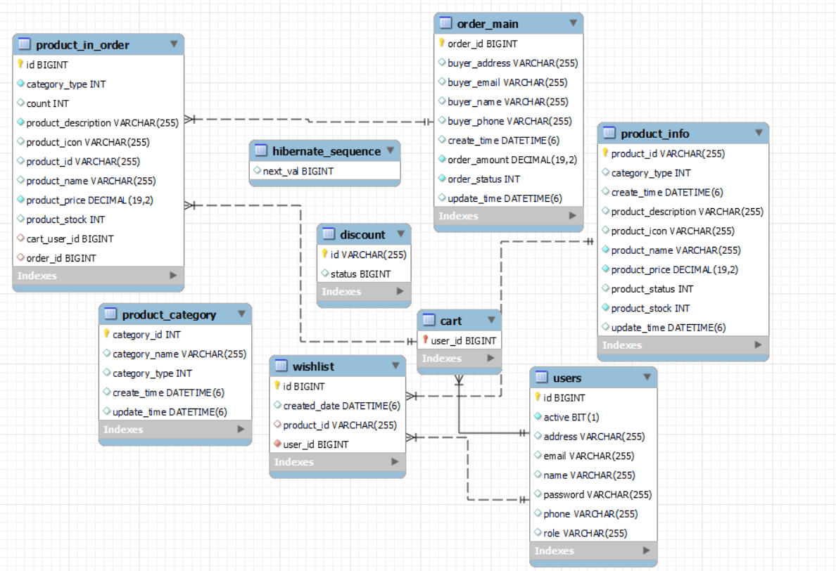
DATABASE SCHEMA

Slide 8
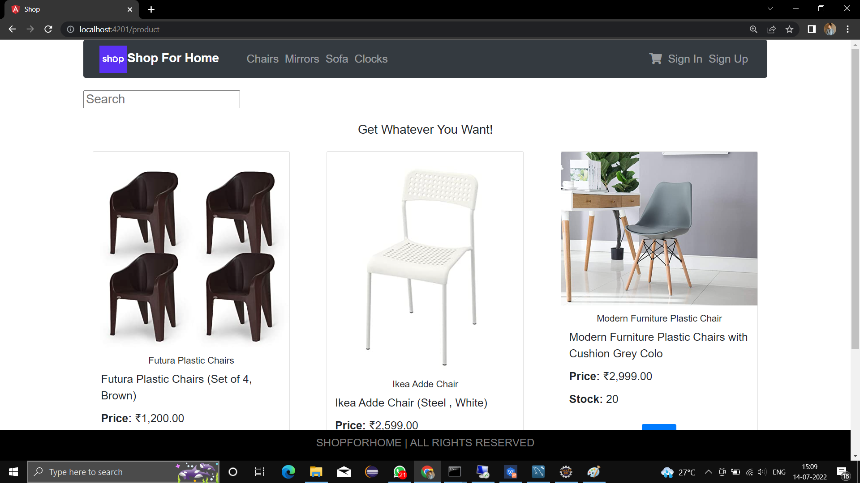
ECOMMERCE TEMPLATE(HOME PAGE)

Slide 9
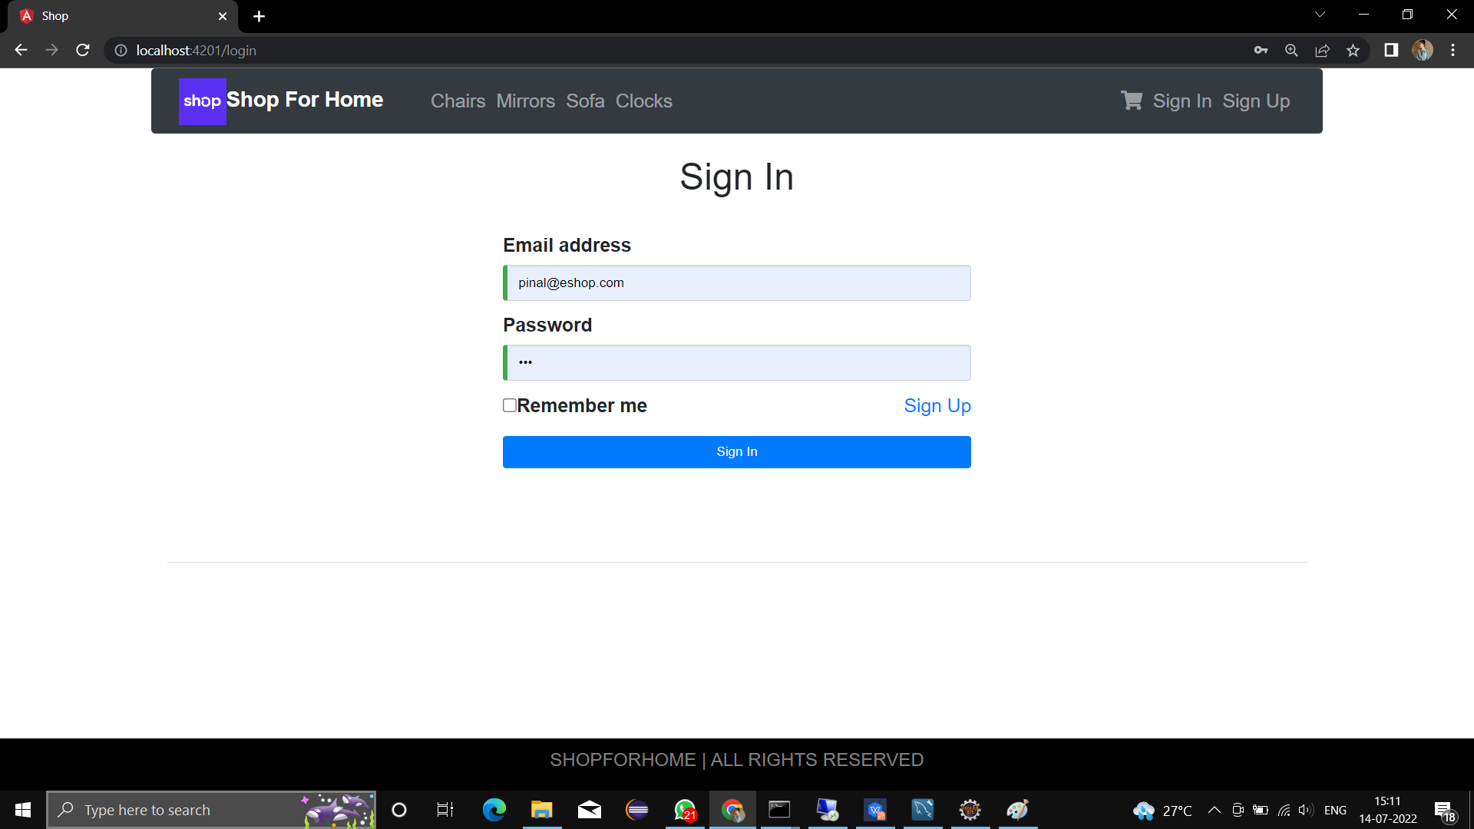
SIGN IN
User is able to login and logout into the Application

Slide 10
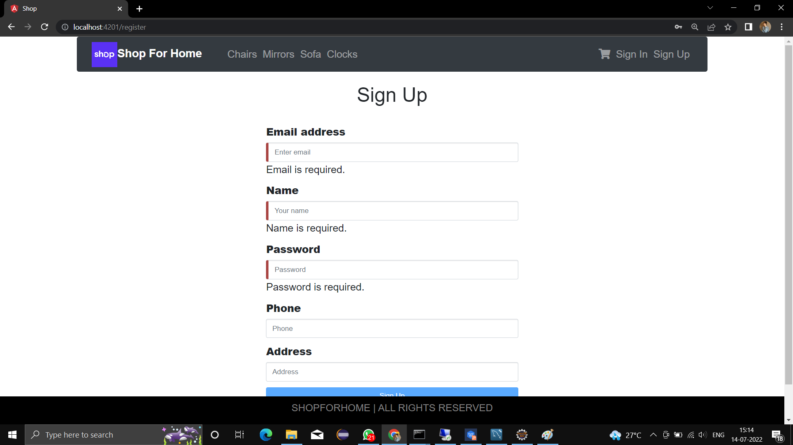
SIGN UP
User is able to register into the Application

Slide 11
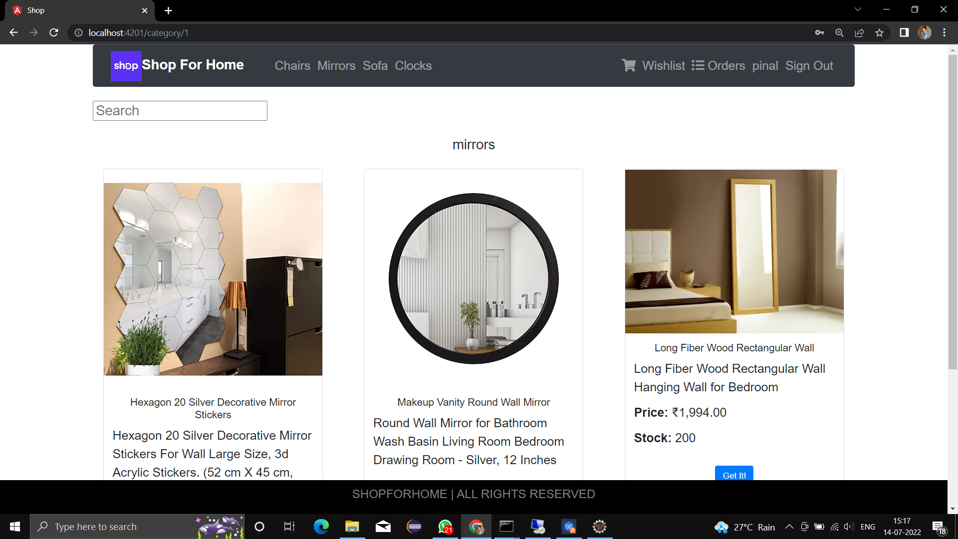
PRODUCT LIST
user is able to see the products in different categories

Slide 12
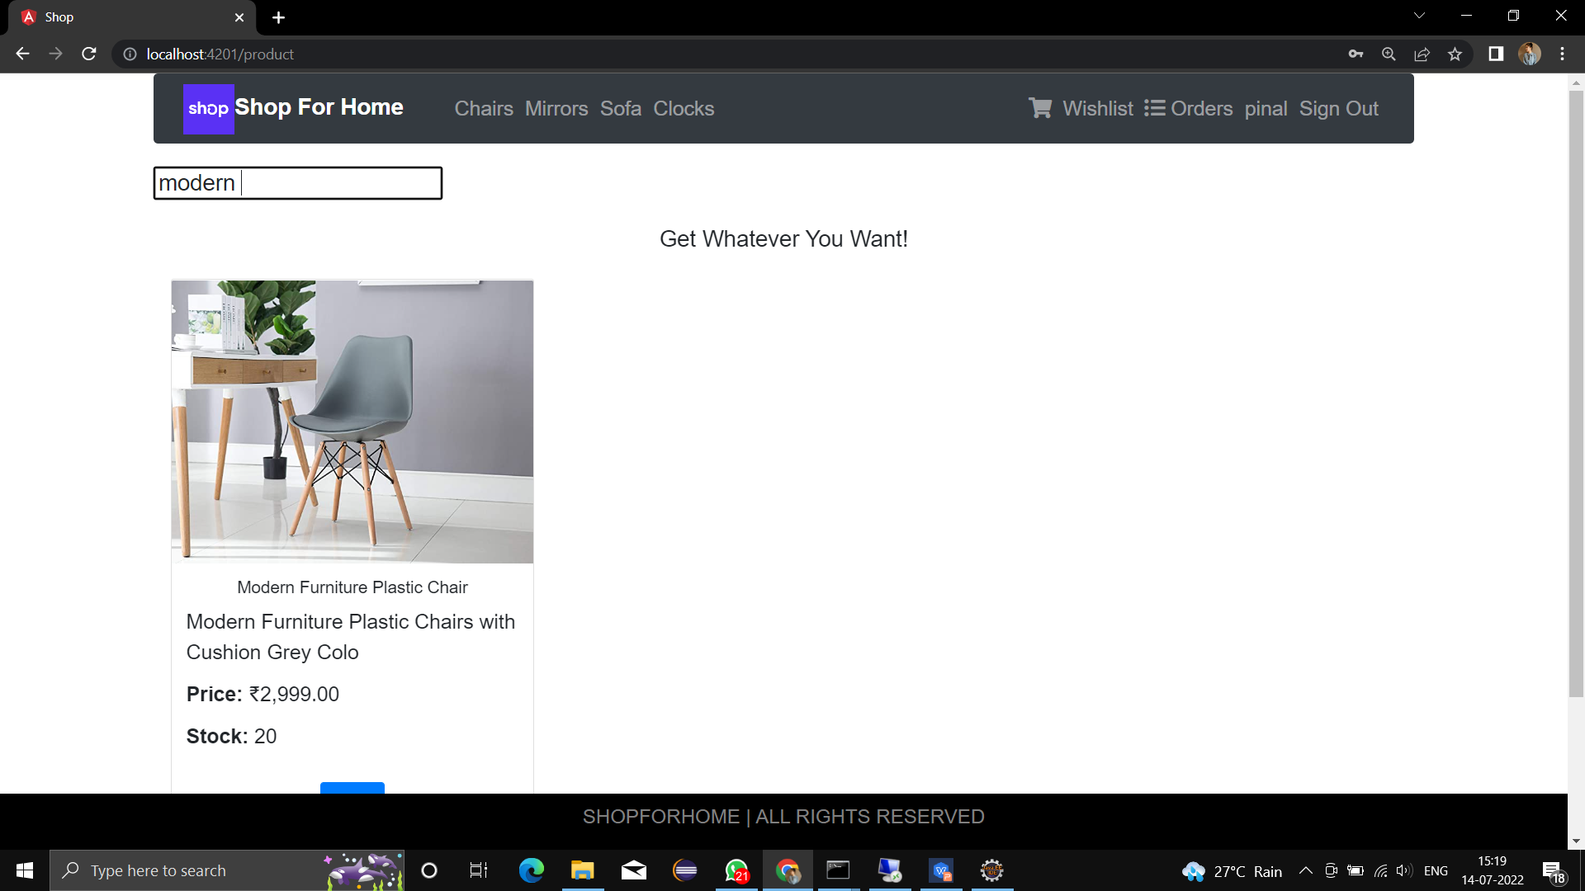
SEARCH
User can search different product items

Slide 13
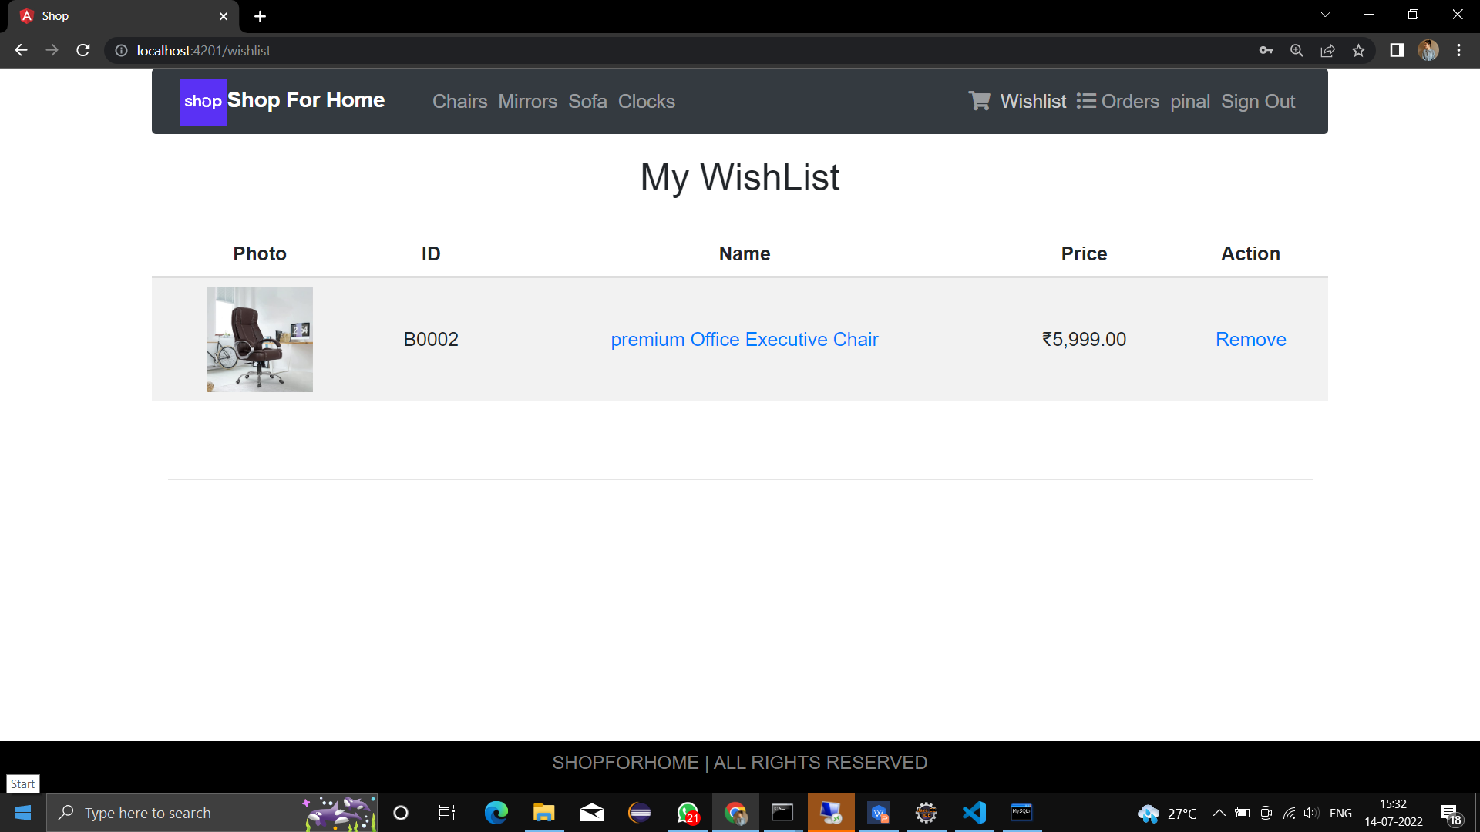
WISHLIST
User is be able to get the Wishlist option to add those products which they but don’t want to order now.

Slide 14
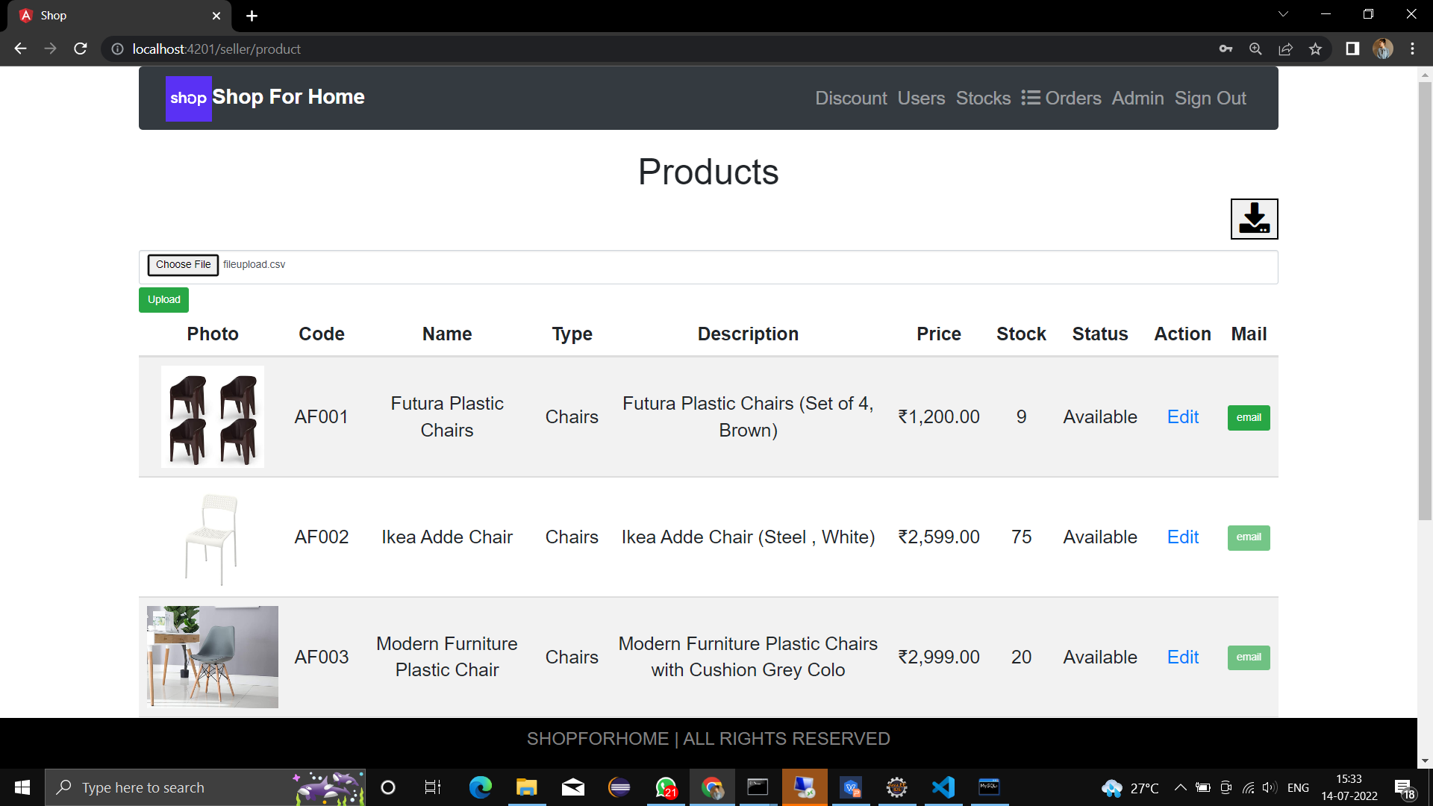
BULK UPLOAD

Slide 15
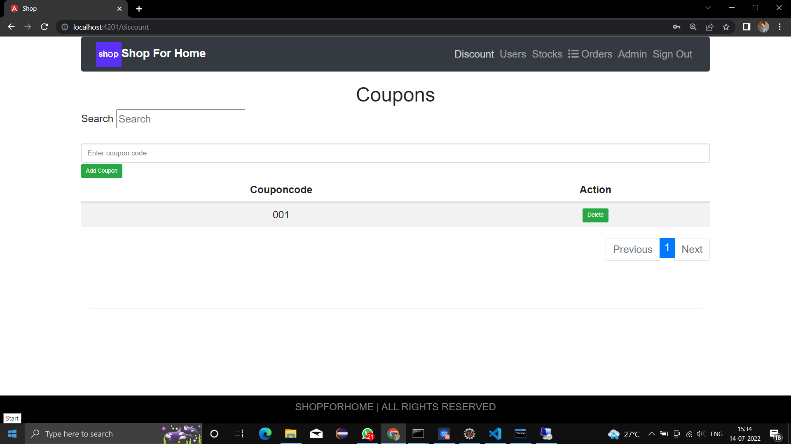
DISCOUNT COUPONS
User is able to get different discount coupons.

Slide 16
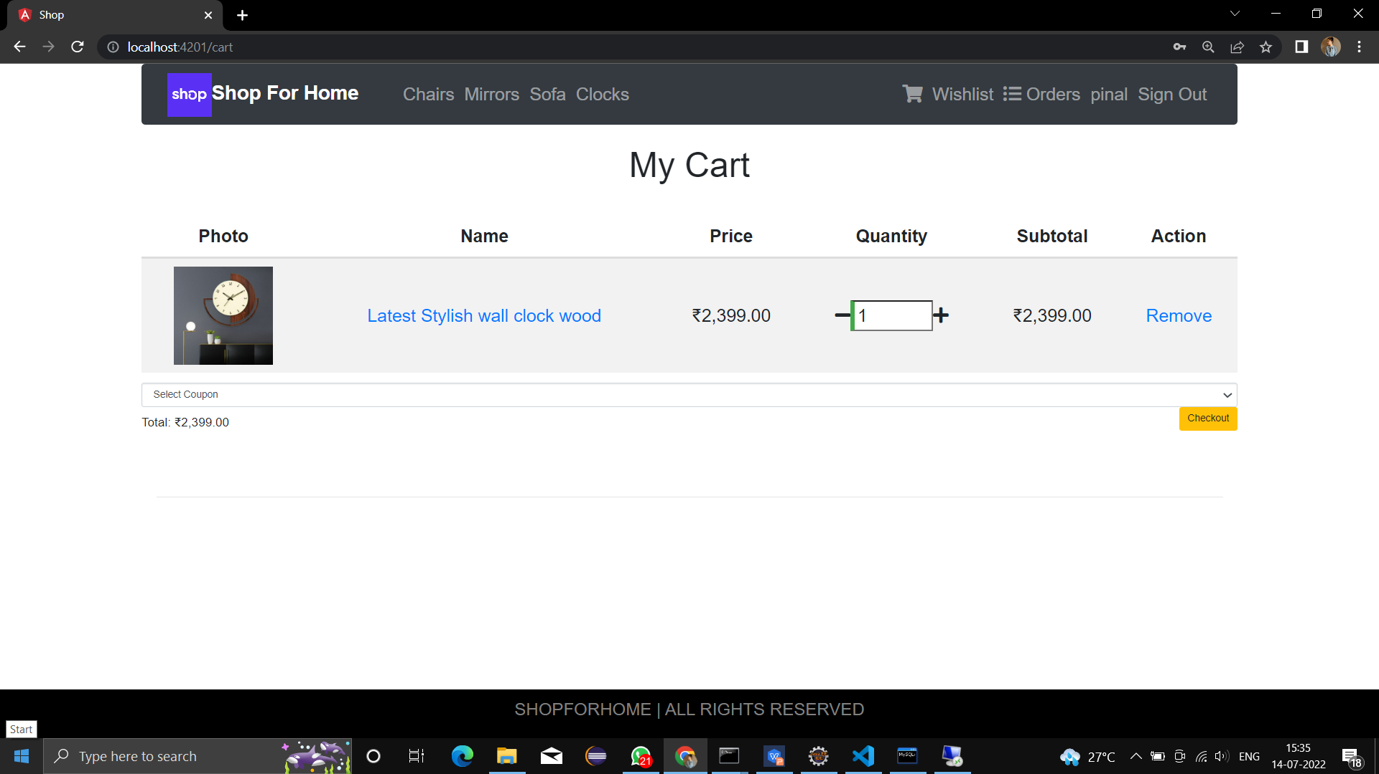
CART OPTION
User is able to add the products into the shopping , to increase or decrease the quantity added in the cart and to add “n” number of products in to the cart.

Slide 17
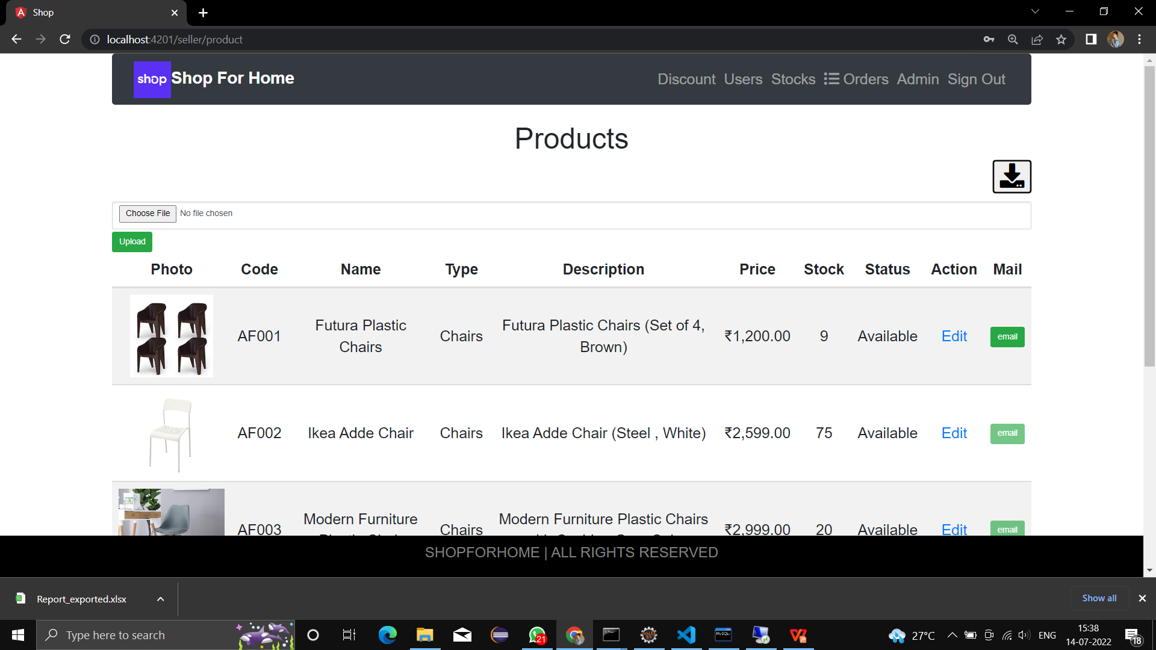
STOKE AND SALES REPORT
Admin is able to get the sales report of a specific duration.

Slide 18
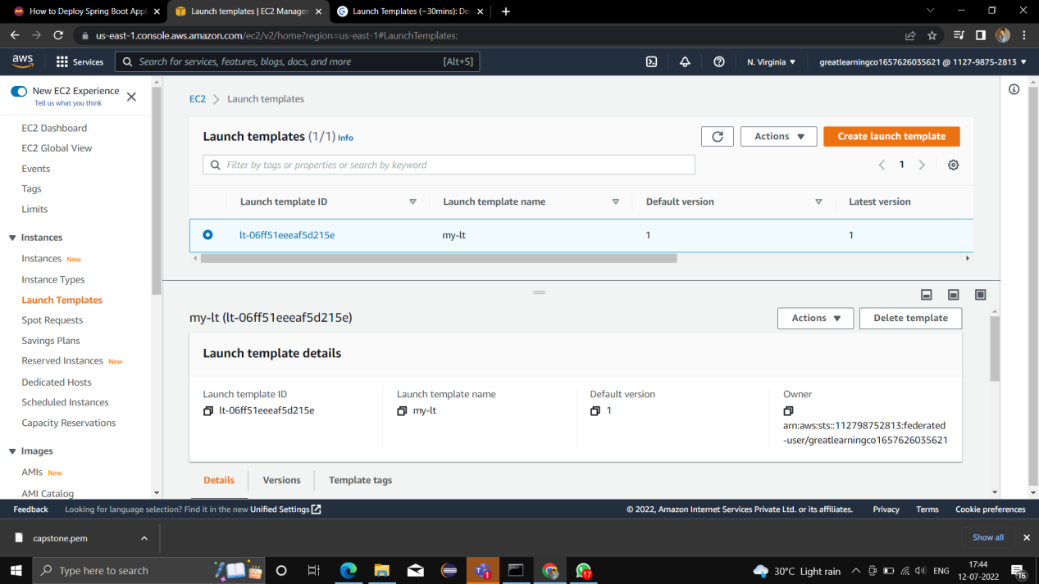
DEPLOYING EC2 INSTANCES Launch Templates

Slide 19
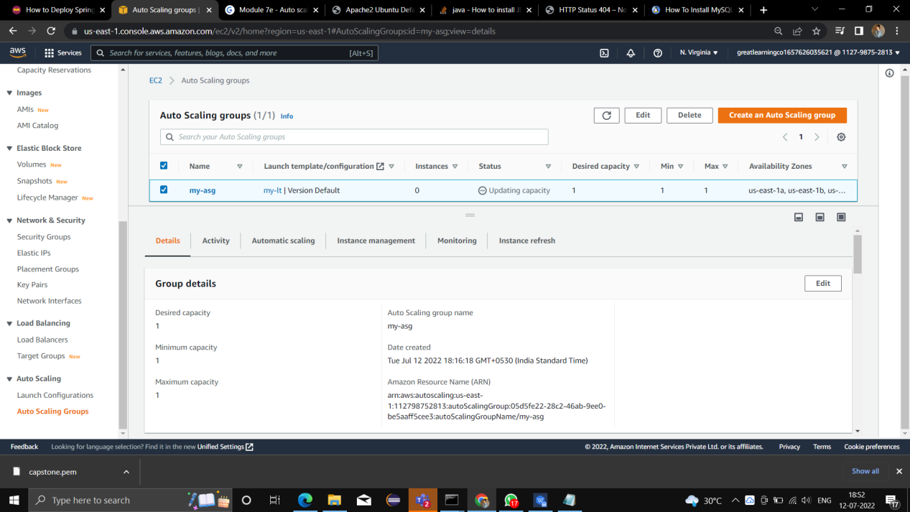
Auto Scalling Group

Slide 20
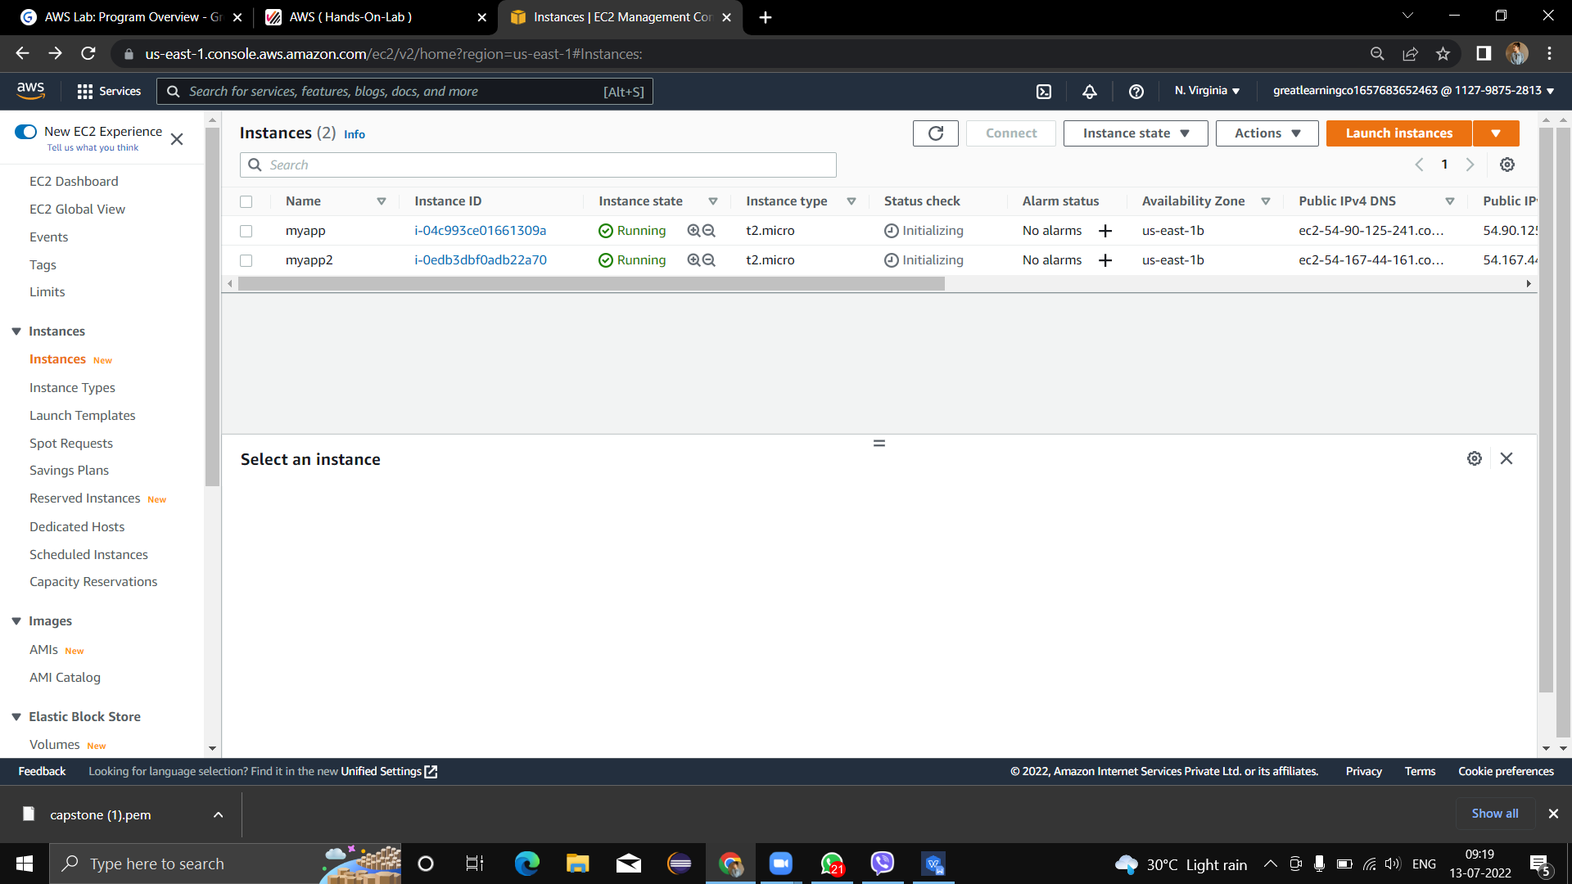
EC2 Instances

Slide 21
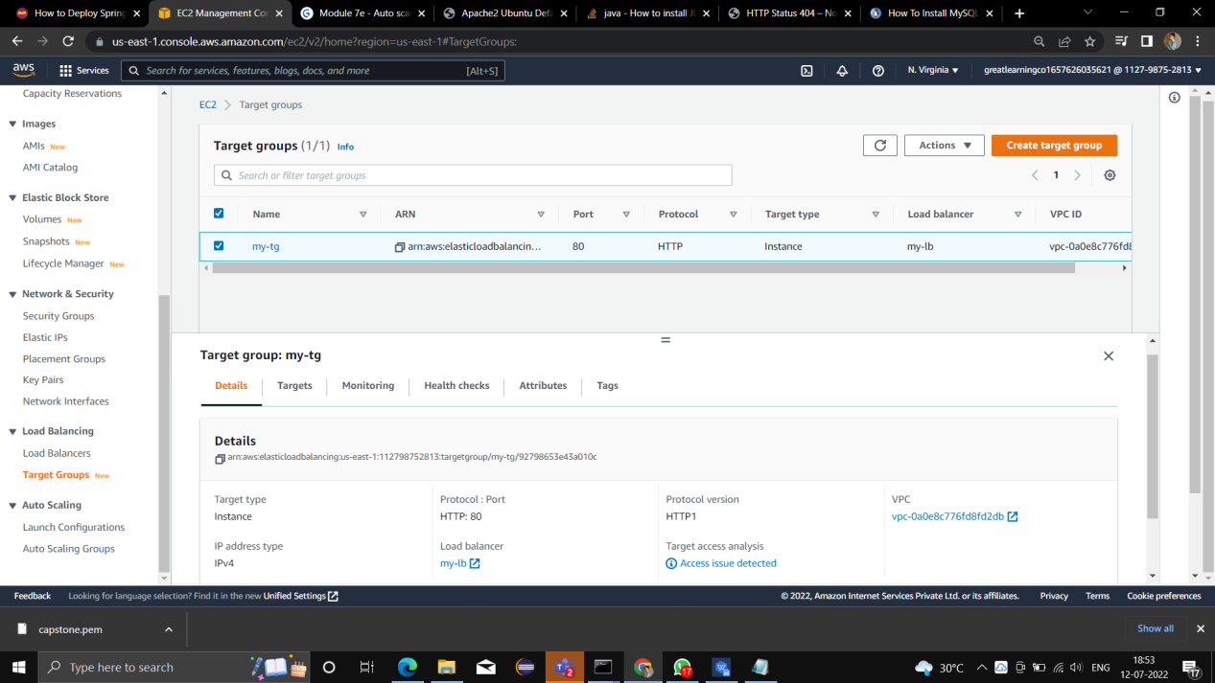
Target Group

Slide 22
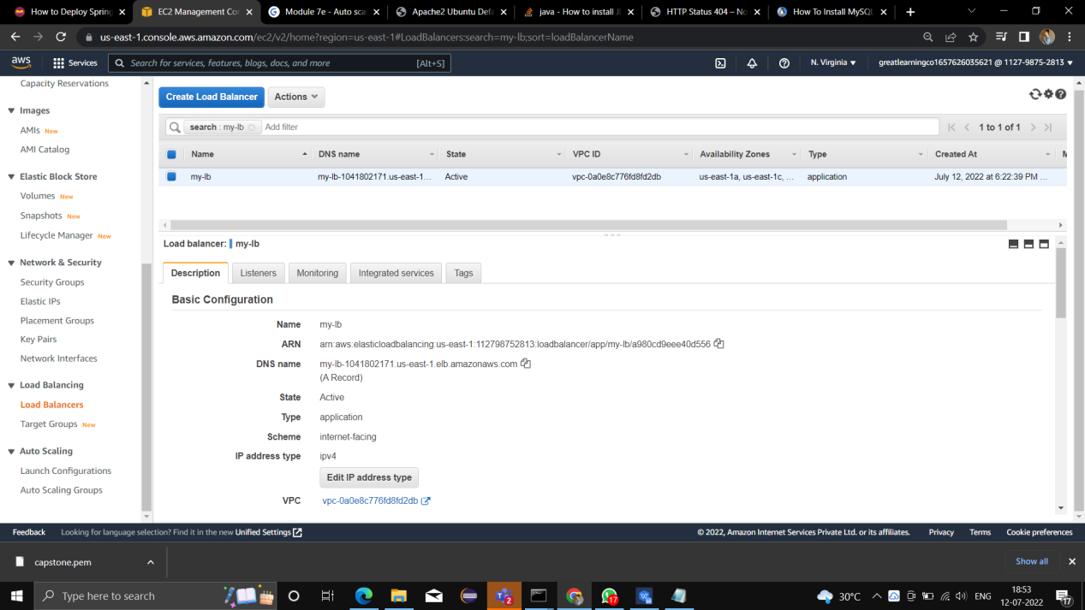
Load Balancer

Slide 23
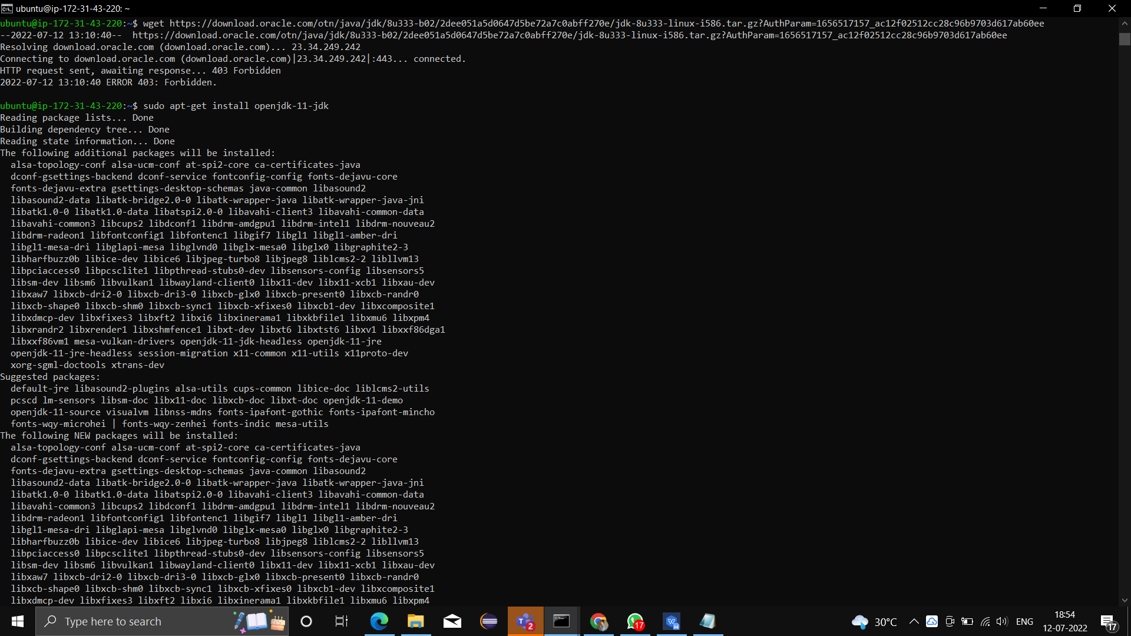
JDK Installation

Slide 24
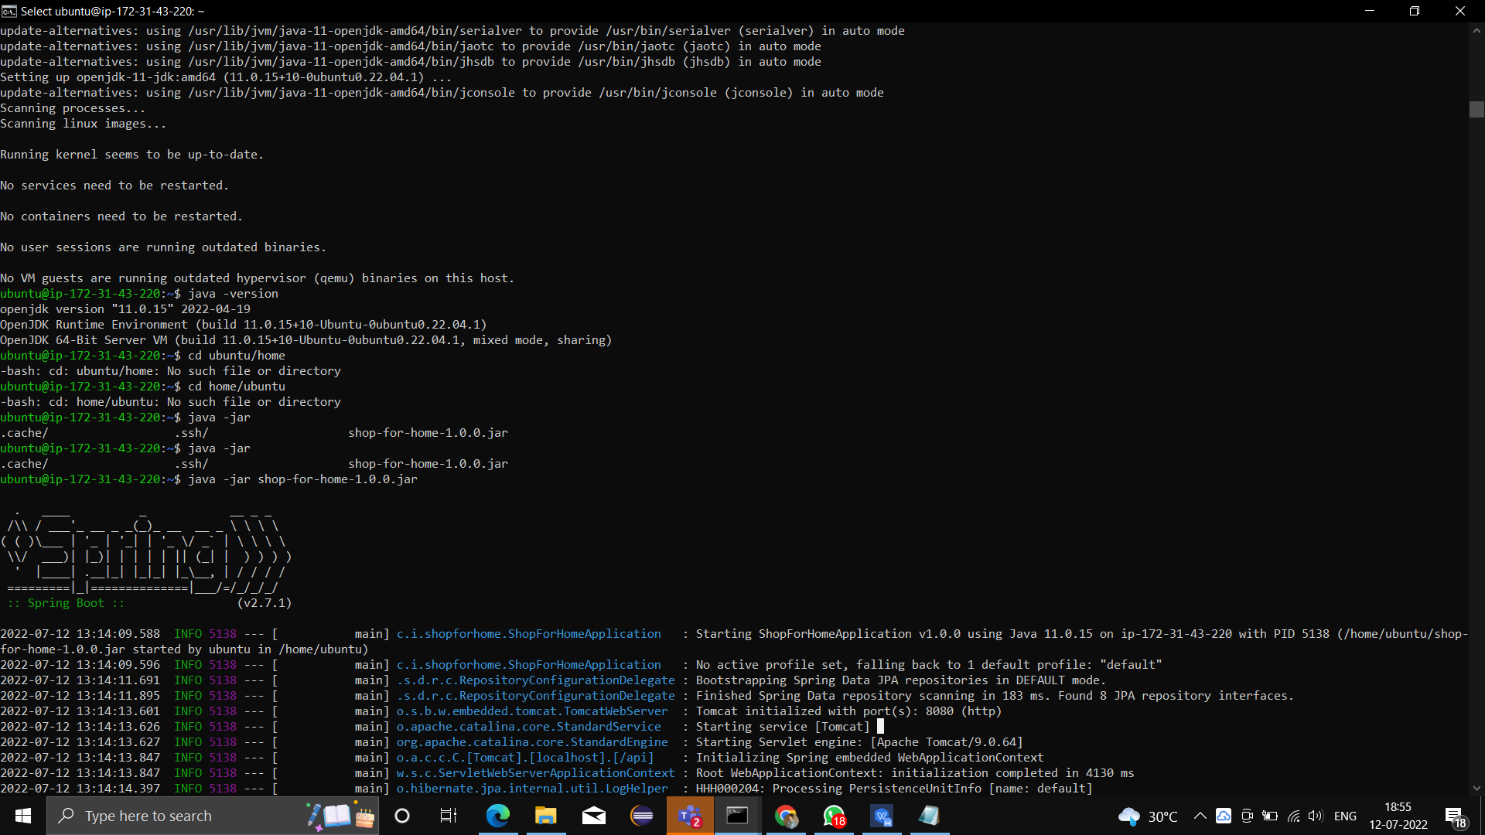
Starting the Application shop-for-home-1.0.0.jar

Slide 25
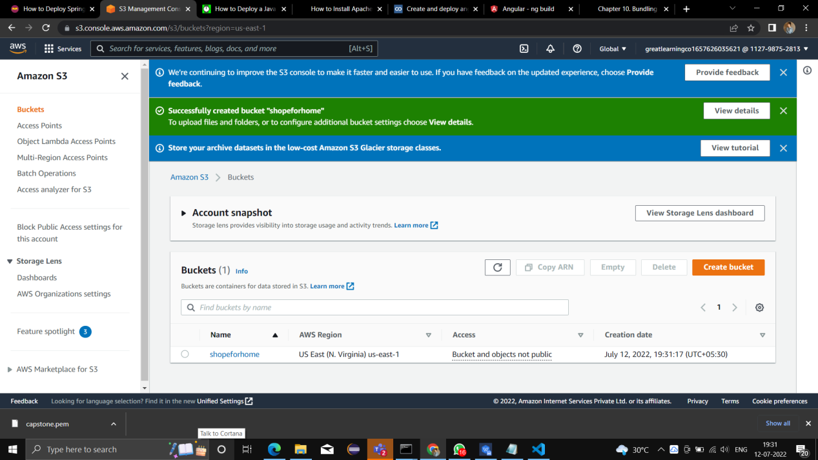
S3 Bucket

