Slide 1

ROAD TRAFFIC ACCIDENTS FATALITY Prevention
Greater London, UK
Author: Max Brear
Version: 1.0
Last Updated: 20 July 2018

Slide 2
Introduction
In 2016 there were over 25,000 traffic accidents on Greater London’s roads resulting in 30,270 casualties
8.3% (2,501) of those casualties were reported as having severe or fatal injuries requiring urgent medical attention
Whilst severe casualty numbers have been decreasing, 2016 saw the highest level for 4 years prompting authorities to consider new preventative & reactive measures

Slide 3
Problem Statement
Road safety funding in London is not unlimited, therefore a targeted approach to accident prevention and reaction can be adopted to minimise severe casualties
Hypothesis | Preventative: Road traffic safety measures can be designed to target roads who’s characteristics have a higher probability of severe accidents Reactive: Initial feedback from emergency calls can be used to identify accidents more likely to result in severe casualties, thus prompting a substantial response from the emergency services
Assumptions | 2016 data set is sufficient to predict future trends (ignoring any changing factors such as road usage policy, vehicle safety improvements etc.) Sufficient and accurate accident data can be captured during emergency calls to influence targeted emergency response Data extracted from the Transport for London website is complete and includes all non-severe / minor road accidents (to avoid sample bias)
Problem Type | Supervised Single-Variable Classification (Logistic Regression)

Slide 4
Data
Traffic accident data taken from Transport for London’s open data source
Some Selected Features…....
Data File | Description | Target Variable | Features | Rows | Data Key / Index
Casualty File | List of casualties associated with road traffic accidents | Casualty Severity | Unique Features = 15 Common Features = 4 | Fatal = 116 Serious = 2,385 Slight = 27,769 Total = 30,270 | AREFNO (Incident Reference number)
Attendant File | List of road traffic accidents including associated road characteristics, vehicles involved and casualties | - | Unique Features = 21 Common Features = 4 | Fatal = 114 Serious = 2,289 Slight = 22,723 Total = 25,126
Data Set | Feature | Details
Attendant | Road Class | Road Type Classification
Attendant | Speed Limit | Road Speed Limit
Attendant | Speed Limit | Road Speed Limit
Attendant | Junction Type | Type of Junction e.g. Single, Multi
Attendant | Ped Crossing | Type of Crossing Facilities
Data Set | Feature | Details
Attendant | Light | Light Conditions at time of incident
Attendant | Weather | Conditions at time of incident
Attendant | Surface | Type of Road Surface & Condition
Casualty | Restriction | Vehicle in an unauthorised lane?
Casualty | Driver Age | Age of the Driver

Slide 5
Exploratory Data Analysis (EDA)
--- Features & Data Types ---
<class 'pandas.core.frame.DataFrame'>
Range Index: 30270 entries, 0 to 30269
Data columns (total 37 columns):
dtypes: int64(11), object(26)
memory usage: 8.5+ MB
AREFNO 30270 non-null object
Borough 30270 non-null object
Boro 30270 non-null int64
Easting 30270 non-null int64
Northing 30270 non-null int64
CREFNO 30270 non-null int64
Casualty Class 30270 non-null object
Casualty Sex 30270 non-null object
Casualty Age (Banded) 30270 non-null object
Casualty Age 30270 non-null int64
No. of Casualties 30270 non-null int64
Casualty Severity 30270 non-null object
Ped. Location 30270 non-null object
Ped. Movement 30270 non-null object
Mode of Travel 30270 non-null object
Location 30270 non-null object
Accident Severity 30270 non-null object
No. of Casualties in Acc. 30270 non-null int64
No. of Vehicles in Acc. 30270 non-null int64
Accident Date 30270 non-null int64
Day 30270 non-null object
Time 30270 non-null object
Highway 30270 non-null object
Road Class 1 30270 non-null object
Road No. 1 30270 non-null int64
Road Type 30270 non-null object
Speed Limit 30270 non-null object
Junction Detail 30270 non-null object
Junction Control 30270 non-null object
Road Class 2 30270 non-null object
Road No. 2 30270 non-null int64
Ped. Crossing Decoded 30270 non-null object
Light Conditions (Banded) 30270 non-null object
Weather 30270 non-null object
Road Surface 30270 non-null object
Special Conditions 30270 non-null object
C/W Hazard 30270 non-null object
Highlights
Data frame full populated with no null values
Majority of features not numeric, requiring significant data cleanup
Standardization / consolidation of categorical data used to reduce model complexity especially following one hot coding

Slide 6
Feature Selection
Step 1: User removed features (36 down to 24 features)
Step 2: Automated Feature Selection
Remove Features with missing values in more than 50% of rows (0)
Remove Features with a correlation magnitude greater than 0.95 (7)
Remove Low or Zero importance Features (+5)
Remove Features with single unique values (+20)
Correlation > 0.95
Low / Zero Importance
Single Unique Values
107
75

Slide 7
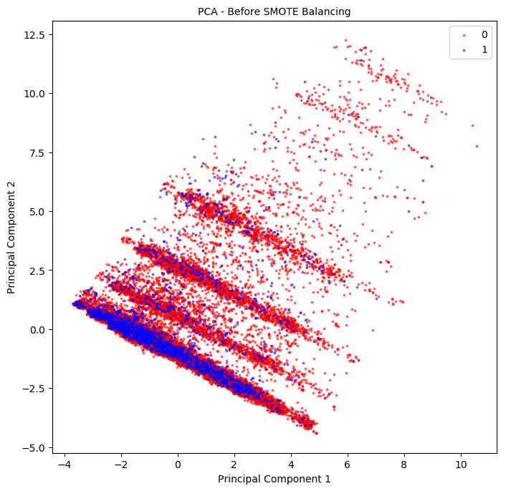
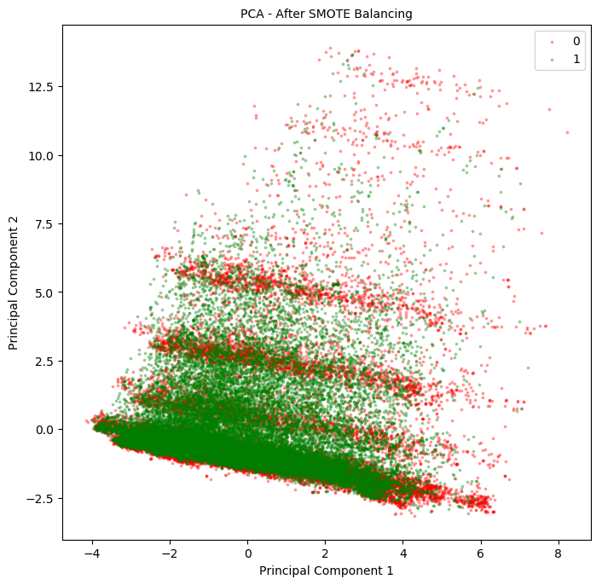
Data Imbalance
Dataset: 91.7% Class 0 (Non-Severe) / 8.3% Class 1 (Severe)
Approach: Over sampling based on SMOTE
df.shape
[(0, 27769), (1, 2501)] / (30270, 73)
df.shape
[(0, 27769), (1, 27769)] / (55538, 73)

Slide 8
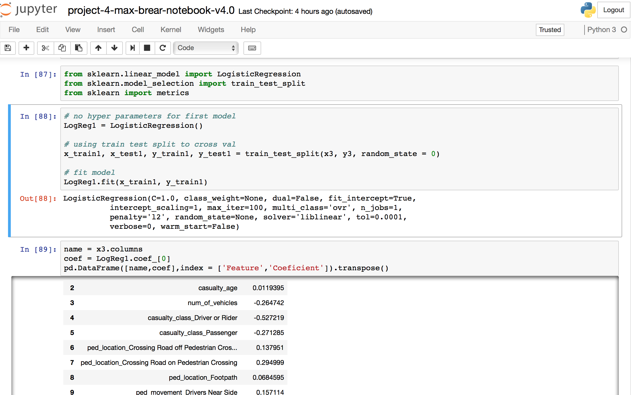
Logistic Regression (TTSplit)

Slide 9
Model Accuracy
Initial Accuracy Score: 67.49%
Confusion Matrices: Array ([[4222, 2748],[1769, 5146]])
ROC: 0.675
Log loss: 11.24
Accuracy following Cross-Validation: 67.75%
Regularization to optimize model – from initial results (cees values)

Slide 10
Recommendations & Next steps
Logistic Regression model will enhance casualty prediction with accuracy greater than 67%
Recommendations:
Emergency services leverage model during calls to establish likelihood that the accident may result in a severe level causality
Further examination is needed to establish those road characteristics which tend to result in severe casualties in order to implement a suitable preventative road safety investment strategy
Next Steps:
Further model optimization can be performed to increase accuracy beyond 97% e.g.
Feature scaling
Hyperparameter Tuning - Grid Search
etc…

