Slide 1
AIDI – 1100- 02 INTODUCTION TO AI DEVELOPMENT Group No: 4
Group Members
Ryan Shaw
Pruthviben Patel
Nick Elliott
Arunpriya Gobinath
Nishith Patel

Slide 2
Outline
Importing and Scanning data
02. Data Parsing and storage
03. Stocks of interest
04. Visualization
05. Stock Recommendation & Summary

Slide 3
Technology Used
Language used – Python.
Jupyter Notebook/Google Colab – for coding and debugging.
Github - for sharing all the input from individuals and to showcase our work.
Libraries – BeautifulSoup, Pandas, Numpy, Regular Expression, Date Time, Requests
Plotly/matplotlib - for the visualization of stocks.
Yfinance Python – to get all the data of stocks.

Slide 4
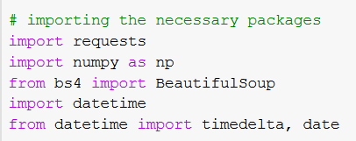
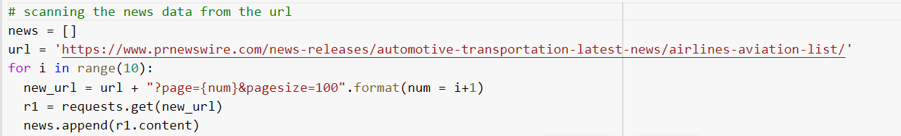
Importing and Scanning data
The pages fetched from the URL are embedded in a list.
Importing Packages
Scanning 10 pages from the website URL
Embedding all the pages in a list named NEWS

Slide 5
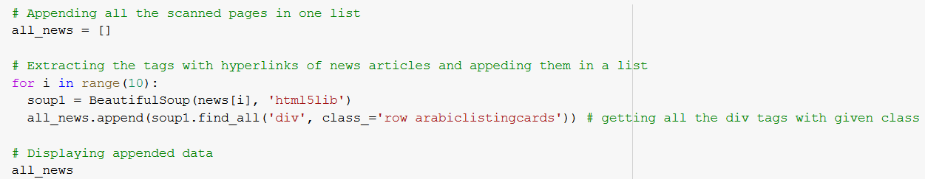
Importing and Scanning data
Scanning of data is done with the use of BeautifulSoup Library.
Creating a list to store div tags
Using BeautifulSoup to extract from webpage
Extract all items with div tag

Slide 6
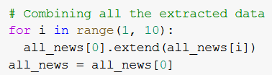
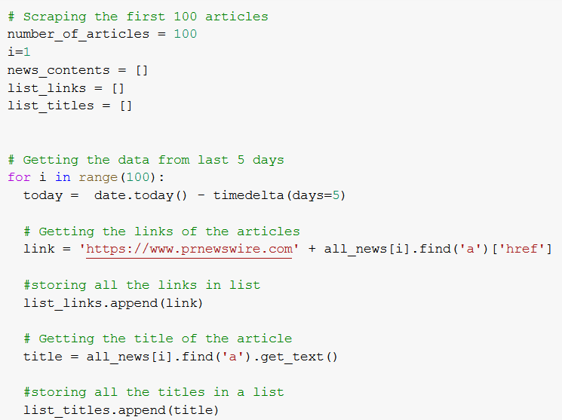
Parsing and storage
Scraping first 100 articles
Combining all the extracted data in all_news
Getting links and titles of articles from last 5 days

Slide 7
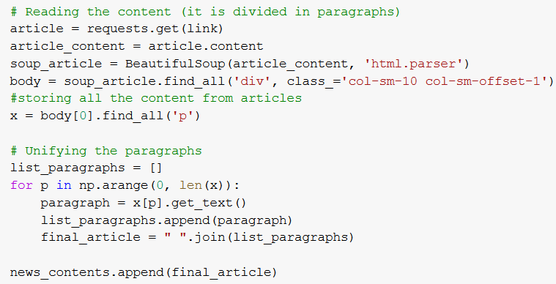
Parsing and storage
Reading the content of article stored in p tags in div tags using html.parser and find_all().
Storing the content in a list named news_contents.

Slide 8
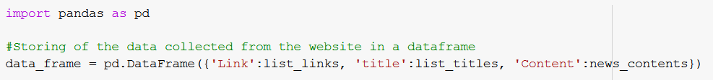
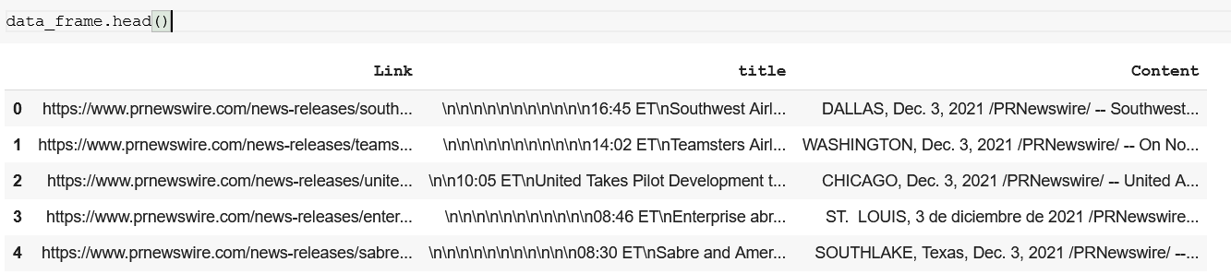
Parsing and storage
Data Collected from the website is now stored in a Dataframe.

Slide 9

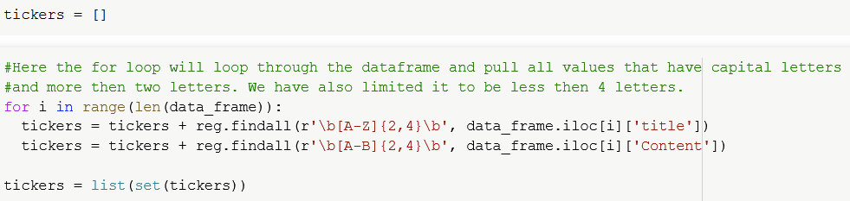

Stock of Interest
Utilized the Regular Expression operator to find stock symbols.
Words greater than 2 letters but less than 4.
From the list of symbols, 3 were selected for further exploration.
We selected SSP, ACY, and DAL stock tickers.

Slide 10
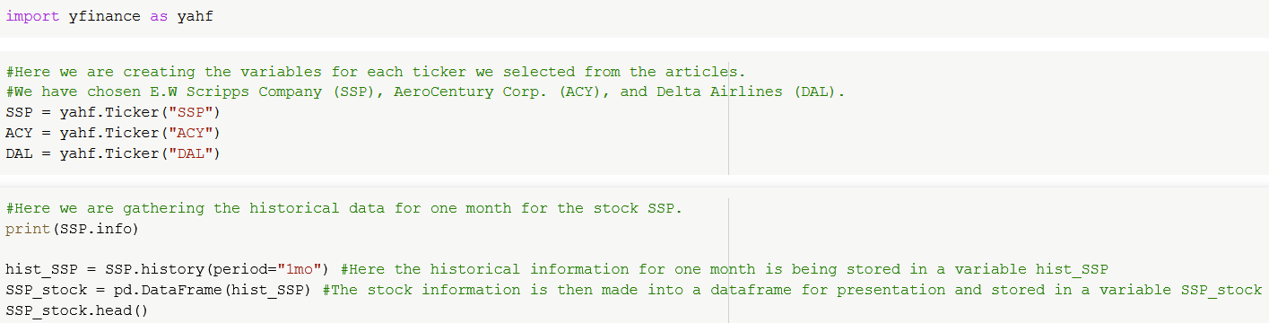
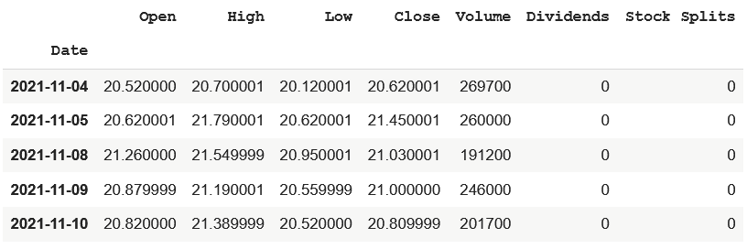
Stock of Interest
Yahoo Finance Module
Output of Historical data

Slide 11
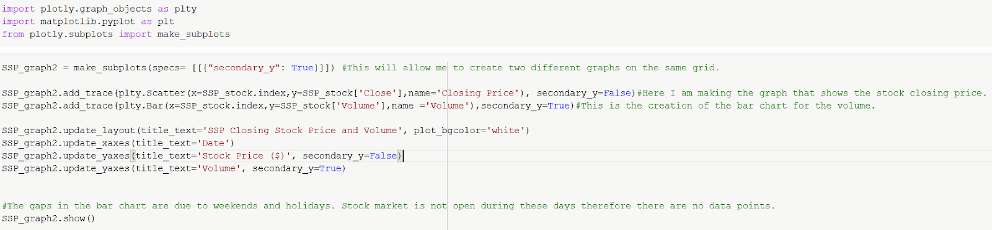
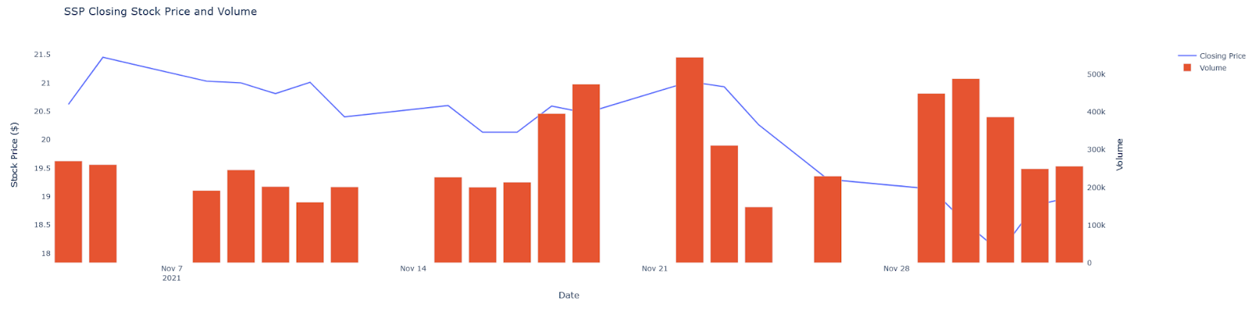
Visualization
Plotly Module Used to make Graph
Stocks Closing Price and Volume

Slide 12
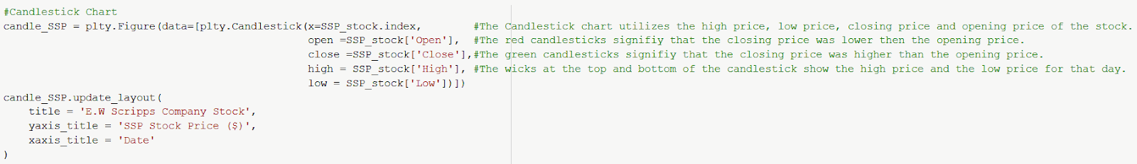
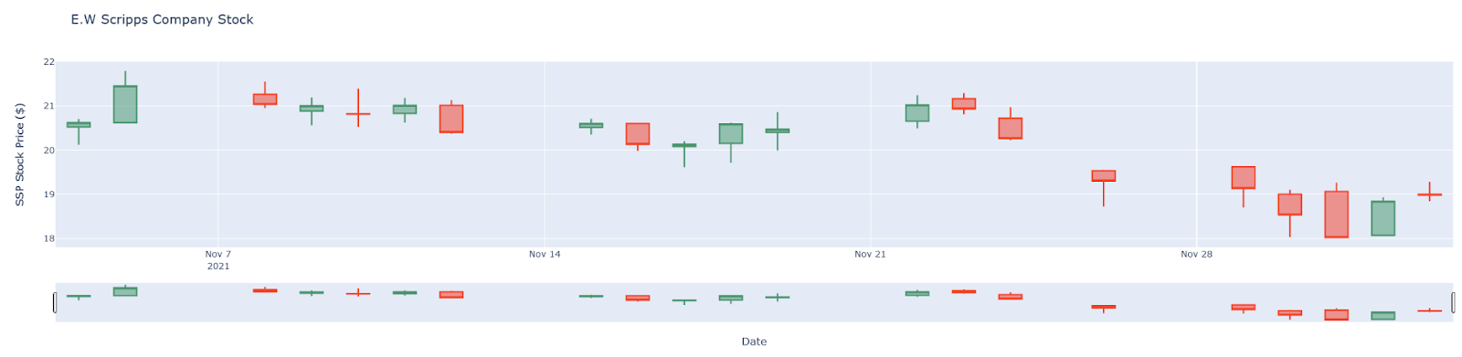
Visualization
Using candlestick chart it shows Scripps Company Stocks according SSP Stock price with Date

Slide 13
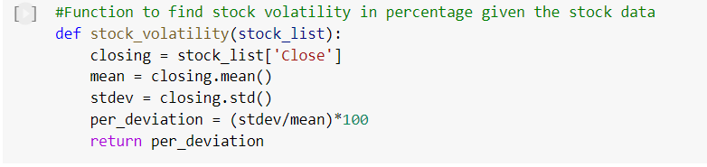
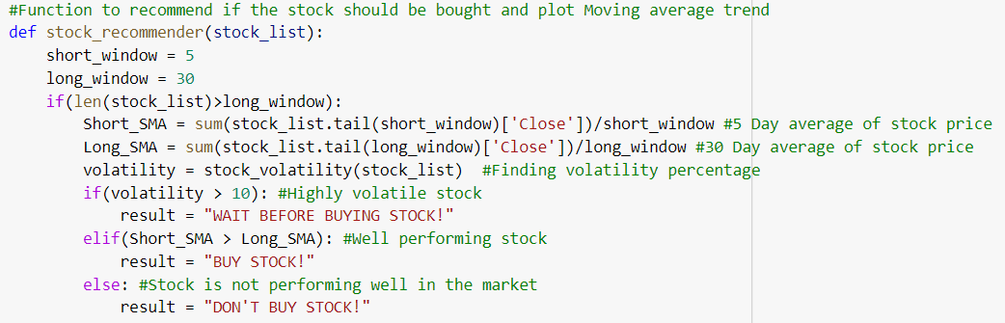
Stock Recommendation
Wait before Buying – if volatility > 10%.
Buy – if 5 Day SMA > 30 Day SMA
Otherwise, Don’t Buy

Slide 14
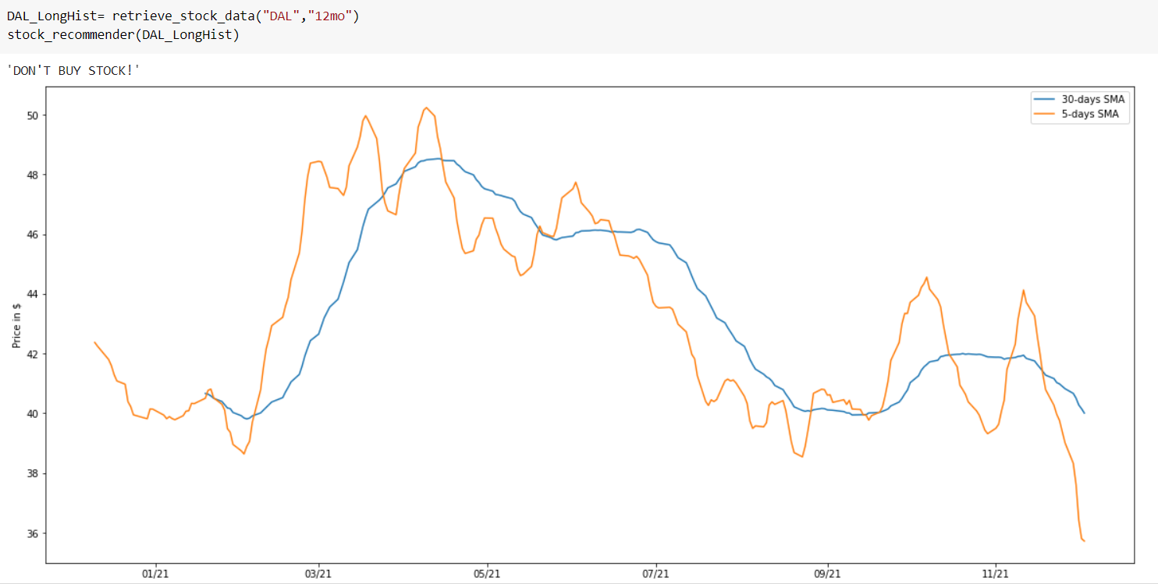
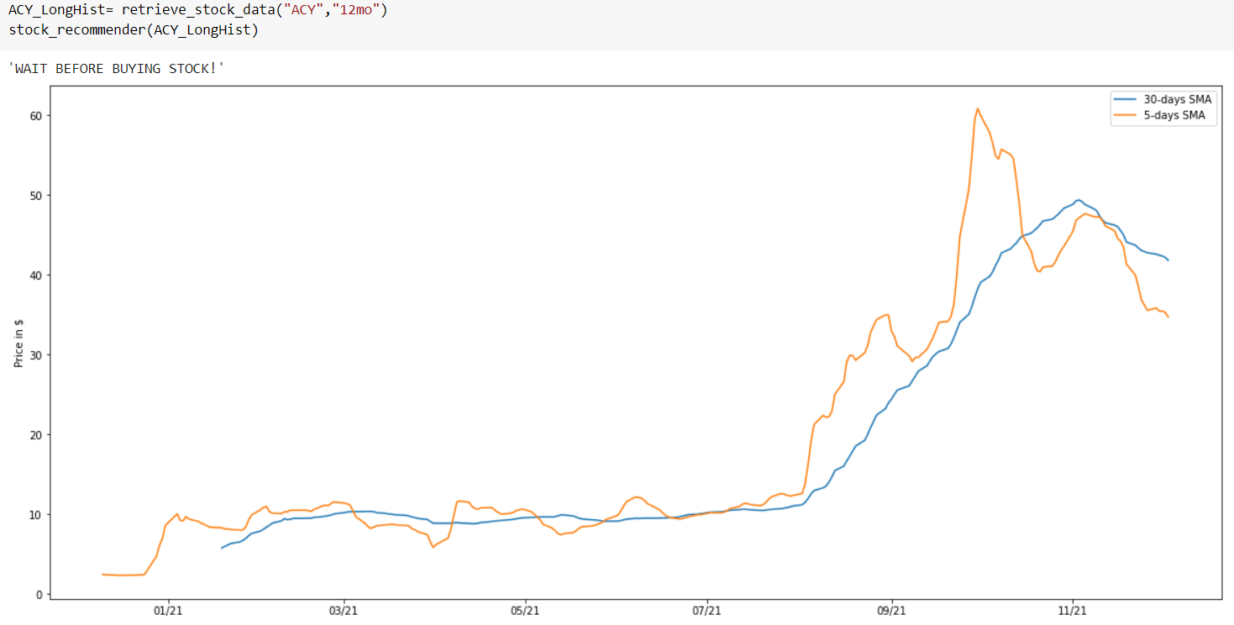
Stock Recommendation - Examples
DAL – Don’t Buy stock
ACY – Wait Before Buying Stock

Slide 15
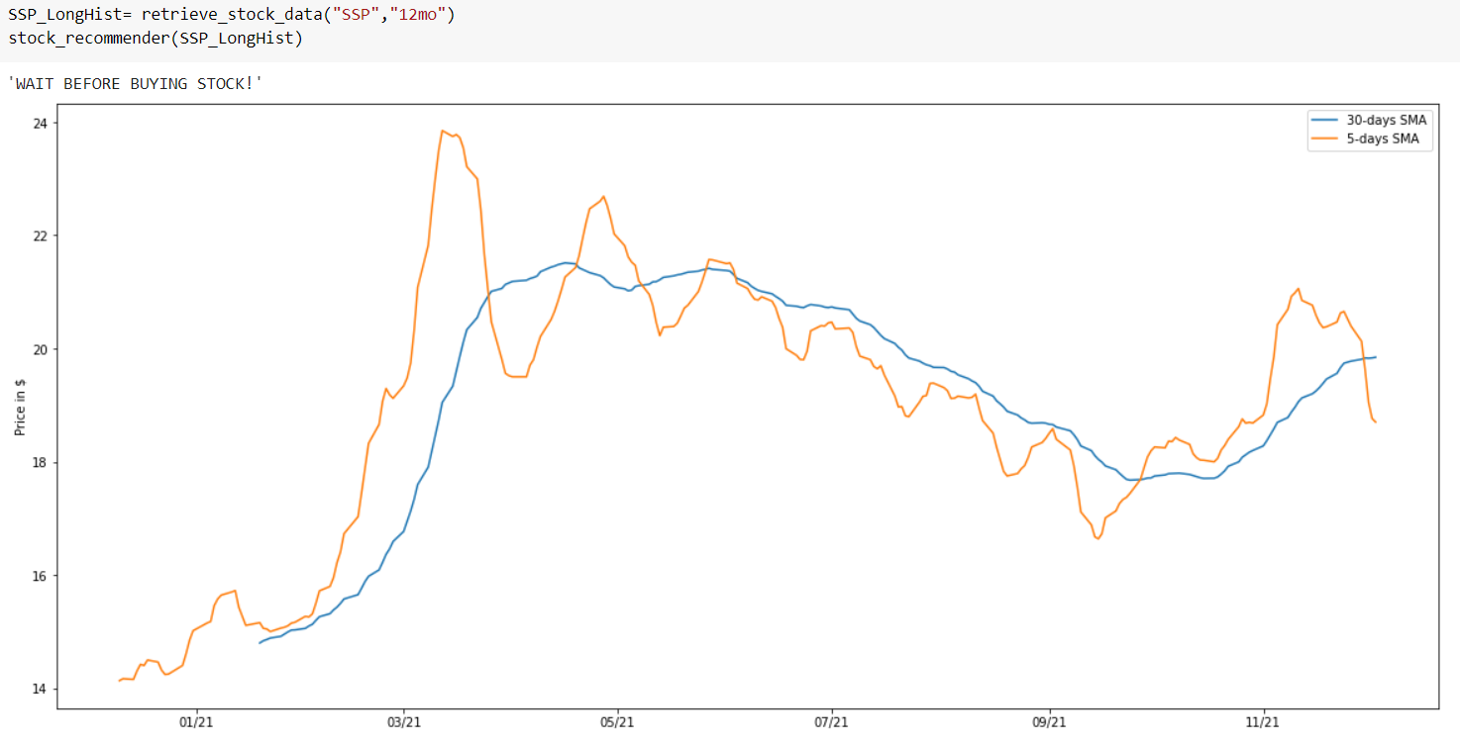
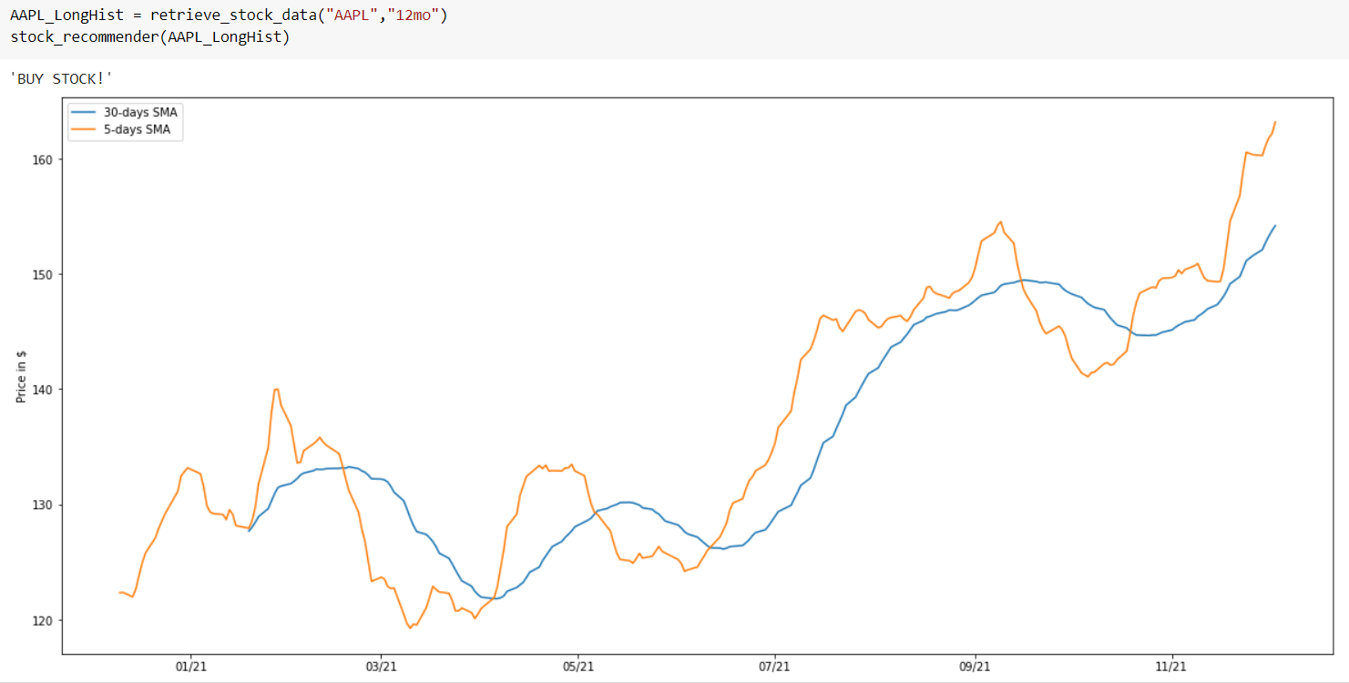
Stock Recommendation - Examples
SSP – Wait before Buying stock
AAPL – Buy Stock

Slide 16
Summary
Chosen Industry: Airline and Aviation
Scan and parse: News from PRNewswire website using industry specific URL.
Chosen Stocks: DAL(Delta Airlines), SSP(E.W Scripps Company), ACY(AeroCentury Corp.)
Recommendation for purchase of stocks using Volatility and Simple Moving Averages
Please refer our Github Link: https://github.com/PineTree007/stock-recommender.git

Slide 17

Thank you
Any Questions?

