Slide 1
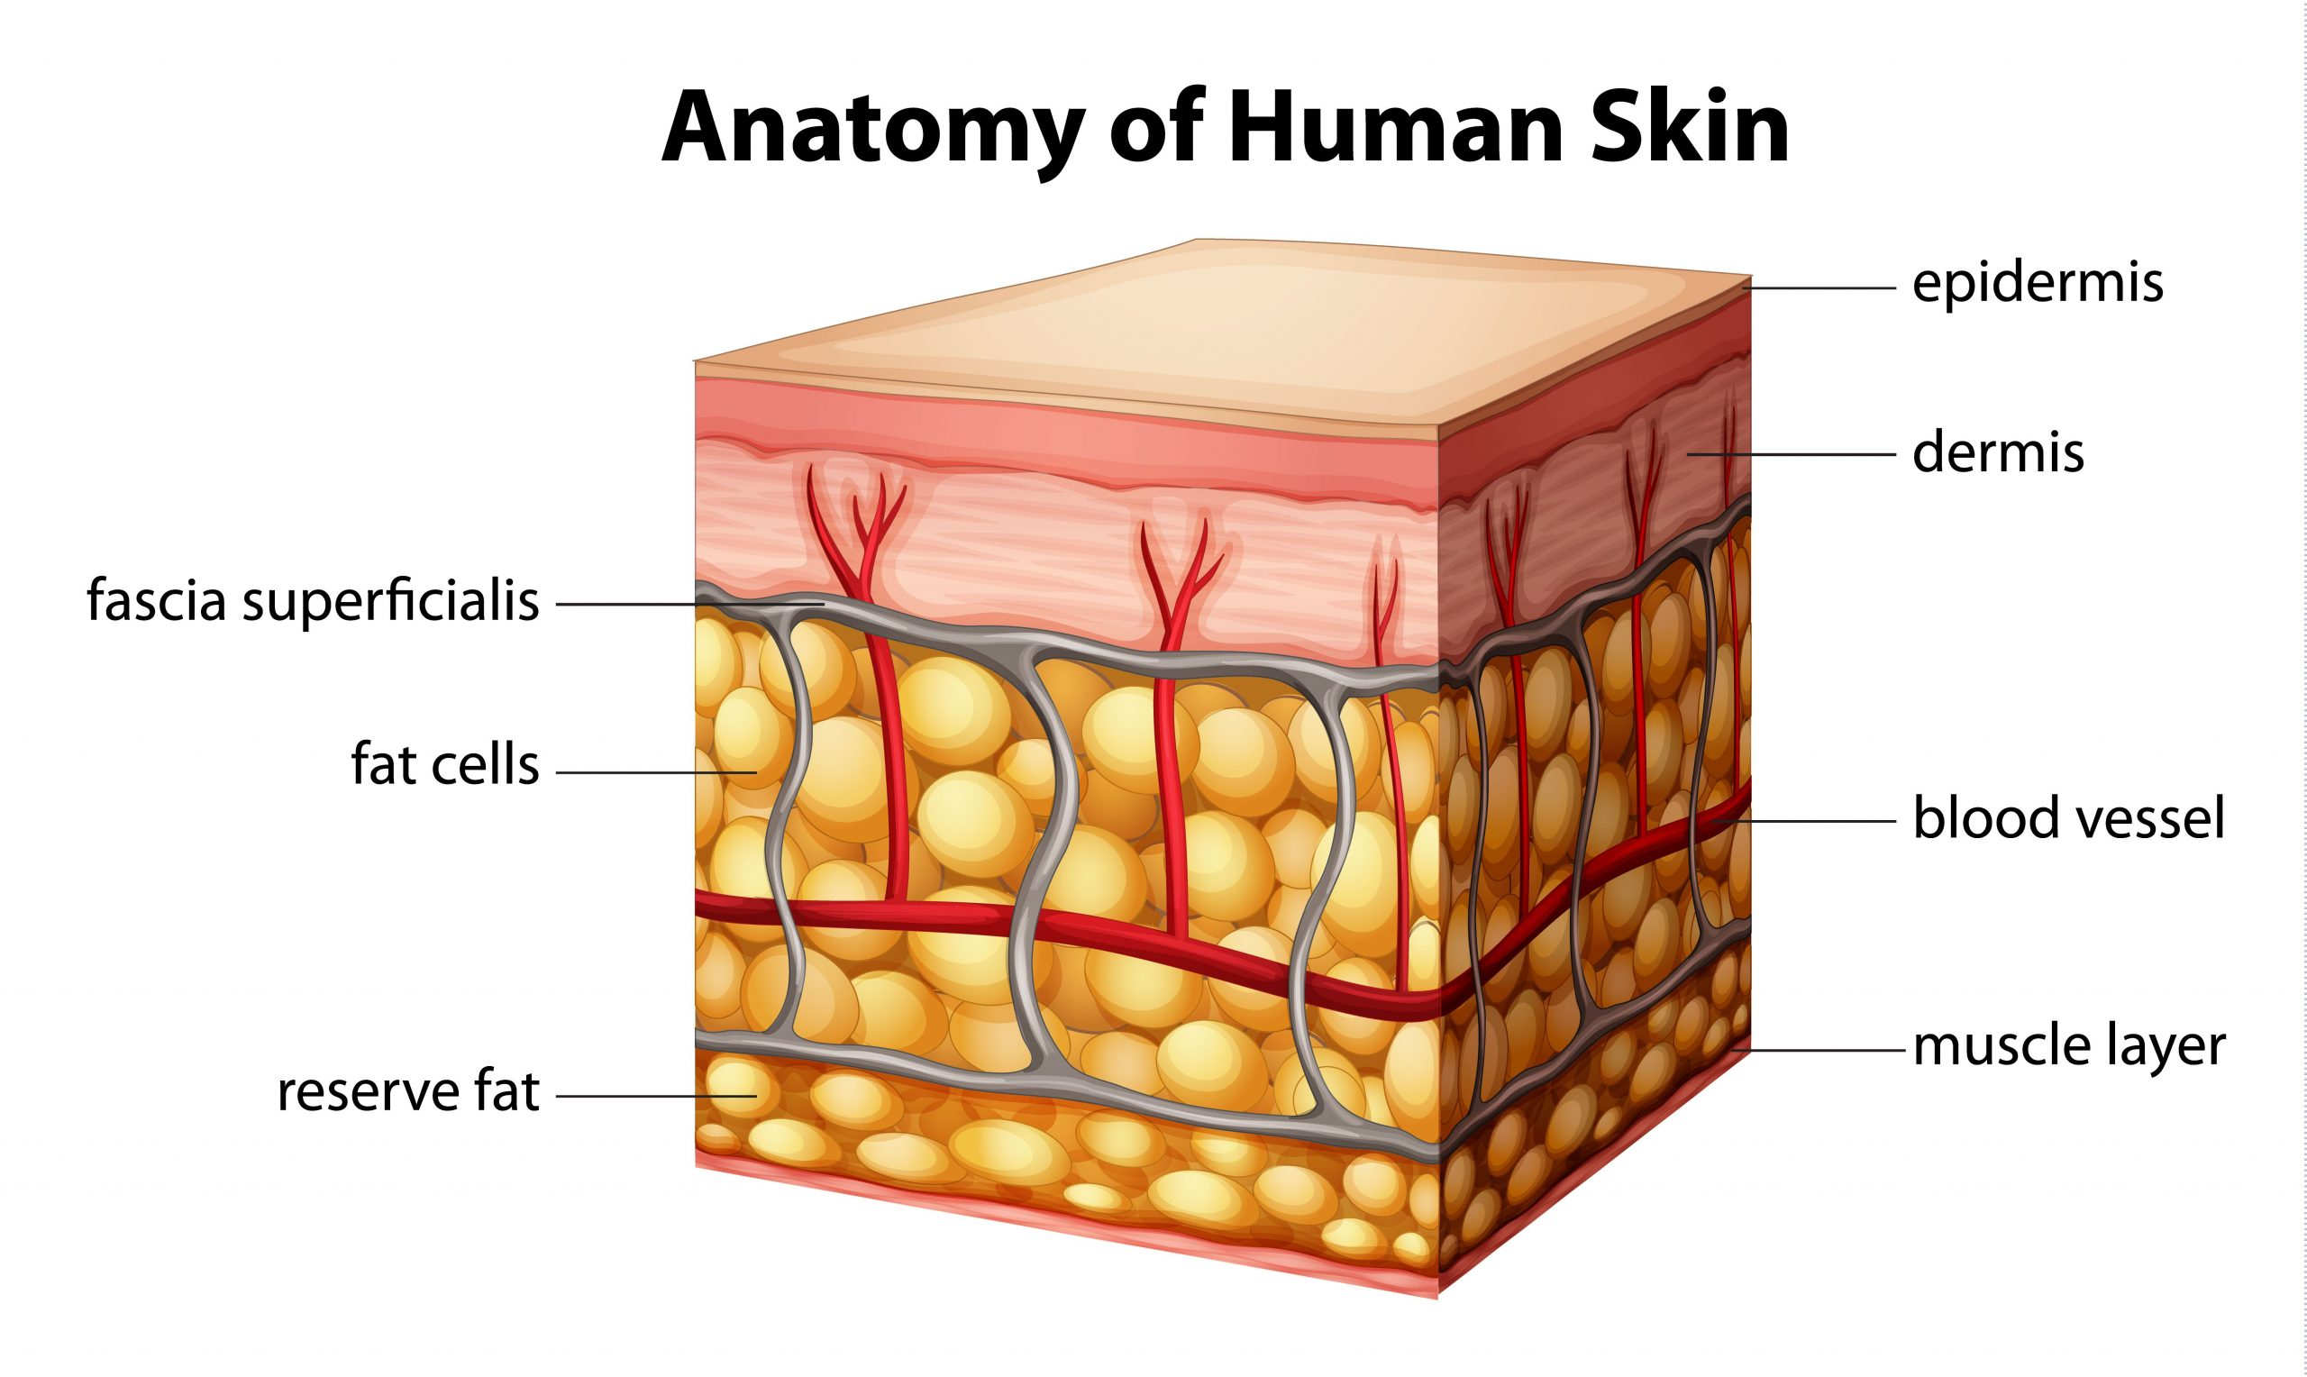
RNA-seq Analysis of Scar Tissue
Shengchen Xie
[5]
Notes:
[5] https://thenakedchemist.com/scars-on-face-treatment/

Slide 2
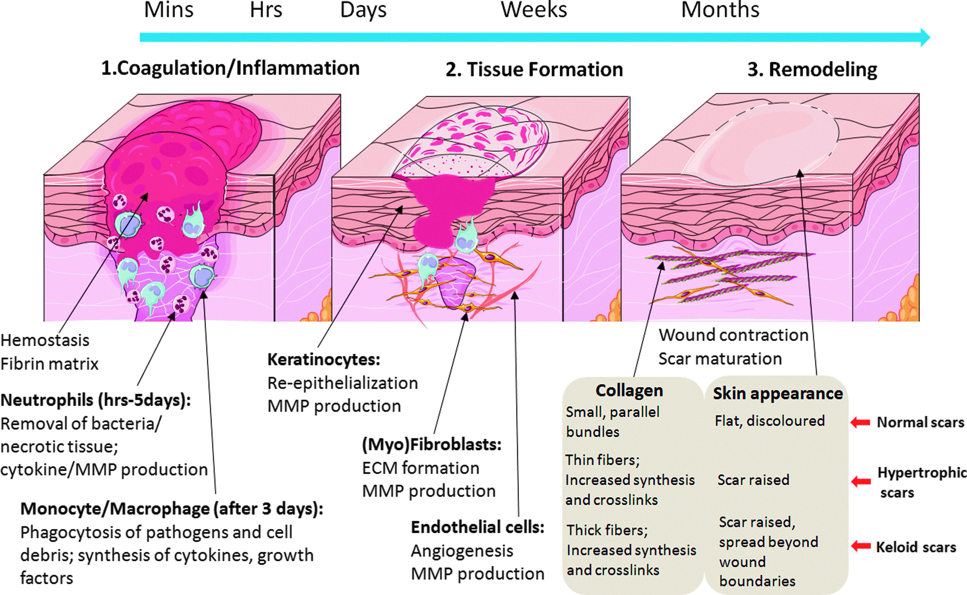
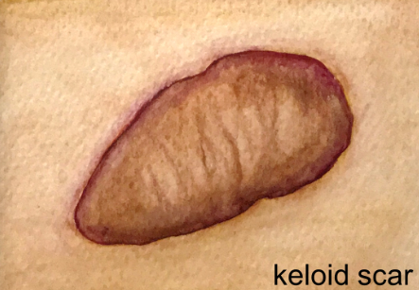
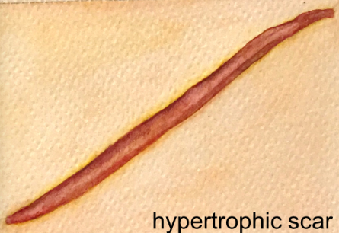
Keloid and hypertrophic scar
Hallmark: excessive extracellular matrix
Key difference: hypertrophic stays local, keloid affects surrounding skin
Potential causes: fibroblast disorder Or inflammation
[1]
[2]
Notes:
Excessive extracellular matrix contains immune cells and fibroblasts, and its secretion like collagen and glycoproteins
Wound healing: blood clot formation, inflammation, epithelization (proliferation, replace damaged/lost cell, basically immature scar), fibroplasia (collagen formation)
Fibroblast difference: Keloid fibroblasts are more sensitive to growth factors like TGFB1, might be due to more receptors.
Prolonged inflammation causes more extracellular matrix formation
Info:
https://www.ncbi.nlm.nih.gov/pmc/articles/PMC7015170/
Pictures
[1] https://www.liebertpub.com/doi/10.1089/wound.2013.0485
[2] https://www.google.com/url?sa=i&url=https%3A%2F%2Fonlinelibrary.wiley.com%2Fdoi%2Ffull%2F10.1111%2Fexd.14121&psig=AOvVaw3_BR-0udNZsVc4_eJ1Grot&ust=1699674158704000&source=images&cd=vfe&opi=89978449&ved=0CBQQjhxqFwoTCJjNmuHBuIIDFQAAAAAdAAAAABAE

Slide 3
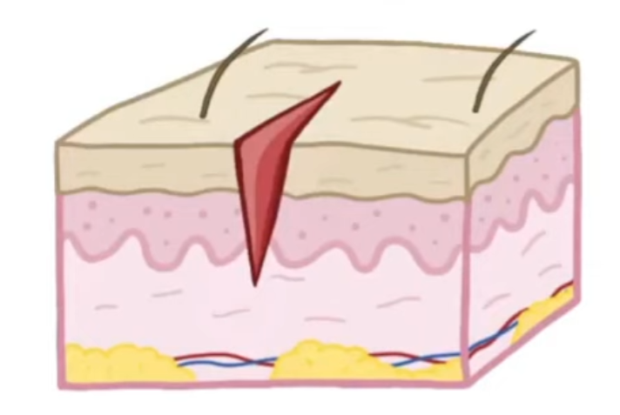
A Priori hypothesis
Study of interest: what makes keloid scar much larger in appearance and does not go away untreated?
Hypothesis:.
keloid fibroblasts overproduce its secretion like collagen and overreact to GF due to overabundance of receptors
Data:
Fibroblast from the affected skin was used
Method: RNA-seq
[3]
Notes:
[3] https://www.youtube.com/watch?v=hC-NwyolPtQ

Slide 4

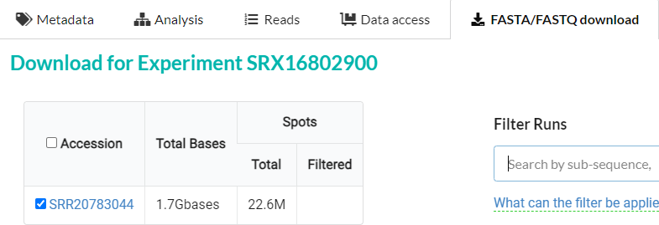
Sequence Data
Found on NCBI GEO https://www.ncbi.nlm.nih.gov/geo/query/acc.cgi?acc=GSE210434
Downloaded from NIH SRA https://www.ncbi.nlm.nih.gov/geo/query/acc.cgi?acc=GSE210434
Notes:
Got data from NCBI GEO.
Downloaded using fasterdump and the input is SRR id

Slide 5

Sequence Data
9 samples total (3*normal, 3*keloid, 3*hypertrophic)
Samples were run in single end
One sample run per lane on flowcell
Notes:
No concatenation needed. All 9 samples are about 22M reads so adequate for downstream analysis

Slide 6
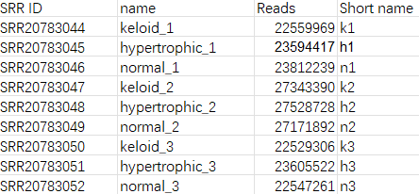
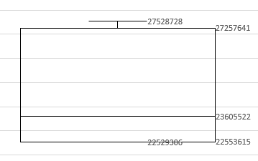
Pre-alignment sequencing metrics
Analysis on Keloid group vs Hypertrophic group
# of read process: wget fastqfile
wc –l *.fastq > count.txt
Manually put in excel and divide them by 4
Max reads: 27.5M
Min reads: 22.5M
Mean reads: 24.5M

Slide 7
Tophat2 alignment
1. Download reference file of whole genome (FASTQ) and transcriptome (GTF) from ensembl.org
2. Download sample files from SRA and convert to FASTQ using fasterq-dump
3. Use bowtie2-build to index the whole genome FASTA file
4. Use tophat2 to map samples against reference transcriptome file to create BAM file and get alignment info
Notes:
GTF holds annotation info

Slide 8
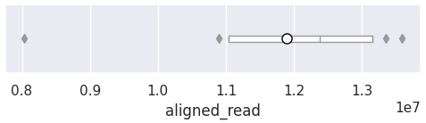
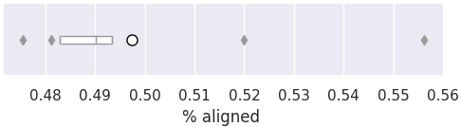
Tophat2 alignment summary
9 samples
Max: 13584516, min: 8034598, mean: 11894160
Max: 55.6%, min: 47.6%, mean: 49.7%
Notes:
Alignment to transcriptome. White circle is avg

Slide 9
Cuffdiff – keloid vs hypertrophic scar
1. Create symbolic link for bam file
2. Use cuffdiff with stats to get gene expression data
* Get gene_exp.diff to filter for gene of interest:
a. > +2 log2 fold difference & < -2 log2 fold difference
log2 fold difference = log2(h exp) – log2(k exp)
b. p value =< 5e-05
4. Use cuffdiff with no stats to get FPKM value
* get FPKM values from genes.fpkm_tracking
5. Extract FPKM for filtered genes
Notes:
Cuffdiff commands involves using FASTQ reference for fragment bias correction and GTF reference for annoatation
Positive log2 fold difference = higher expression in hypertrophic samples

Slide 10
Cuffdiff result
gene | n1_FPKM | n2_FPKM | n3_FPKM | k1_FPKM | k2_FPKM | k3_FPKM | h1_FPKM | h2_FPKM | h3_FPKM
ADD2 | 0.0193807 | 0.0337806 | 0.719541 | 0.0406707 | 0.0121901 | 0.0041789 | 0.474858 | 9.31128 | 12.7225
HOXA10 | 0.52793 | 0 | 0.00993655 | 0.0191014 | 0.190916 | 0.546747 | 9.12849 | 18.2389 | 5.83454
HOXA11 | 0.137825 | 0 | 0 | 0.0525853 | 0.00875635 | 0.0247617 | 4.78464 | 0.726839 | 2.38128
COMP | 0.386135 | 0.65551 | 1.48917 | 0.0495868 | 2.61191 | 1.94148 | 0.0626088 | 22.0417 | 83.6046
HOTAIR | 0 | 0 | 0 | 0 | 0.076555 | 0 | 1.83451 | 1.41427 | 0.493291
HOXA11-AS | 0.233056 | 0 | 0 | 0 | 0.0626376 | 0.157547 | 2.90769 | 2.48736 | 2.17926
LINC00511 | 2.92589 | 3.24873 | 2.56081 | 1.15977 | 1.15439 | 0.936305 | 2.93526 | 0.914638 | 105.058
HOXA-AS2 | 1.31446 | 0.0593661 | 0 | 0.0608256 | 0.232244 | 0.0607519 | 5.95826 | 9.40478 | 6.18676
> +2 log2 fold difference & < -2 log2 fold difference
log2 fold difference = log2(h exp) – log2(k exp)
p value =< 5e-05
Unfiltered (60,000+ rows)
Filtered (128 rows)

Slide 11
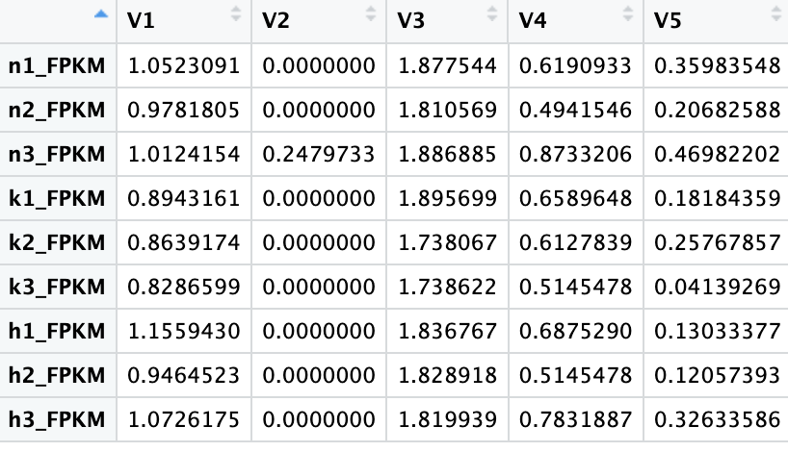
Data cleaning
Remove unnamed genes and remove genes without any expression
Normalize FPKM values by adding 1 to all, and apply log10
Transpose it into a matrix
Results: 75 upregulated genes, 45 downregulated

Slide 12
Plots using unfiltered table
Log10(FPKM)
Box and whisker
Code: boxplot(t(t6))
PCA
Code: autoplot(prcomp(t6), data= t6_sample, colour = "sample")
Notes:
The plots show unsurprising result. Without filtering it should be random
Mention log2fold and significance

Slide 13
Plots using filtered table
Dendrogram
Code: plot(dend, main="mc_eu_complete")
Heatmap
Heatmap(mc, name="FPKM", cluster_columns = FALSE, column_split = split)
Notes:
Used Euclidean distance with complete method
Similar dendrogram but not the same
n1 as outlier
Unexpected: expected keloid and hypertrophic to be grouped

Slide 14
Plots using filtered table
Code:
autoplot(prcomp(mc), data= mc_sample, colour = "sample")

Slide 15
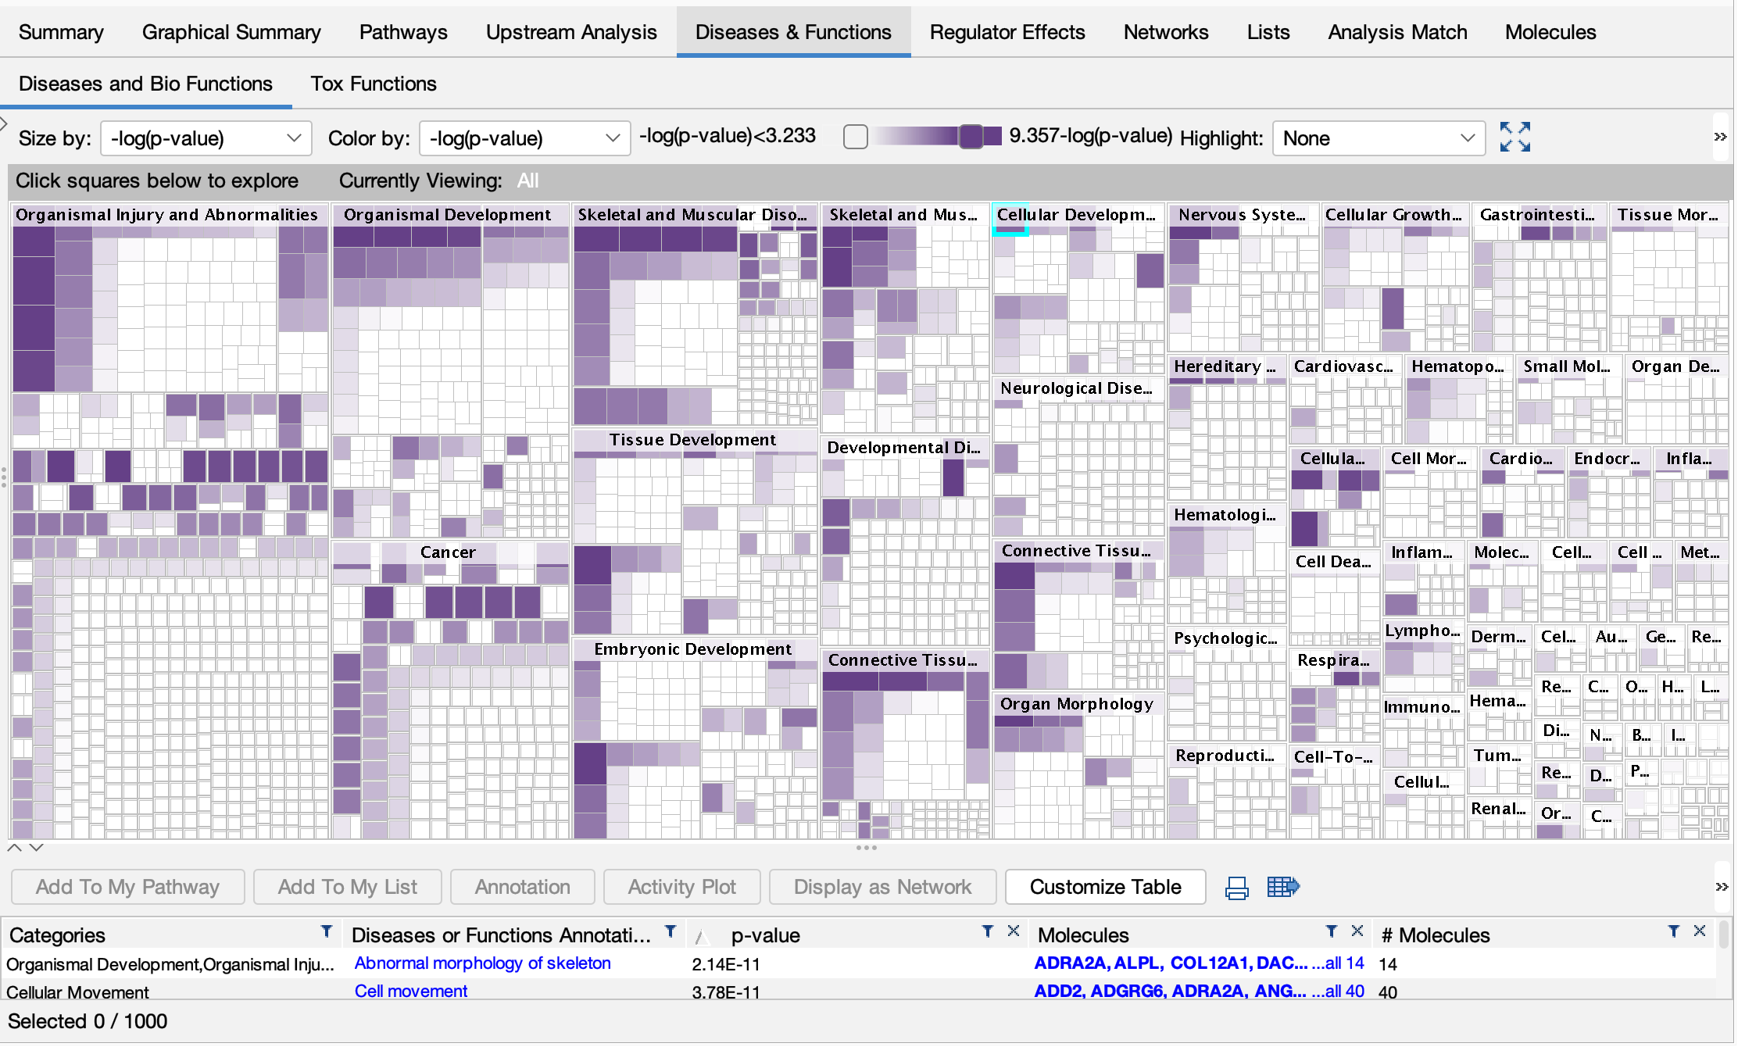
Pathway analysis (h as case, k as control)
IPA was used to analyze pathway
Results shown are genes in hypertrophic samples that are up regulated compared to that of keloid
Notes:
Uploading upregulated gene in hypertrophic
Do the same for downregulated gene

Slide 16
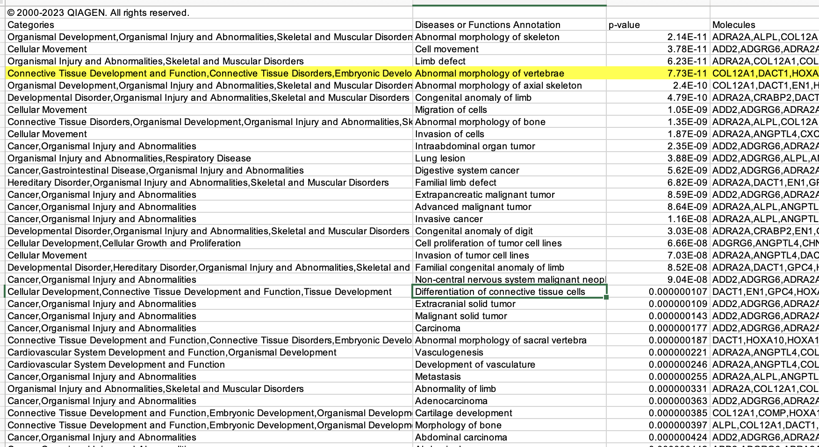
Analysis result
Notes:
Scan the result in diseases or functions annotation to connect the dots

Slide 17
Analysis result – up gene
Col12A1 produces a part of collagen XII. Collagen XII is involved in tissue repair and regeneration.
LOF mutation of Col12A1 causes connective tissue defect [4]
Collagen XII gene mutation causes mEDS.
Patients with mEDS (a condition) exhibit delayed motor development, muscle weakness, joint laxity, hypermobility, joint contractures, and abnormal wound healing. [5]
A few papers confirm Col12A1 expression decreases over the lifetime
SOX4 facilitate wound healing[6], less expressed in k samples
Notes:
No literature found to specifically address the direct connection between col12a1 gene and the 2 conditions
Less expressed in k and n. even less in keloid
Casual connection, col12a1 and healing ability.
Maybe Col12a1 decides the amount of scar tissue formed in keloid and hypertrophic scar? Keloid can be less dense than hypertrophic
Sox4 helps, but didn’t say how
[4] https://www.ncbi.nlm.nih.gov/pmc/articles/PMC5236000/
[5] https://www.ncbi.nlm.nih.gov/pmc/articles/PMC10017729/
[6]https://www.sciencedirect.com/science/article/abs/pii/S0141813023041405

Slide 18
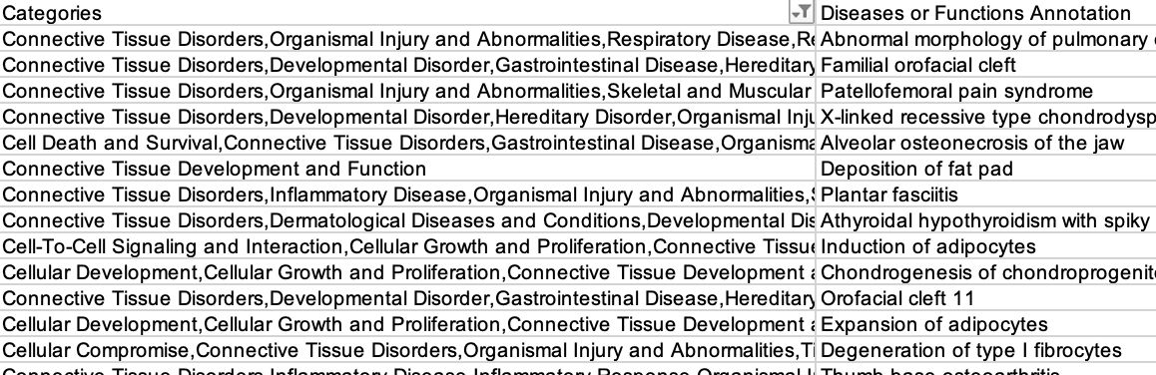
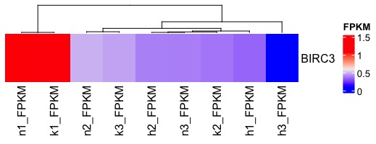
Analysis result – down gene
Not-so-related pathway and disease
BIRC3 inhibits apoptosis, but also expressed in n1
Notes:
Expected to see something connects to GF receptor
BIRC3 might explain some but also present in n1, not consistent

Slide 19
Conclusion
Hypothesis: keloid fibroblasts overproduce its secretion like collagen and overreact to GF due to overabundance of receptors.
Fail to support
Conflicting data:
Normal sample and keloid sample have similar gene expression level.
Hypertrophic sample is significantly different but unexpected
Potential improvement:
Compare hypertrophic/keloid to normal sample
Use more quantitative way to identify suspicious gene
Notes:
Hypothesis isn’t supported by data. Nothing found on fibroblast GF receptors, only photoreceptor

