Slide 1
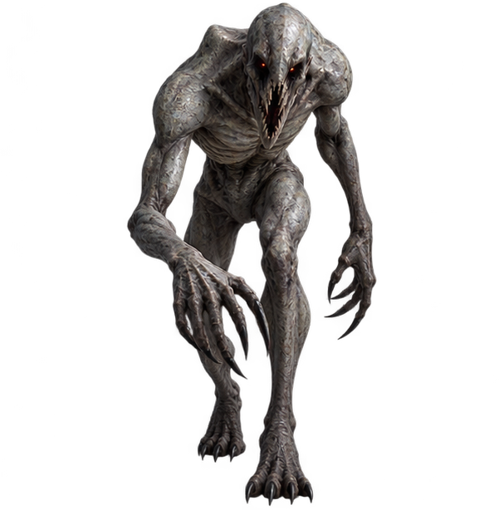
NO KEYBOARD · NO MOUSE · NO CONTROLLER
ECHO
You are blind in a cave.
Your voice is your only light.
A horror escape game played in total darkness, controlled only by your voice and your head. A webcam and a microphone are the whole controller.
TEAM
TRACK
HACKATHON
Solo Levelling
Track 2: PlayLab
MGM2026
In-game artwork: a Hollow. Blind. It hunts by sound.
Notes:
ECHO is a horror escape game you play in the dark with only your voice and your head. Webcam and mic are the whole controller. Team Solo Levelling, Track 2 PlayLab.

Slide 2




Proposed Solution
Sound is sight. The input is not a button in disguise: it IS the core mechanic.
THE CHALLENGE Play without keyboard, mouse, touch or controller, where the input is meaningfully tied to gameplay.
ONE CLAP, TWO RADII
CLAP · CLICK · KNOCK
A sonar pulse reveals the cave. Louder = see further, and be heard further.
HUM
A quiet beam where you look. Pitch sets width, loudness sets range. Heard only within ~5 m.
TURN YOUR HEAD
Look left and right. MediaPipe tracks head yaw.
LEAN IN · LEAN BACK
USP: every input is a bet. Sound always carries further than it reveals, so seeing the cave tells the Hollows where you are.
Walk. A gentle lean is silent; a full lean makes footsteps they can hear.
Notes:
Every input is analog and physical. The chart is straight from the game's config: a clap reveals 5 to 24 m but is heard 4 to 34 m away, so every clap is a trade-off. No buttons in disguise.

Slide 3
Technical Approach
Sensor → signal processing → intent → pure game logic → real-time feedback, all in the browser.
WEBCAM
640×480 · 30 fps
MediaPipe Face
Landmarker
GPU delegate
Head yaw · lean · presence
One-Euro smoothed
IntentBuilder
+ calibration
PlayerIntent
turn · speed · pulses · beam
World.update()
pure TypeScript
hearing · Hollows · the Hush · levels
three.js reveal shader
Web Audio HRTF 3D
MICROPHONE
raw, no AGC
MicAnalyzer
128-sample hops (2.7 ms)
Clap onsets · YIN pitch
noise floor · hum detector
HUD + debug panel
The game logic never touches a sensor. A dev-only keyboard sim feeds the same PlayerIntent, which is how 141 unit tests drive the game.
THE HOLLOW'S BRAIN
HANDS-FREE CALIBRATION · ~45 s
nothing found: back to idle
1
2
3
4
5
6
7
IDLE
wanders
hears
HUNT
runs to the sound
arrives
SEARCH
6 s
Face
Quiet room
Neutral pose
Look left
Clap
Hum
Speaker leak
within 1.1 m
Runs 3.6 m/s from afar, slows to 1.9 m/s up close: faster than you walk, slower when near, so a quiet escape works.
Every step: says what and why → countdown → live reading → result.
CATCH
TypeScript
Vite
three.js
MediaPipe
Web Audio
Vitest
Notes:
One frame: webcam to MediaPipe for head yaw and lean, mic to our own DSP for clap onsets and YIN pitch. IntentBuilder turns signals into a PlayerIntent; the game logic is pure TypeScript and never sees a sensor. Hollows are blind state machines driven only by what they hear.

Slide 4
Feasibility & Viability
It already works: a playable 3-level prototype, measured on an ordinary laptop with integrated graphics.
30 fps
6.5 ms
141
0
face tracking on an Intel integrated GPU
to render the cave per frame, inside a 20 ms budget
unit tests, all passing
extra hardware: webcam + mic, runs offline in Chrome
141 TESTS BY LAYER
RISKS WE DESIGNED FOR
Noisy hackathon hall
Calibrated noise floor; a clap must spike, then drop 8 dB within 75 ms
The game hears itself
Headphones + a speaker-leak test during calibration
Face lost, bad light
Auto-pause after 0.4 s without a face
Weak laptop
Adaptive render scale below 40 fps; all assets bundled offline
Viable: browser distribution, zero install, zero hardware cost. Levels are ASCII maps, so new content is cheap.
Notes:
Everything here is measured, not projected: 30 fps face tracking and 6.5 ms cave render on the laptop's integrated GPU, 141 passing unit tests. Each venue risk has a built-in mitigation.

Slide 5

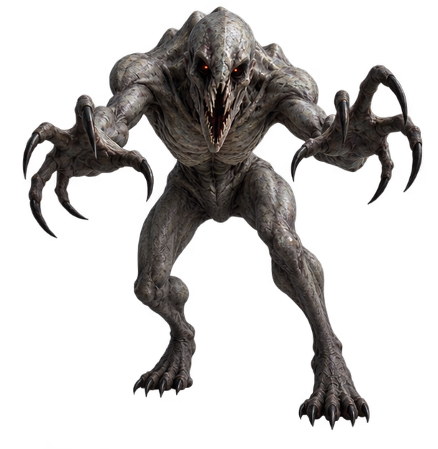




Impact & Benefits
Your body is the controller.
Accessibility
Input becomes the game
Fully hands-free play for people who can't use a keyboard, mouse or controller.
Alt-input as the fun, not a gimmick: your noise is both your light and your danger.
Real immersion
Reusable & low barrier
You hold your breath, lean in slowly and hum quietly. The fear is physical.
A face + voice → intent pipeline any browser game can adopt. Any laptop, no install.
Seen only in the flash of your own clap.
Notes:
Who it helps: players who can't use their hands; designers looking for alternative input that's actually fun; and anyone building browser games, because the face and voice pipeline is reusable.

Slide 6



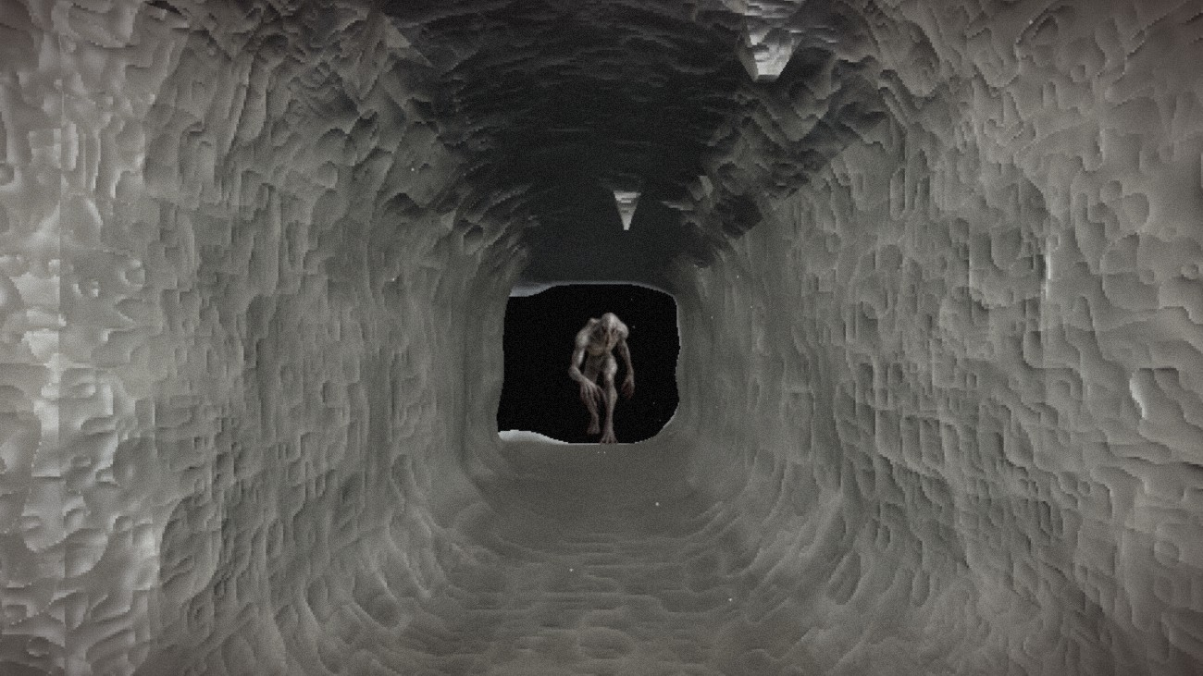
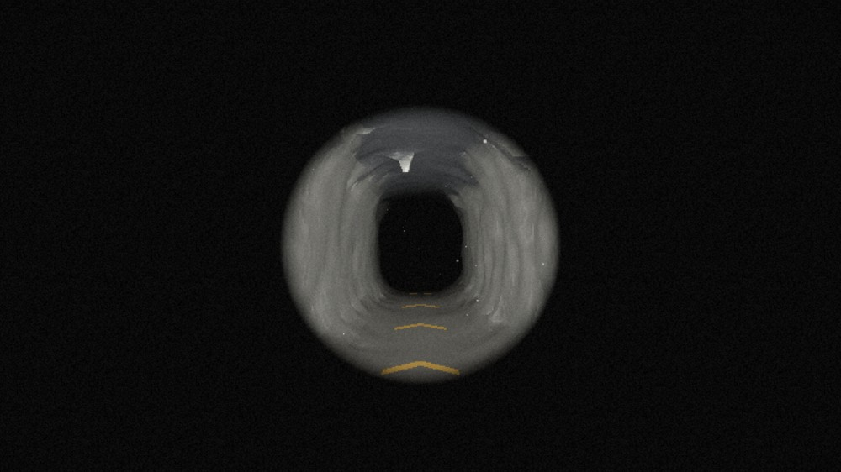

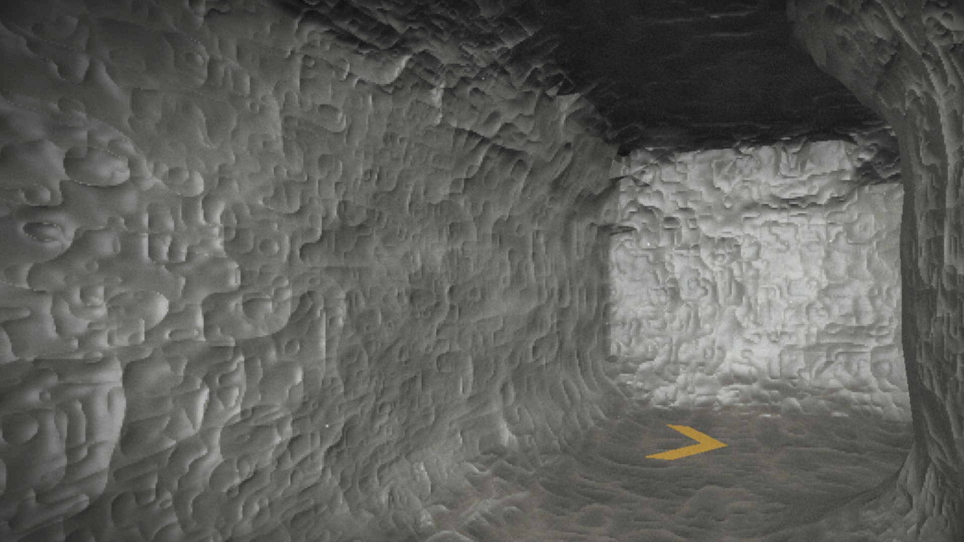
Research & References
The techniques under the hood, plus related research and games.
Signal processing
Vision & rendering
Related work
YIN pitch estimation: de Cheveigné & Kawahara, JASA 2002
One Euro Filter: Casiez, Roussel & Vogel, CHI 2012
Percussive onset detection with an adaptive noise floor
MediaPipe Face Landmarker (Google)
Surface Nets meshing of distance fields: Gibson, 1998
three.js · Web Audio API (HRTF panning)
Human echolocation: Thaler, Arnott & Goodale, PLoS ONE 2011
Sound-driven horror games: Dark Echo (2015), Perception (2017), Stifled (2017)
Clap: the pulse reveals a Hollow
Hum: a narrow, quiet beam
It heard you
Awakening: gold arrows to the exit
Notes:
References for the DSP and vision building blocks, plus the inspirations. Bottom row: real in-game screenshots.

