Slide 1

Global Power Analysis: Energy, Economics, and Emissions
Mid-Term Presentation
Kevin Shao – Mar 11, 2025
Notes:
Good [morning/afternoon], everyone. My name is Kevin Shao, and today I will present the progress on my project ‘Global Power Plants Analysis: Energy, Economics, and Emissions.’ I will walk you through the data integration process, the exploratory and advanced analyses, and our progress toward answering the research questions.

Slide 2
Project Overview & Research Questions
Overview:
Integrate global power plant data with socioeconomic, emissions, and policy indicators.
Research Questions:
How does a country’s renewable power plant capacity share correlate with its CO₂ emissions (or carbon intensity) over time?
Do countries with stronger green growth policies show lower fossil-fuel capacity and higher renewables share?
Notes:
Here is a brief overview of the project. Our goal is to merge multiple datasets—from the Global Power Plant Database, World Bank, IEA, and OECD—to address two main research questions: the relationship between renewable capacity and CO₂ emissions, and how green growth policies relate to the energy mix.

Slide 3
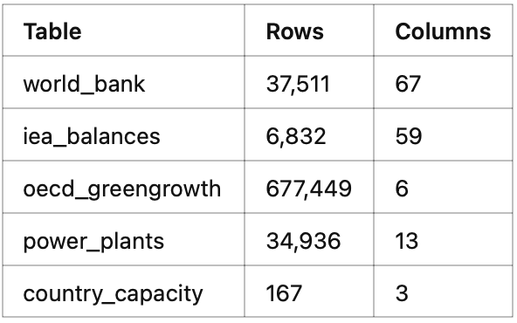
Data Sources & Integration
Data Sources:
Global Power Plant Database
World Bank WDI (socioeconomic & emissions data)
IEA World Energy Balances
OECD Green Growth Indicators (policy)
Integration Process:
Standardize country codes/names
Aggregate plant-level data by fuel type
Merge with country-level indicators
Notes:
This slide outlines our primary data sources. We standardized the data from each source and merged them by country (and year, where possible) to build a comprehensive dataset that links power plant capacity, economic indicators, and policy measures

Slide 4
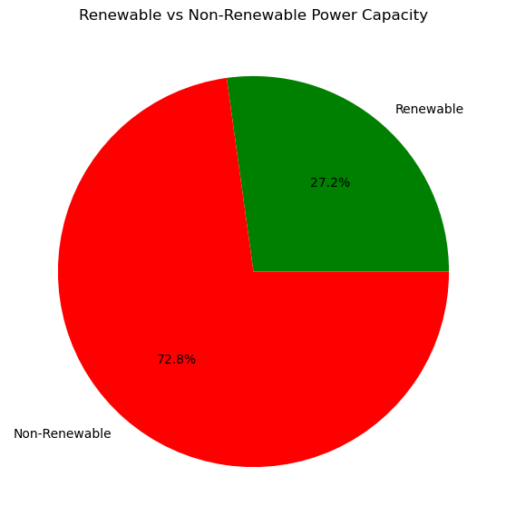
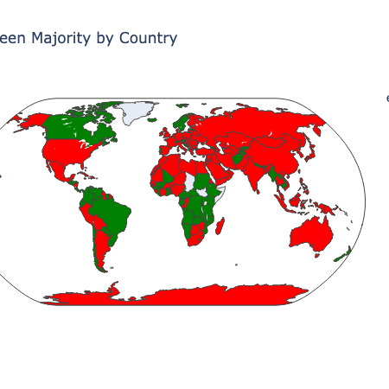
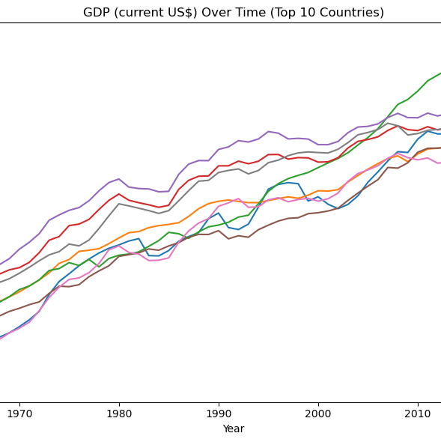
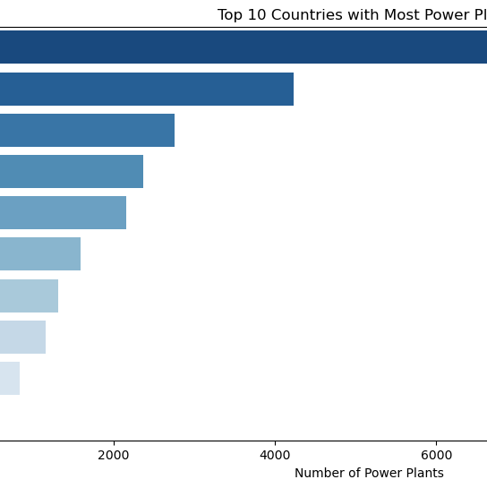
EDA
Visualizations:
Bar charts of power plant counts by country
Capacity breakdown by fuel type
Geospatial mapping of power plant distribution
Time series of key World Bank indicators
Notes:
In the EDA phase, I generated various visualizations to understand the distribution of power plants by country and fuel type, along with time trends in key economic and emissions indicators. These visuals helped identify initial patterns and outliers in the data.

Slide 5
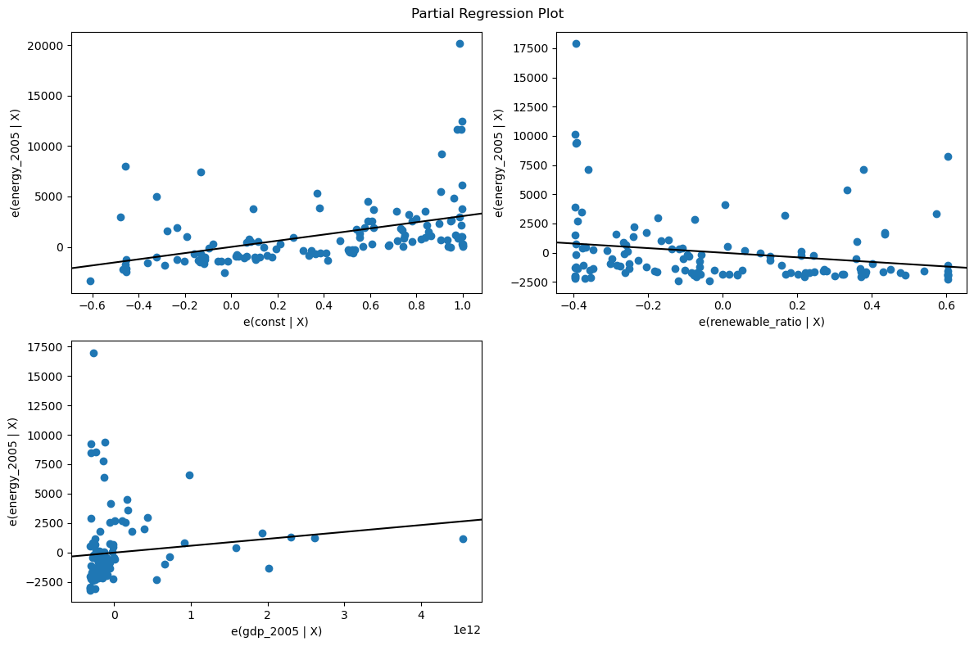
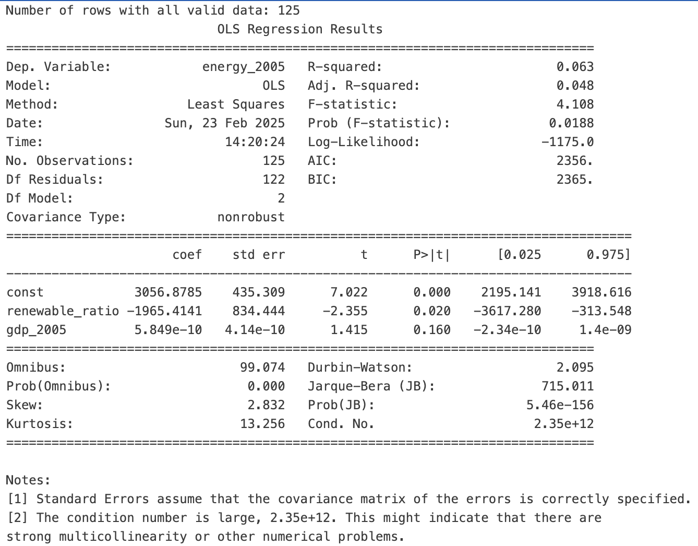
Simple Analysis & Findings
Key Analysis:
Correlation analyses (e.g., renewable capacity ratio vs. energy use)
Basic regression results (simple OLS models)
Findings:
Preliminary relationships are weak (low R² values)
Indications that fossil fuel share might influence energy use
Notes:
My simple analysis included correlations and basic regressions. While initial results show weak relationships, they point toward the importance of fossil fuel capacity. These findings set the stage for more advanced, panel data analyses

Slide 6
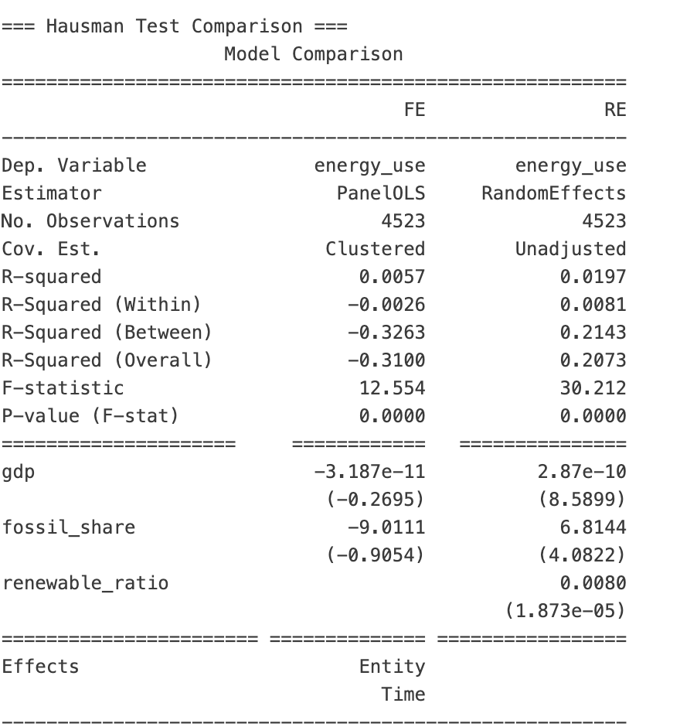
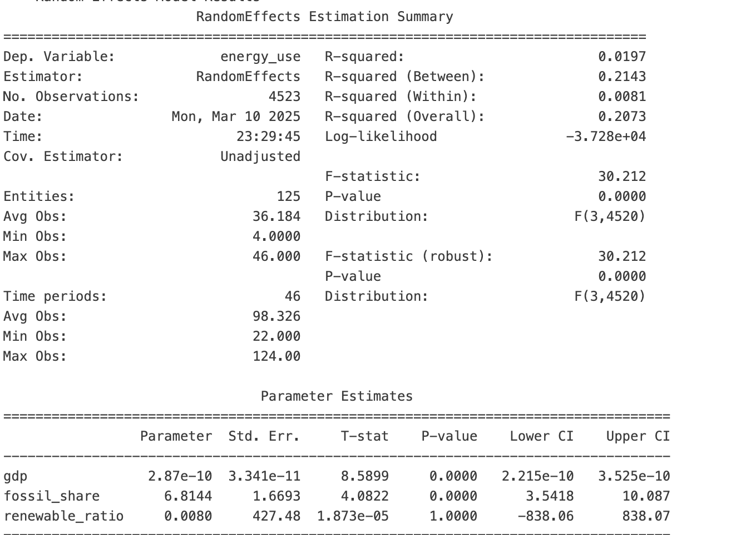
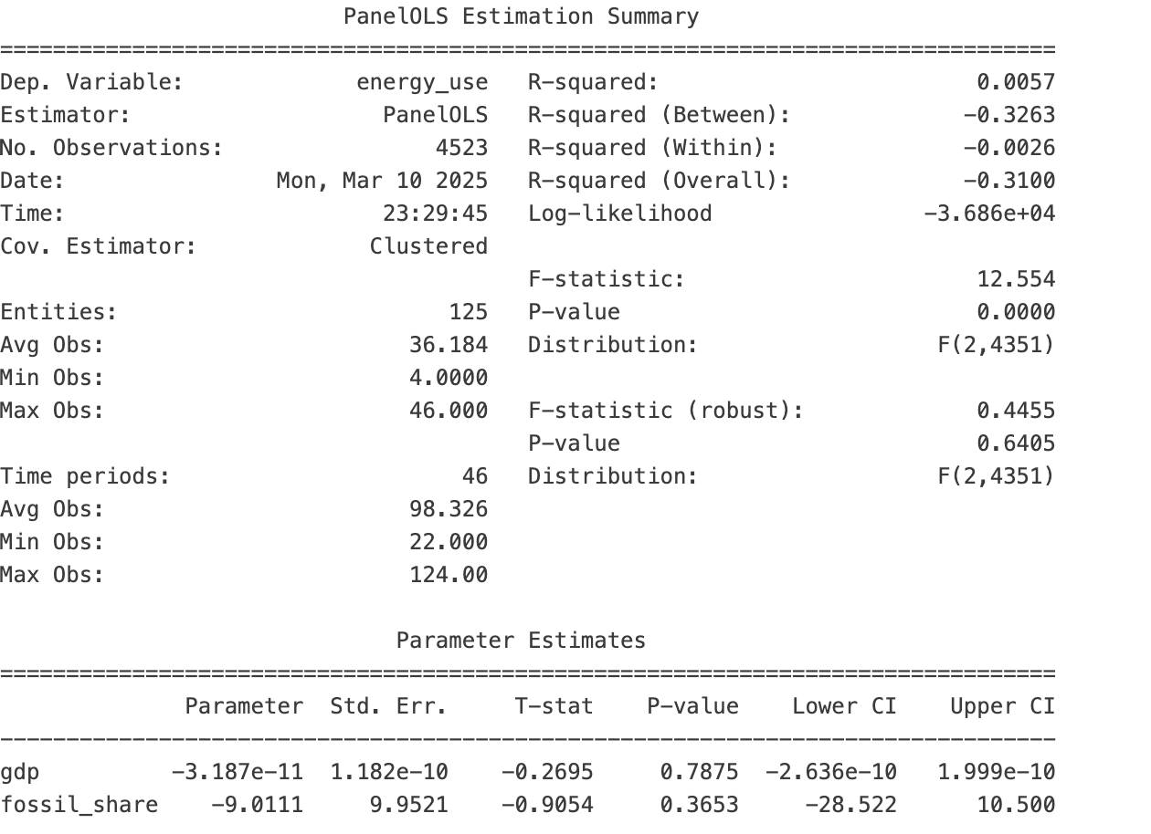
Advanced Panel Data Analysis
Methodology:
Two-way Fixed Effects (FE) and Random Effects (RE) models
Hausman test to compare FE and RE specifications
Key Results:
FE model (using varying variables like GDP and fossil_share)
RE model – note the challenges with time-invariant variables like renewable_ratio
Hausman test results (showing unobserved, time invariant factors matters)
Notes:
In the advanced analysis, I used panel data methods to control for both country and time-specific effects. The FE model focused on variables that vary over time, while the RE model attempted to include time-invariant factors. The Hausman test helps us decide which specification is more appropriate. Although some variables like renewable_ratio are absorbed by fixed effects, the RE model gives us insights into time-invariant factors when collinearity issues are managed
In our Fixed Effects model—which looks at changes over time within each country—we used GDP and Fossil Fuel Share as predictors. The results show that neither GDP (p = 0.79) nor Fossil Fuel Share (p = 0.37) is statistically significant, and the model’s R-squared is very low. In plain terms, when we examine how energy use changes within a country over time, these two factors don’t seem to have a clear impact.
On the other hand, the Random Effects model, which compares differences across countries, shows that both GDP and Fossil Fuel Share are highly significant (p < 0.001). This means that countries with higher GDP and a higher share of fossil fuels tend to have higher energy use. However, the Renewable Ratio isn’t significant in this model.
The Hausman test comparison reveals that the differences between the Fixed and Random Effects models are important—suggesting that unchanging, country-specific factors matter. In simple words, factors that don’t vary over time (like inherent country characteristics) are important, so the Fixed Effects model might be more reliable for understanding how energy use changes within a country.
Overall, these results tell us that while looking across countries (Random Effects) shows clear relationships, the variation over time within individual countries (Fixed Effects) is not well explained by just GDP and fossil fuel share. This indicates that we need to refine our models and likely add other variables, such as CO₂ emissions, to better understand what drives energy use
• What I Did:
I built two types of models:
• Fixed Effects Model: Looks at how changes within each country over time affect energy use. It removes constant factors (like geography or long-term policies) so we see the effect of variables that change.
• Random Effects Model: Uses both differences within countries and differences between countries, keeping constant factors in the mix.
I then compared these models using a Hausman test to see which one gives more reliable results.
• In Simple Terms:
The Fixed Effects model tells us how changes inside one country (like changing GDP or fuel share) affect energy use. The Random Effects model looks at differences between countries as well as changes within them. The test (Hausman) showed that the unchanging, country-specific factors matter a lot, so the Fixed Effects model is likely better for understanding the changes over time.

Slide 7
Key Insights & Policy Implications
Insights:
Economic size (GDP) and fossil fuel share significantly relate to energy use.
Policy indicator (environment-related tax) shows promise for further exploration.
Implications:
Findings can inform policymakers on how economic and energy mix factors affect emissions.
There is potential to identify best practices for reducing fossil fuel dependency.
Notes:
These models provide initial insights. While GDP and fossil fuel share are statistically significant, the role of renewable capacity and policy indicators needs further exploration. The implications are important for understanding how green growth policies might help reduce fossil fuel dependency.
• Fossil Fuel Share Coefficient: 6.8144
• t-statistic: 4.0822
• p-value: 0.0000
This indicates that, even when GDP is included in the model, fossil fuel share is a statistically significant predictor of energy use (p-value < 0.001). In simple terms, it means that differences in fossil fuel share have a significant impact on energy use independent of GDP.

Slide 8
Next Steps
Next Steps in Analysis:
Refine panel regression models (including CO₂ emissions and other policy indicators).
Conduct additional robustness checks and diagnostics (e.g., tests for serial correlation).
Extend the analysis to answer the full research questions:
Explore the relationship between renewable capacity share and CO₂ emissions (total and per GDP).
Delve deeper into the impact of green growth policies on energy mix.
Final Deliverables:
Cleaned merged dataset
Comprehensive analysis report
Interactive dashboards/visualizations for stakeholders
Notes:
Moving forward, I plan to refine the panel models by including CO₂ emissions data and further policy indicators. Additional robustness checks will strengthen the analysis. Ultimately, the final deliverables will include a fully cleaned dataset, a comprehensive report, and interactive visualizations that highlight the energy transition across countries.

Slide 9
Project Status & Roadmap
Current Status:
Data integration, EDA, simple analysis, and initial advanced panel regressions have been completed.
Am I addressing my proposal questions?
Partially. The current work lays the groundwork by addressing economic and energy mix relationships.
The next phase will directly integrate CO₂ emission data to answer the key research questions on renewable share vs. emissions.
Roadmap:
Finalize model specifications
Incorporate CO₂ and policy analysis in detail
Prepare final report and recommendations
1. Data Integration & EDA ✅
2. Simple Analysis ✅
3. Advanced Panel Analysis✅
3a. Detailed Policy Analysis (NS)
4. Incorporate CO2 Emission Data (NS)
5. Model Refinement (Upcoming)
6. Deliverables (Upcoming)
Notes:
As of now, the project is in the analysis stage. We have completed data integration, EDA, and both simple and advanced regression analyses. While we have made significant progress on the relationships among energy use, GDP, and fossil fuel share, further work is needed to fully address the proposal’s research questions—specifically, linking renewable capacity and policy measures to CO₂ emissions. The roadmap ahead includes refining our models, incorporating CO₂ data, and finalizing the recommendations

