Slide 1
NV Center in Diamond ISC
Tyler Smart – 03/24/21

Slide 2
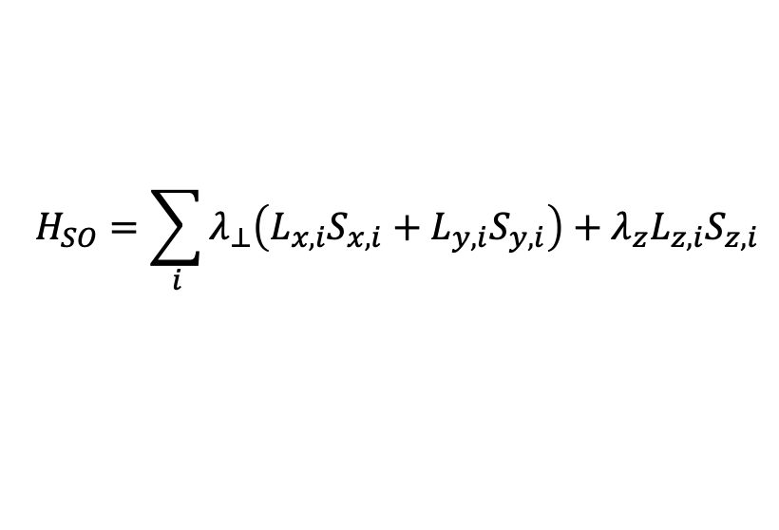
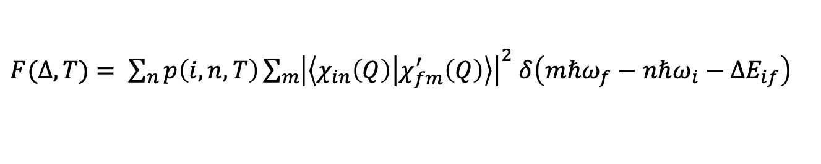
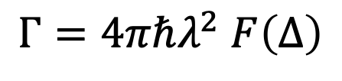



Intersystem Crossing
Intersystem crossing rate due to SOC ($λ$) between triplet and singlet states
$$Γ=4πℏλ_{ }^{2} F\left(Δ\right)$$
The overlap integral $F\left(Δ, T\right)$ is computed as (using 1D effective phonon):
$F(Δ, T)= \sum_{n}{p\left(i,n,T\right)\sum_{m}{{\left|\left\langle χ_{in}\left(Q\right) | χ_{fm}^{′}\left(Q\right)\right\rangle \right|}^{2} δ\left(mℏω_{f}−nℏω_{i}−ΔE_{if}\right)} }$
The SO Hamiltonian:
$$H_{SO}=\sum_{i}{λ_{⊥}\left(L_{x,i}S_{x,i}+L_{y,i}S_{y,i}\right)+λ_{z}L_{z,i}S_{z,i}}$$
can be computed in ORCA and is responsible for spin-flip process
$λ_{⊥}$: $\left|1,±1\right\rangle →\left|0,0\right\rangle$
$λ_{z}$: $\left|1,0\right\rangle →\left|0,0\right\rangle$
($\left|S,m_{s}\right\rangle$)

Slide 3
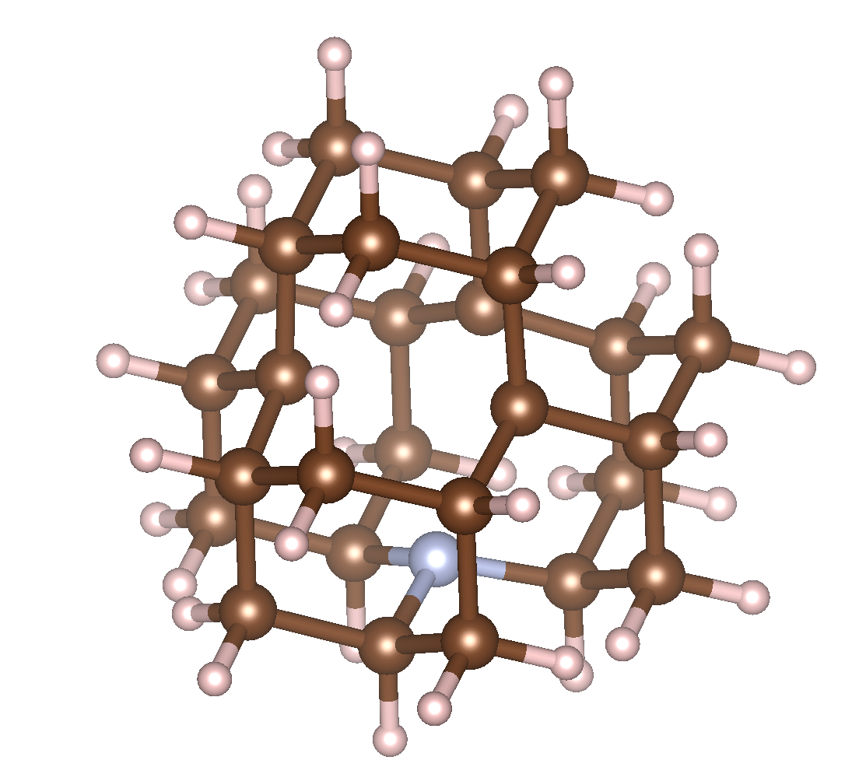
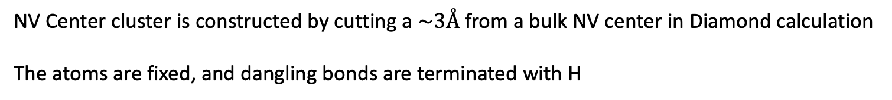
SOC in ORCA
NV Center cluster is constructed by cutting a $\sim 3Å$ from a bulk NV center in Diamond calculation
The atoms are fixed, and dangling bonds are terminated with H
{'C': 27, 'H': 36, 'N': 1}

Slide 4
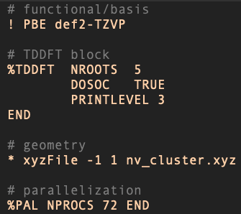
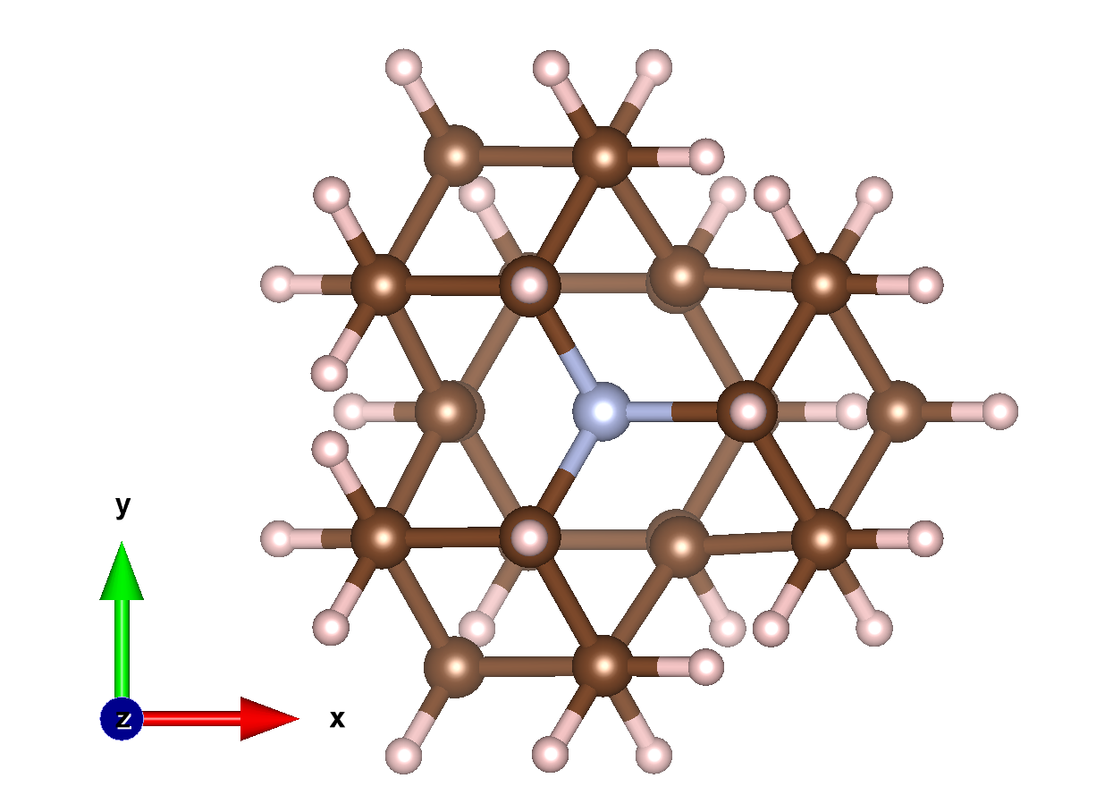
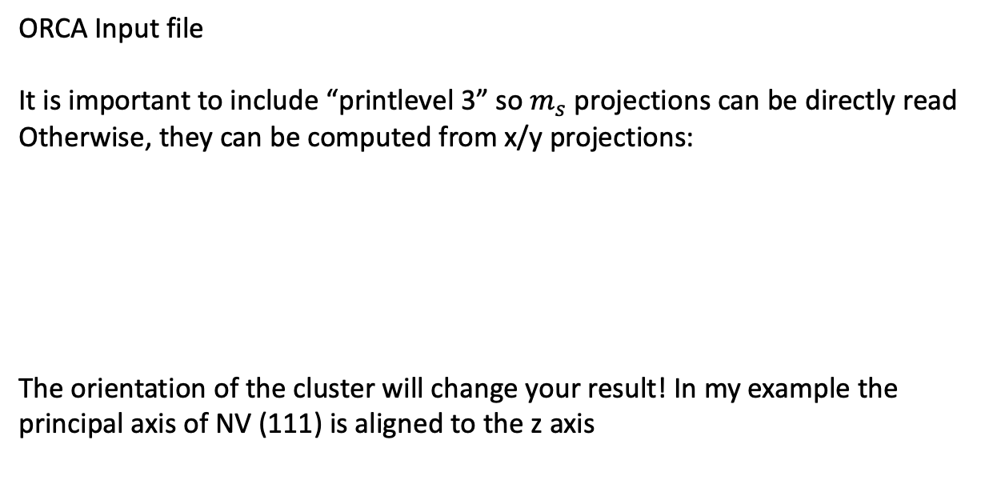
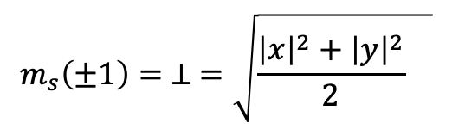
SOC in ORCA
Note calculation is done in the singlet state
(S=0, Multiplicity = 1)
ORCA Input file
It is important to include “printlevel 3” so $m_{s}$ projections can be directly read
Otherwise, they can be computed from x/y projections:
The orientation of the cluster will change your result! In my example the principal axis of NV (111) is aligned to the z axis
$$m_{s}\left(±1\right)= ⊥ =\sqrt{\frac{{\left|x\right|}^{2}+{\left|y\right|}^{2}}{2} }$$

Slide 5
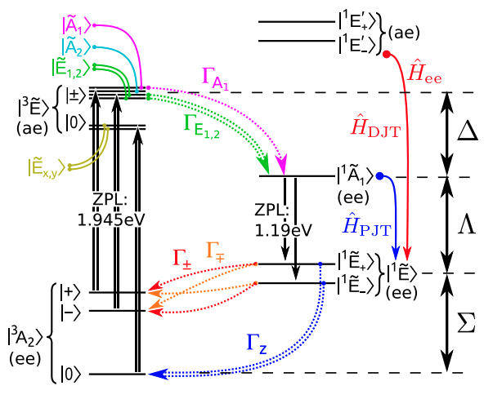
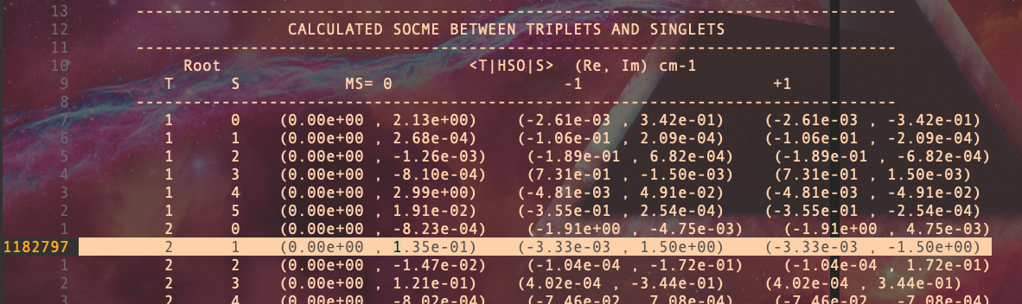

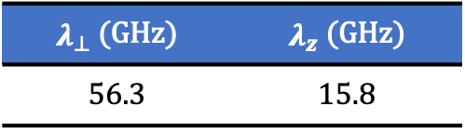
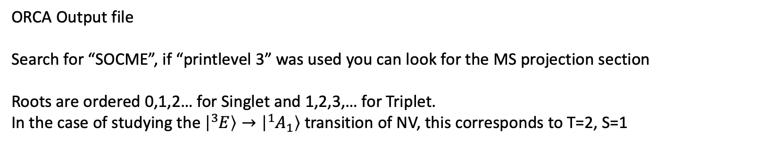

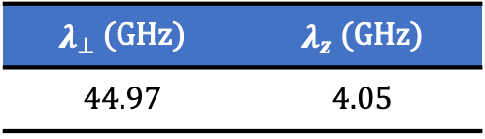

SOC in ORCA
ORCA Output file
Search for “SOCME”, if “printlevel 3” was used you can look for the MS projection section
Roots are ordered 0,1,2… for Singlet and 1,2,3,… for Triplet.
In the case of studying the $\left|{}_{ }^{3}E\right\rangle →\left|{}_{ }^{1}{A_{1}}\right\rangle$ transition of NV, this corresponds to T=2, S=1
$$λ_{z}$$
$$λ_{⊥}$$
PRB 98, 085207 (2018)
Calculating their norm, and converting to GHz we get:
Previous Theory
PRB 96, 081115(R) (2017)
$λ_{⊥}$ (GHz) | $λ_{z}$ (GHz)
44.97 | 4.05
$λ_{⊥}$ (GHz) | $λ_{z}$ (GHz)
56.3 | 15.8
Exp $λ_{z}=5$ GHz

Slide 6
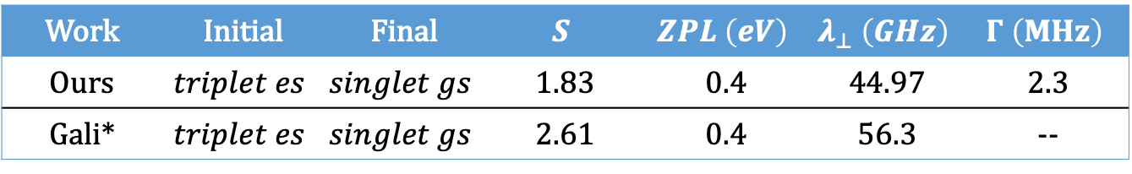
Intersystem Crossing
NV Center in Diamond result
$Γ=4πℏλ_{⊥}^{2} F\left(Δ\right)$, $F(Δ, T)= \sum_{n}{p\left(i,n,T\right)\sum_{m}{{\left|\left\langle χ_{in}\left(Q\right) | χ_{fm}^{′}\left(Q\right)\right\rangle \right|}^{2} δ\left(mℏω_{f}−nℏω_{i}−ΔE_{if}\right)} }$
Geometry used
Work | Initial | Final | $$S$$ | $$ZPL \left(eV\right)$$ | $$λ_{⊥} \left(GHz\right)$$ | $$Γ \left(MHz\right)$$
Ours | $$triplet es$$ | $$singlet gs$$ | 1.83 | 0.4 | 44.97 | 2.3
Gali* | $$triplet es$$ | $$singlet gs$$ | 2.61 | 0.4 | 56.3 | --
Exp: 8 and 16 MHz (there are two observed ISC when considering the vibronic nature of the triplet exicted state which we did not consider)
* From Gali PRB2017, HR approximation with excluded e phonons
** The singlet es ($\left|{}_{ }^{1}{A_{1}}\right\rangle$) cannot be simulated by DFT so the singlet gs geometry is used instead and an approximate ZPL energy of 0.4 eV is used, see Gali’s paper for further discussion
*** For more accurate depiction of the ISC in Diamond the vibronic nature of $\left|{}_{ }^{3}E\right\rangle$ must be considered

