Slide 1
Some notes from ORCA manual 5.0.3
Algorithmic variations, options, add-ons, modifiers,. . .
restricted Hartree Fock (RHF) reference selects closed-shell SCF
unrestricted Hartree Fock (UHF) reference selects open-shell SCF
“Please have in mind that, as it is, you can only calculate the SOC between excited singlets and the spin-adapted triplets. There is no SOC starting from a UHF/UKS wavefunction. If you want more information printed such as the full SOC matrix or triplet-triplet couplings, please set a higher PRINTLEVEL.” -- P208 ORCA manual
2S+1
1. If set * xyzFile -1 3 nv_cluster.xyz in TDDFT:
WARNING: your system is open-shell and RHF/RKS was chosen
===> : WILL SWITCH to UHF/UKS
INFO : Checking CIS options ...
[file orca_main/mainchk.cpp, line 2072]: ERROR (CIS/TDDFT): Spin-orbit coupling only implemented for RHF reference
2. If set * xyzFile -1 3 nv_cluster.xyz in CASSCF:
ORCA finished by error termination in GTOInt
Calling Command: mpirun -np 64 /data/groups/ping/kli103/programs/orca/orca/orca_gtoint_mpi job3.int.tmp job3
[file orca_tools/qcmsg.cpp, line 458]:
.... aborting the run
there is error when using RKS for CASSCF with the setup of * xyzFile -1 3 nv_cluster.xyz

Slide 2
Calculation details
ORCA manual:
These were specifically developed for scalar relativistic calculations and are individually adapted to the DKH2 and ZORA Hamiltonians.
The DKH correction to the SOC operator is implemented in ORCA as a correction to the one-electron part of the SOMF operator.
The AutoAux keyword can also be very useful as it creates a large auxiliary basis set based on your selected orbital basis set.
The use of AutoAux auxiliary basis set is because
RI-J approximation is default for GGA in ORCA, and an auxiliary basis set is needed (https://sites.google.com/site/orcainputlibrary/basis-sets/ri-and-auxiliary-basis-sets)
I am not sure what basis set should be with cc-pVDZ-DK
The AutoAux keyword can also be very useful as it creates a large auxiliary basis set based on your selected orbital basis set. (https://sites.google.com/site/orcainputlibrary/basis-sets/ri-and-auxiliary-basis-sets)
 | My calc. details
active space | CASSCF(4,6)
functional | PBE
basis set | cc-pVDZ-DK
Hamiltonian | DKH
auxiliary basis set | AutoAux
symmetry | C_{3v}
C-H bond | 1.09 A
Additional note:
cc-pVDZ-DK and DKH Hamiltonian are used in Ref. [1]
What functional and auxiliary basis set were used in Ref. [1] were not mentioned so unclear
[1] Bhandari et. al. Phys. Rev. B 103, 014115 (2021)

Slide 3
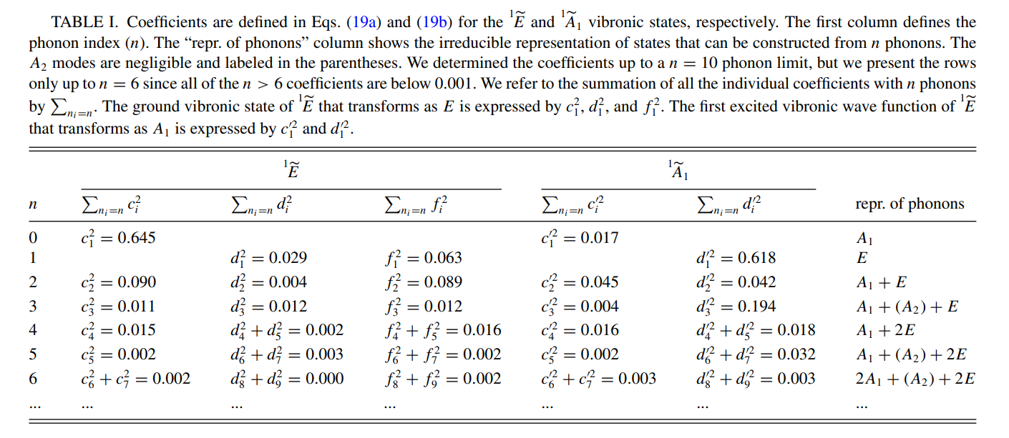
State-mixing coef for effective SOC
PHYSICAL REVIEW B ˝ 98, 085207 (2018)

