Slide 1
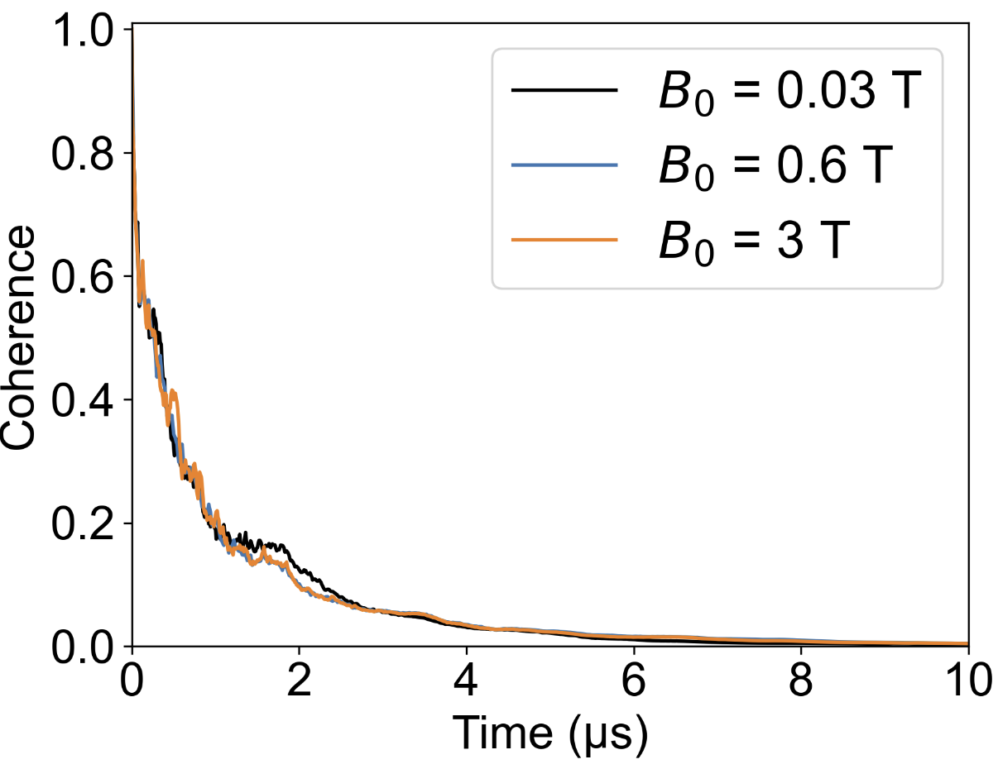
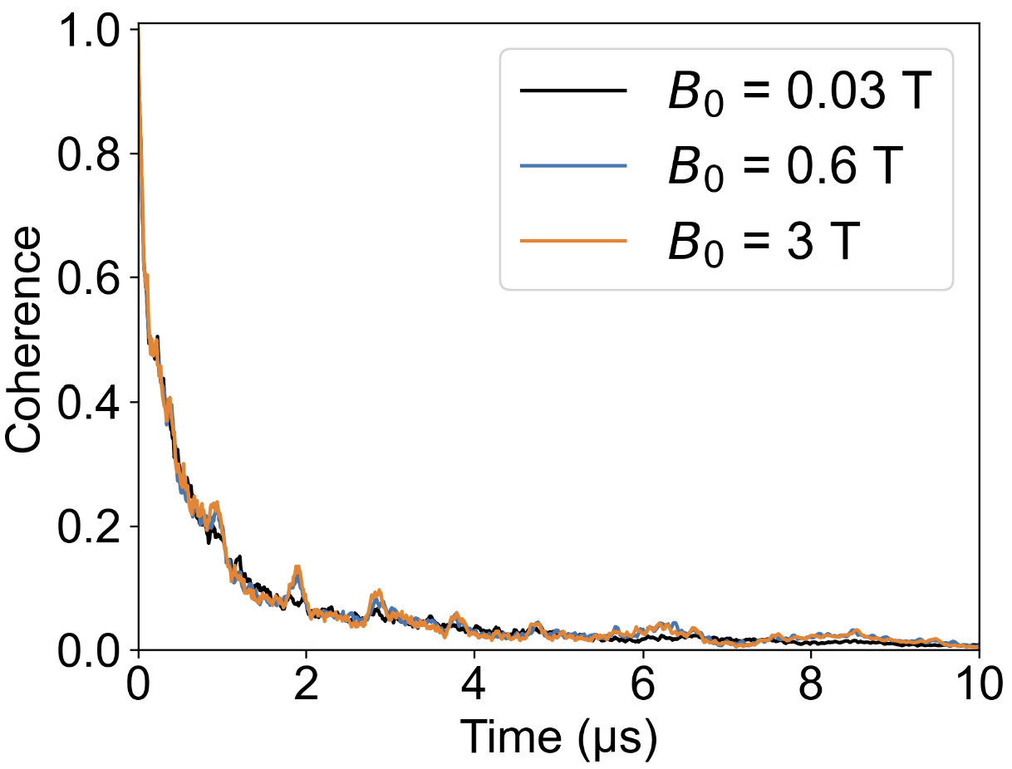
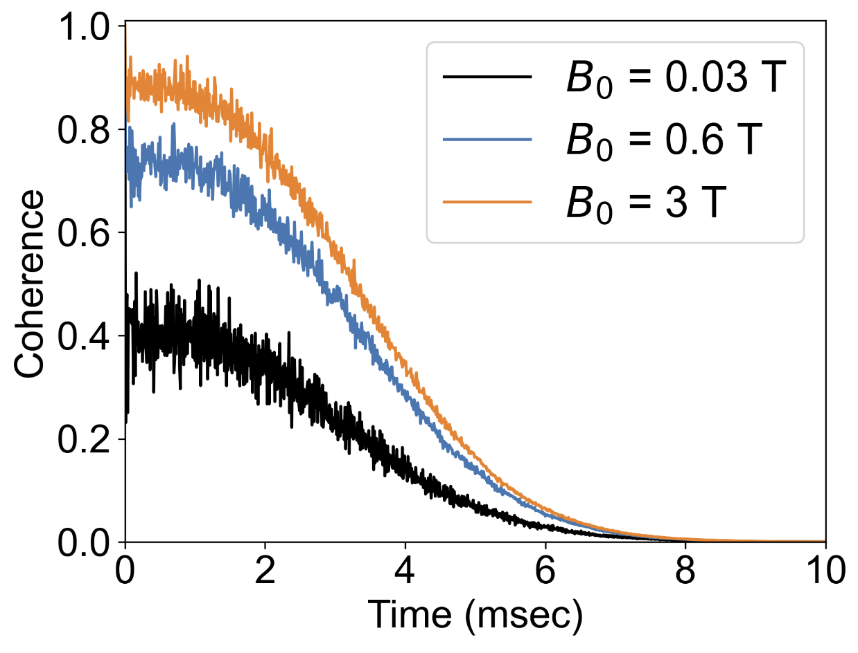
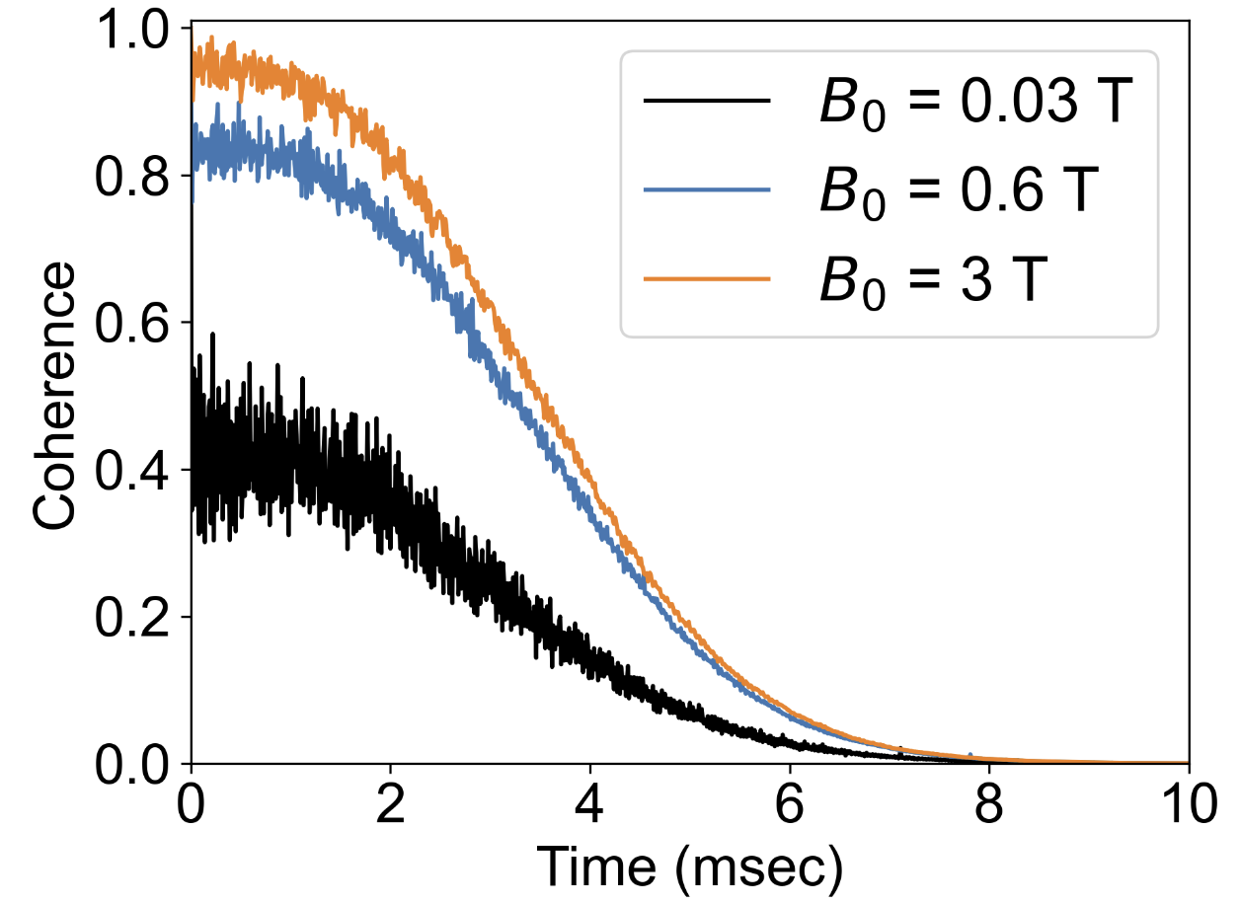
(a)
Free induction decay
(b)
Free induction decay
Nb_{Zn}v_{O}
Mo_{Zn}v_{O}
(c)
Hahn-echo decay
(d)
Hahn-echo decay
Nb_{Zn}v_{O}
Mo_{Zn}v_{O}

Slide 2
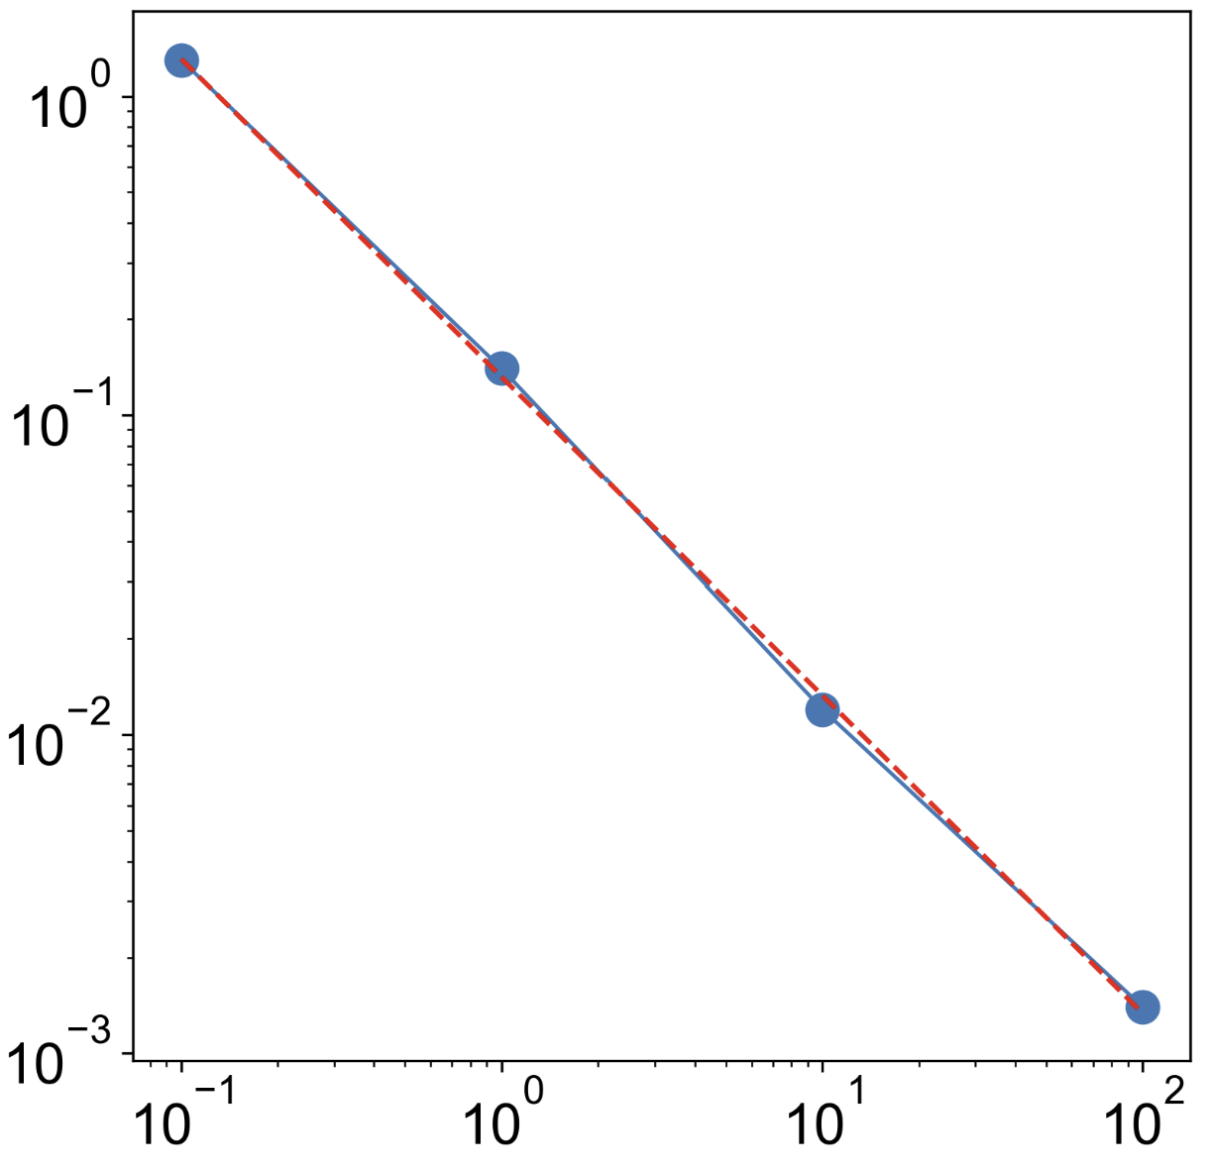
Nuclear-spin-limited T₂ (~4 ms)
T_{2, elec} (ms)
Slope of the linear fitting line = -0.99
Electron spin concentration (ppm)

Slide 3
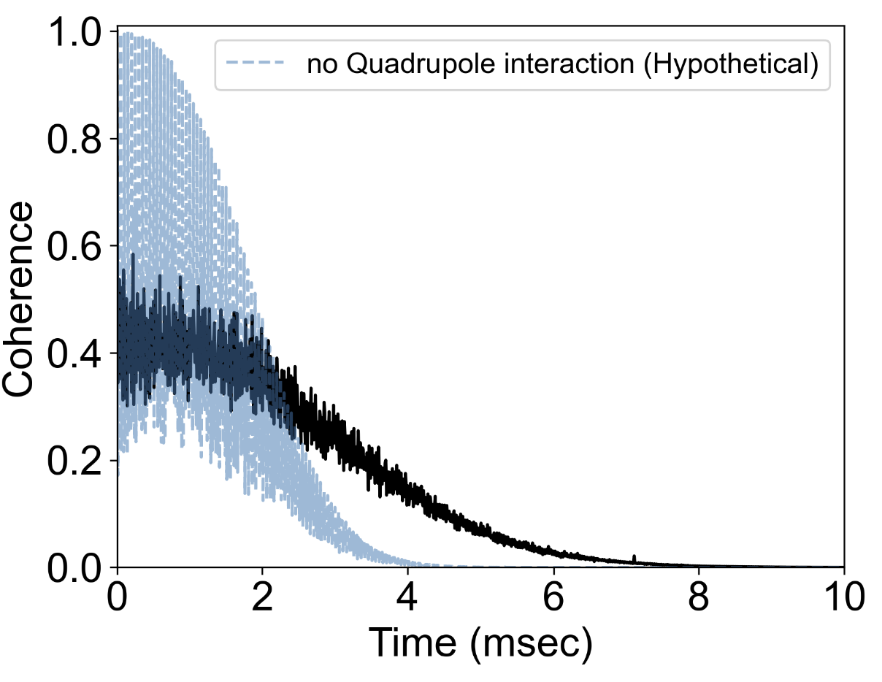
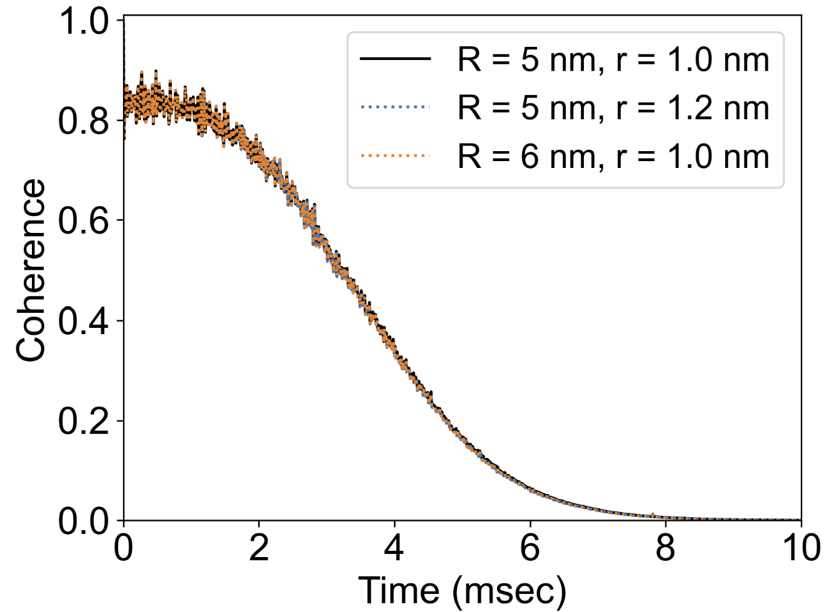
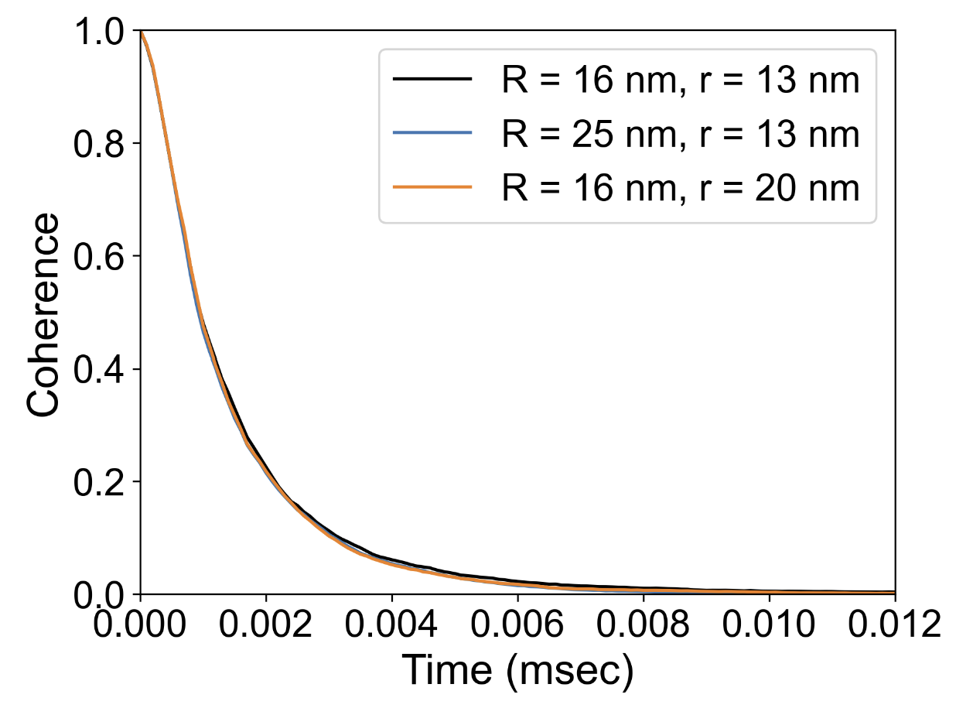
(a)
(b)
Nuclear spin bath
Electronic spin bath (100 ppm)
Mo_{Zn}v_{O}
Mo_{Zn}v_{O}
Mo_{Zn}v_{O}
B₀ = 300 G

