Slide 1
Brain Tumor Segmentation in MRI

Slide 2
1.
Data
2.
Data Preprocessing
Outline
3.
Model
4.
Result
Outline
Notes:
Data
Data preprocessing
Model
Result

Slide 3
Part one
01
Data

Slide 4
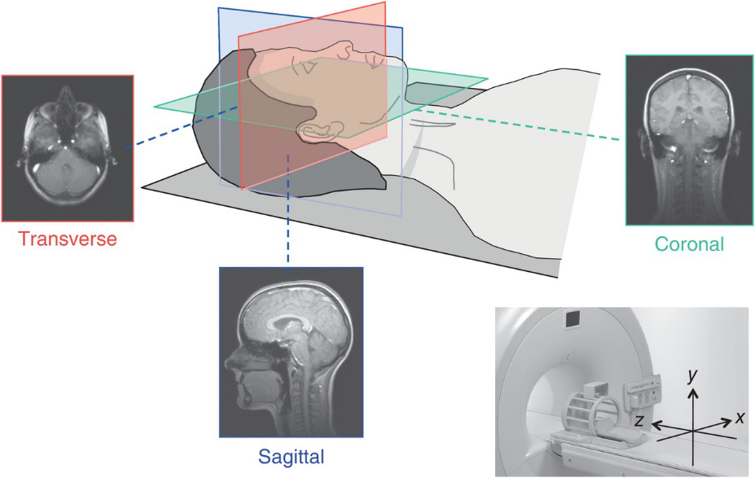
Data – MRI

Slide 5
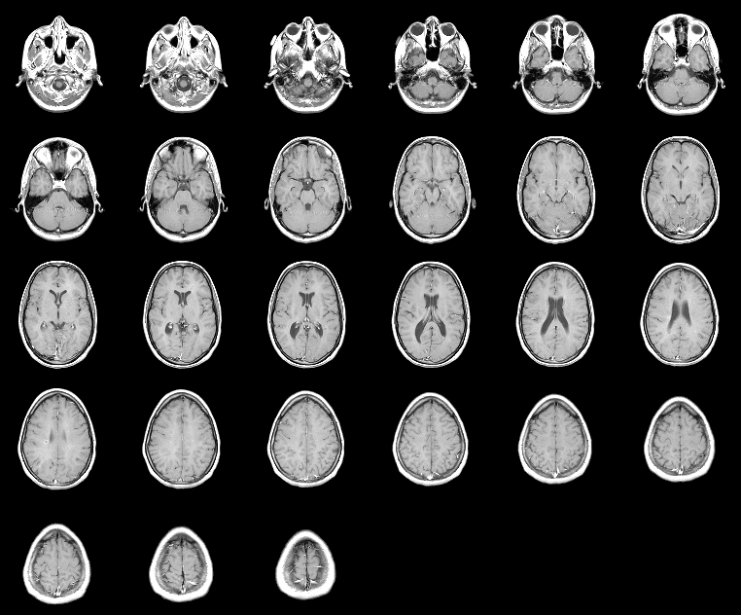
Data – MRI Slices

Slide 6
Part two
02
Data
Preprocessing

Slide 7
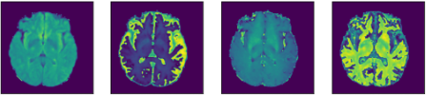
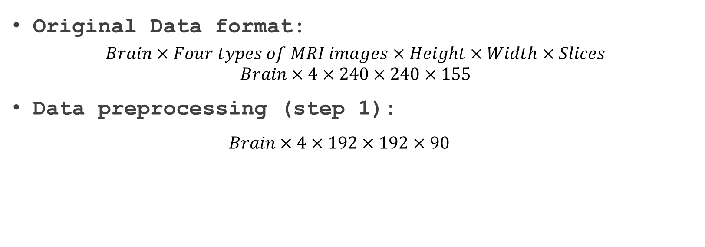
Data preprocessing
Original Data format:
$$Brain×Four types of MRI images×Height×Width×Slices$$
$$Brain×4×240×240×155$$
Data preprocessing (step 1):
$$Brain×4×192×192×90$$
Flair
T1
T1C
T2
B. H. Menze et al. The Multimodal Brain Tumor Image Segmentation Benchmark (BRATS). Oct. 2015.

Slide 8
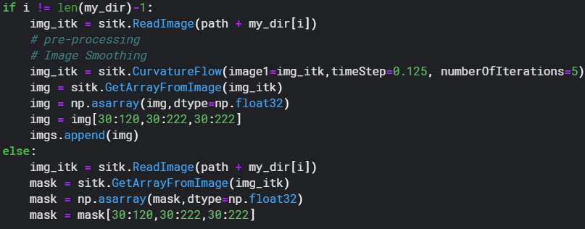
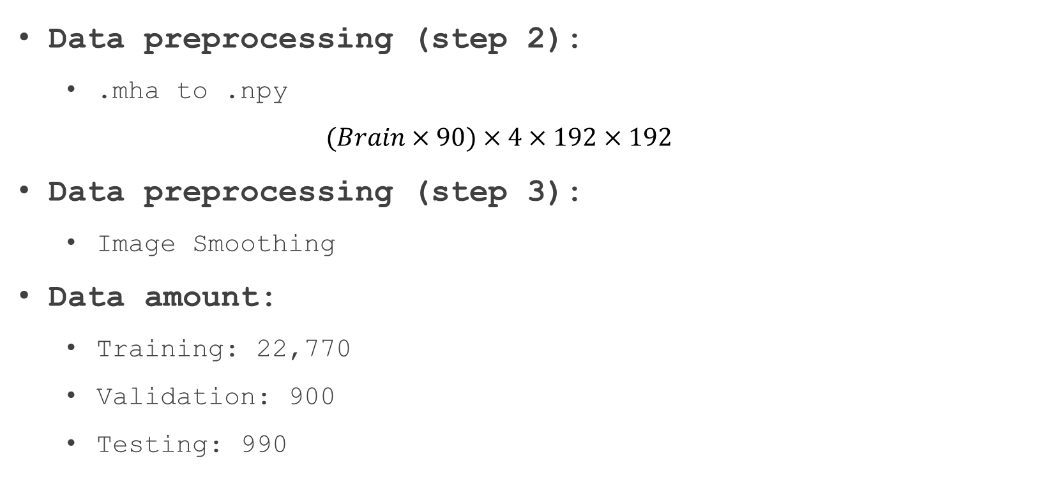
Data preprocessing for 2D segmentation
Data preprocessing (step 2):
.mha to .npy
$$(Brain×90)×4×192×192$$
Data preprocessing (step 3):
Image Smoothing
Data amount:
Training: 22,770
Validation: 900
Testing: 990
Notes:
Data preprocessing (step 2):
.mha to .npy
$$(Brain×90)×4×192×192$$
Data preprocessing (step 3):
Image Smoothing
Data amount:
Training: 22,770
Validation: 900
Testing: 990

Slide 9
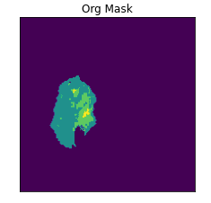
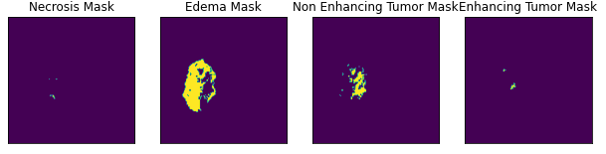
Data preprocessing for Label
Original Label
One-hot encoding
Notes:
Data preprocessing (step 2):
.mha to .npy
$$(Brain×90)×4×192×192$$
Data preprocessing (step 3):
Image Smoothing
Data amount:
Training: 22,770
Validation: 900
Testing: 990

Slide 10
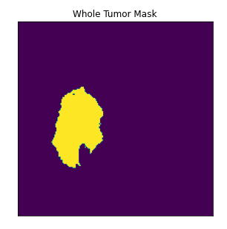
Data preprocessing for Task
Task | Explanation | Patient Data
Whole Tumor | Complete Tumor | Label 1+2+3+4
Tumor Core | Tumor Core | Label 1+3+4
Active Tumor | Enhancing Tumor | Label 4
B. H. Menze et al. The Multimodal Brain Tumor Image Segmentation Benchmark (BRATS). Oct. 2015.
Notes:
Data preprocessing (step 2):
.mha to .npy
$$(Brain×90)×4×192×192$$
Data preprocessing (step 3):
Image Smoothing
Data amount:
Training: 22,770
Validation: 900
Testing: 990

Slide 11
Part three
03
Model

Slide 12
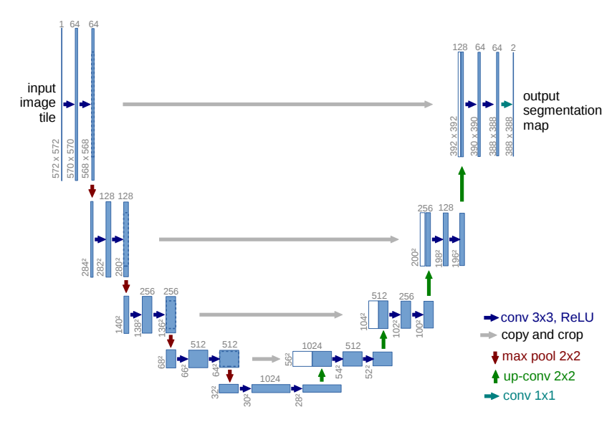
Model - Unet
Olaf et al. U-Net: Convolutional Networks for Biomedical Image Segmentation. 2015.

Slide 13
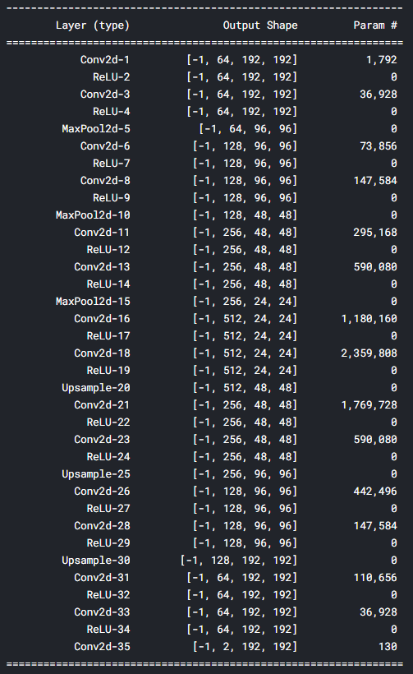
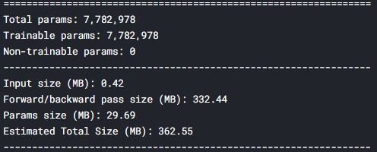
Model Architecture

Slide 14
Part four
04
Result

Slide 15
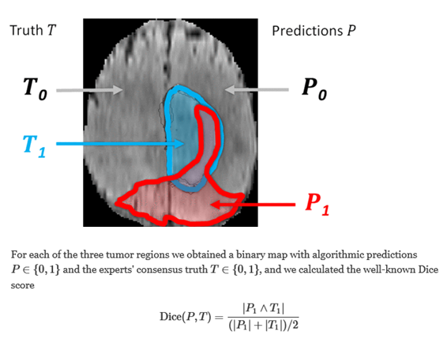
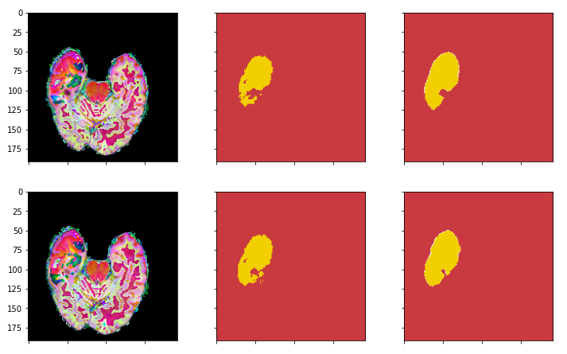
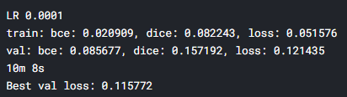
Result

Slide 16
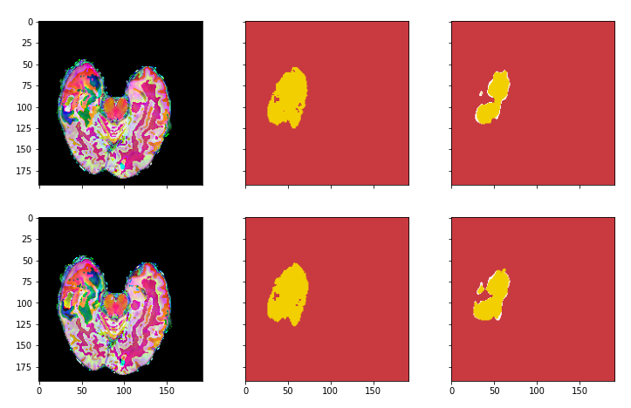
Result

