Slide 1
Python 3 + iGraph + NetworkX Install Tutorial
Network Science
Ping-En Lu
2019.02.22

Slide 2
Python 3
Debian/Ubuntu
sudo apt-get install python3
Mac
https://brew.sh/index_zh-tw.html
brew install python3
Windows
https://www.python.org/downloads/release/python-372/
64-bit: Windows x86-64 executable installer
32-bit: Windows x86 executable installer

Slide 3
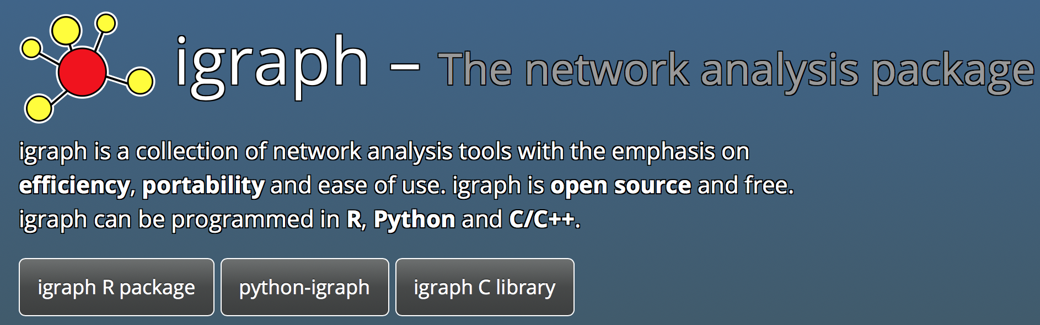
iGraph http://igraph.org

Slide 4
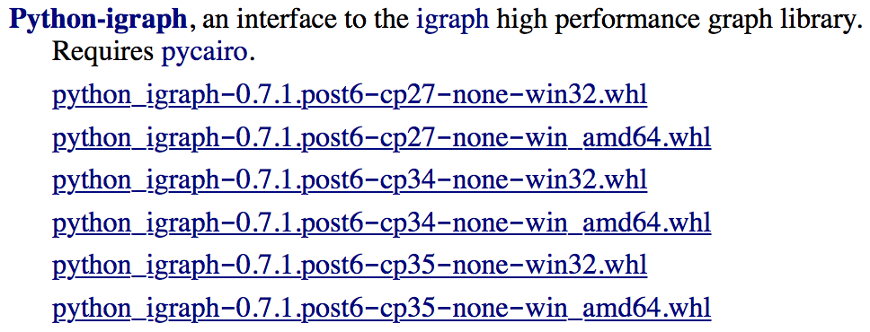
Install igraph (Python)
Unix like (Linux)
sudo apt-get install libxml2-dev zlib1g-dev -y
sudo -H pip3 install python-igraph
MacOS
到App Store安裝Xcode，安裝完後進去同意「使用者協議」，與輸入密碼確認執行權限，接著如果有要你裝完剩下的尾檔就安裝
xcode-select --install
sudo -H pip3 install python-igraph
Windows
https://www.lfd.uci.edu/~gohlke/pythonlibs/
pip3 install python-igraph-0.7.1.post6-cp35-none-win_amd64.whl

Slide 5
Python packages might need
python-igraph / NetworkX
Numpy
Matplotlib
A good code editor such as:
Visual Studio Code https://code.visualstudio.com
Extension for python: https://code.visualstudio.com/docs/python/python-tutorial
Python
Code Runner
…
Sublime text 3

Slide 6
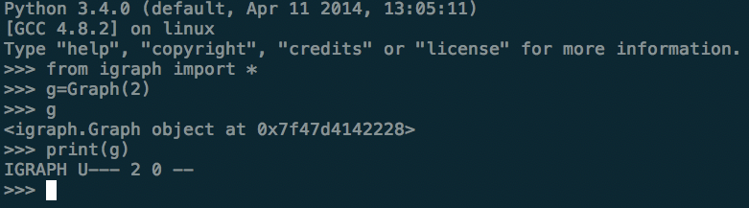
Python demo
Tutorial: http://openhome.cc/Gossip/Python/

Slide 7
GNU R
Debian/Ubuntu
sudo apt-get install r-base
MacOS
brew install caskroom/cask/brew-cask
brew cask install xquartz
brew tap homebrew/science
brew install r --with-openblas
Windows
https://ftp.yzu.edu.tw/CRAN/

Slide 8
Install igraph (R)
Windows: 開啟IDE
其他OS: 輸入R
http://igraph.org/r/
Download and install the package
install.packages("igraph")
Load package
library(igraph)

Slide 9
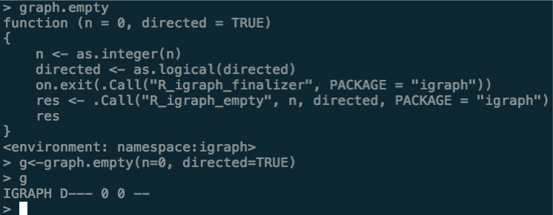
GNU R demo
Tutorial: http://www.cyclismo.org/tutorial/R/

Slide 10
VirtualBox
https://www.virtualbox.org/wiki/Downloads
http://download.virtualbox.org/virtualbox/5.2.4/VirtualBox-5.2.4-119785-Win.exe

Slide 11
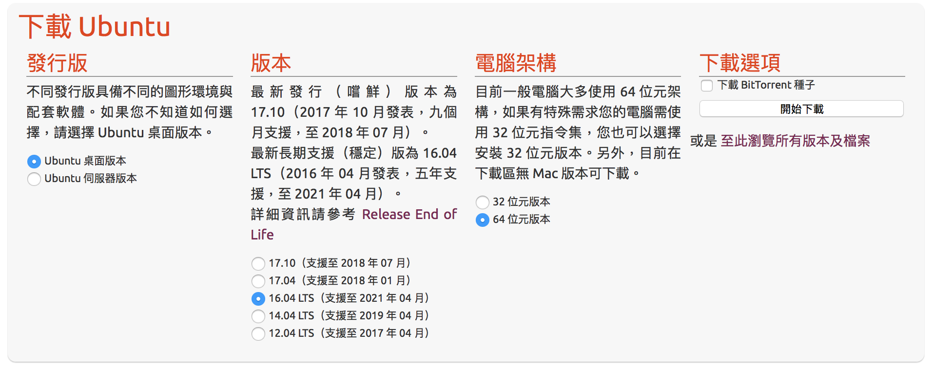
Ubuntu
https://www.ubuntu-tw.org/modules/tinyd0/

Slide 12
Install Ubuntu on VirtualBox
Tutorial: http://blog.xuite.net/yh96301/blog/432341564

