Slide 1
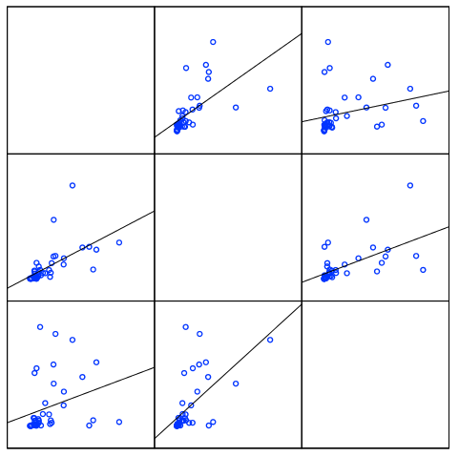
MAOB
MAOA
COMT
MAOA
MAOB
COMT
Figure S1. Scatter plots showing the correlation between MAOA, MAOB, and COMT mRNA expression (n = 42)

