Slide 1

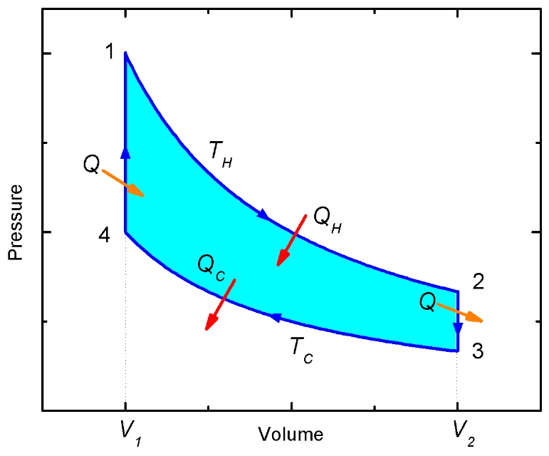
Microscopic Engine
熱統計物理一演示
助教：許誠桓

Slide 2
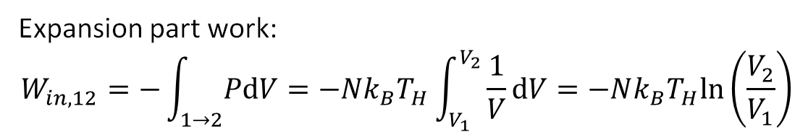
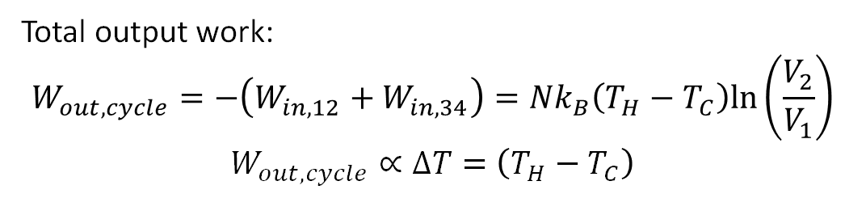

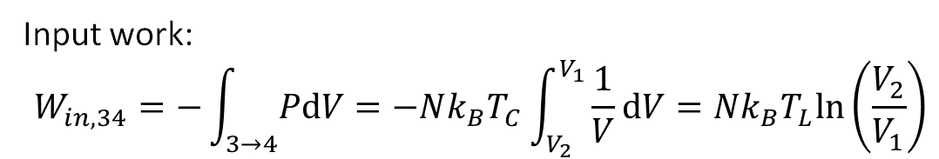
Stirling engine
1→2: Isothermal(等溫) expansion
2→3: Constant-volume cooling
3→4: Isothermal compression
4→1: Constant-volume heating
$$\text{đ}W_{in}=−PdV=−\text{đ}W_{out}$$
Expansion part work:
$$W_{in,12}=−\int_{1→2}^{ }{PdV}=−Nk_{B}T_{H}\int_{V_{1}}^{V_{2}}{\frac{1}{V}dV}=−Nk_{B}T_{H}ln\left(\frac{V_{2}}{V_{1}}\right)$$
Input work:
$$W_{in,34}=−\int_{3→4}^{ }{PdV}=−Nk_{B}T_{C}\int_{V_{2}}^{V_{1}}{\frac{1}{V}dV}=Nk_{B}T_{L}ln\left(\frac{V_{2}}{V_{1}}\right)$$
Total output work:
$$W_{out,cycle}=−\left(W_{in,12}+W_{in,34}\right)=Nk_{B}\left({T_{H}−T}_{C}\right)ln\left(\frac{V_{2}}{V_{1}}\right)$$
$$W_{out,cycle}∝∆T=\left({T_{H}−T}_{C}\right)$$

Slide 3
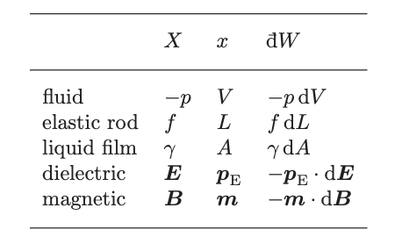

Various forms of “Work”
$$\text{đ}W_{in}=−Xdx$$
Generalized force
(e.g. pressure, external field)
Generalized displacement
(e.g. volume, dipole moment)
In microscopic viewpoint, we can control particles by adding a potential well.
Question: Can we build a heat engine by modifying the “curvature” of potential well, and output some (net) “work” to the environment?

Slide 4
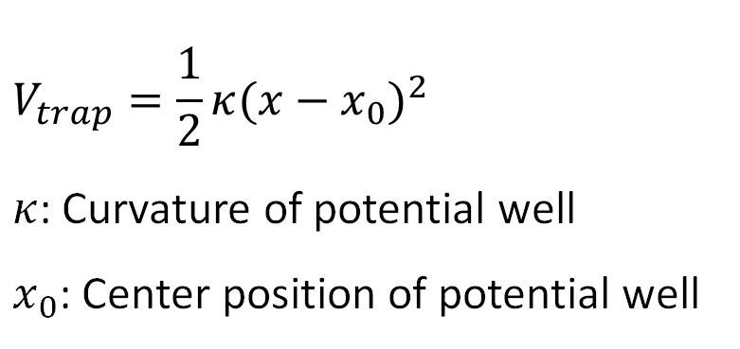
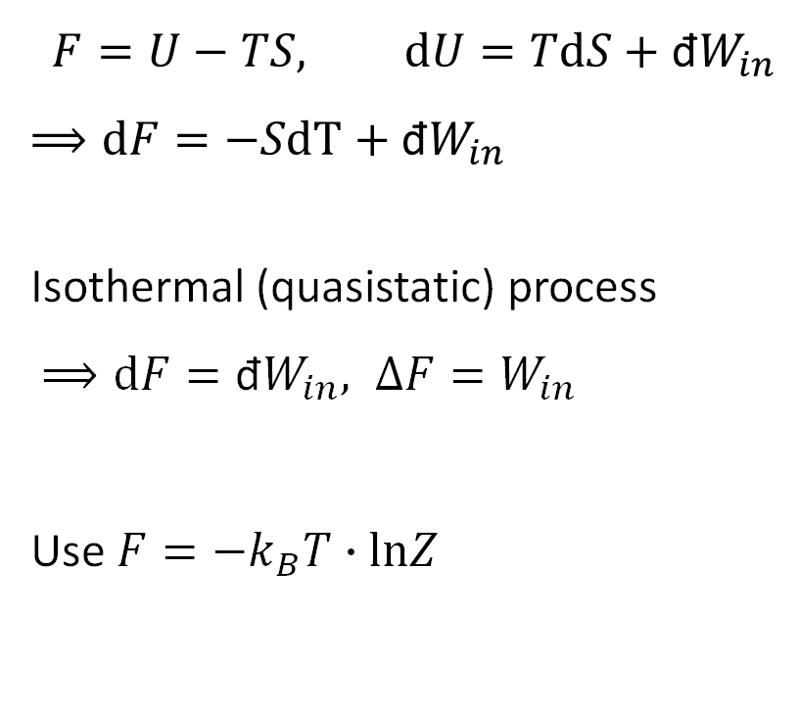
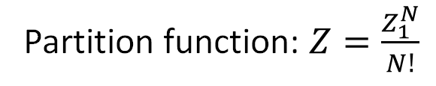
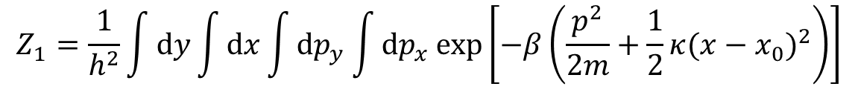
“Work” of changing curvature
$$V_{trap}=\frac{1}{2}κ{(x−x_{0})}^{2}$$
$κ$: Curvature of potential well
$x_{0}$: Center position of potential well
$$F=U−TS, dU=TdS+\text{đ}W_{in}$$
$$⟹dF=−SdT+\text{đ}W_{in}$$
Isothermal (quasistatic) process
$⟹dF=\text{đ}W_{in}, ∆F=W_{in}$
Use $F=−k_{B}T∙lnZ$
Partition function: $Z=\frac{Z_{1}^{N}}{N!}$
$$Z_{1}=\frac{1}{h^{2}}\int{dy}\int{dx\int{{dp}_{y}\int{{dp}_{x}\exp\left[−β\left(\frac{p^{2}}{2m}+\frac{1}{2}κ{(x−x_{0})}^{2}\right)\right]}}}$$

Slide 5
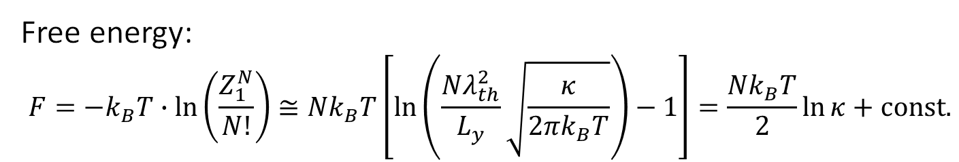
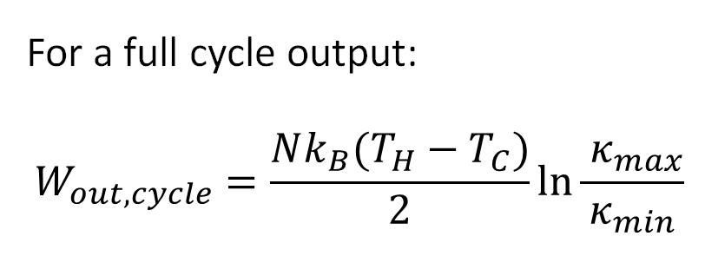
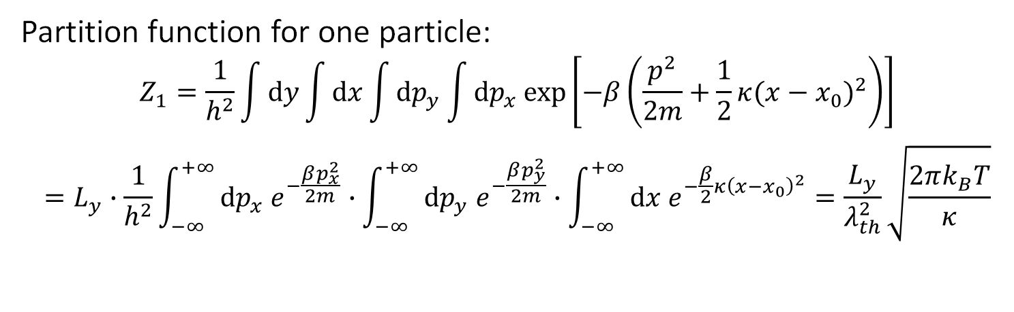
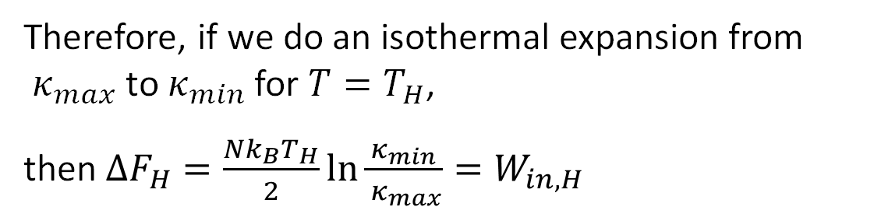

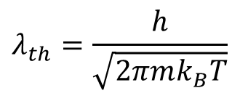
Partition function for one particle:
$$Z_{1}=\frac{1}{h^{2}}\int{dy}\int{dx\int{{dp}_{y}\int{{dp}_{x}\exp\left[−β\left(\frac{p^{2}}{2m}+\frac{1}{2}κ{(x−x_{0})}^{2}\right)\right]}}}$$
$$=L_{y}∙\frac{1}{h^{2}}\int_{−∞}^{+∞}{{{dp}_{x} e}^{−\frac{βp_{x}^{2}}{2m}}}∙\int_{−∞}^{+∞}{{{dp}_{y} e}^{−\frac{βp_{y}^{2}}{2m}}}∙\int_{−∞}^{+∞}{{dx e}^{−\frac{β}{2}κ{\left(x−x_{0}\right)}^{2}}}=\frac{L_{y}}{λ_{th}^{2}}\sqrt{\frac{2πk_{B}T}{κ}}$$
$$λ_{th}=\frac{h}{\sqrt{2πmk_{B}T}}$$
Free energy:
$$F=−k_{B}T∙ln\left(\frac{Z_{1}^{N}}{N!}\right)≅Nk_{B}T\left[\ln\left(\frac{Nλ_{th}^{2}}{L_{y}}\sqrt{\frac{κ}{2πk_{B}T}}\right)−1\right]=\frac{Nk_{B}T}{2}\ln{κ}+const.$$
$$\left(\ln{N!}≅N\ln{N}−N\right)$$
For a full cycle output:
$$W_{out,cycle}=\frac{Nk_{B}(T_{H}−T_{C})}{2}\ln{\frac{{ κ}_{max}}{κ_{min}}}$$
Therefore, if we do an isothermal expansion from ${ κ}_{max}$ to $κ_{min}$ for $T=T_{H}$,
then $ΔF_{H}=\frac{Nk_{B}T_{H}}{2}\ln{\frac{κ_{min}}{{ κ}_{max}}}=W_{in,H }$

Slide 6
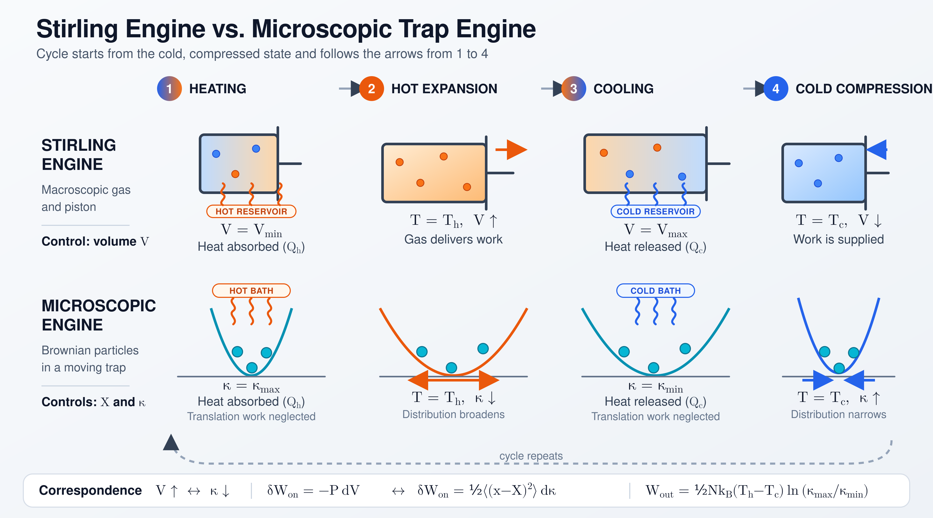

Slide 7
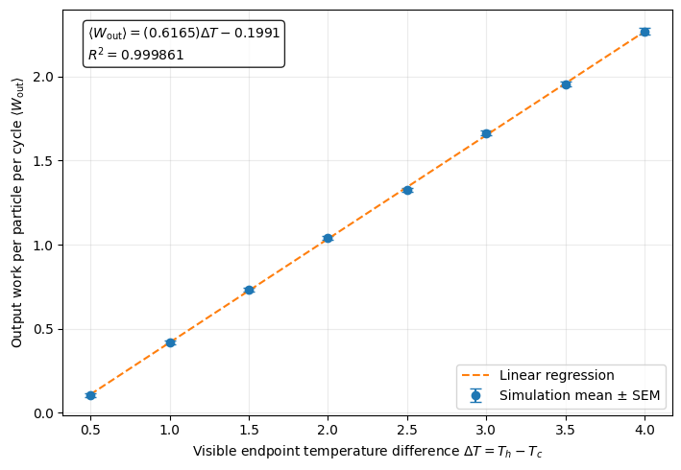
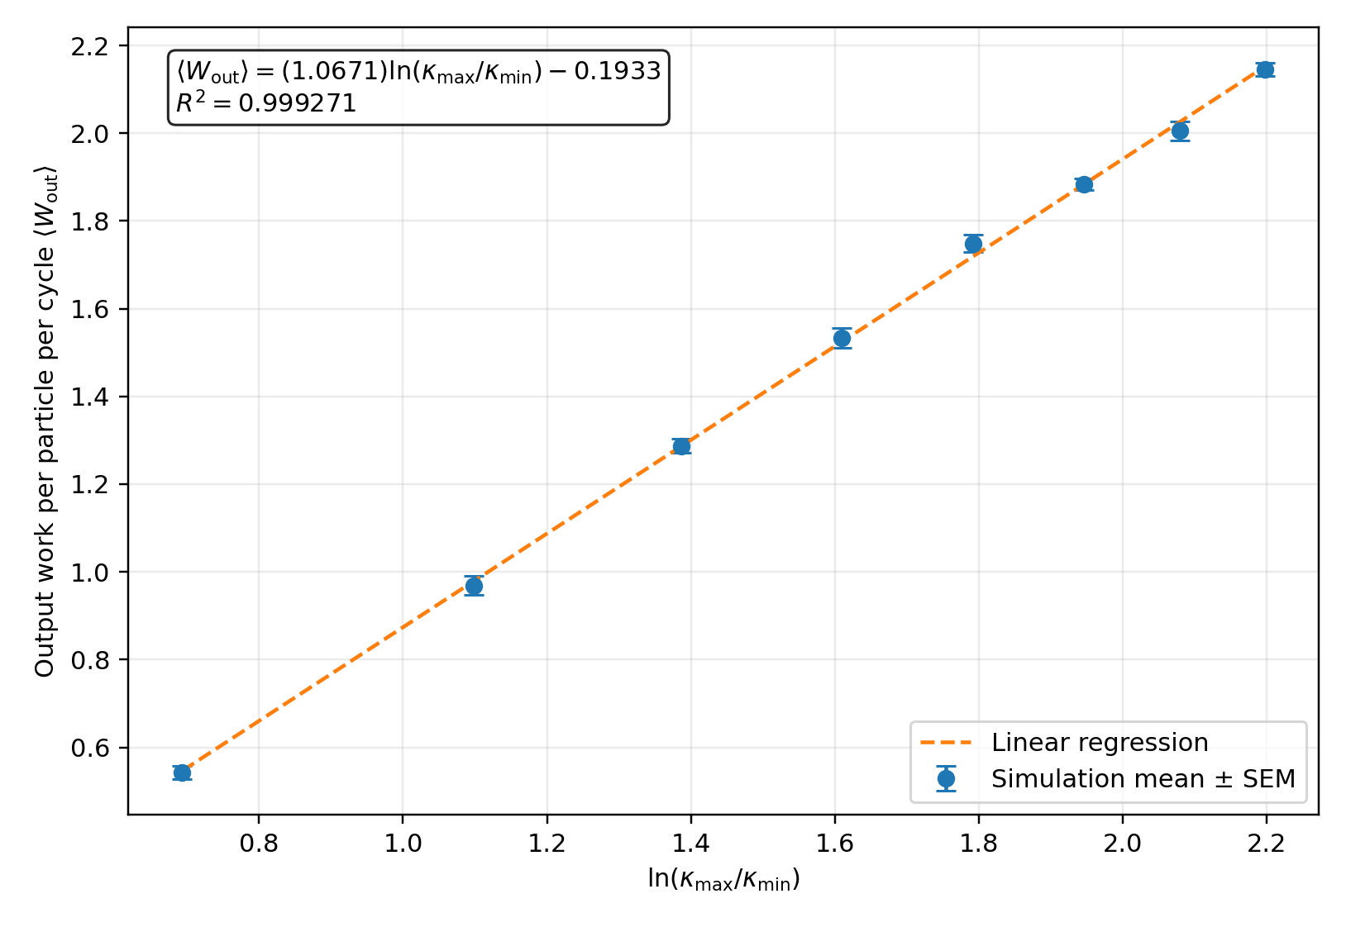
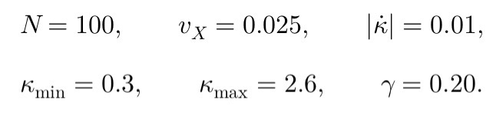
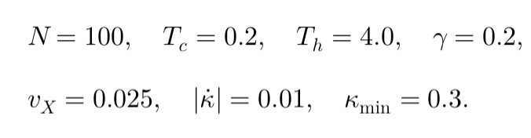
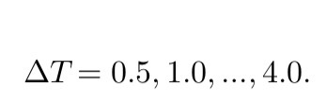
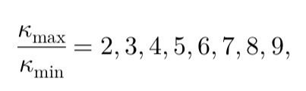

Theoretical prediction:
Slope=0.6170
Theoretical prediction:
Slope=1.0857

Slide 8
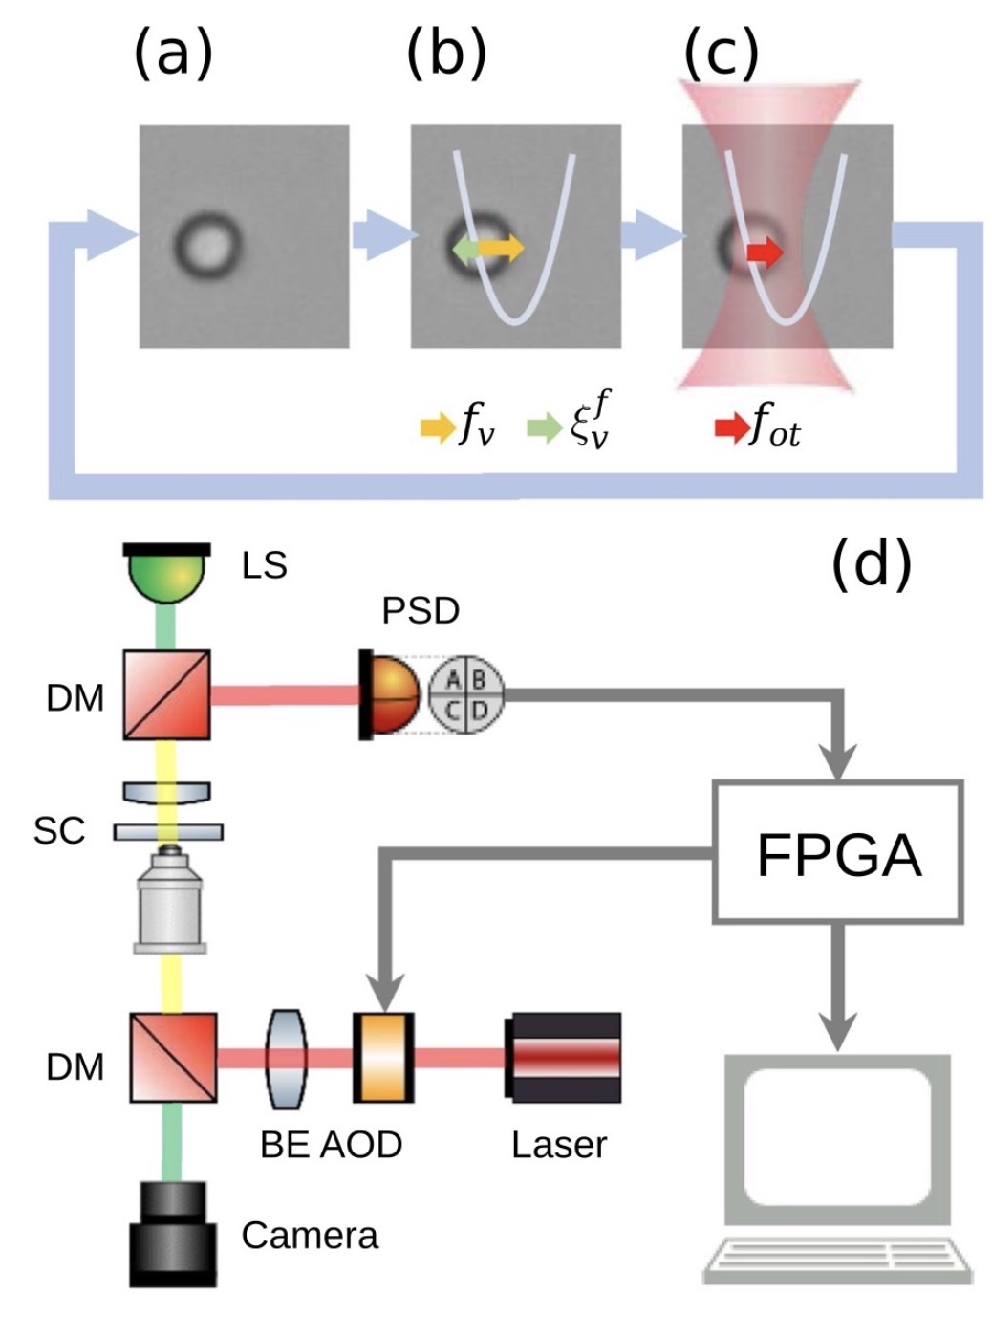
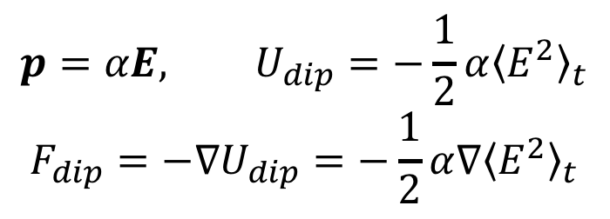
Experiment
Dielectric particles in viscous liquid
Optical tweezers (Rayleigh approx.)
Change the focal point to control particles
$$p=αE, U_{dip}=−\frac{1}{2}α{\left\langle E^{2}\right\rangle }_{t}$$
$$F_{dip}=−∇U_{dip}=−\frac{1}{2}α∇{\left\langle E^{2}\right\rangle }_{t}$$

Slide 9
AI操作指南
在製作模擬網頁之前，請依照以下步驟與AI互動。
  請勿直接轉貼我的網址給AI
  請先嘗試用文字描述我先前模擬的物理設定與原理
  針對「系統如何對粒子指定溫度」進行討論。這裡不一定要用和我的相同方法，也要求理解太多數學細節，但你必須確保你自己清楚模擬的具體實作方法。
  寫出模擬網站後，請對「曲率」、「曲率改變速度」、「位能移動速度」影響進行測試，並提出定性上如何設定比較接近準靜條件（比較效率）。

Slide 10
參考評分標準
1% ：討論系統指定溫度的方式，並做出類似的可視化網站模擬。（必須讓系統做出正功才算成功）
0.5% ：討論物理參數（見前頁）定性上對準靜態近似的影響，並從模擬數據中得到驗證
0.5% ：在適當的參數和邊界條件，將「溫差」、「曲率比值（取對數）」兩者分別對「一個循環的對外做功」做圖，每個數據點可做多次取平均，並驗證關係均為線性。（斜率、截距等受物理設定與邊界條件影響，不需精確對照簡報的圖）
(Bonus) 0.5% ：目前的模擬是x方向有硬牆作為體積限制，y方向取週期邊界條件，然而這樣會受硬牆反射影響分配函數。你能夠設法將兩個方向都設定成週期邊界，且同時確保物理模擬的有效性嗎？
除了html檔，請再交一份pdf進行以上文字說明與作圖部分（文字說明請自己寫，勿直接從AI複製）

Slide 11
Further questions
What are the “Generalized force” and “Generalized displacement” in this system?
How can the moving speed and changing rate of potential well affect the system? Will it increase or decrease the net work?
How can we control the temperature of the particle during the simulation? Is the “temperature” quantity well-defined?

Slide 12
































































Slide 13
















































