Slide 1
Java Design patterns

Slide 2
Module Objectives
At the end of this module, participants will be able to:
Uderstand What is Template Method Design Pattern
Uderstand What is Bridge Design Pattern
Uderstand How To create immutable class in java.

Slide 3
Template Method Design Pattern
Template Design Pattern or Template Method is the behavioral design pattern that defines the skeleton of an algorithm in the superclass but lets subclasses override specific steps of the algorithm without changing its structure.
This pattern falls under the category of the “behavioral” design patterns as it is concerned with how classes collaborate and communicate with other classes.

Slide 4
Key Components
Abstract Class
Concrete Classes
Template Method Invocation
Hooks
Pattern provides a way to define the skeleton of an algorithm in the superclass
while allowing subclasses to provide specific implementations for certain steps.
This promotes code reuse and ensures that the overall algorithm structure
remains consistent across different implementations.

Slide 5
Example for Template Method Design Pattern
Let’s assume we are developing a game that involves different characters
e.g. warriors, mages, archers
They have a common sequence of actions during their turn in a battle. However, each character may have specific behavior for certain actions like
attacking,
defending,
and resting.

Slide 6
Example for Template Method Design Pattern
The ‘Character’ class is the abstract class that defines the template method ‘takeTurn()’. The concrete subclasses (‘Warrior’ and ‘Mage’) implement the abstract methods (‘startTurn()’, ‘performAction()’, ‘endTurn()’) according to their specific behaviors.
The client code (‘Game’ class) can create instances of different characters and invoke their ‘takeTurn()’ method, relying on the template method to ensure a common sequence of actions.

Slide 7
Bridge Design Pattern
Bridge design pattern is one of the Structural design pattern.
According to GoF bridge design pattern is :
Decouple an abstraction from its implementation so that the two can vary independently.
The implementation of bridge design pattern follows the notion to prefer Composition over inheritance.

Slide 8
Bridge Design Pattern
Bridge design pattern can be used when :
both abstraction and implementation can have different hierarchies independently
and we want to hide the implementation from the client application.

Slide 9
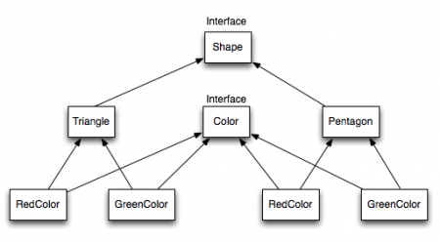
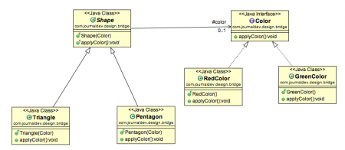
Example for Bridge Design Pattern
Interface hierarchy in both
interfaces and implementations
After using bridge design pattern
to decouple the interfaces from implementation

Slide 10
Creating Immutable classes
characteristics of immutability
The class must be declared as final so that child classes can’t be created.
Data members in the class must be declared private so that direct access is not allowed.
Data members in the class must be declared as final so that we can’t change the value of it after object creation.
A parameterized constructor should initialize all the fields performing a deep copy so that data members can’t be modified with an object reference.
Deep Copy of objects should be performed in the getter methods to return a copy rather than returning the actual object reference

Slide 11
Thank you

