Slide 1
使用FairMOT計算屋內人數
Using FairMOT calculating population indoor
組員: D0782956 平祖安
D0746384 李筱文
D0746353 岳 靈
D0746413 李琛瑤
D0745782 杜怡嫺

Slide 2
目錄
JDE
FairMOT
Demo

Slide 3
Part1 JDE

Slide 4
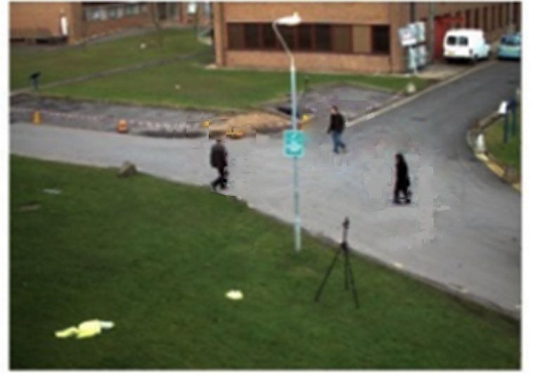
Detect use
RPN
YoloV3
Track use
匈牙利演算法
卡爾曼濾波

Slide 5
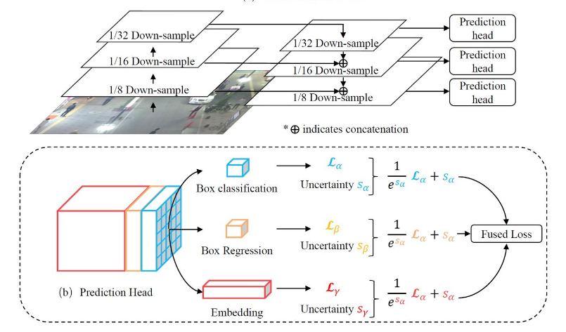
JDE architecture

Slide 6
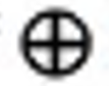
Convolution Pooling
Skip connection
Convolution
Pooling
: Indicates concatenation

Slide 7
Loss function
預測各類別的機率
(cross entropy)
Box classification

Slide 8
Loss function
目標檢測的邊框回歸
(smooth-L1)
Box Regression

Slide 9
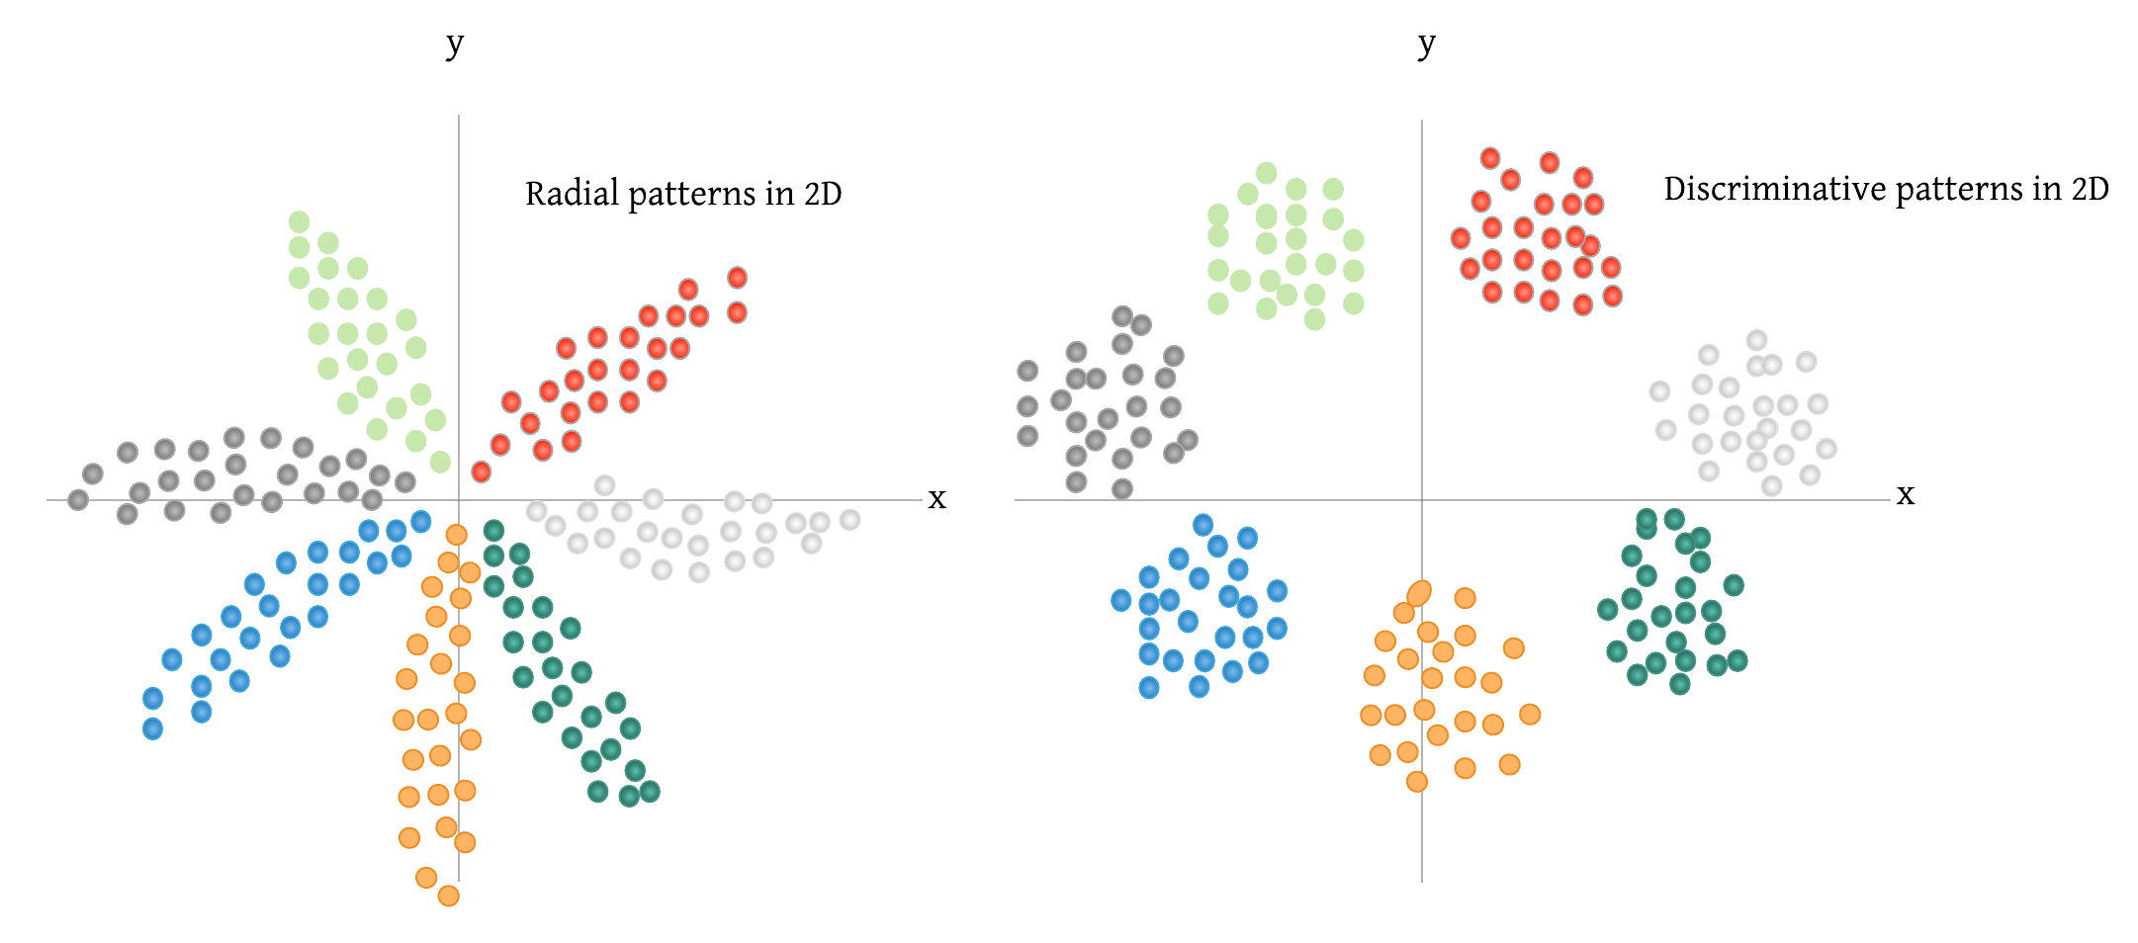
Loss function
(triplet loss)
Embedding
Matrix Learning

Slide 10
Automatic Loss
Balancing
Fused Loss
task-dependent uncertainty

Slide 11
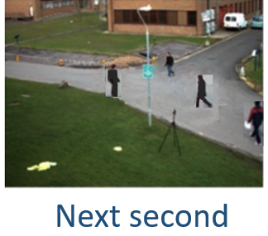
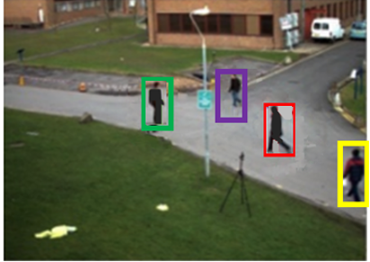
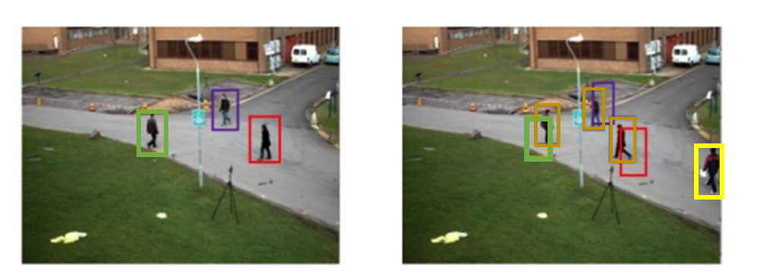
Detect

Slide 12
Track
Next second

Slide 13
Part2 FairMOT

Slide 14
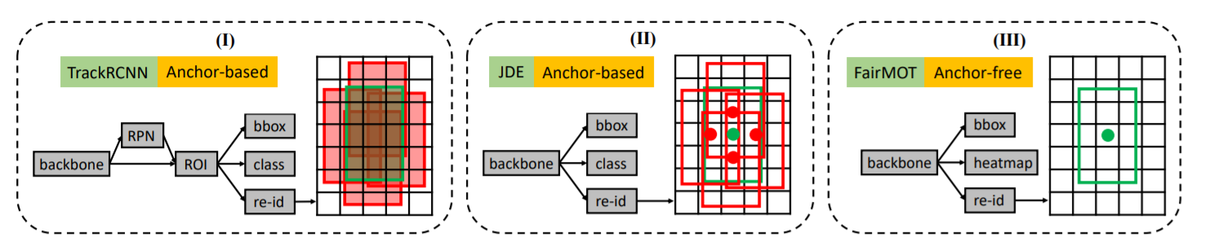
Comparison of the one-shot trackers and FairMOT

Slide 15
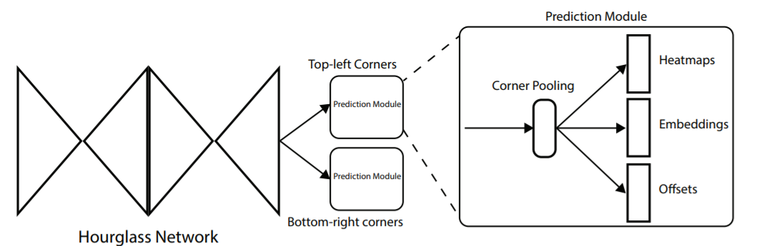
Overview of CornerNet
Notes:
cornerNet借用了hourglass network作為他的backbone特徵提取網路，常被用在姿勢估計，此為兩個hourglass module頭尾相連效果。
head: 二分支输出 Top-left corners 和 Bottom-right corners

Slide 16
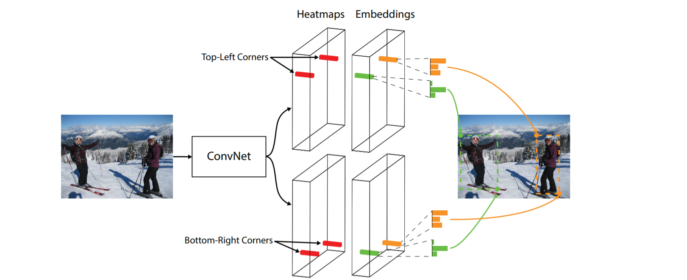
CornerNet
檢測目標物的一對關鍵點(左上角與右上角)，以及每個角的嵌入向量。

Slide 17
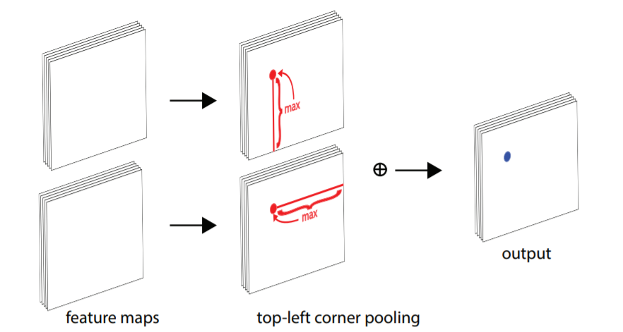
Corner pooling

Slide 18
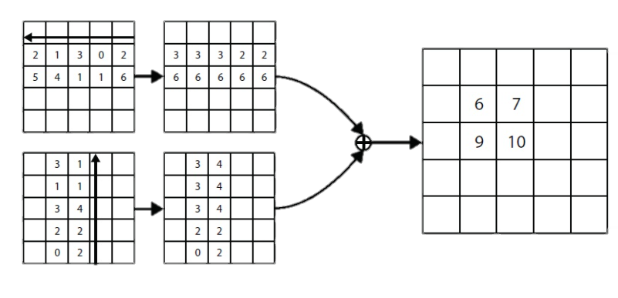
沿該方向遇到a的最大值做為填充值，即可快速實現corner pooling

Slide 19
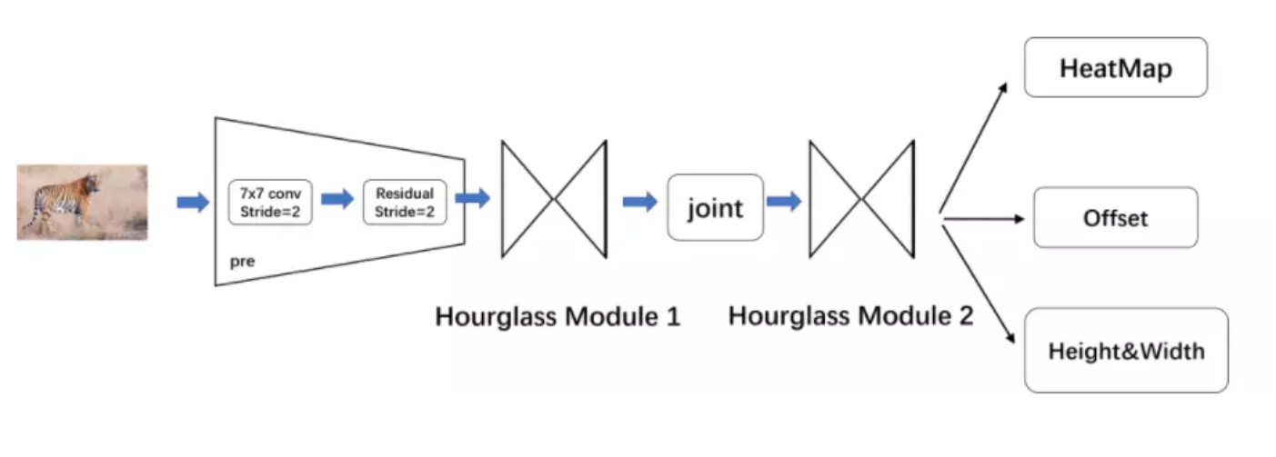
CenterNet
Notes:
（1）pre,將圖片壓縮為原來的1/4
（2）Hourglass Module 1,第一個沙漏型神經網路模塊
（3）joint，連接兩個模塊
（4）Hourglass Module 2,第二個

Slide 20
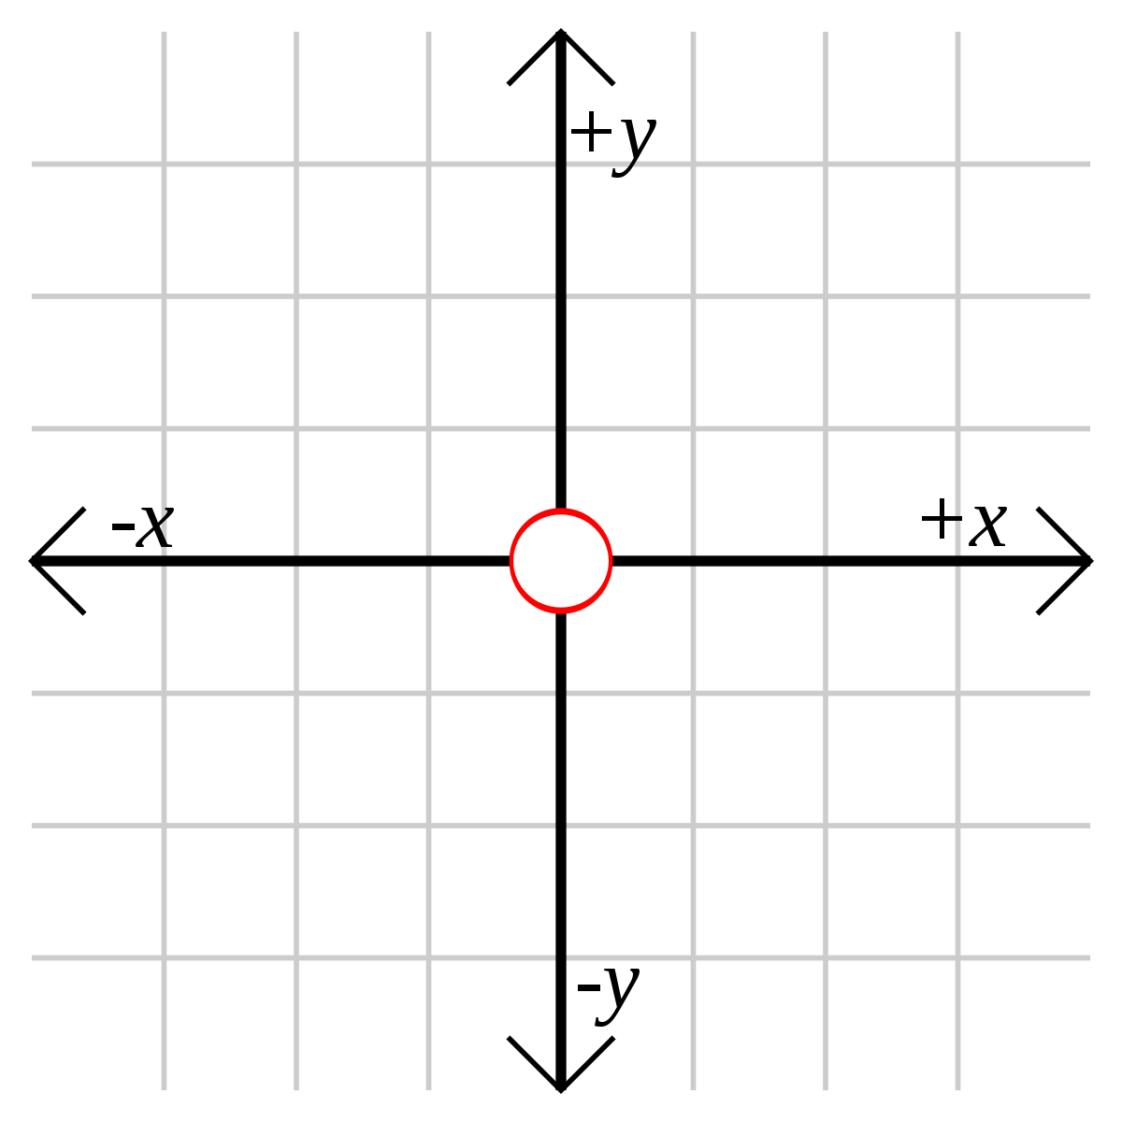

Slide 21
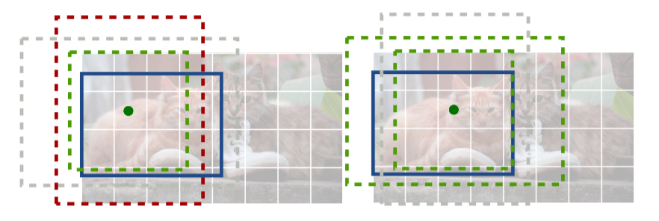
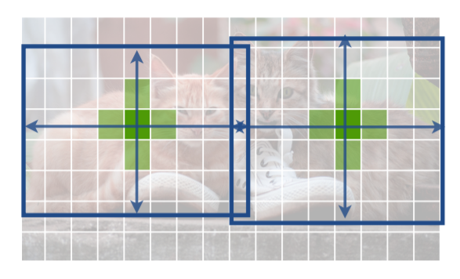
Anchor based
Center point based

Slide 22
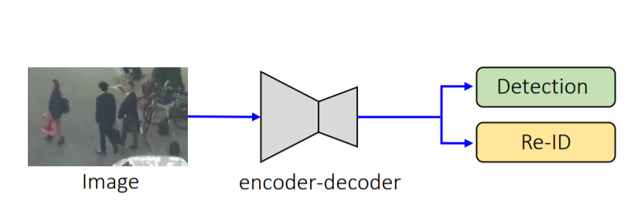
The Technical Approach

Slide 23
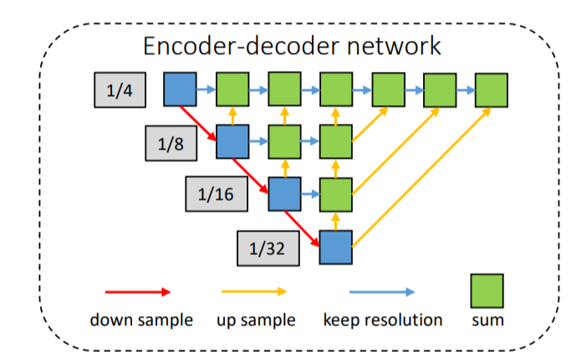

Slide 24
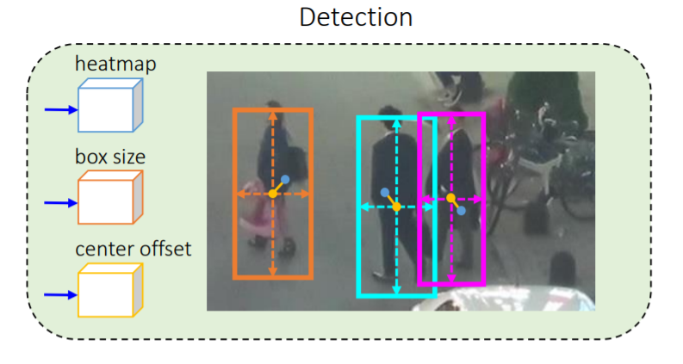
預測物體中心的位置
更精確的定位對象
預估Anchor目標邊界

Slide 25
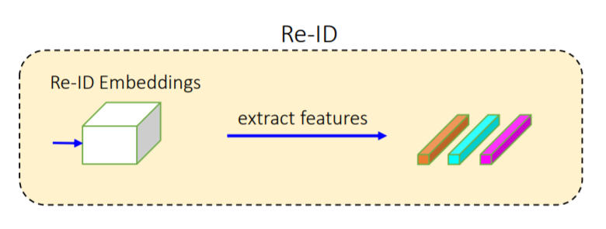

Slide 26
Part3 Demo

Slide 27
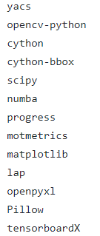
環境
所需套件 | version
Python | 3.6
cuda | 10.0
cudnn | 7.3.1
pythorch | 1.2.0
torchvision | 0.4.0
cudatookit | 10.0
opencv-python | 4.1.1.26
pip install -r requirements.txt

Slide 28

環境
專案根目錄新增models資料夾，放入模型fairmot_dla34.pth
專案根目錄安裝DCNv2
安裝ffmepg用於將處理過的frame生成影片

Slide 29
配置文件opt.py
FairMOT/src/lib/opt.py function update_dataset_info_and_set_heads
if opt.task == 'mot’: opt.heads = {'hm': opt.num_classes, 'wh': 2 if not opt.cat_spec_wh else 2 * opt.num_classes, 'id': opt.reid_dim}

Slide 30
資料讀取和預處理
FairMOT/src/lib/datasets/dataset/jde.py
class JointDataset
FairMOT/src/lib/utils/image.py
gaussian_radius draw_umich_gaussian

Slide 31
LOSS function
FairMOT/src/lib/trains/mot.py
class MotLoss

Slide 32
Tracker
FairMOT/src/lib/tracker/multitracker.py
class JDETracker
''' Step 1: Network forward, get detections & embeddings'''
''' Step 2: First association, with embedding'''
''' Step 3: Second association, with IOU'''
""" Step 4: Init new stracks"""

Slide 33
Tracker
https://github.com/luanshiyinyang/FairMOT
FairMOT/src/camera.py
def recogniton():
result_root = opt.output_root if opt.output_root != '' else '.'
mkdir_if_missing(result_root)
print("start tracking")
dataloader = datasets.LoadVideo(0, opt.img_size)
result_filename = os.path.join(result_root, 'results.txt')
frame_rate = dataloader.frame_rate
frame_dir = None if opt.output_format == 'text' else os.path.join(result_root, 'frame')
eval_seq(opt, dataloader, 'mot', result_filename,
save_dir=frame_dir, show_image=False, frame_rate=frame_rate)
frame_dir = None if opt.output_format == 'text' else os.path.join(result_root, 'frame')
eval_seq(opt, dataloader, 'mot', result_filename,
save_dir=frame_dir, show_image= True, frame_rate=frame_rate)

Slide 34
Demo影片

