Slide 1
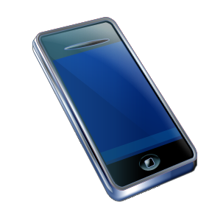
Server
Server App
Android app for Bluetooth communication between U3 and ZigBee
Configuring nodes
To local / remote nodes
Set GPIO mode
Read GPIO values
Read AI values
Set report mode (sampling / change)
Set GPIO values
Scan ZigBee devices
Server for controlling the nodes
HTTP server
JSON RPC between server and client
U3
Bluetooth
Bluetooth
BT-ZigBee
Combo
ZigBee
(Coordinator)
TCP
Server
Device
ZigBee
(Device)
Switch, Relay

Slide 2
Configuring Nodes
Coordinator / Router / End-Device
AT+NT=0, 1, 2, 3, 4
0=none, 1=coordinator, 2=router, 3=end-device, 4=sleepy end-device
For coordinator, Permit Joining
AT+PJ=255 (or sec)
Node name
AT+NN=<value> (up to 16 chars)
Scanning
AT+AS : scan network
AT+ES : scan energy of the channels
AT+DS : scan nodes in the current network
AT+RS : showing RSSI and LQI RSSI=-100~+127dBm, LQI=0~255

Slide 3
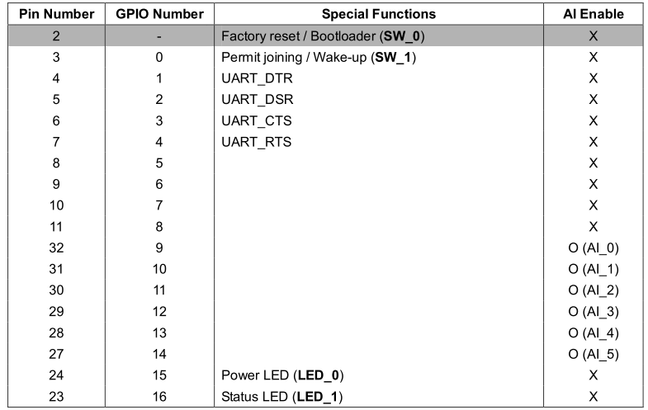
Configuring GPIOs
Mode setting
AT+GPIO<number>=<value>
0=disabled, 1=DIN, 2=DOUT(low), 3=DOUT(high), 4=AIN (9~14), 5=reserved
In / Out
AT+DIO? or AT+DIO<number>?
AT+DIO=<value> or AT+DIO<number>=<value>
Analog
AT+AI? or AT+AI<number>?
출력값을 실제 측정된 전압값으로 변환
출력값이 0 ~ 7FFF 인 경우, Voltage (mV) = Value * 0.1
출력값이 8000 ~ FFFF 인 경우 Voltage (mV) = (Value – 65536) * 0.1
온도센서에서 실제 측정된 전압값을 온도로 변환
Temperature(℃) ={ Volt(mV) -600(mV)} * 0.1(℃/mV)
조도센서에서 실제 측정된 전압값을 조도로 변환
Illumination(Lux) = Volt(mV) * 0.25(Lux/mV)

Slide 4
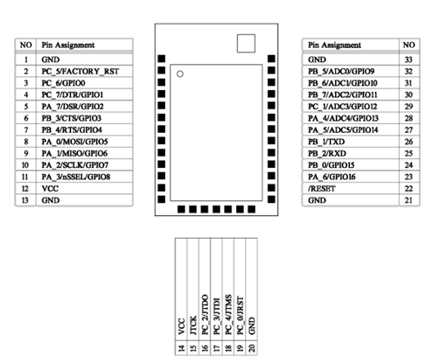
Configuring GPIOs
Periodic Sampling
AT+DL=<IEEE address>
ATS42=<value> Sampling period (sec)
ATS43=<value> 0 for DL, 1 for Sink node
ATZ
Data format : ++<IEEE address>|<GPIO value><CR>
Change Detection Sampling
AT+DL=<IEEE address>
ATS43=<value> 0 for DL, 1 for Sink node
ATS44=<value> 0 for not using sampling
ATZ

Slide 5
Configuring BT-ZigBee Combo
Configuring as Coordinator
AT+NT=1
AT+NN=BT_ZIGBEE_COMBO
UI
Configuring Node
Node Type
Node Name
Configuring GPIO
GPIO NO, PIN NO, MODE

Slide 6
Client App
Query the devices
Showing the devices configured by Server App
Attributes are shown as Icon
Switches (R/W)
Volume (R/W)
Remote Control (R/W)
Temperature (R)
Luminance (R)
Send control and receive current status
Rule making
On, Off, Toggle rules

Slide 7
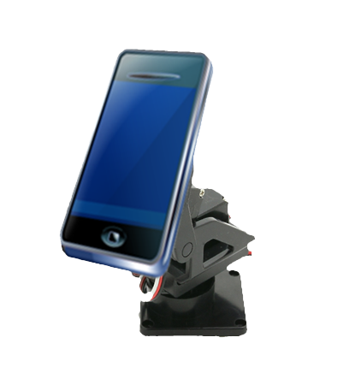
Apparatus – Main
Pan & Tilt Gimbal for FPV
160 degree with Gimbal
Phone is attached to the gimbal
PWM signal is used for rotating the phone
Power
Charger is used
Power is distributed to both BT-ZigBee combo and Phone
BT ZigBee
USB Charger Plug

Slide 8
Apparatus – Lamp Switch
RELAY
touch
RELAY
ZIGBEE
P
O
W
E
R
FUSE

Slide 9
Apparatus – Power Outlet
ZIGBEE
P
O
W
E
R
FUSE
RELAY

