Slide 1
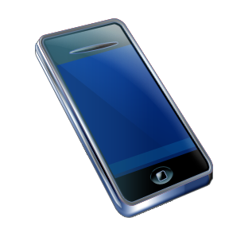
Server
Server App
Android app for Bluetooth communication between U3 and ZigBee
Configuring nodes
To local / remote nodes
Set GPIO mode
Read GPIO values
Read AI values
Set report mode (sampling / change)
Set GPIO values
Scan ZigBee devices
Server for controlling the nodes
TCP socket for connection
U3
Bluetooth
Bluetooth
BT-ZigBee
Combo
ZigBee
(Coordinator)
TCP
Server
Device
ZigBee
(Device)
Switch, Relay

Slide 2
Configuring Nodes
Coordinator / Router / End-Device
AT+NT=0, 1, 2, 3, 4
0=none, 1=coordinator, 2=router, 3=end-device, 4=sleepy end-device
For coordinator, Permit Joining
AT+PJ=255 (or sec)
Node name
AT+NN=<value> (up to 16 chars)
Scanning
AT+AS : scan network
AT+ES : scan energy of the channels
AT+DS : scan nodes in the current network
AT+RS : showing RSSI and LQI RSSI=-100~+127dBm, LQI=0~255

Slide 3
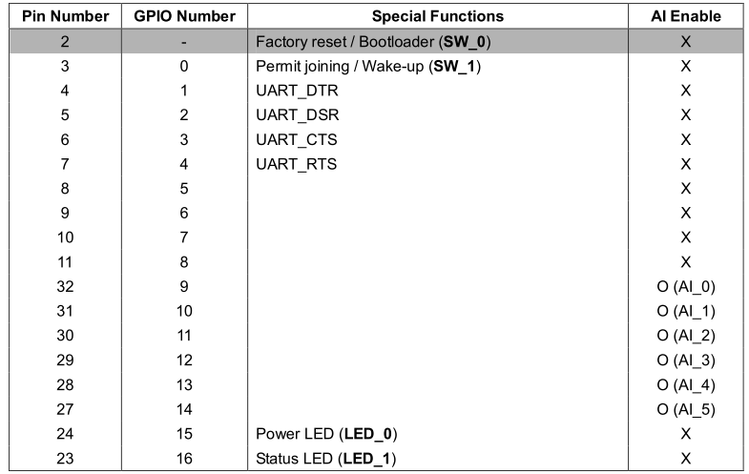
Configuring GPIOs
Mode setting
AT+GPIO<number>=<value>
0=disabled, 1=DIN, 2=DOUT(low), 3=DOUT(high), 4=AIN (9~14), 5=reserved
In / Out
AT+DIO? or AT+DIO<number>?
AT+DIO=<value> or AT+DIO<number>=<value>
Analog
AT+AI? or AT+AI<number>?
출력값을 실제 측정된 전압값으로 변환
출력값이 0 ~ 7FFF 인 경우, Voltage (mV) = Value * 0.1
출력값이 8000 ~ FFFF 인 경우 Voltage (mV) = (Value – 65536) * 0.1
온도센서에서 실제 측정된 전압값을 온도로 변환
Temperature(℃) ={ Volt(mV) -600(mV)} * 0.1(℃/mV)
조도센서에서 실제 측정된 전압값을 조도로 변환
Illumination(Lux) = Volt(mV) * 0.25(Lux/mV)

Slide 4
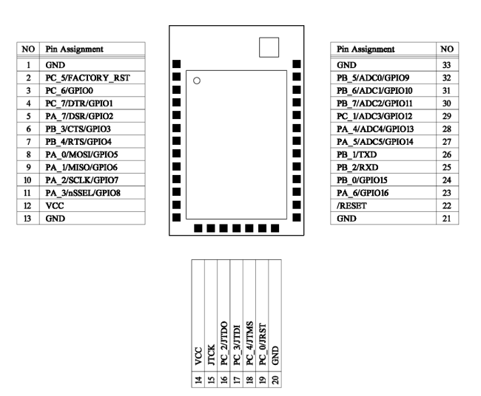
Configuring GPIOs
Periodic Sampling
AT+DL=<IEEE address>
ATS42=<value> Sampling period (sec)
ATS43=<value> 0 for DL, 1 for Sink node
ATZ
Data format : ++<IEEE address>|<GPIO value><CR>
Change Detection Sampling
AT+DL=<IEEE address>
ATS43=<value> 0 for DL, 1 for Sink node
ATS44=<value> 0 for not using sampling
ATZ

Slide 5
Configuring BT-ZigBee Combo
Configuring as Coordinator
AT+NT=1
AT+NN=BT_ZIGBEE_COMBO
UI
Configuring Node
Node Type
Node Name
Configuring GPIO
GPIO NO, PIN NO, MODE

Slide 6
Client App
Query the devices
Showing the devices configured by Server App
Attributes are shown as Icon
Switches (R/W)
Volume (R/W)
Remote Control (R/W)
Temperature (R)
Luminance (R)
Send control and receive current status

