Slide 1
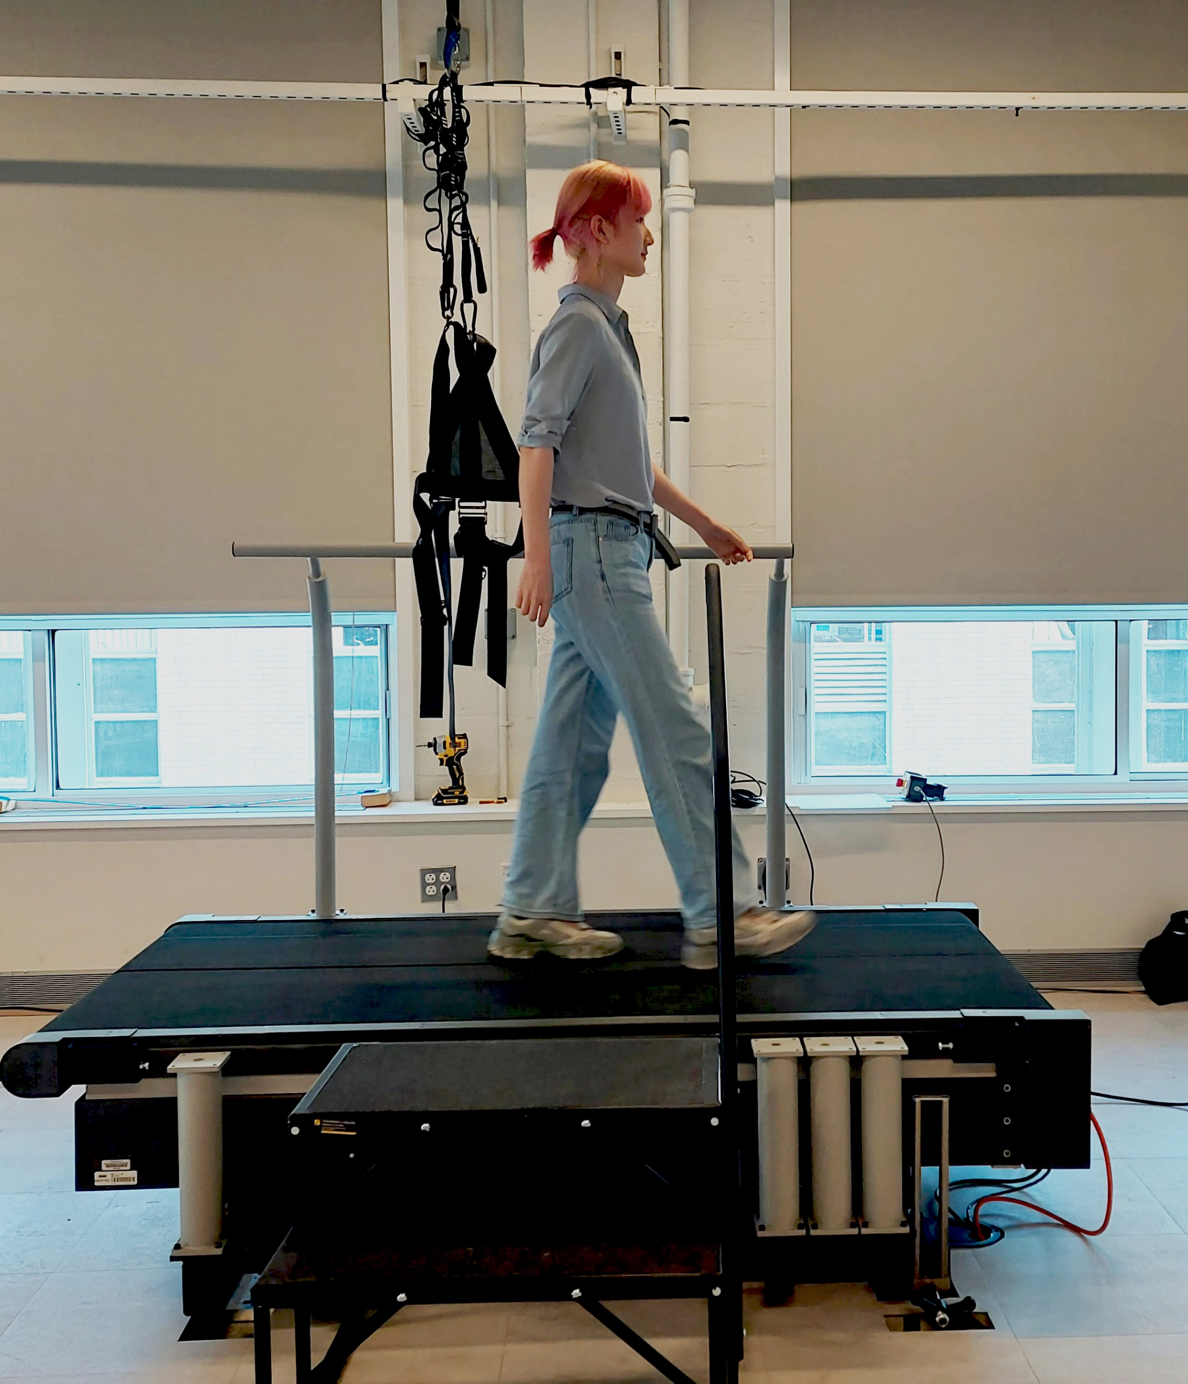
Spring Semester Report:
MATLAB App for instrumented treadmills: COM tracking and self-pacing control
#change this picture to treadmill pic
Student: Guangping Liu
Notes:
30

Slide 2
Outline
Motivation
Previous Work
SPT App for PC
Communication between treadmill and MATLAB
Sagittal Kalman Filter
Speed Controller
Lateral Kalman Filter
MATLAB App Designer
Notes:
30 seconds

Slide 3
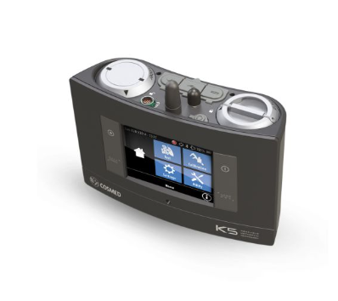
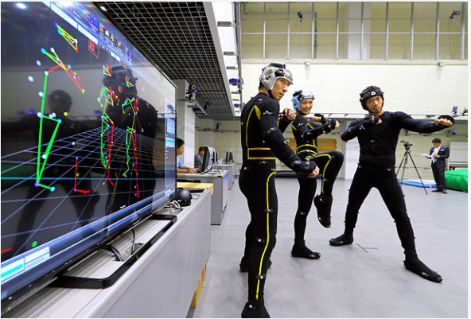
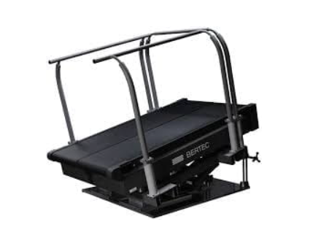
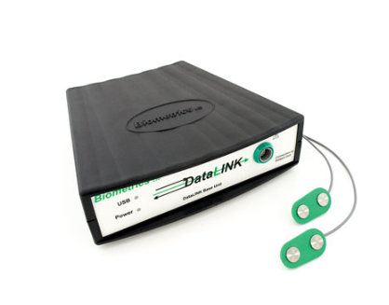
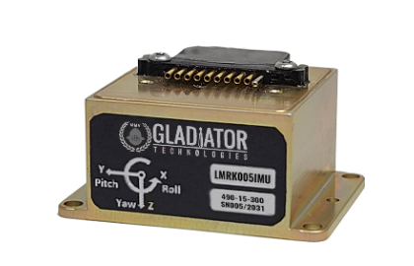
Metabolic measurement system:Energy consumption
Motivation
Motion Capture System: kinematics
Treadmill:GRF
IMU:kinematics
Electromyography(EMG):Muscle activation
Notes:
These are common equipments in a locomotion lab.
treadmill:+com,+self-pacing

Slide 4
Motivation
The relationship between gait speed and mediolateral stability depends on a person's preferred speed
https://www.nature.com/articles/s41598-023-32948-z
COM
-mediolateral stability
-sagittal: self-paced treadmill
Notes:
lateral COM is important to walking stability, refer to a paper
sagittal COM contribute to self-pacing treadmill
what is self-pacing treadmill: it is an instrumented treadmill which keep tracking subject’s walking speed to simulate a overground walking
why it’s important

Slide 5
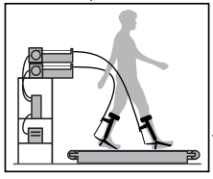
Motivation
Test assistive devices
Preferred walking speed
A self-pacing treadmill
Rehabilitation
Notes:
1 mins
A self-pacing treadmill
Other self-paced treadmills…(exoskeleten)
Free walking speed
Preferred walking speed
Rehabilitation:gait analysis of
Test assistive devices

Slide 6
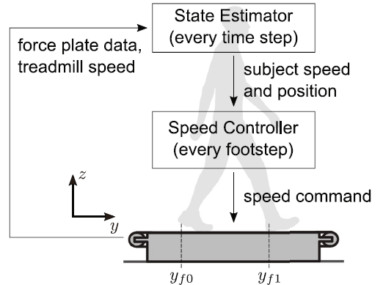
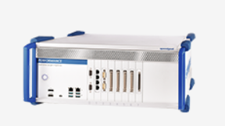
Previous Work
Using force data to self-pace an instrumented treadmill and measure self-selected walking speed
https://jneuroengrehab.biomedcentral.com/articles/10.1186/s12984-020-00683-5

Slide 7
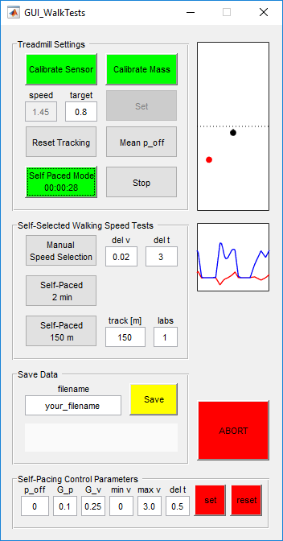
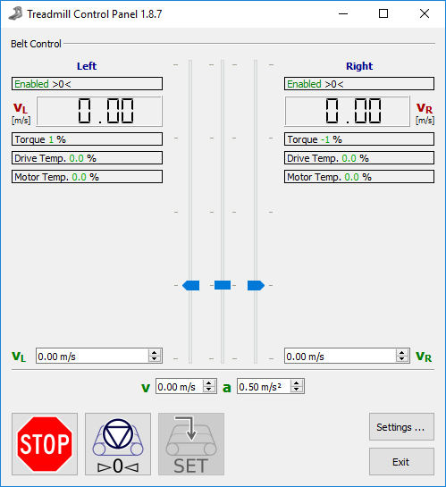
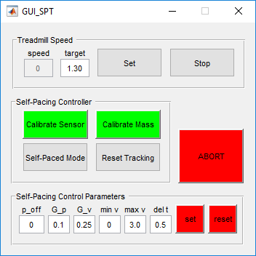
Previous Work
Self-pacing Test
Walking Test
Notes:
1 mins(2)
what are these apps
the first:the panel from Bertec to control the treadmill speed. set it to remote control in this paneel.
self pacing GUI
walking test GUI

Slide 8
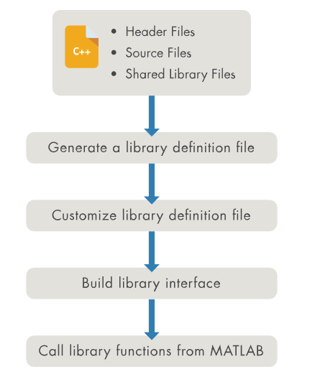

SPT App: communication
Why do we need the communication?
Kick Speedgoat out of our working flow
How do we do it?
mex function
adaptor/ Call C from Matlab
Call C++ from Matlab
Live Code definition file
Generate Interface
Communication
Data stream
Remaining Problems
Some functions doesn’t work
Break down
MATLAB Support
Notes:
1 mins(3)
Why do we need the communication?
-we wanna simplify the equipment needed in research so we want to remove speedgoat from our list.
What we have:
-Bertec SDK
-Matlab

Slide 9
SPT App: State estimator
Kalman Filter for Com speeds and positions
Target:
Input: accelerations from ground reaction force(fy), measurements
Output: com positions(p), com speeds(v)
Notes:
1 min(4)
Clarify why do we need Kalman filter:
-state estimator: com positions and speeds to speed controller
-input is the grf, measurements
-out put

Slide 10





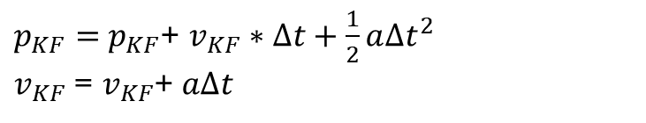
SPT App: State estimator
Kalman Filter for Com speeds and positions
Time Update(Prediction):
Measurement Update:
Notes:
1 min(5)
What is Kalman filter
-a linear optimal estimator to estimate states and update by measurements with noisy.
-two parts:
Prediction: model is the motion with an acceleration
Measurement: equations
How to get measurement:
-we cannot get it directly
-calculate

Slide 11
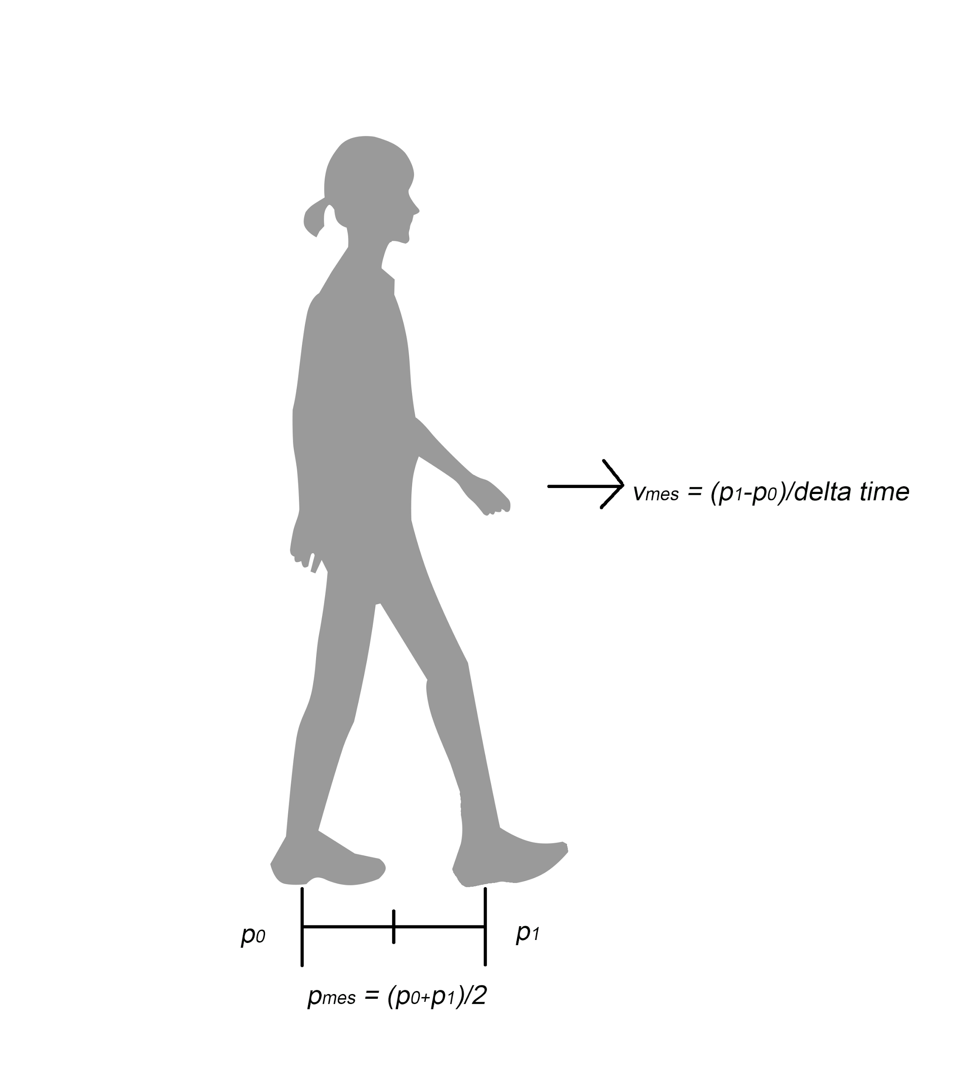
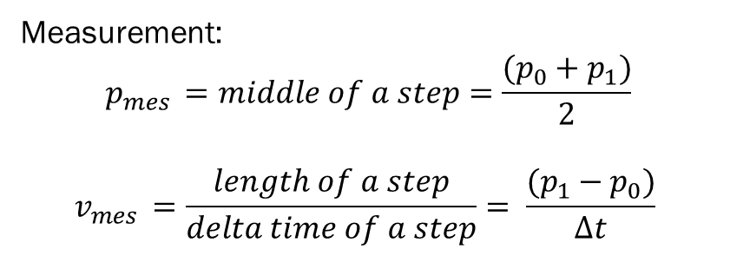
SPT App: State estimator
Kalman Filter for Com speeds and positions
#add a explain plot here
Notes:
1 min(6)

Slide 12

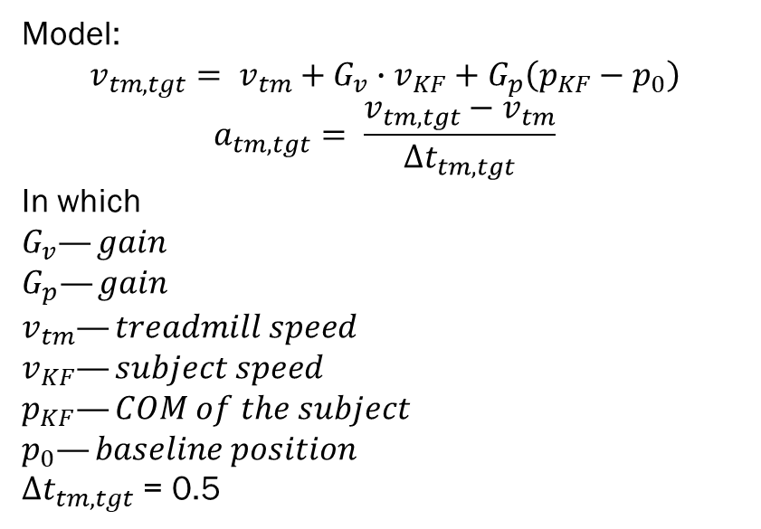
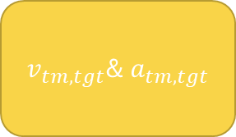
SPT App: Speed Controller
Treadmill speed
Kalman filter
Speed Controller
Speed Controller
Notes:
1min(7)
input
output
the way to keep subject walking in the middle of the treadmill is: set two gains. If walk faster, give a larger target velocity; if walk on the front part of the treadmill, larger velocity.
change gains to control how fast the treadmill goes to the subjects velocity
gp=0.1
gv=0.25

Slide 13
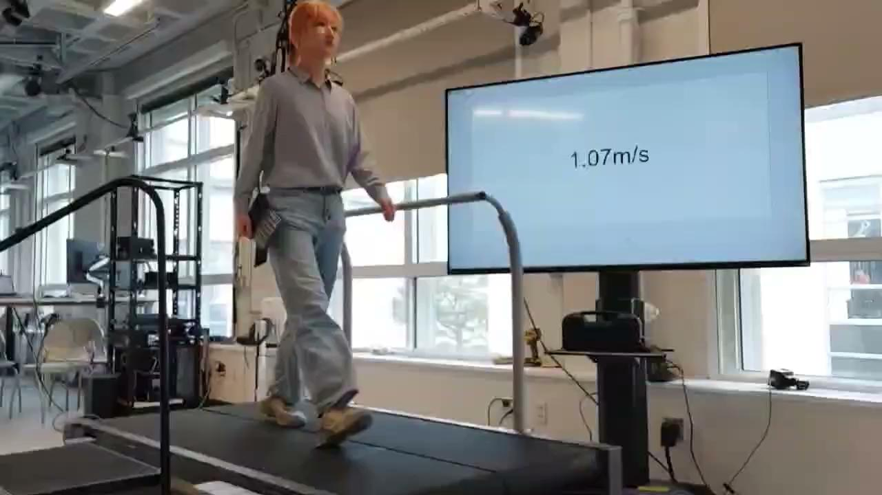
SPT App
Notes:
1min(8)

Slide 14
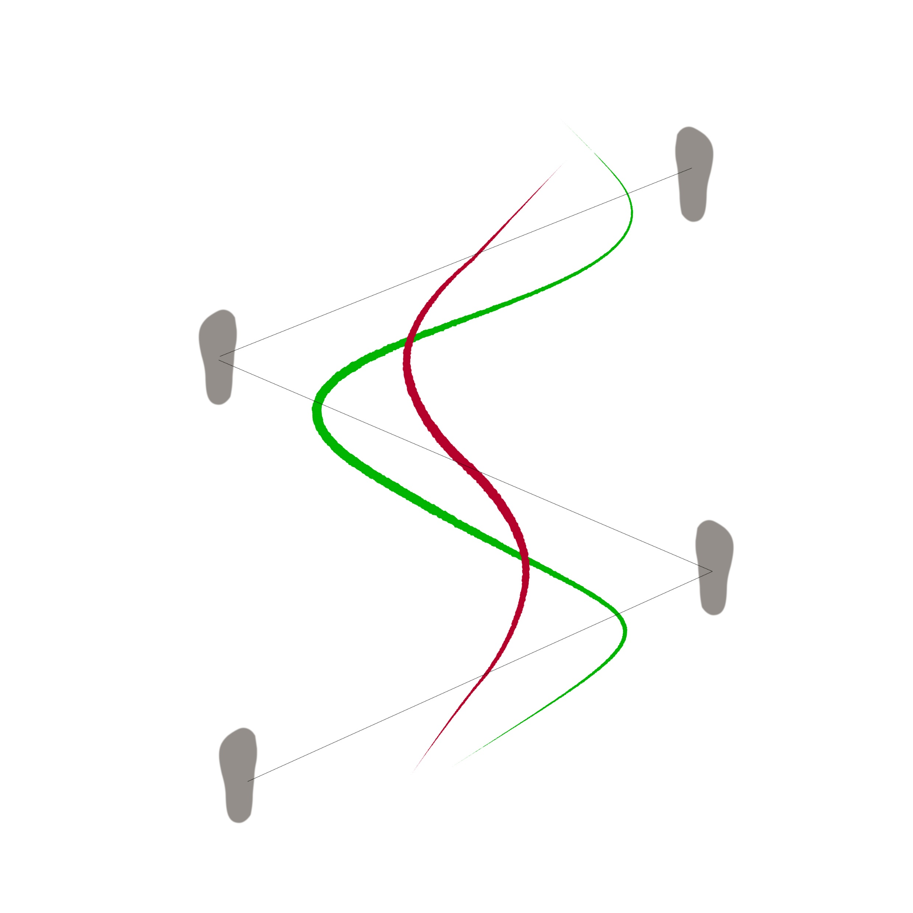
Lateral COM tracking
Green line: true COM trajectory
Red line: fake COM trajectory
Lateral Kalman Filter( Sliding Window)
Prediction Model: Movement with acceleration
Measurement Update: A lateral kinetic COM model
How to estimate lateral COM?
-estimate lateral COM by the relationship between two lines
Result of the model:
-averaged lateral COM: sliding window Kalman filter with last three states
-speed of averaged lateral COM
Notes:
Because we don’t know the offsets so we want to find a way to cancel the offsets.
Average two curves to two points and these two points can cancel out each other.
Don know the real curve so we choose the middle points of two lines and average A and B as a point which is C to represent the averaged COM

Slide 15
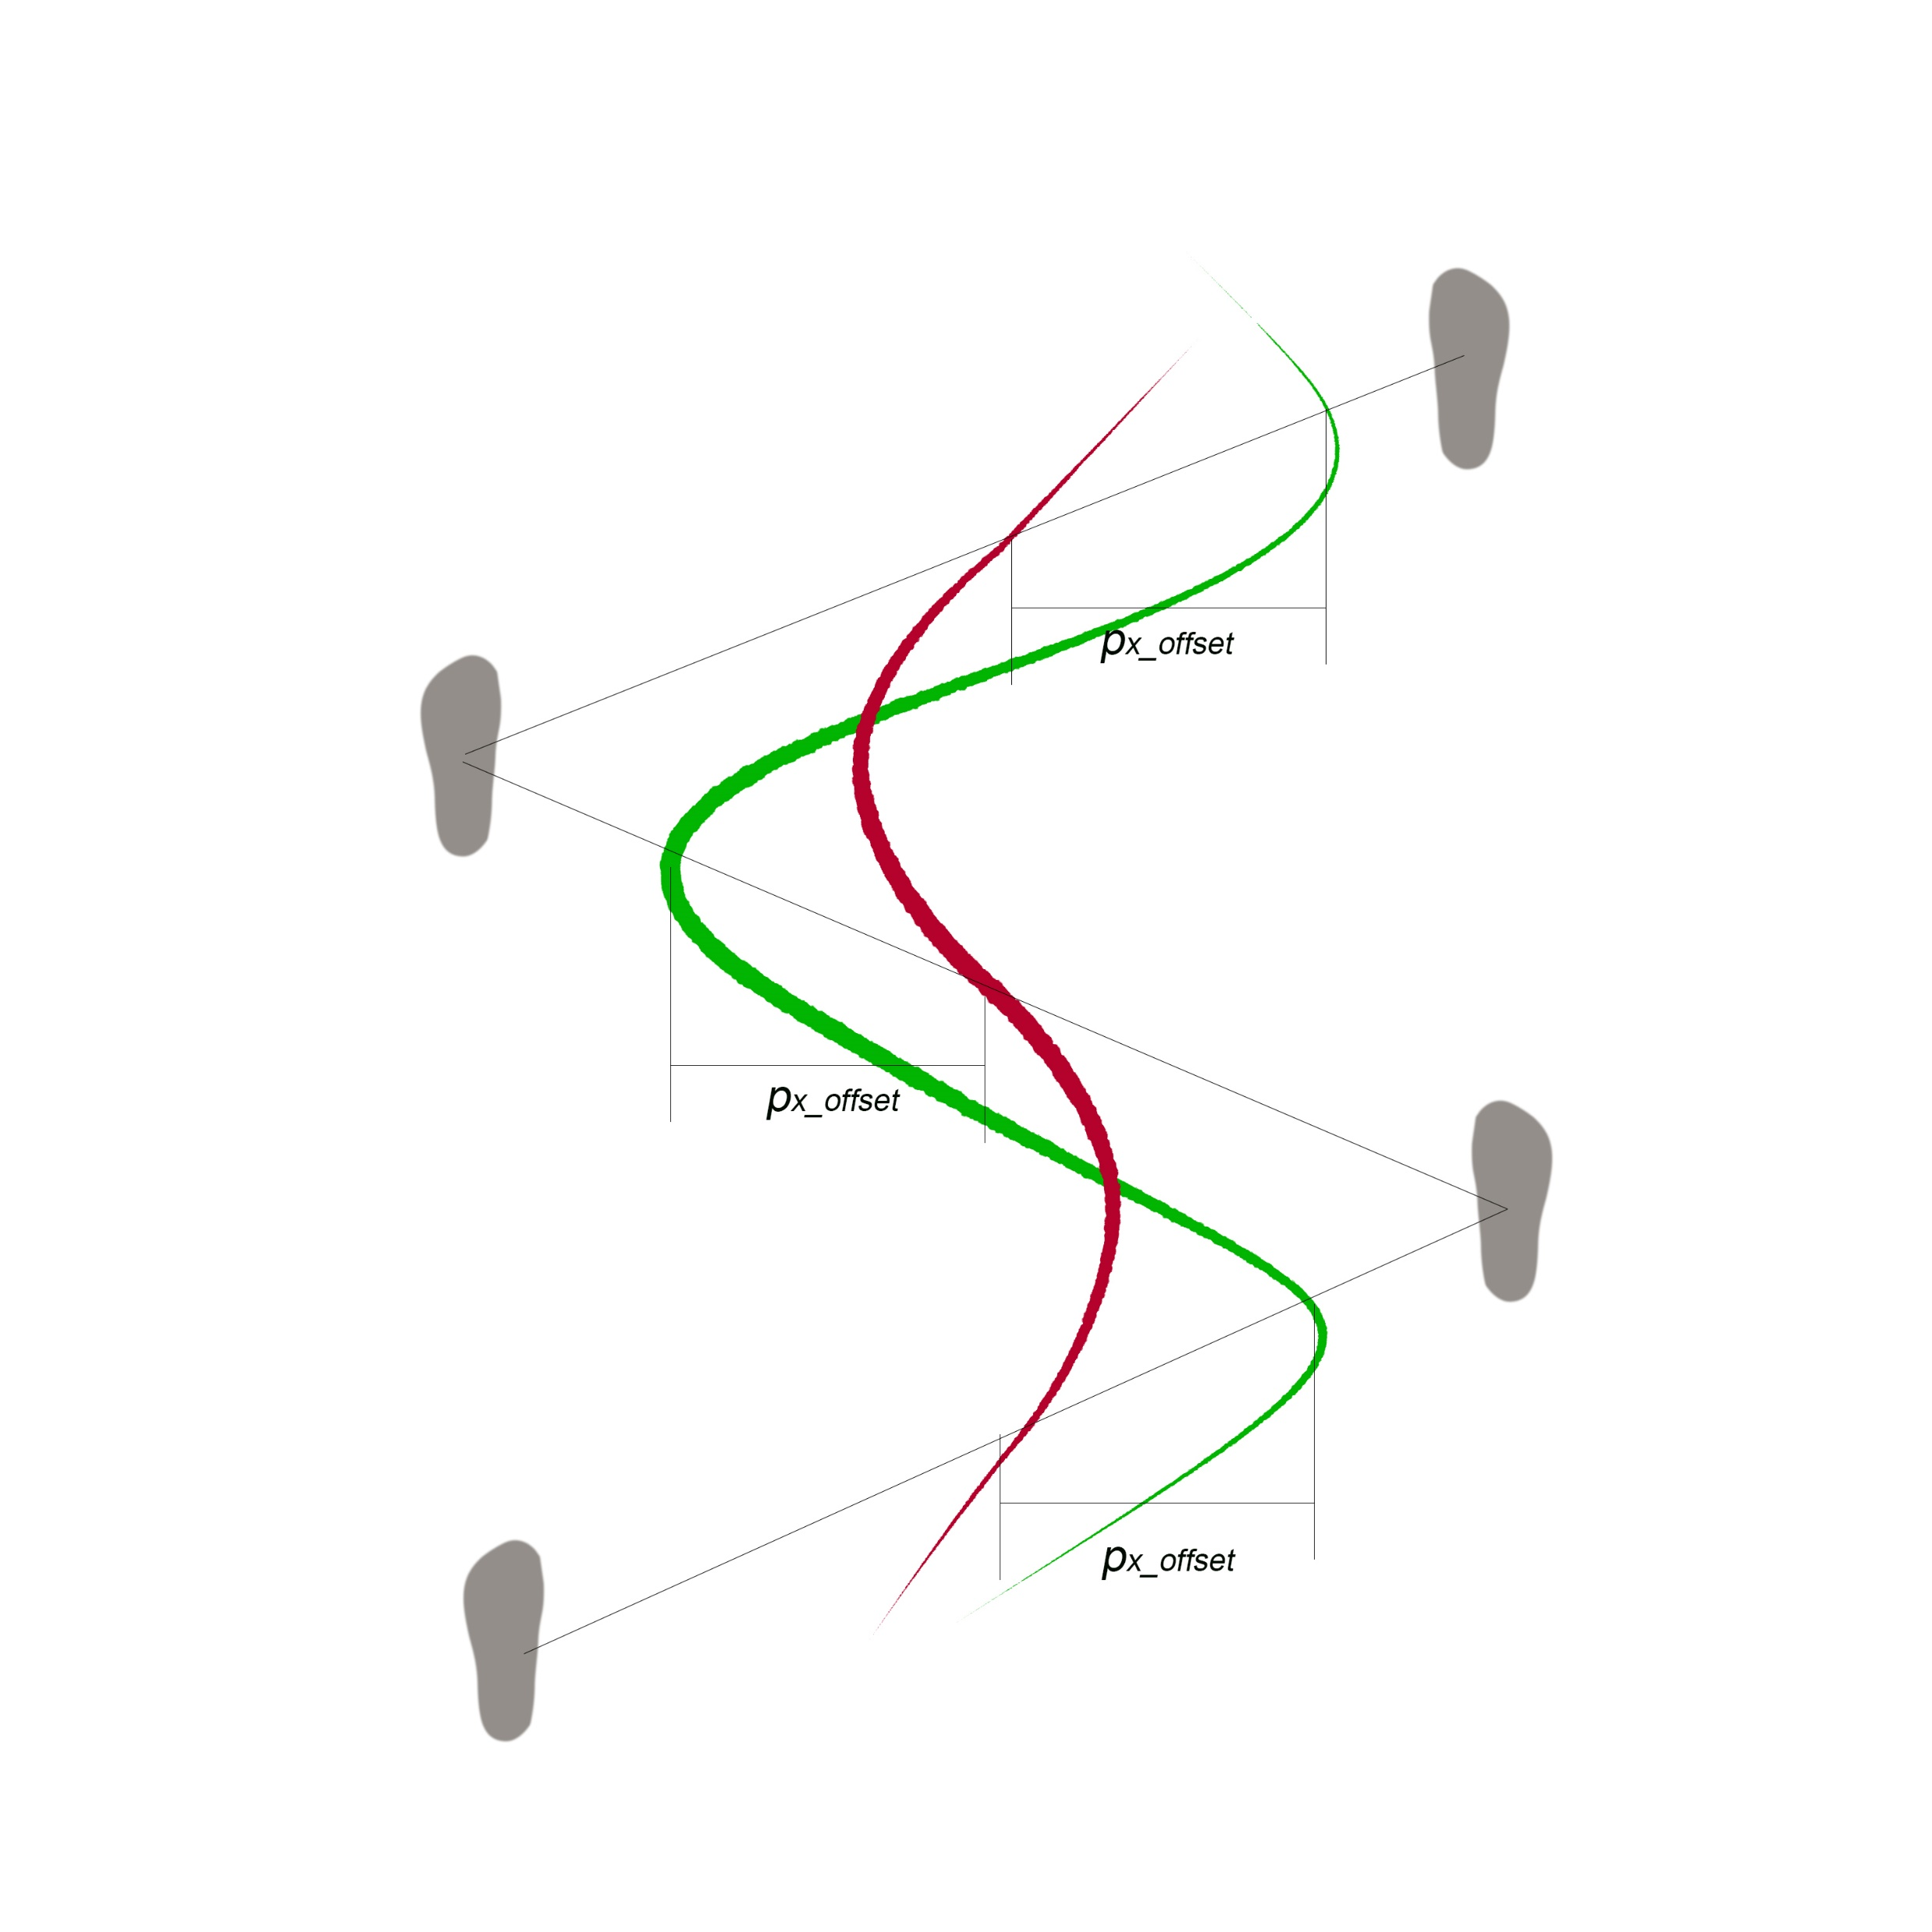
Lateral COM tracking
Lateral Kalman Filter( Sliding Window)
Details of the model:
-hypothesis
-the averaged COM of the true COM trajectory
-the relationship of the averaged COM between two lines
-geometry calculation of the averaged COM

Slide 16
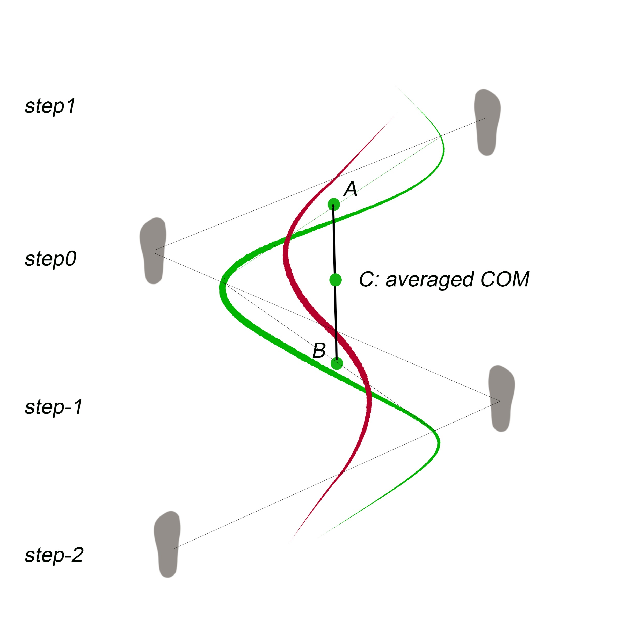
Lateral COM tracking
Details of the model:
-hypothesis
-the averaged COM of the true COM trajectory
-the relationship of the averaged COM between two lines
-geometry calculation of the averaged COM
Notes:
Because we don’t know the offsets so we want to find a way to cancel the offsets.
Average two curves to two points and these two points can cancel out each other.
Don know the real curve so we choose the middle points of two lines and average A and B as a point which is C to represent the averaged COM

Slide 17
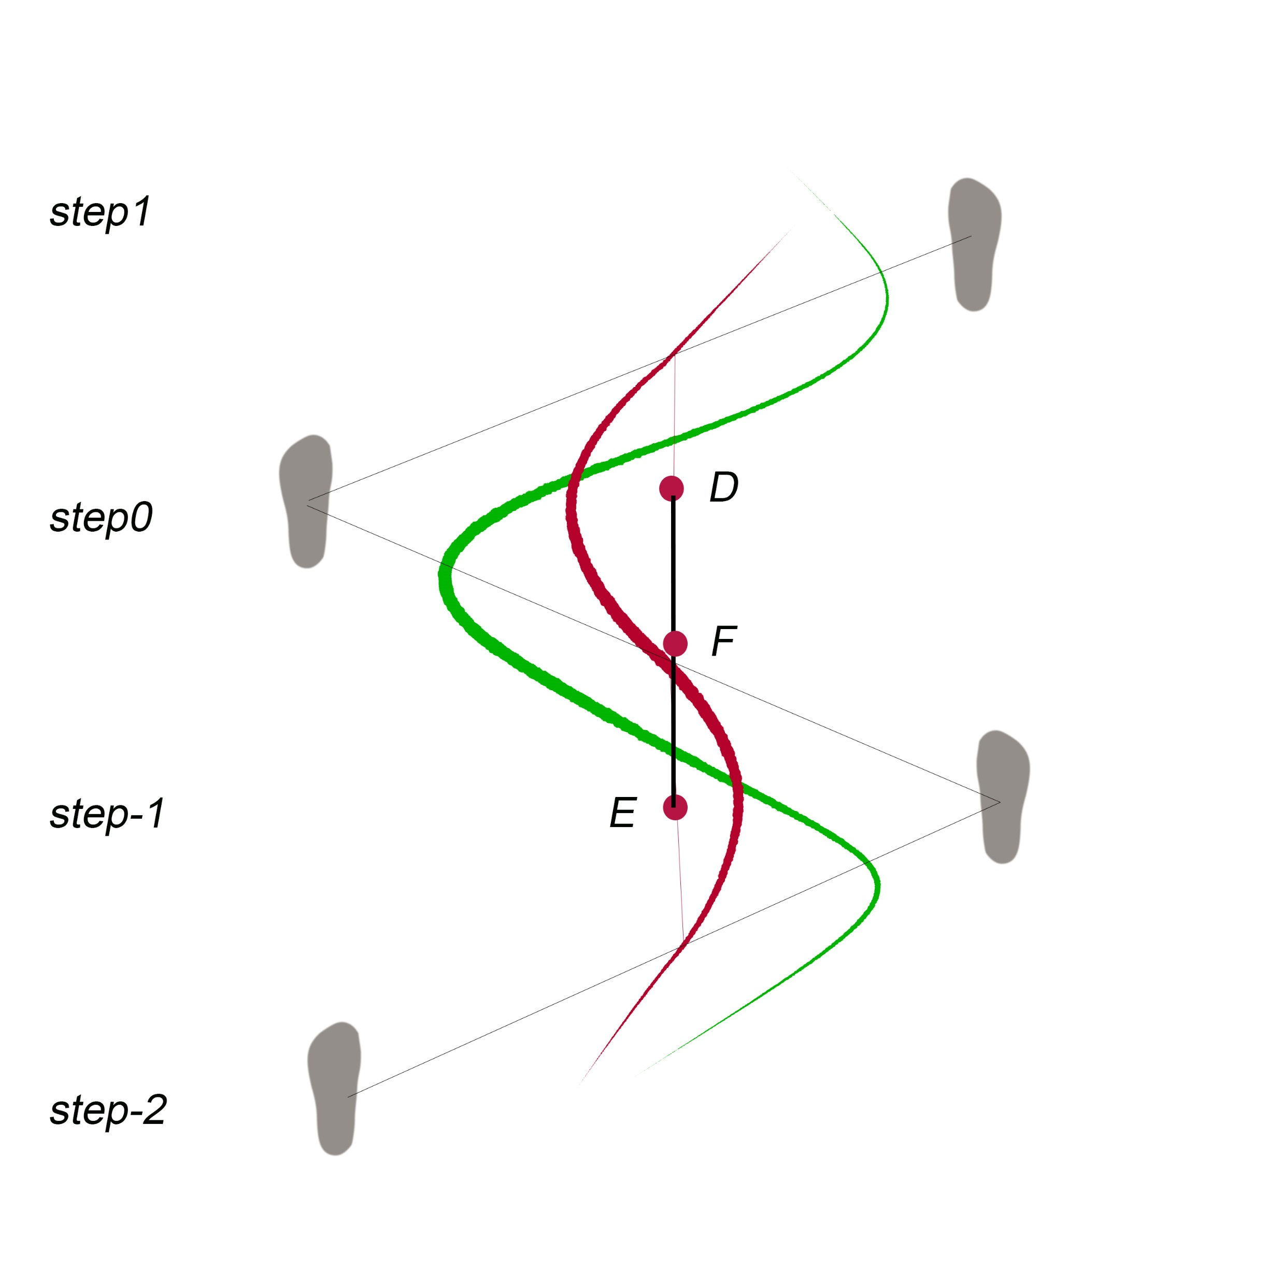
Lateral COM tracking
Details of the model:
-hypothesis
-the averaged COM of the true COM trajectory
-the relationship of the averaged COM between two lines
-geometry calculation of the averaged COM
Notes:
We only have the middle point of each step by cop calculation
Do the same thing to the fake COM trajectory
F and C is on the same vertical line which means the Lateral COM of F and C are the same

Slide 18
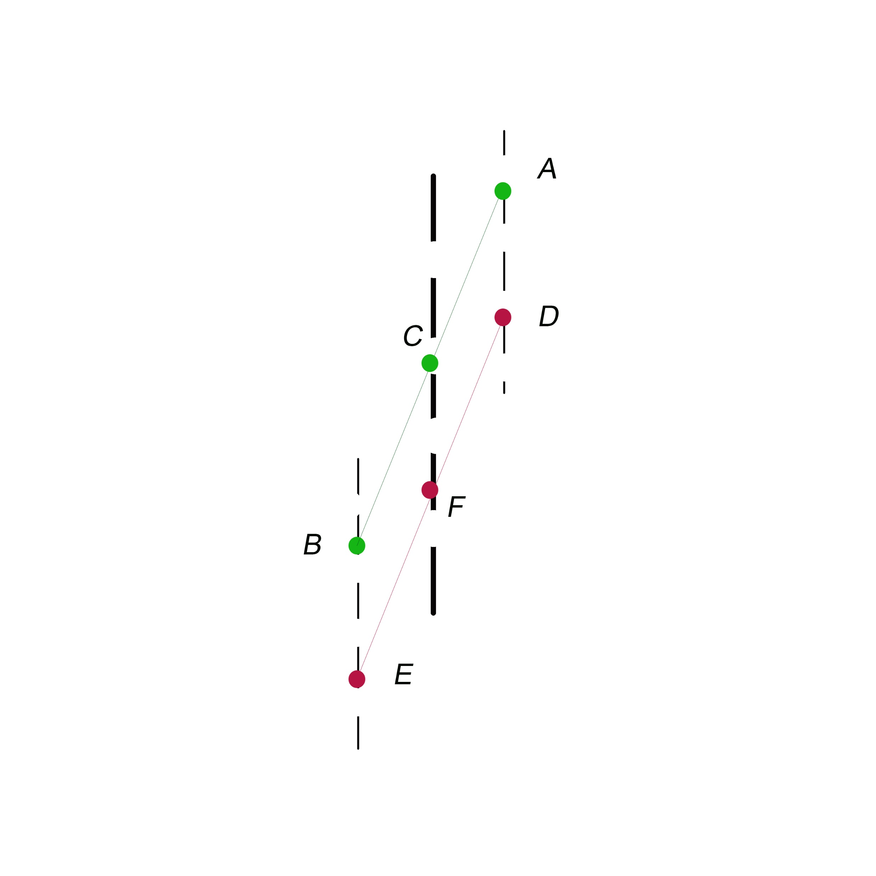
Lateral COM tracking
What conditions cause F and C are on the same vertical line?
-similar quadrilateral
ne
Notes:
What we have now:
C and F are the middle point. Suppose C and F are on a vertical line.
Based on similar triangle rules(, line AD and Line BE should be vertical lines.

Slide 19
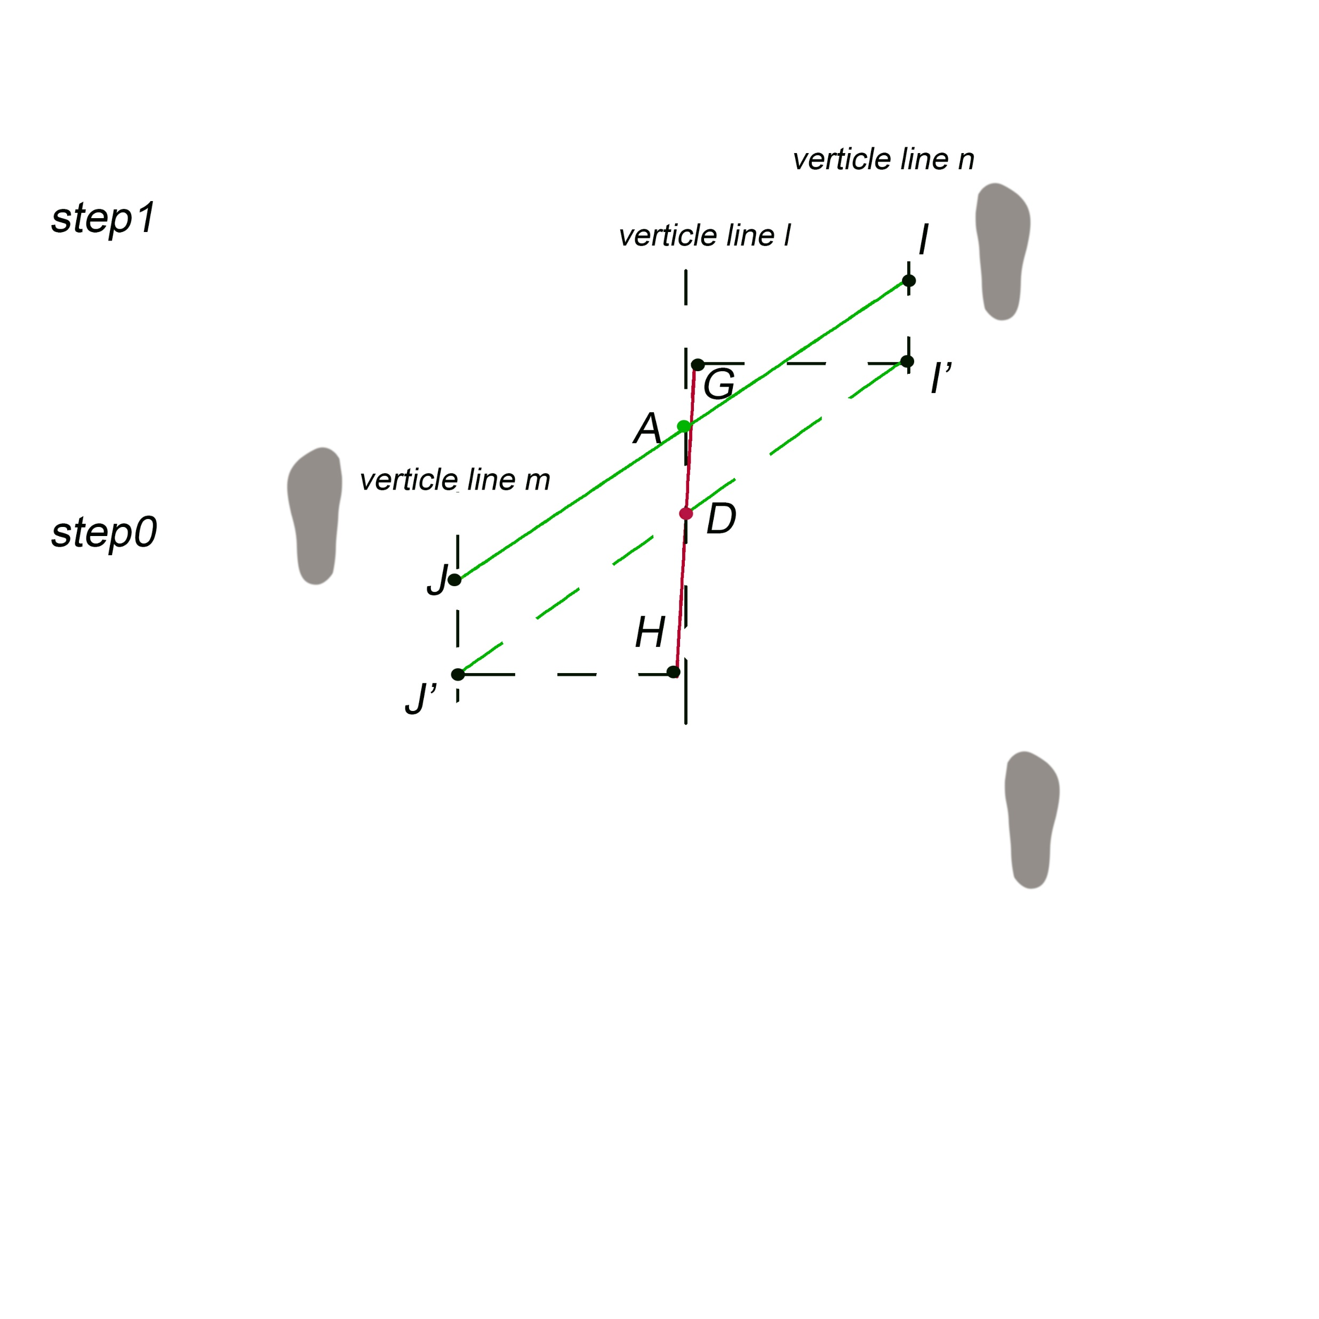
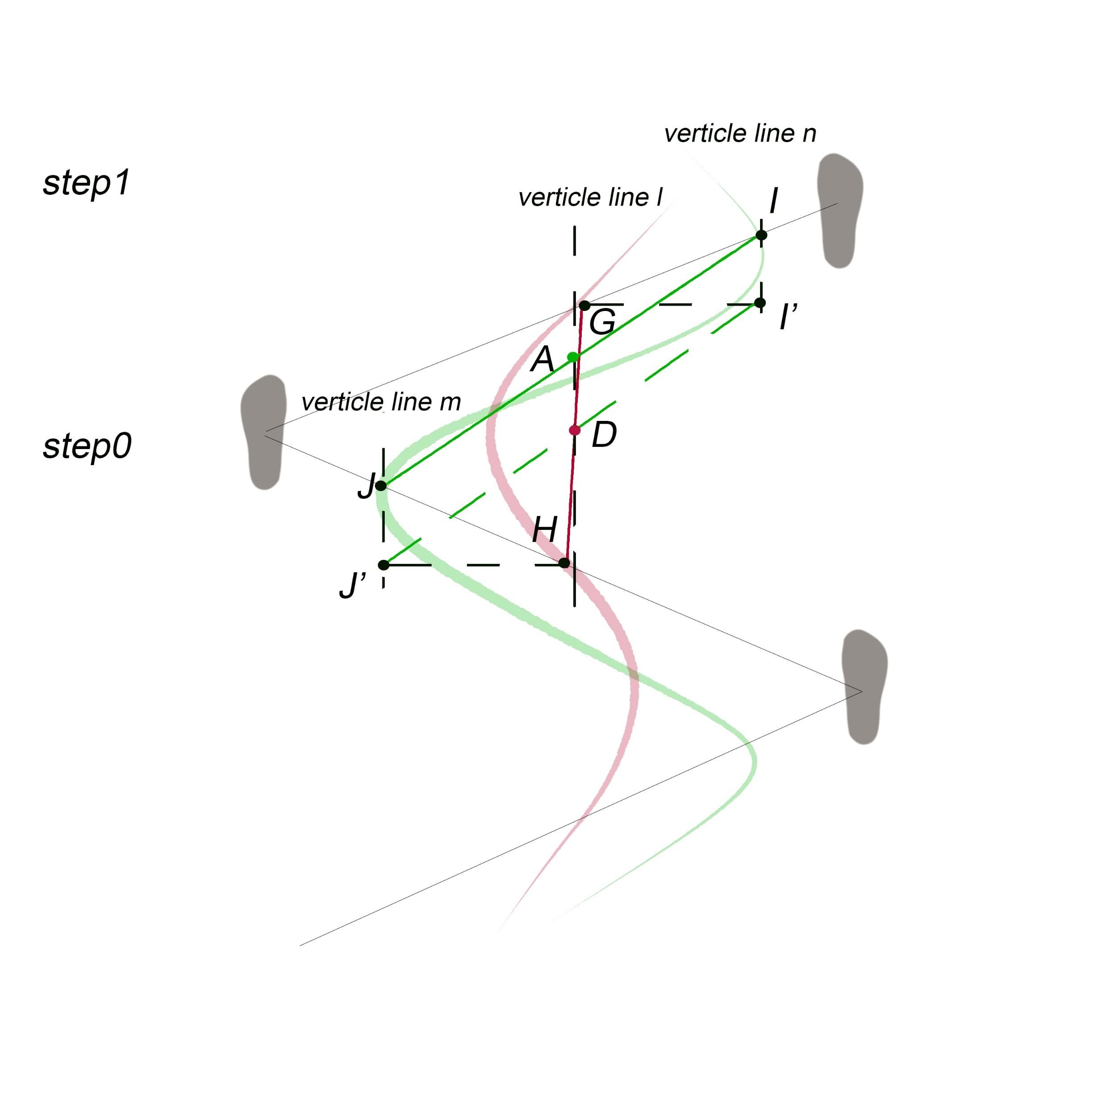
Lateral COM tracking
Notes:
Prove A and D are in the same vertical line
-G and H is the middle point of each step, I and J are the true COM with offset, Gi’=J’H because of the hypothesis, A and D are the middle point of IJ and GH
-triangle GDI’=DHJ’->D is the middle point of J’I’
-II’ is parallel to JJ’, based on similar quadrilateral rules, vertical line l is parallet to vertical line m. so AD are on the same vertical line.
Up to now, we know we can use the averaged com of the red line to replace the green line

Slide 20
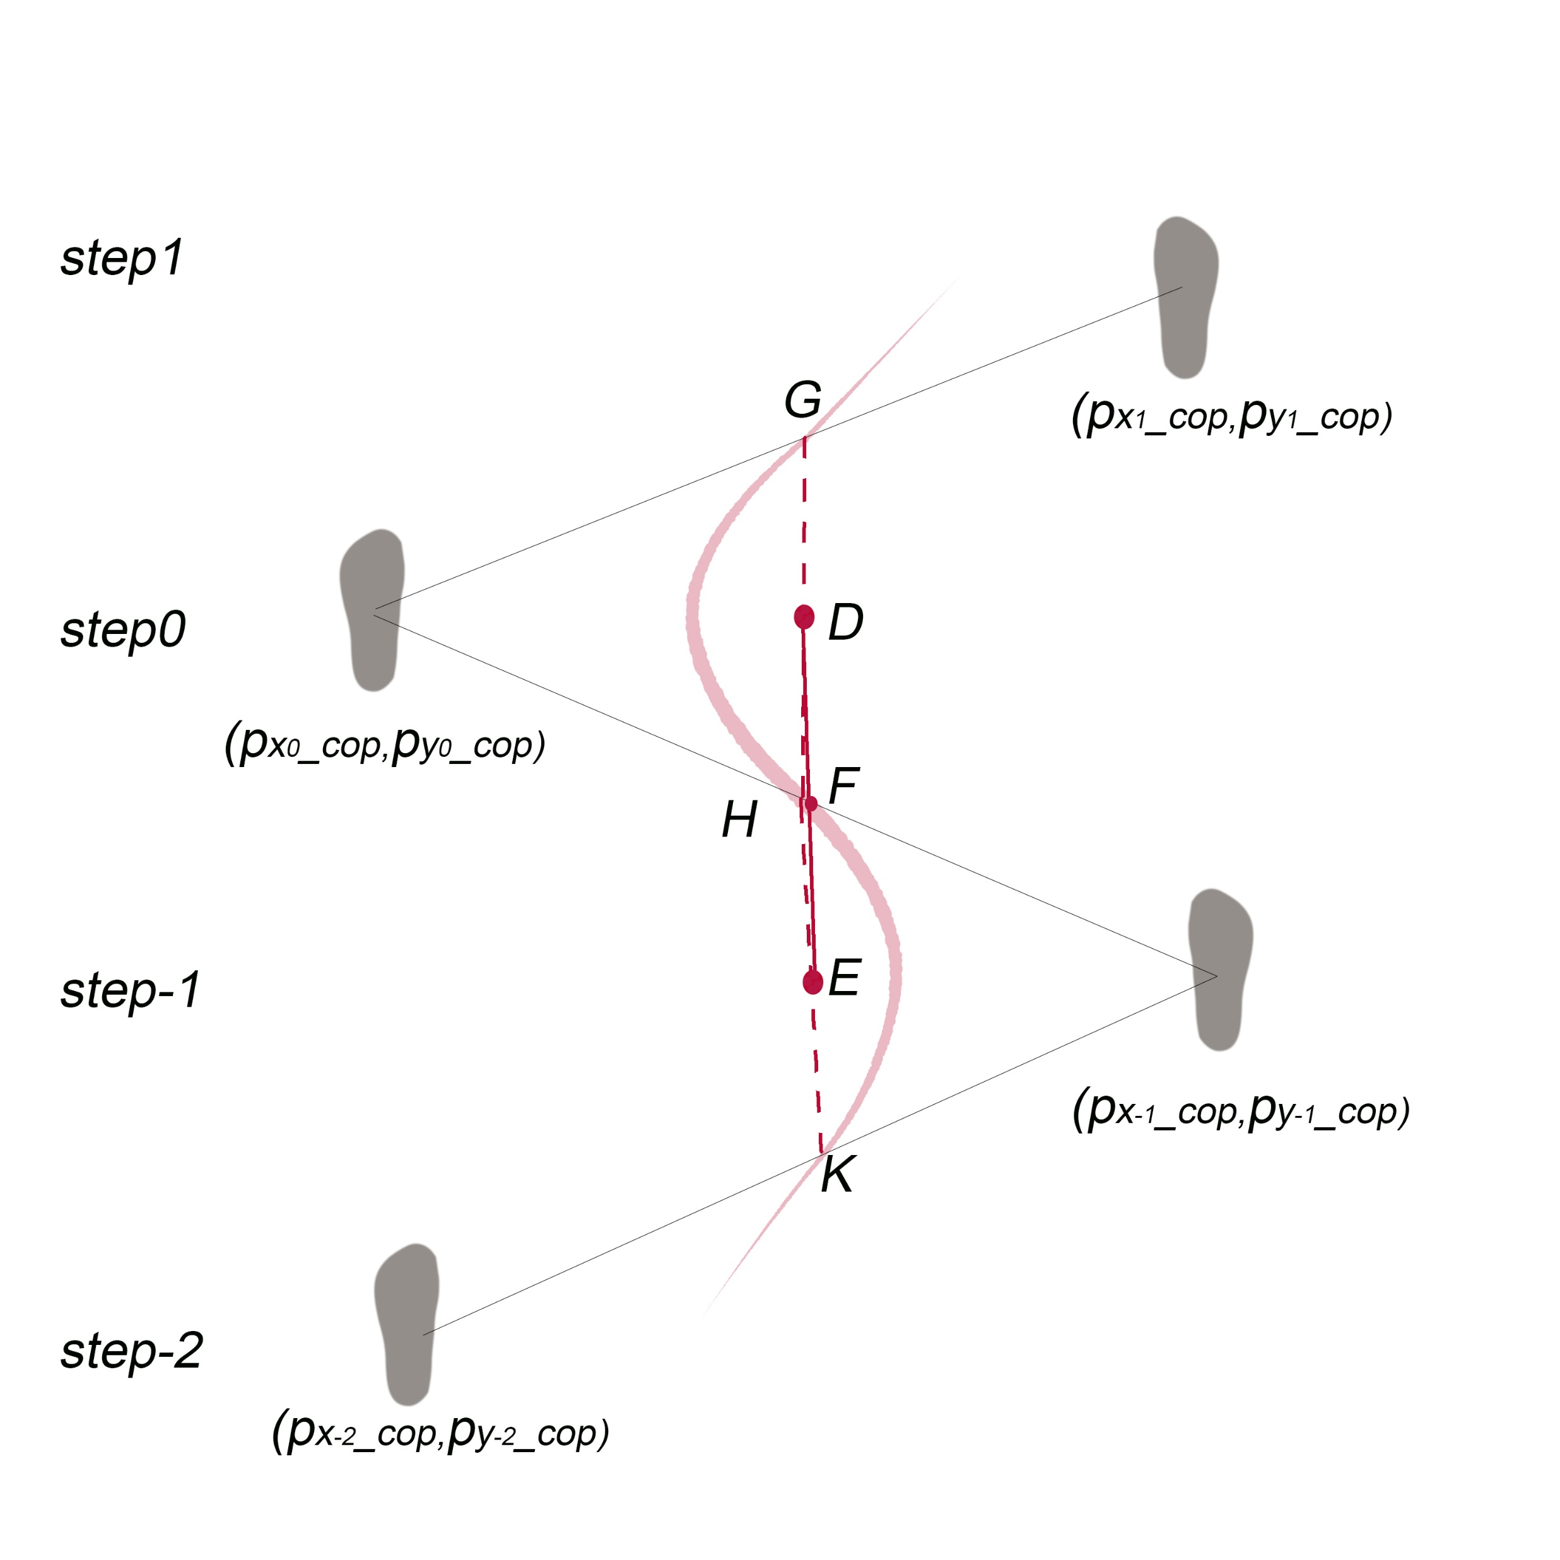

Lateral COM tracking
Details of the model:
-geometry calculation of the averaged COM
Notes:
7 mins(15)

Slide 21
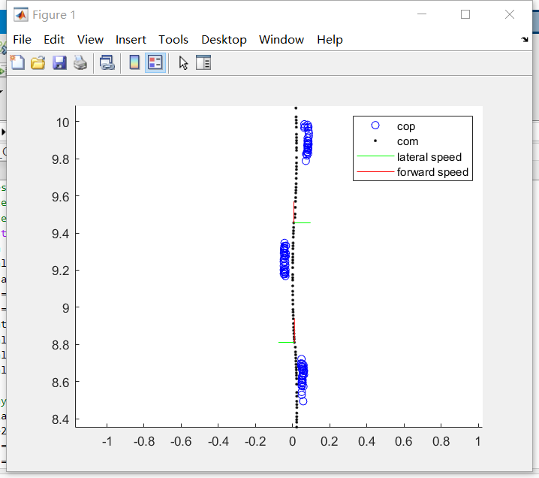
Lateral COM tracking

Slide 22

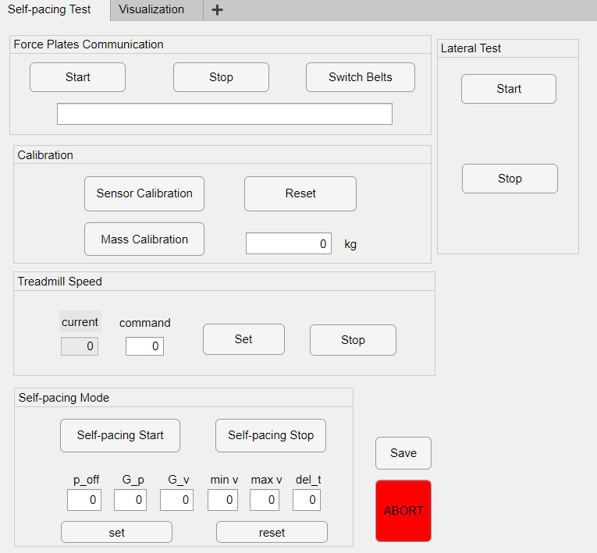
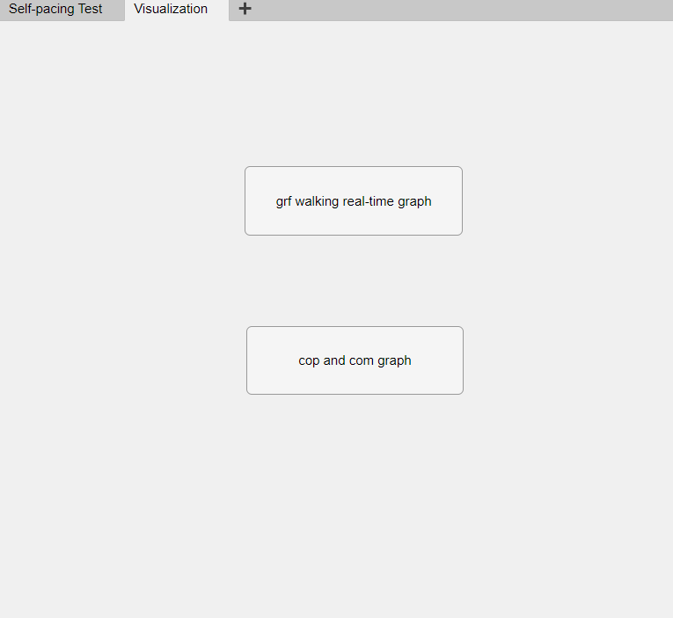
SPT App: GUI
MATLAB App Designer
Notes:
1 min(16)

Slide 23
Thanks

