Slide 1
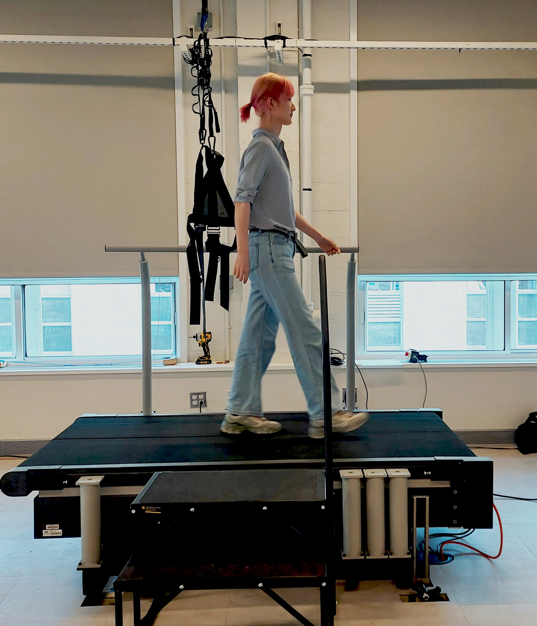
Project Report:
MATLAB App for instrumented treadmills: COM tracking and self-pacing control
#change this picture to treadmill pic
Student: Guangping Liu
Notes:
30

Slide 2
Outline
Motivation
SPT App for PC
Overview
Communication between treadmill and MATLAB
State Estimator
Speed Controller
Notes:
30 seconds

Slide 3
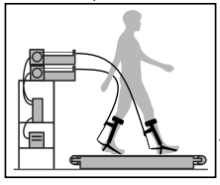
Motivation
Test assistive devices
Preferred walking speed
A self-pacing treadmill
Rehabilitation
Notes:
1 mins
A self-pacing treadmill
What is self-pacing tm
Why self-pacing treadmill:
Preferred walking speed
Rehabilitation:gait analysis of
Test assistive devices

Slide 4
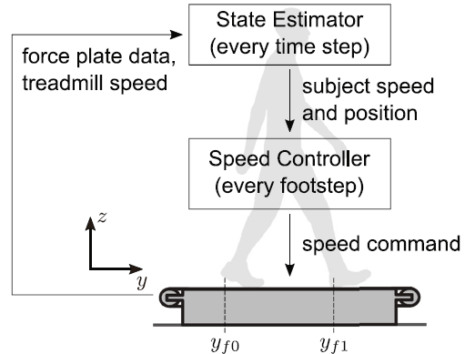
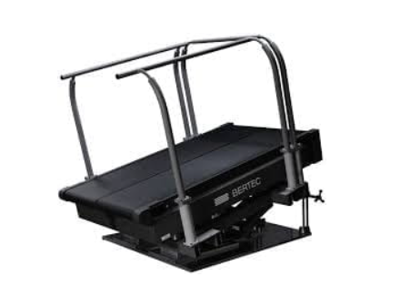
SPT App: Overview
Notes:
How self-pacing tm works?

Slide 5
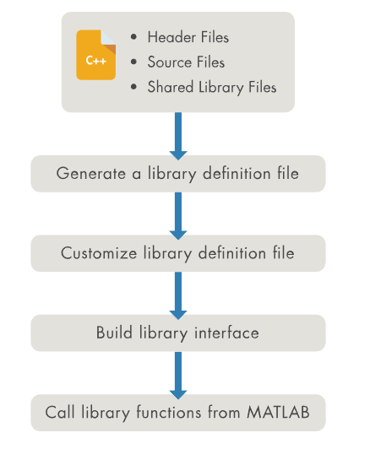

SPT App: communication
How do we do it?
mex function: source file
adaptor/ Call C from Matlab:That is the
Function for C
Call C++ from Matlab
Live Code definition file
Generate Interface
Communication
Data stream
Remaining Problems
Some functions doesn’t work
Break down
Notes:
How can MATLAB communicate to treadmill:
SDK
Mex function: don’t have source file
Call C from matlab: this is for c
Call C++ from matlab: compile functions in matlab and call the compiled functions when communicating
Problem: crashes occasionally; cannot access the second device in MATLAB(check again); serial number

Slide 6
SPT App: State estimator
Kalman Filter for Com speeds and positions
Target:
Input: accelerations from ground reaction force(fy), measurements, observation
Output: com positions(p), com speeds(v)
Notes:
1 min(4)
Clarify why do we need Kalman filter:
-state estimator: com positions and speeds to speed controller
-input is the grf, measurements
-out put

Slide 7





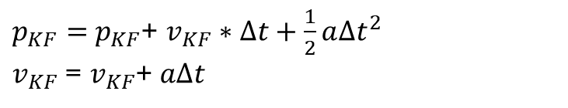
SPT App: State estimator
Kalman Filter for Com speeds and positions
Time Update(Prediction):
Measurement Update:
Notes:
1 min(5)
What is Kalman filter
-a linear optimal estimator to estimate states and update by measurements with noisy.
-two parts:
Prediction: model is the motion with an acceleration
Measurement: equations
How to get measurement:
-we cannot get it directly
-calculate

Slide 8
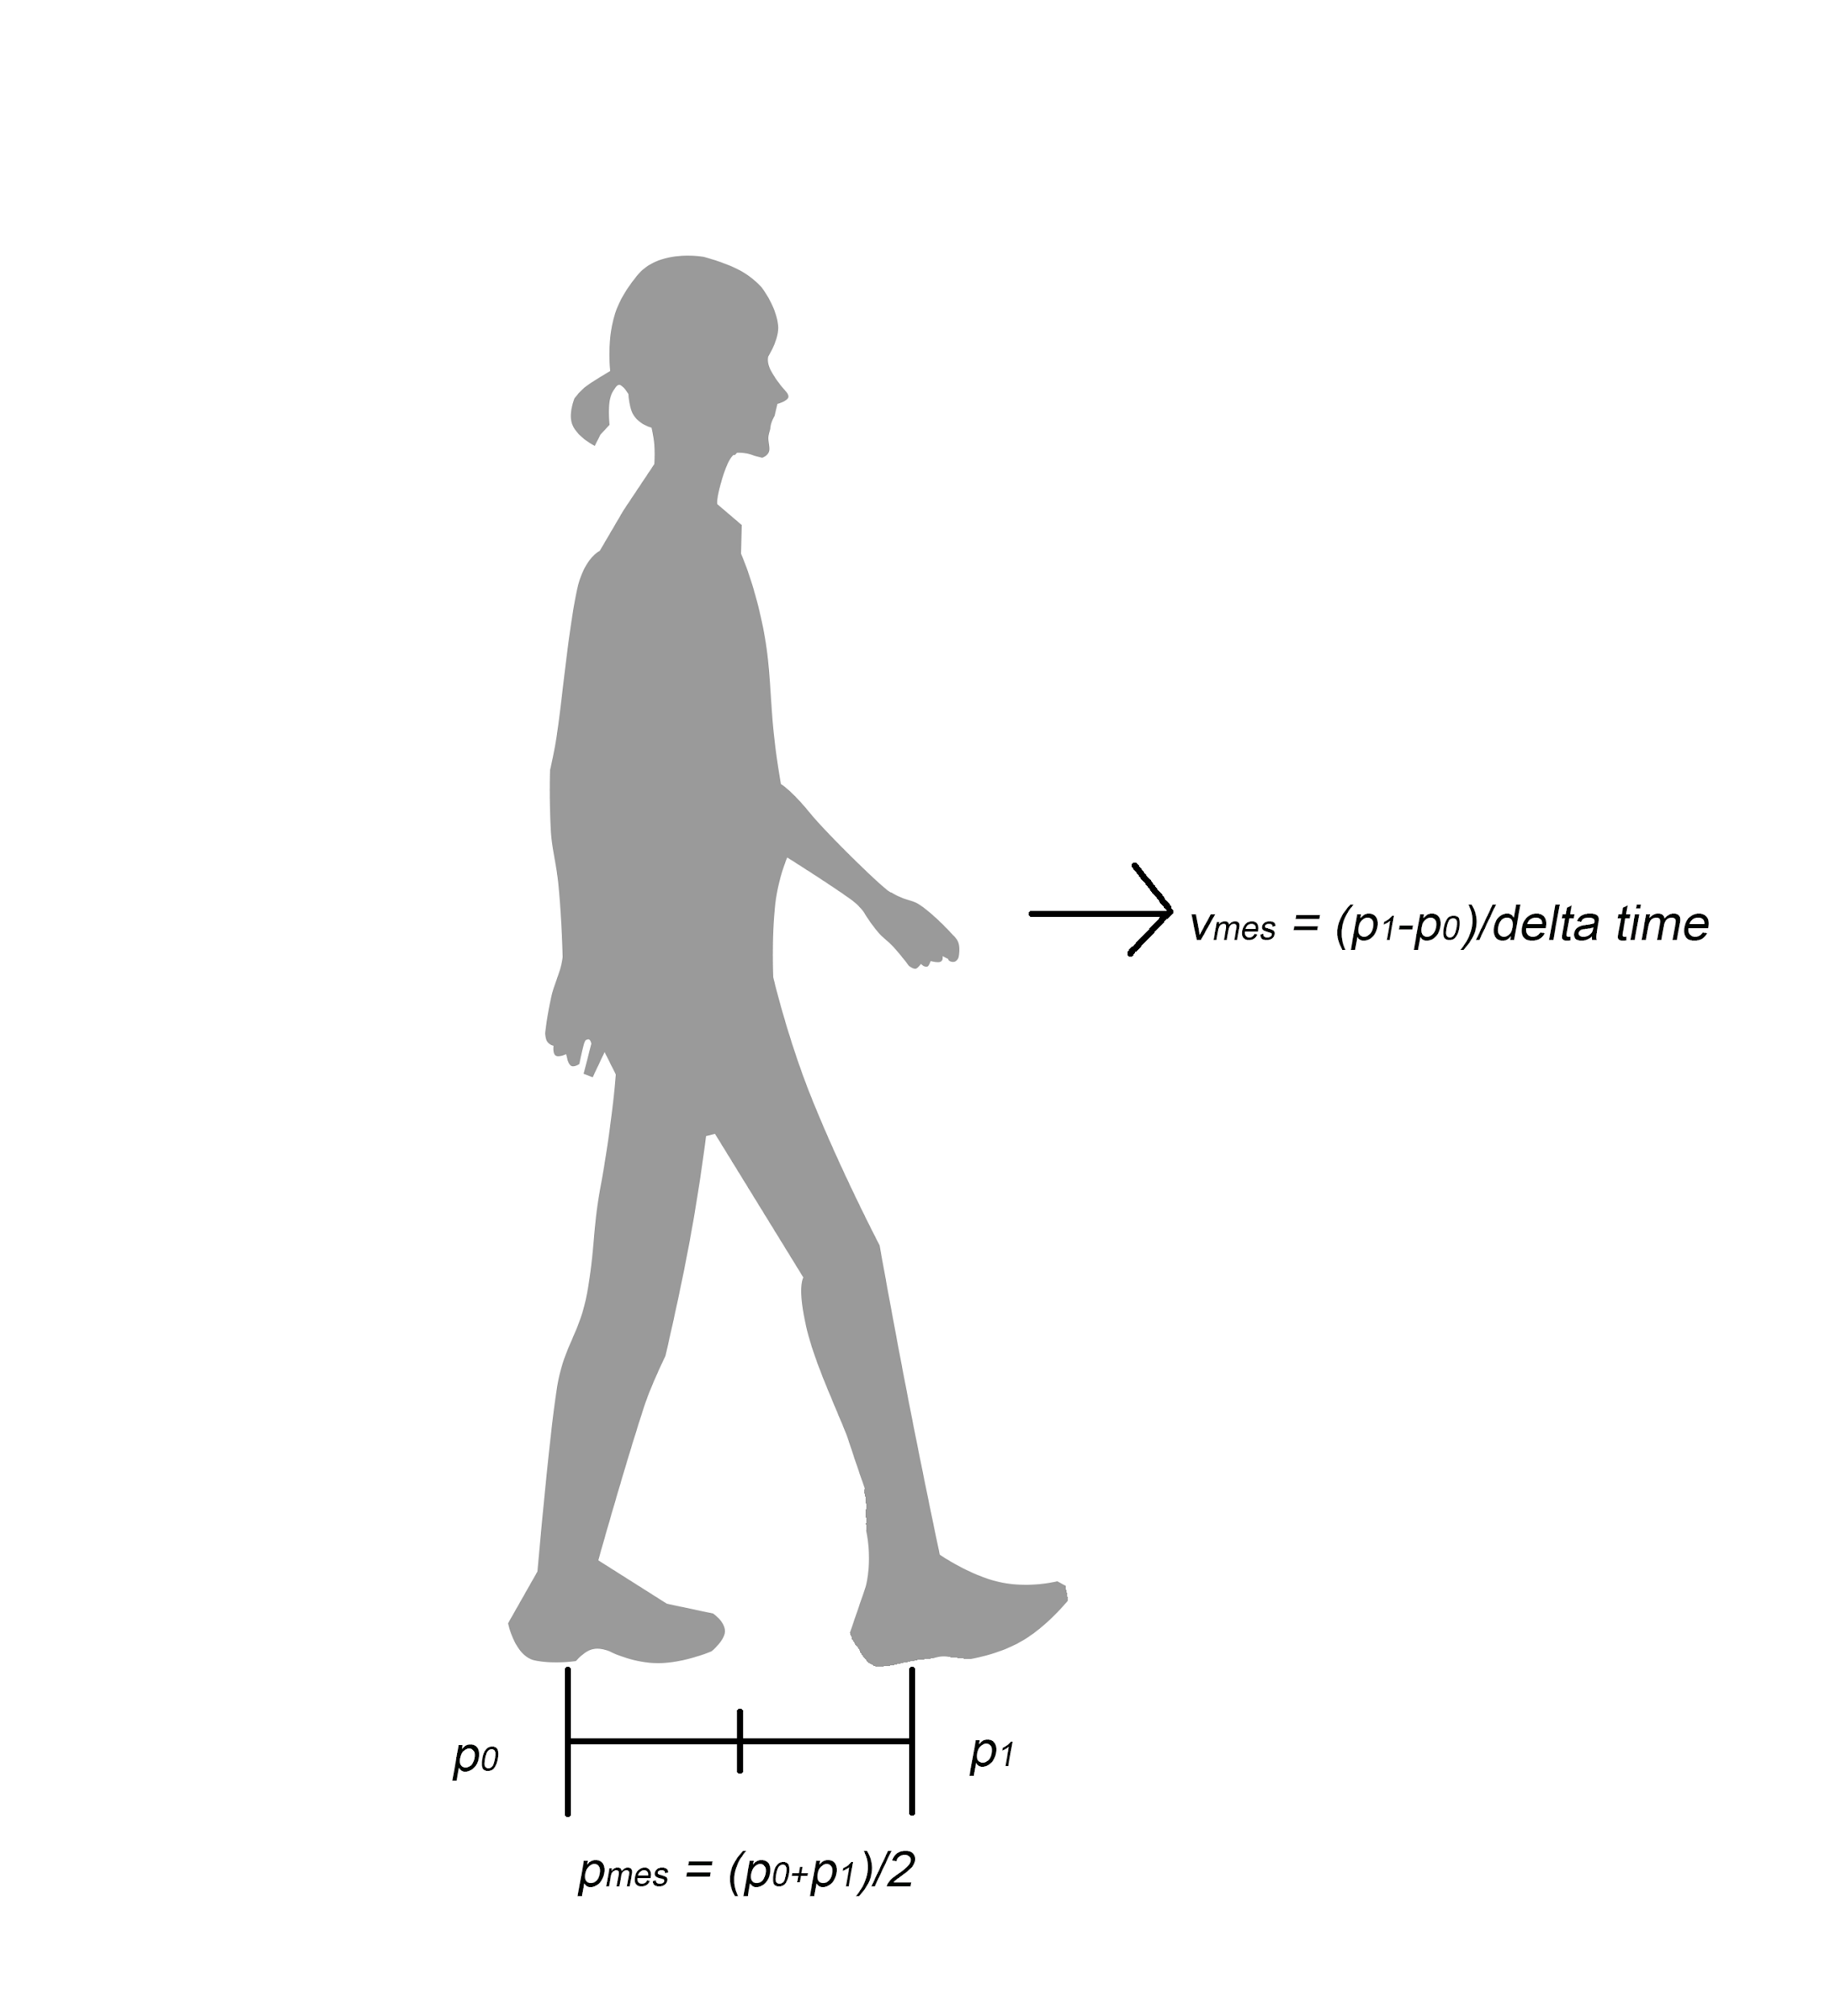
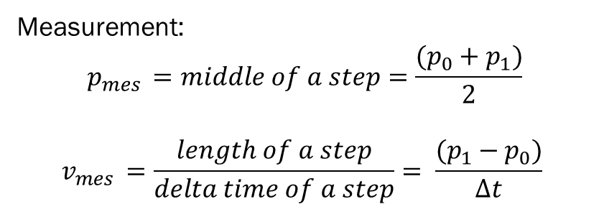
SPT App: State estimator
Observation model for forward Com speeds and positions
Notes:
Forward kf observation model
What is p? what is v?

Slide 9
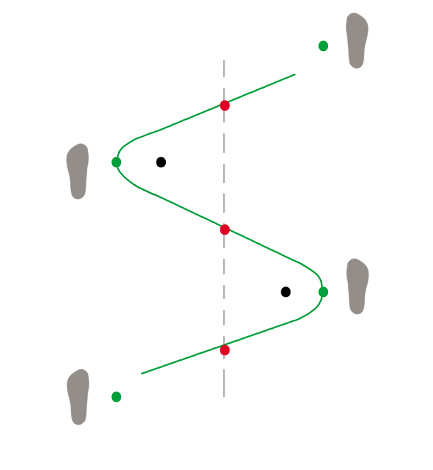
SPT App: State estimator
Observation model for lateral Com speeds and positions
Red points: the middle point of each step
Grean points: the max shift of lateral COM
Black points: the averaged point of each stride
Notes:
Lateral kf observation model:
Introduce points, the line and foot steps
Why do we use the average of a stride?
Midpoint, is not the original point, the average of the right step is in the right of the middle point, the left step is in the left of the middle point. So averaging this two points we means we have to use a stride

Slide 10
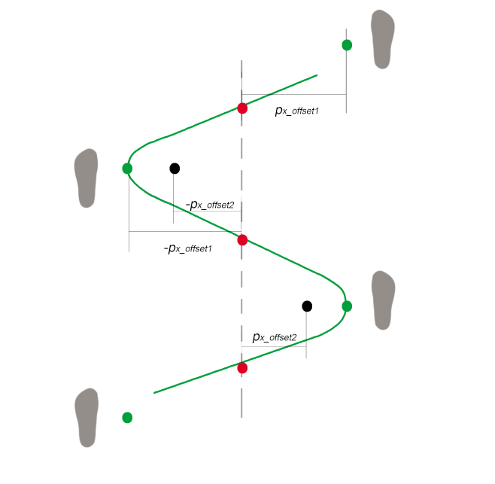


SPT App: State estimator
Observation model for lateral Com speeds and positions
A lateral kinetic COM model(estimate the COM in two strides)
-hypothesis:
$$\left|p_{x_{offset2}}\right|=a unique constant$$
Use two strides to cancel out the offset
$$\left|p_{x_{offset1}}\right|=a unique constant$$
Suppose the max shift of lateral COM in each stride is the same
Notes:
Introduce assumptions:
Why do we use the average of a stride?
Midpoint, is not the original point, the average of the right step is in the right of the middle point, the left step is in the left of the middle point. So averaging this two points we means we have to use a stride
Because we don’t know the offsets so we want to find a way to cancel the offsets.
Average two curves to two points and these two points can cancel out each other.
Don know the real curve so we choose the middle points of two lines and average A and B as a point which is C to represent the averaged COM
How to estimate lateral COM?
-estimate lateral COM by the relationship between two lines
Result of the model:
-averaged lateral COM: sliding window Kalman filter with last three states
-speed of averaged lateral COM

Slide 11
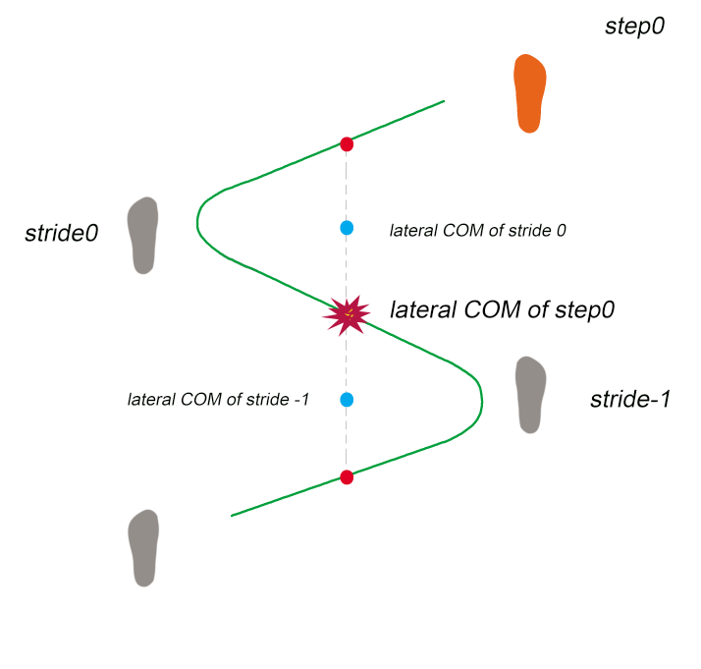
SPT App: State estimator
Target: estimate lateral COM of orange step(step 0)
Method:
$$the lateral com of the step0=$$
$$the midpoint of \left(the com in {stride}_{0} and {stride}_{−1}\right)$$
Notes:
Why do we use the average of a stride?
Midpoint, is not the original point, the average of the right step is in the right of the middle point, the left step is in the left of the middle point. So averaging this two points we means we have to use a stride
Because we don’t know the offsets so we want to find a way to cancel the offsets.
Average two curves to two points and these two points can cancel out each other.
Don know the real curve so we choose the middle points of two lines and average A and B as a point which is C to represent the averaged COM
How to estimate lateral COM?
-estimate lateral COM by the relationship between two lines
Result of the model:
-averaged lateral COM: sliding window Kalman filter with last three states
-speed of averaged lateral COM

Slide 12
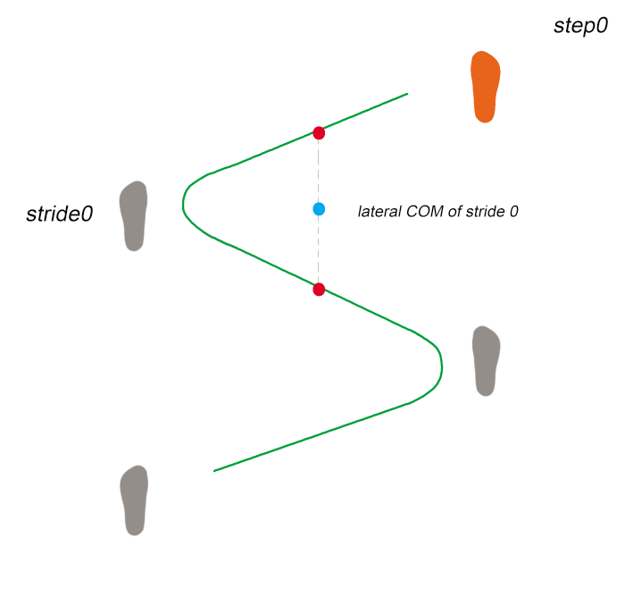
SPT App: State estimator
$$the lateral com of the stride0=the midpoint of the middle points of two steps in stride0$$
Notes:
Why do we use the average of a stride?
Midpoint, is not the original point, the average of the right step is in the right of the middle point, the left step is in the left of the middle point. So averaging this two points we means we have to use a stride
Because we don’t know the offsets so we want to find a way to cancel the offsets.
Average two curves to two points and these two points can cancel out each other.
Don know the real curve so we choose the middle points of two lines and average A and B as a point which is C to represent the averaged COM
How to estimate lateral COM?
-estimate lateral COM by the relationship between two lines
Result of the model:
-averaged lateral COM: sliding window Kalman filter with last three states
-speed of averaged lateral COM

Slide 13
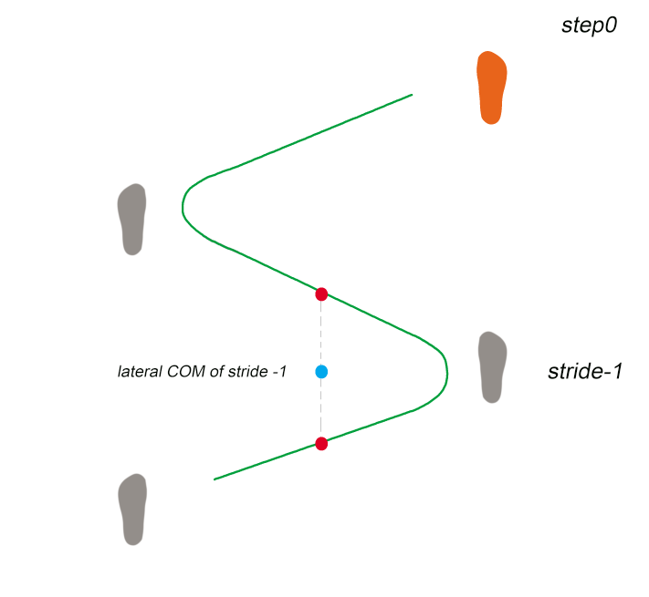
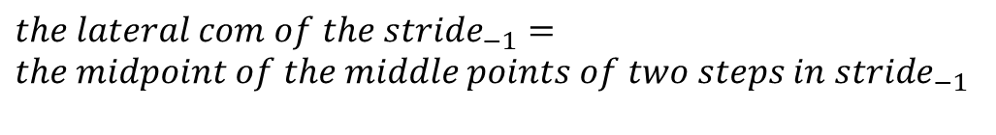
SPT App: State estimator
$the lateral com of the {stride}_{−1}=the midpoint of the middle points of two steps in {stride}_{−1}$

Slide 14
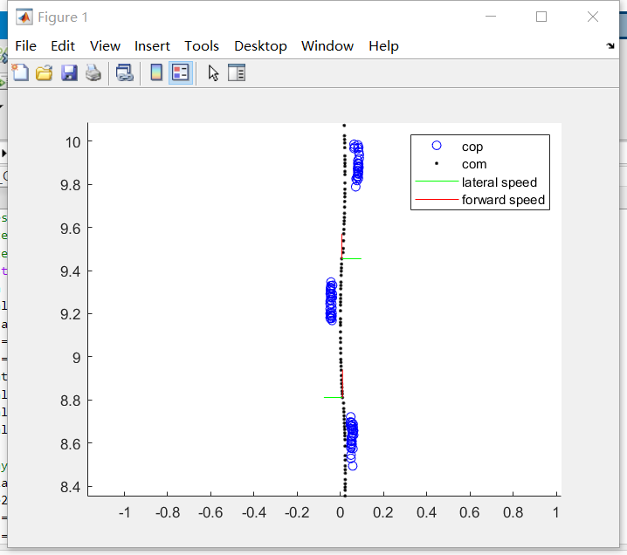
SPT App: State estimator

Slide 15
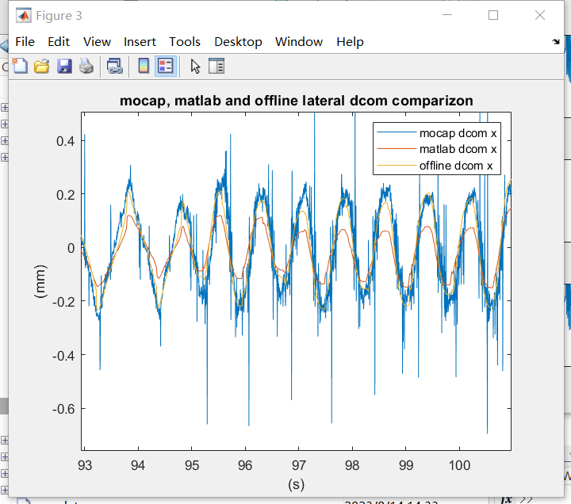
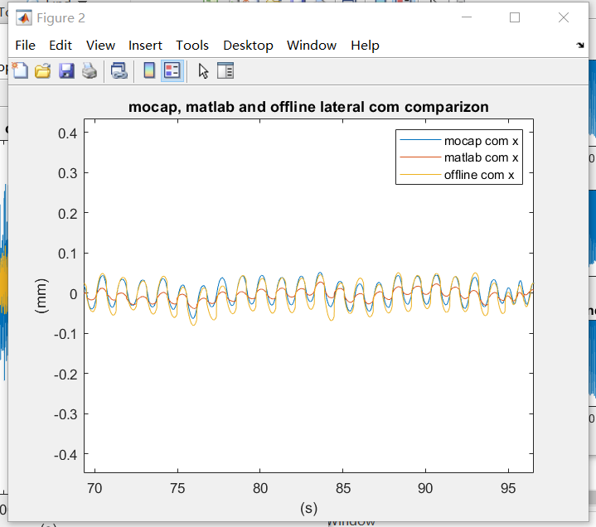
SPT App: State estimator

Slide 16
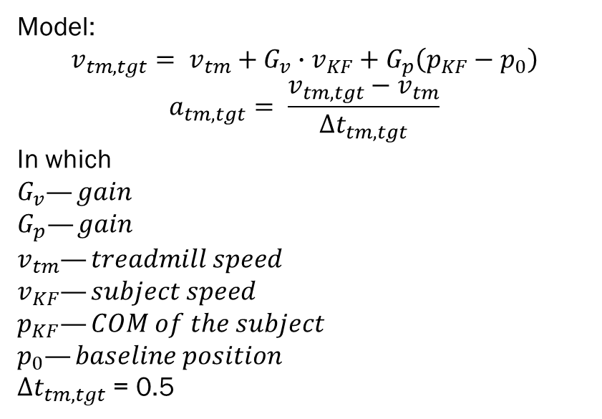
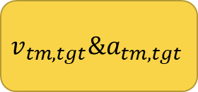

SPT App: Speed Controller
Treadmill speed
$$p_{KF}\&v_{KF}$$
Kalman filter
Speed Controller
Speed Controller
$$v_{tm,tgt}\&a_{tm,tgt}$$
Notes:
1min(7)
input
output
the way to keep subject walking in the middle of the treadmill is: set two gains. If walk faster, give a larger target velocity; if walk on the front part of the treadmill, larger velocity.
change gains to control how fast the treadmill goes to the subjects velocity
gp=0.1
gv=0.25

Slide 17
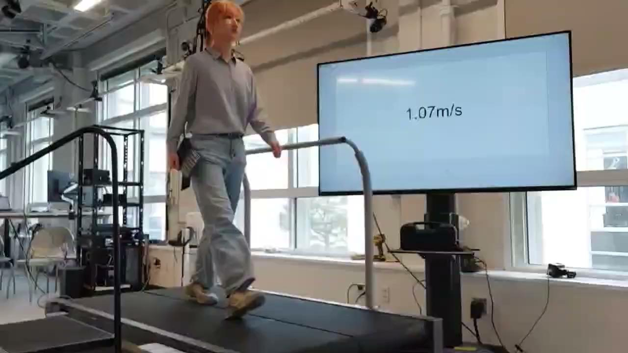
SPT App
Notes:
1min(8)

Slide 18
Thanks

