Slide 1
UPDATE SPI
DD, 6/8/2020

Slide 2
Brief explanation
Start with the file hes_adc_4e1_example_init
Just execute the file in MATLAB and everything should work, it is self-contained
It contains a worked-out example of a draft ES/T3 setup
We basically work with only two functions:
get_spi_ctrlWords: to read data from the SPI (either from MATLAB or from on-chip)
set_spi_ctrlWords: to set data in the SPI (either in MATLAB or on-chip)
To print the full SPI on the command line:
print_full_spi: print SPI (either from MATLAB or from on-chip) on the command line

Slide 3
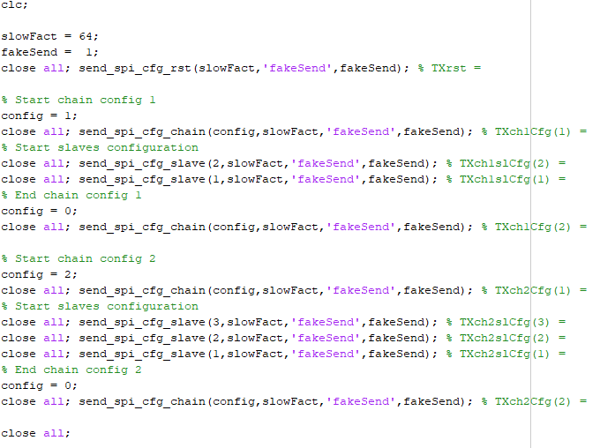
SPI init phase
reset and config
This part is the initialization phase
SPI reset
ES chain and slaves config
T3 chain and slaves config
hes_adc_4e1_example_init (rows 1-29):
reset
ES
T3

Slide 4
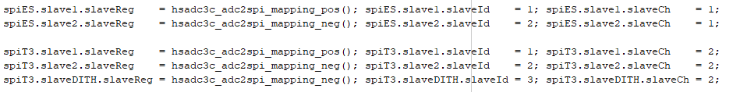
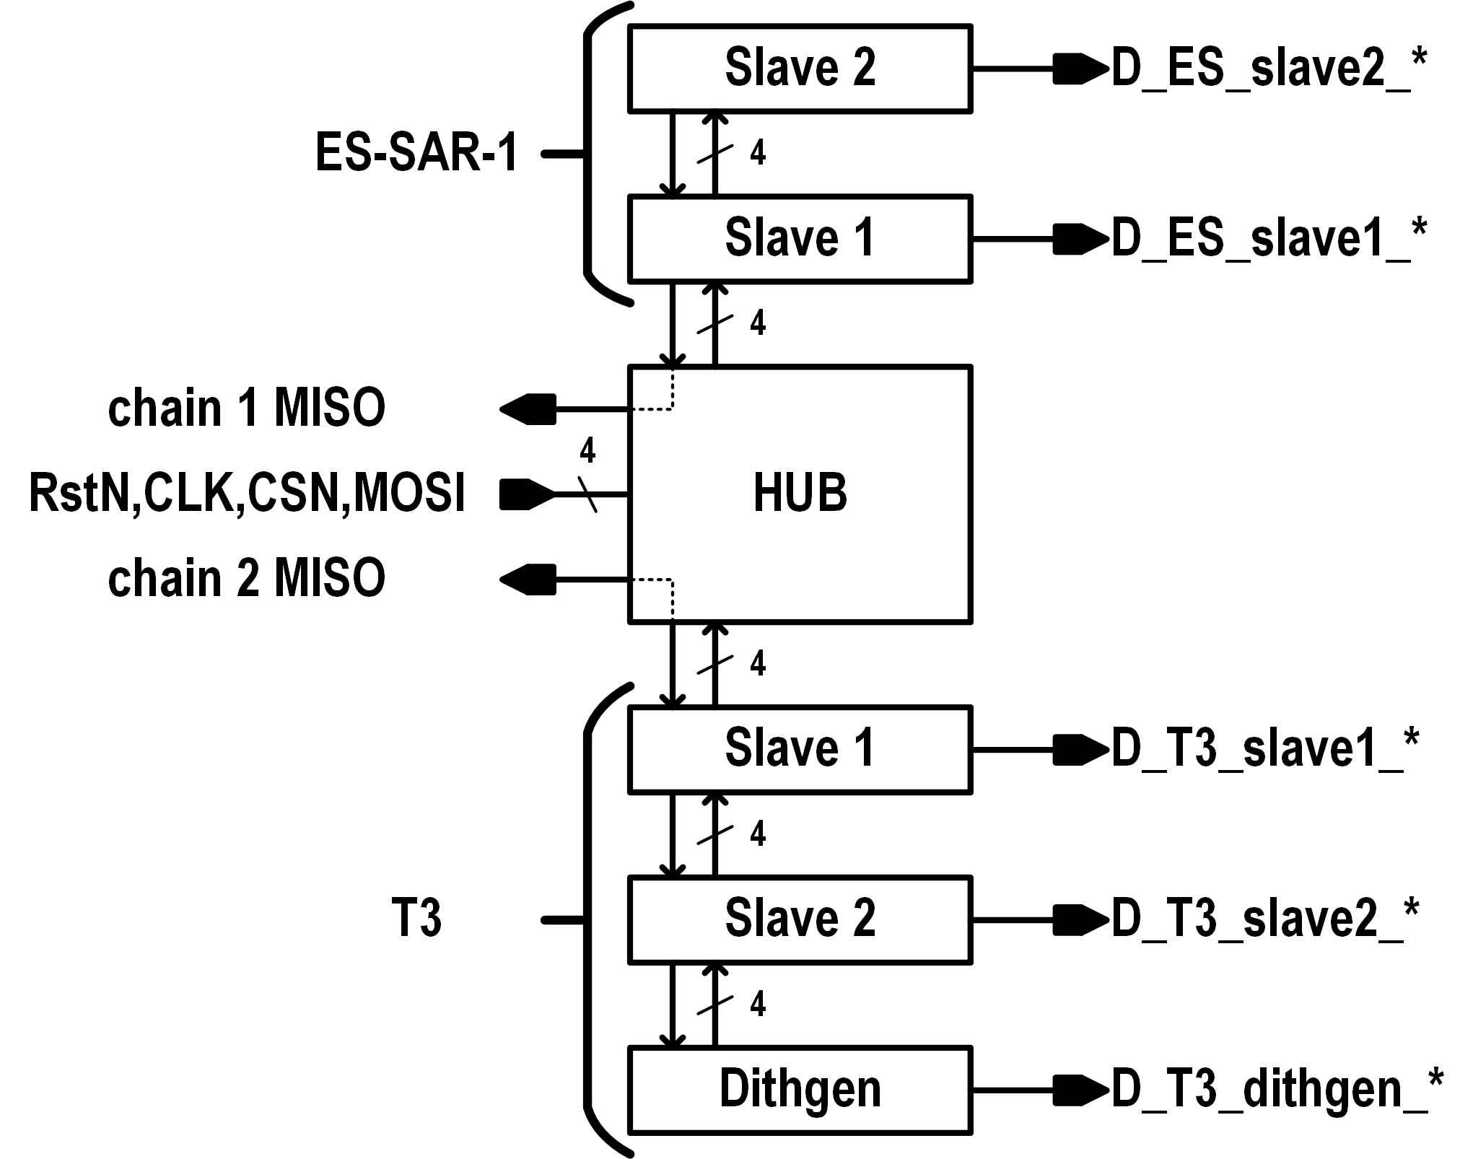
Chains and slaves, ADC to SPI mapping
Example setup
hes_adc_4e1_example_init (rows 31-36):
ES on chain 1, slaves addresses are 1 and 2
T3 on chain 2, slaves addresses are 1, 2 and 3
(note that I reused the bit mapping /naming of 3C only for testing, nothing is hard-coded so it does not matter; just stick to a cell array of 480 rows x 4 cols)
Slaves can be called in any way: here slave1, slave2, slaveDITH

Slide 5
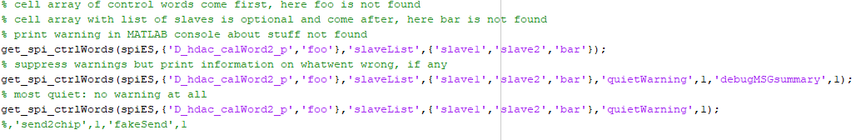
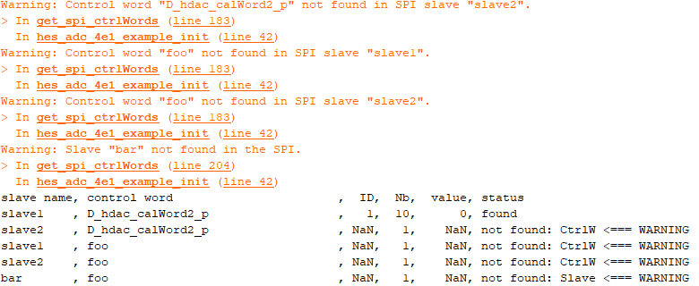
get_SPI_ctrlWords SPI read function
Cal word “D_hdac_calWord2_p” not found in slave1
Cal word “foo” not found in slave1
Cal word “foo” not found in slave2
Slave “bar” not found in SPI
3 example of usage
hes_adc_4e1_example_init (rows 39-46):
Always same inputs, 3 example of usage:
standard: print orange warnings in command window if control word/slave not found
quiet warning: no orange warnings in command windows but still print summary of what went wrong and why
totally quiet: suppress all output so the warning are not shown
1 and 2 gives same info in a different way
Quite resistant to abuses in term of wrong control word / slave name
1.
2.
3.
1.
2.
3.
totally quiet: no warning provided at all

Slide 6
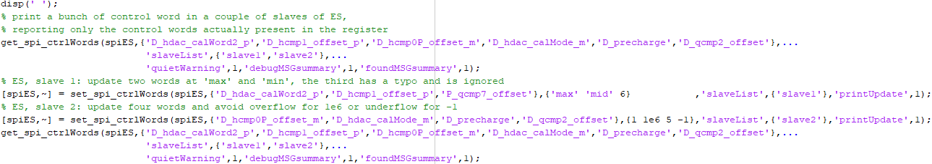
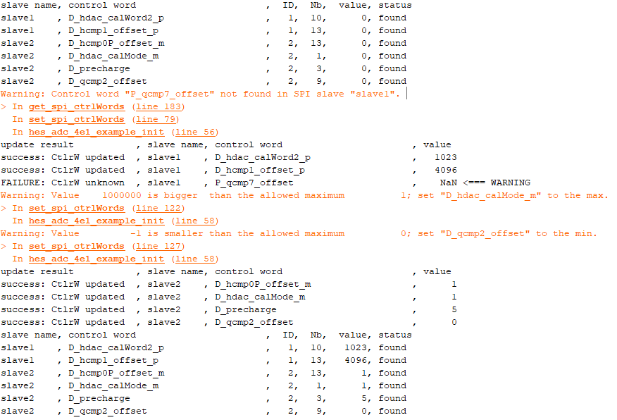
set_SPI_ctrlWords SPI write function
example of usage with logging
hes_adc_4e1_example_init (rows 50-61):
Read some registers via get_SPI_ctrlWords of previous page
Update some registers in slave1 (with a typo in one of the control words) via set_SPI_ctrlWords function
Update some registers in slave2 (trying to cause over/underflow) via set_SPI_ctrlWords function
Control that the registers are correctly updated, again via get_SPI_ctrlWords
start
end
updated
‘max’=2^10-1=1023
‘mid’=2^12=4096
1
1e6 not possible, max=1
5
0 not possible, min=0

Slide 7
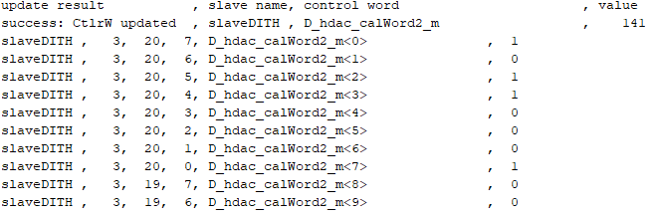
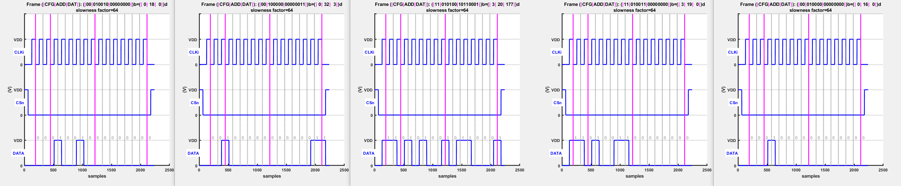
set_SPI_ctrlWords/get_SPI_ctrlWords functions
verbose and fakeSend verifications
hes_adc_4e1_example_init (rows 64-67):
set word D_hdac_calWord2_m<0>=141 in slaveDITH of T3
Verify via verbose get
2^0+2^2+2^3+2^7=141 (qed)
Verify via fakeSend:
reg20 at
2^7+2^5+2^4+2^0=177
chain sel
slave sel
write reg 20
dat 177
write reg 19
all 0s
chain desel
T3 on chain=2
Dith slave add=3
010b=2
111b=3

Slide 8
Conclusions
Functions
get_spi_ctrlWords: to read data from the SPI (either from MATLAB or from on-chip)
set_spi_ctrlWords: to set data in the SPI (either in MATLAB or on-chip)
print_full_spi: print SPI (either from MATLAB or from on-chip) on the command line
ADC 2 SPI mapping files should give a 480 rows times 4 columns MATLAB cell array:
480 rows because there are 60 registers each with 8 bit
4 columns because:
1st column: register number
2nd column: bit number
3rd column: bit name
4th column: bit value (set all bits to 0 and use function set_spi_ctrlWords to set default)
see hsadc3c_adc2spi_mapping_neg.m and hsadc3c_adc2spi_mapping_pos.m as a reference

