Slide 1
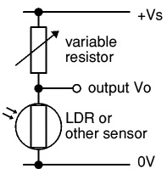


Arduino can read voltages between 0V and 5V with 10-bit (5mV) accuracy
Use voltage divider circuit to get sensor resistance
Variable resistor ranges from 0Ω to 100kΩ, ideally want sensor resistance in that range
Matching sensor resistance initially for maximum response

Slide 2
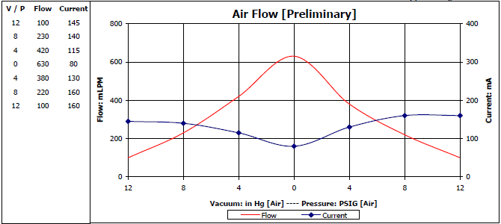
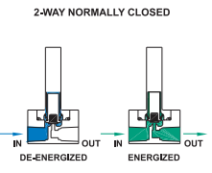
Target flow rate >= 200mLPM
Pump controlled by Arduino microcontroller
Have digital outputs that can provide 5V @ 40mA
2 valves, one with filter to get baseline, only open one at a time
Normally closed, when voltage applied valve opens

