Slide 1
DEVELOPMENT OF Smartphone integrated NANO SENSORs
Albert Chen
University of California, Riverside

Slide 2
Introduction
US Department of Homeland Security
Detection of Chemical Warfare Agents:
Sarin Gas – Tokyo Subway (1995)
Cyanide – WTC (1993)
Detection of Explosive Devices
Oklahoma City Bombing (1995)
Airports to prevent Terrorist attacks
Detection of Landmines
Industrial Detection of Toxic Chemicals
Accidental Spills from Factory Incidents and Transportation Accidents

Slide 3
CURRENT DETECTION METHODS
Detection Method | Advantages | Disadvantages
Detection Paper | Immediate Results Easy Operation | False Alarms Liquids Only
Gas Detection Tube | High Sensitivity | Slow Response One Time Use
Flame Photometric Detector | Quick Response and Recovery High Sensitivity | External Fuel Required
Ion Mobility Spectrometer | Rapid Detection Low Power Consumption | Expensive > $10k
Surface Acoustic Wavelength | Fully Automated | Low Sensitivity Large Device Slow Recovery

Slide 4
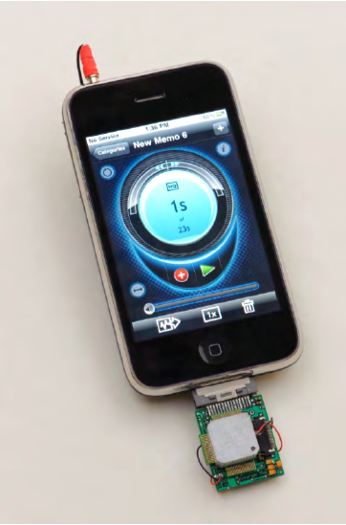
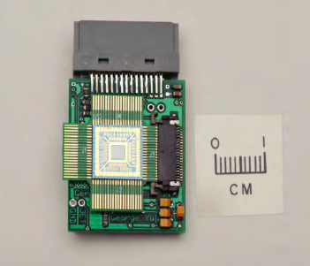
Current development - nasa
NASA Ames Research Center
Smartphone Integrated Device
Images adapted from NASA Ames Research Center

Slide 5
OBJECTIVE
To develop a portable and wearable gas sensor device
Low Cost
~$100 - ~$200 depending on components
Fast response and recovery
Multiple sensors
Temperature
Humidity
GPS

Slide 6
development
Software
Arduino Software Development
Android Software Development
Hardware
Increasing Signal-to-Noise Ratio
PCB Fabrication and Sensor Integration
Assembly
Smartphone Integrated Unit
Stand Alone Unit
Field Tests
Gathering Data/Building a Database
Development of Pattern Recognition Algorithms

Slide 7
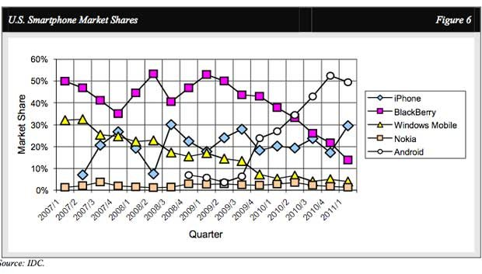
WHY ANDROID?
Most common smartphone OS and gaining market share
Open source development and lots of existing code
More flexible than iOS

Slide 8
DEVICE COMPONENTS
Device | Data Transfer | Display | Power | Sensor
Smartphone Integrated Portable Device | Bluetooth | Smartphone | Battery | Gas
 |  |  |  | Biological
 | Wi-Fi
 |  |  | Solar Cell | Temperature
 | MicroSD | Tablet |  | Humidity
 |  |  |  | Pressure
 | USB |  | USB
 |  |  |  | GPS
Stand Alone Wearable Device | MicroSD | OLED | Battery | Gas
 |  |  |  | Biological
 |  |  | Solar Cell | Temperature
 | USB | Touch Screen |  | Humidity
 |  |  | USB | Pressure
 |  |  |  | GPS

Slide 9
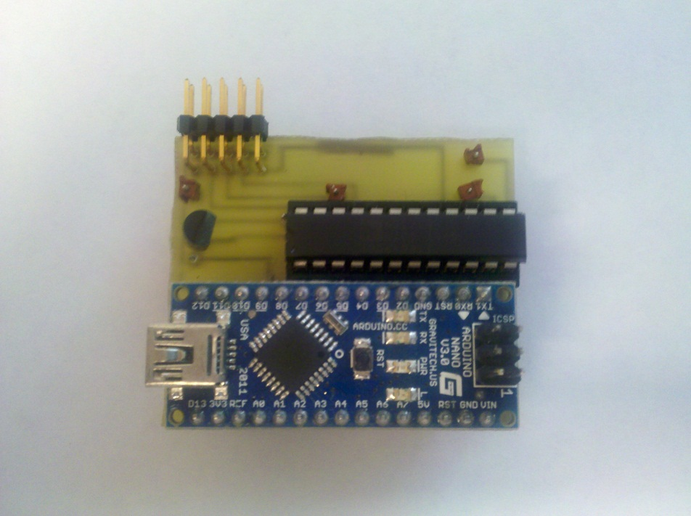
SMARTPHONE INTEGRATED DEVICE
Components
Arduino Nano Microcontroller
Humidity Sensor
Temperature Sensor
Bluetooth
5V Battery
Data Management
Real Time Graph
Communicates with Smartphone or Tablet via Bluetooth
Sensing results stored as .txt file on phone’s microSD card
Can be sent via e-mail or copied off the microSD card

Slide 10
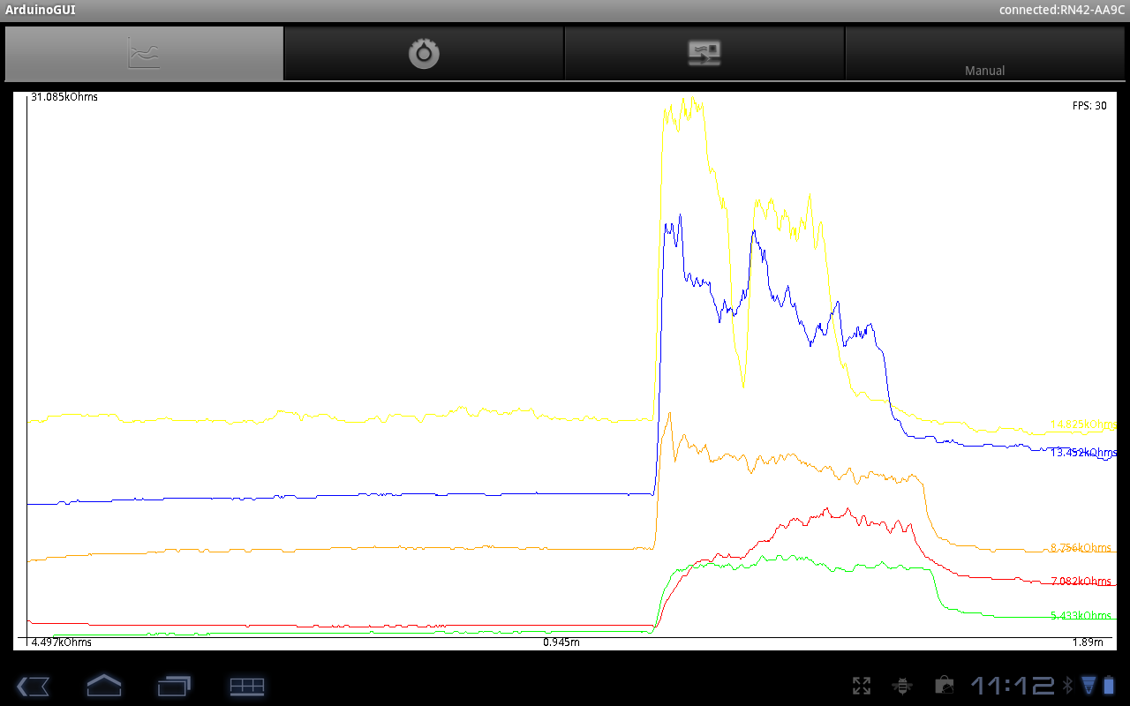
SMARTPHONE APPLICATION

Slide 11
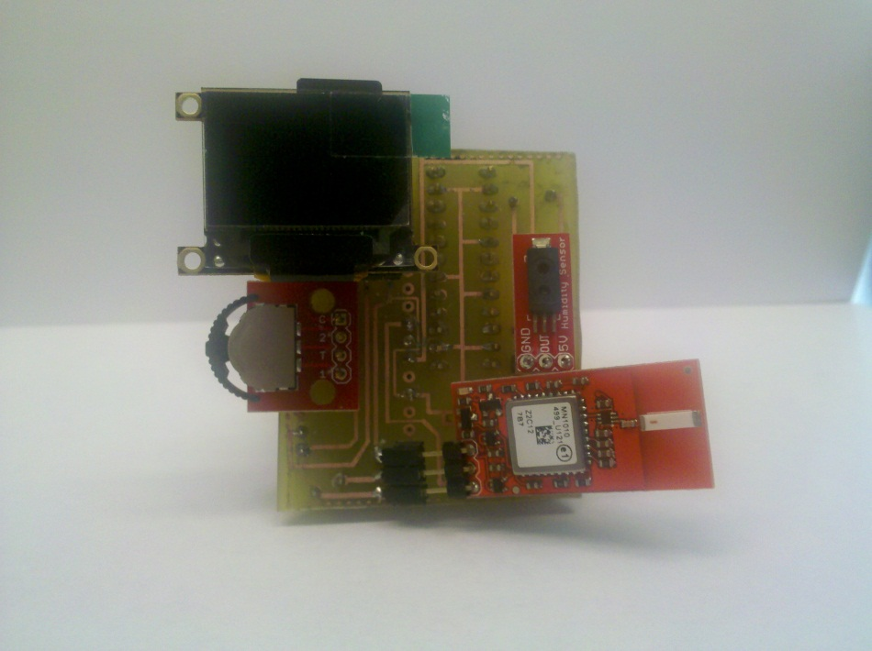
STAND ALONE DEVICE
Components
Arduino Nano Microcontroller
Humidity Sensor
Temperature Sensor
GPS Module
LCD Screen
5V Battery
Data Management
Results stored on microSD card

Slide 12
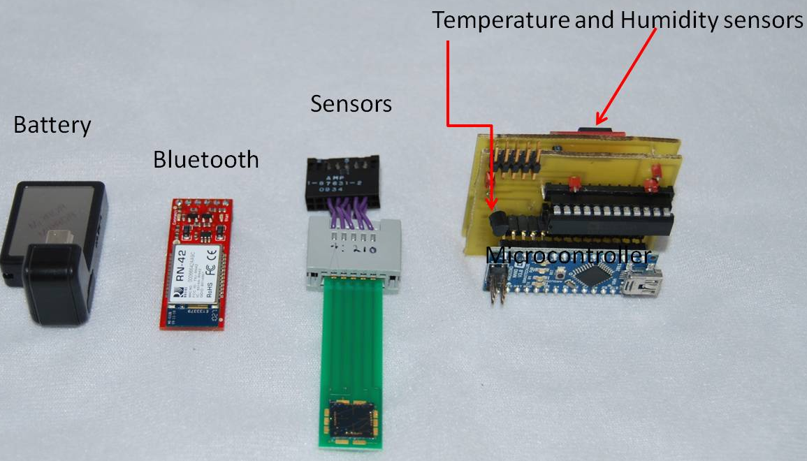
Prototype of Portable device
Smartphone Integrated Nano-Chemiresistive Gas Sensor

Slide 13
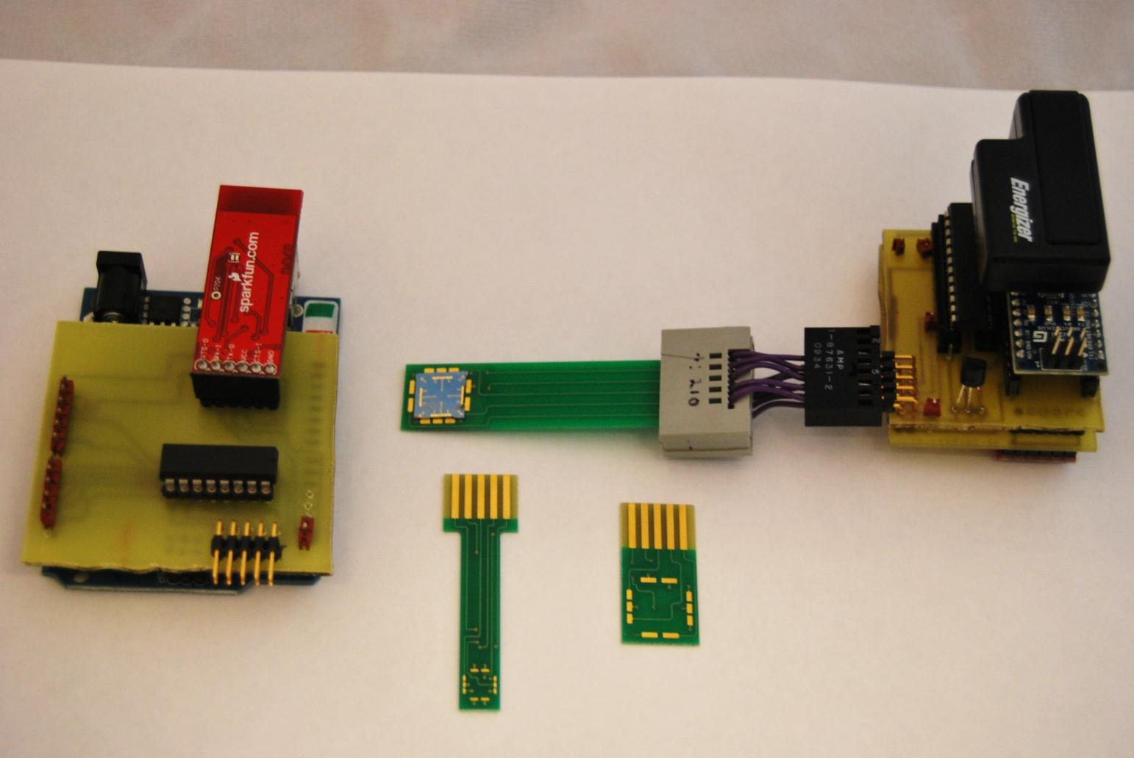
Prototype of wearable device
Portable Device
Wearable Sensor

Slide 14
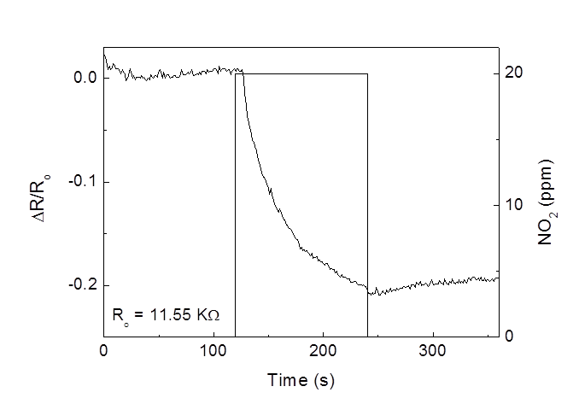

TESTING RESULTS
Bare SWNT sensing response against 20 ppm NO₂ via Arduino
Bare SWNT sensing response against 20 ppm NO₂ via Keithly
$$∆R/R_{0}$$
Time (s)

Slide 15
FUTURE PLANS
Gas Sensor
Wearable stand alone unit
Portable stand alone unit
Biological Sensor
Glucose Sensor
Software
Developing and implementing pattern recognition patterns

