Slide 1
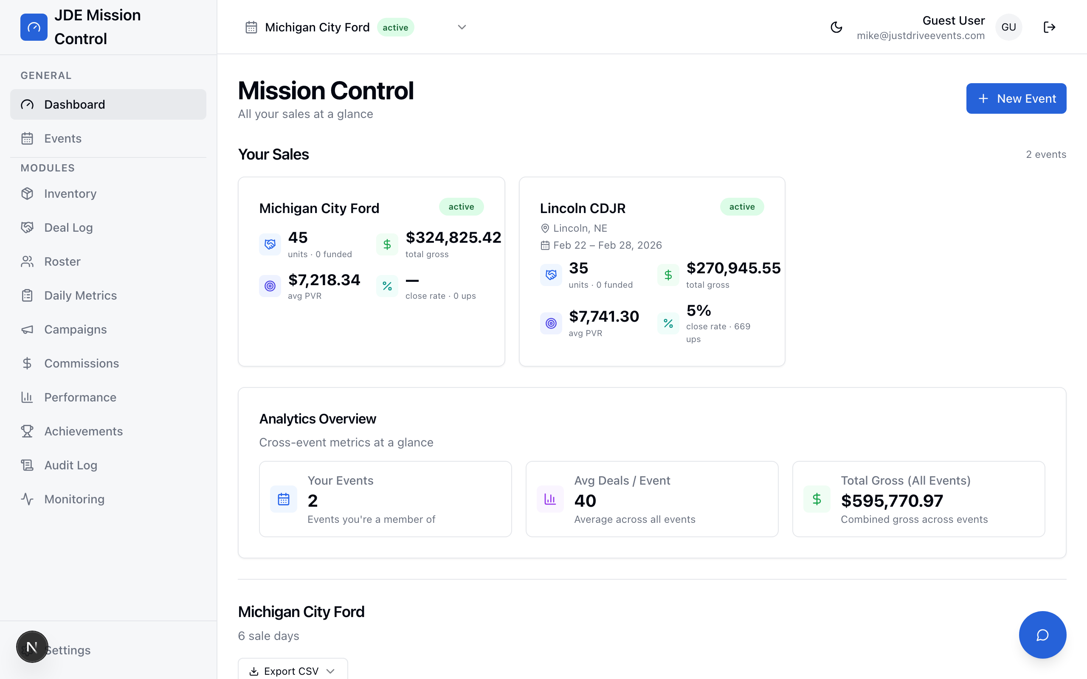
JDE MISSION CONTROL
JDE Mission Control
From Excel Chaos to Central Command
A real-time event management dashboard built for
Just Drive Events — by Mike Stopperich
1 / 13
Notes:
Welcome to JDE Mission Control. This is the system I built to replace the spreadsheet chaos we've been running on for years. Every event, every deal, every metric — one place, real-time. Let me walk you through what it does and why it matters.

Slide 2
JDE MISSION CONTROL
The Old Way
Excel Chaos
Multiple disconnected spreadsheets per event
Manual data entry across Roster, Deal Log, Inventory tabs
No real-time visibility — always 24 hours behind
Version conflicts when multiple people edit simultaneously
Zero automation — every formula, every lookup, by hand
No historical comparison between events
[ Messy Excel Tabs Collage ]
2 / 13
Notes:
This is what we were dealing with. Every event meant a new set of spreadsheets — Roster, Deal Log, Inventory, Daily Metrics — all disconnected. If someone updated a deal at the dealership, I wouldn't see it until the next day. Version conflicts were constant. We were spending more time managing spreadsheets than managing events.

Slide 3
JDE MISSION CONTROL
One Source of Truth
Every event. Every deal. Every metric. Real-time.
BEFORE
AFTER
8+ spreadsheets per event
Manual formulas & lookups
Data always 24 hours stale
No mobile access
No gamification or motivation
No AI assistance
1 dashboard for everything
Auto-calculated stats & KPIs
Real-time Supabase sync
Mobile-responsive design
Badges, streaks, leaderboards
Cruze AI concierge built in
→
3 / 13
Notes:
The vision was simple: one source of truth. Replace every spreadsheet with a single dashboard that updates in real-time. Auto-calculate everything. Make it accessible from any device. And layer on gamification and AI to make it not just functional, but genuinely exciting to use.

Slide 4
JDE MISSION CONTROL
Mission Control at a Glance
Multi-Event Scorecards
12 Modules
Real-Time Sync
See every active event at once.
Status, deal count, gross, PVR —
all on the landing page.
Inventory, Deal Log, Roster,
Daily Metrics, Campaigns,
Commissions, Performance, more.
Supabase powers live updates.
Log a deal — stats refresh
instantly across all views.
4 / 13
Notes:
Here's what you see when you first log in. Every active event shows as a scorecard — deal count, total gross, PVR, status. Click into any event and you have 12 fully built modules. Everything syncs in real-time through Supabase, so the moment a deal is logged at the dealership, the dashboard updates everywhere.

Slide 5

JDE MISSION CONTROL
The Recap You Know & Love
Now live. Now accurate. Now instant.
The same financial recap format the team already uses —
but powered by real data instead of manual entry.
Green rows = funded deals contributing to the bottom line
Every number auto-calculated from the deal log
Export to PDF or print directly from the page
5 / 13
Notes:
This is the recap page — the financial summary the team already knows and loves. Same format, but now it's powered by real deal data instead of manual Excel entry. Green rows are funded deals. Every number is auto-calculated. No more formula errors, no more stale data. You can export to PDF or print it right from the page.

Slide 6
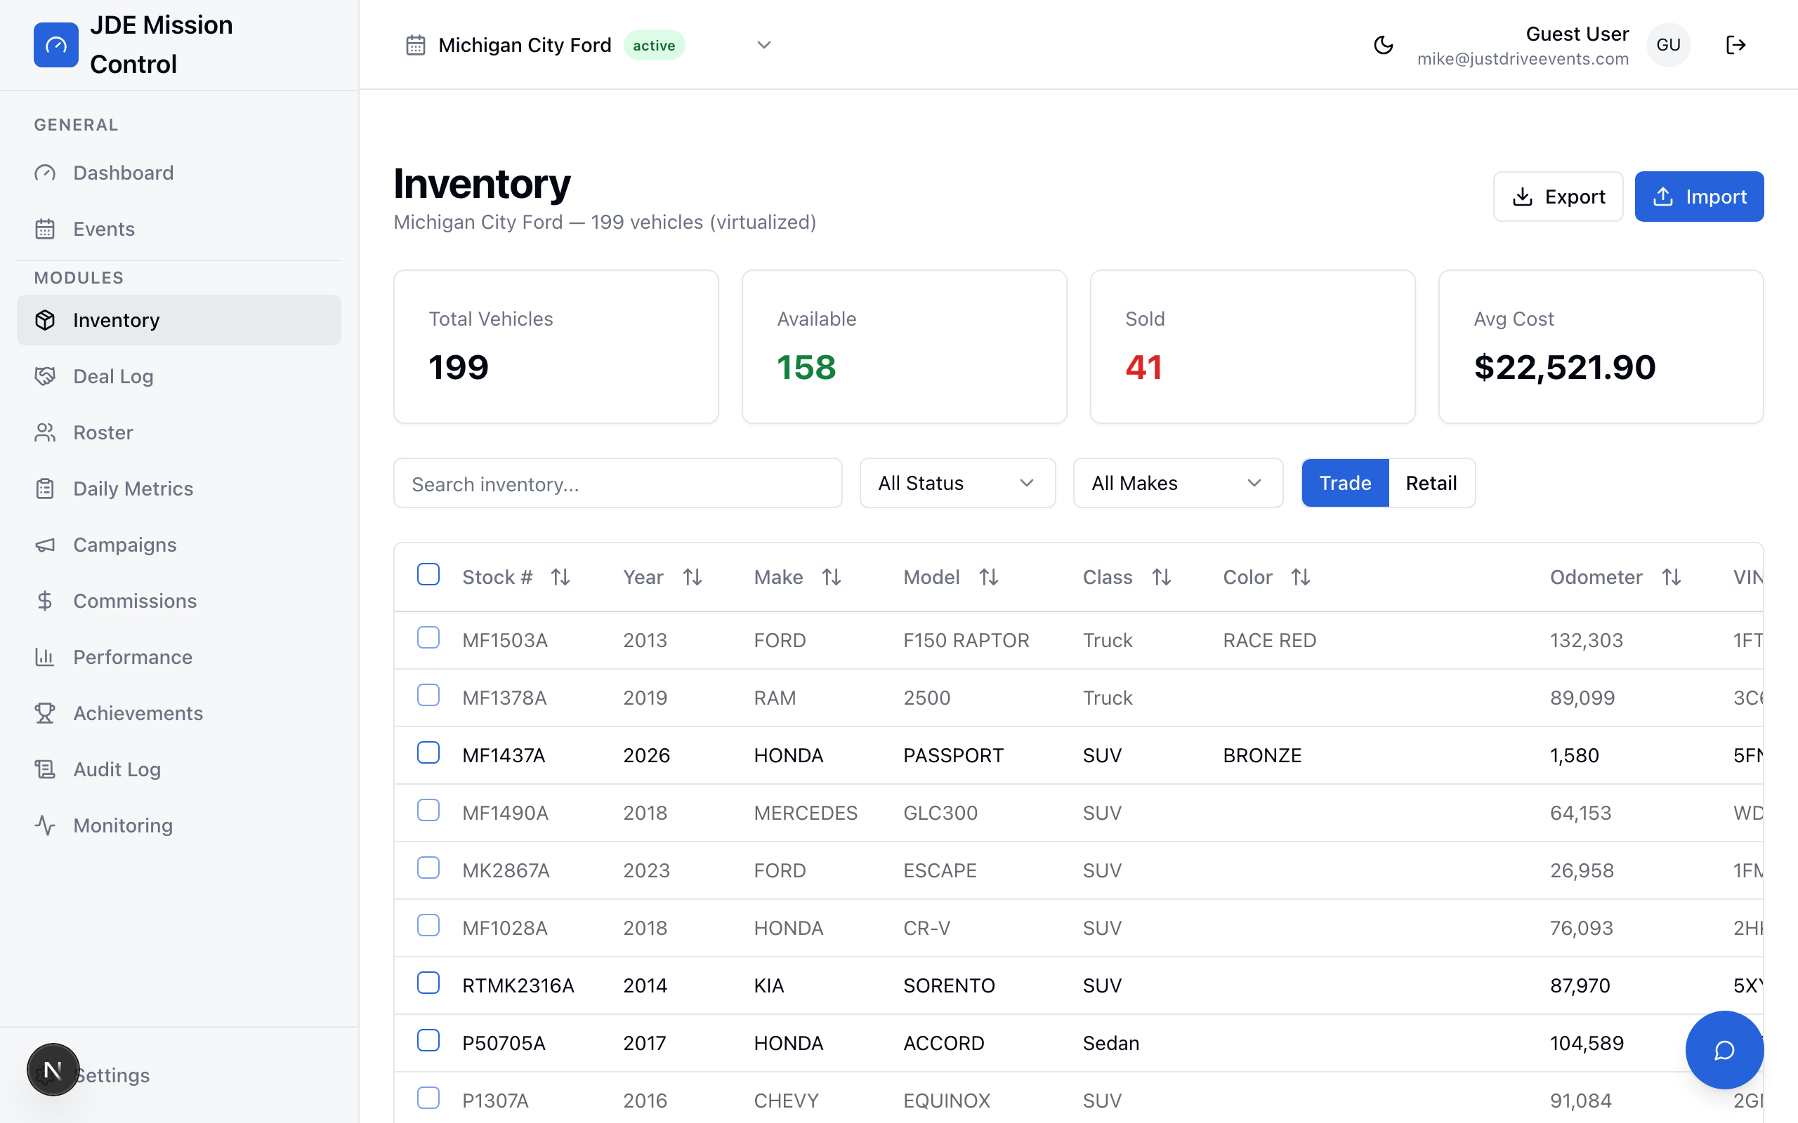
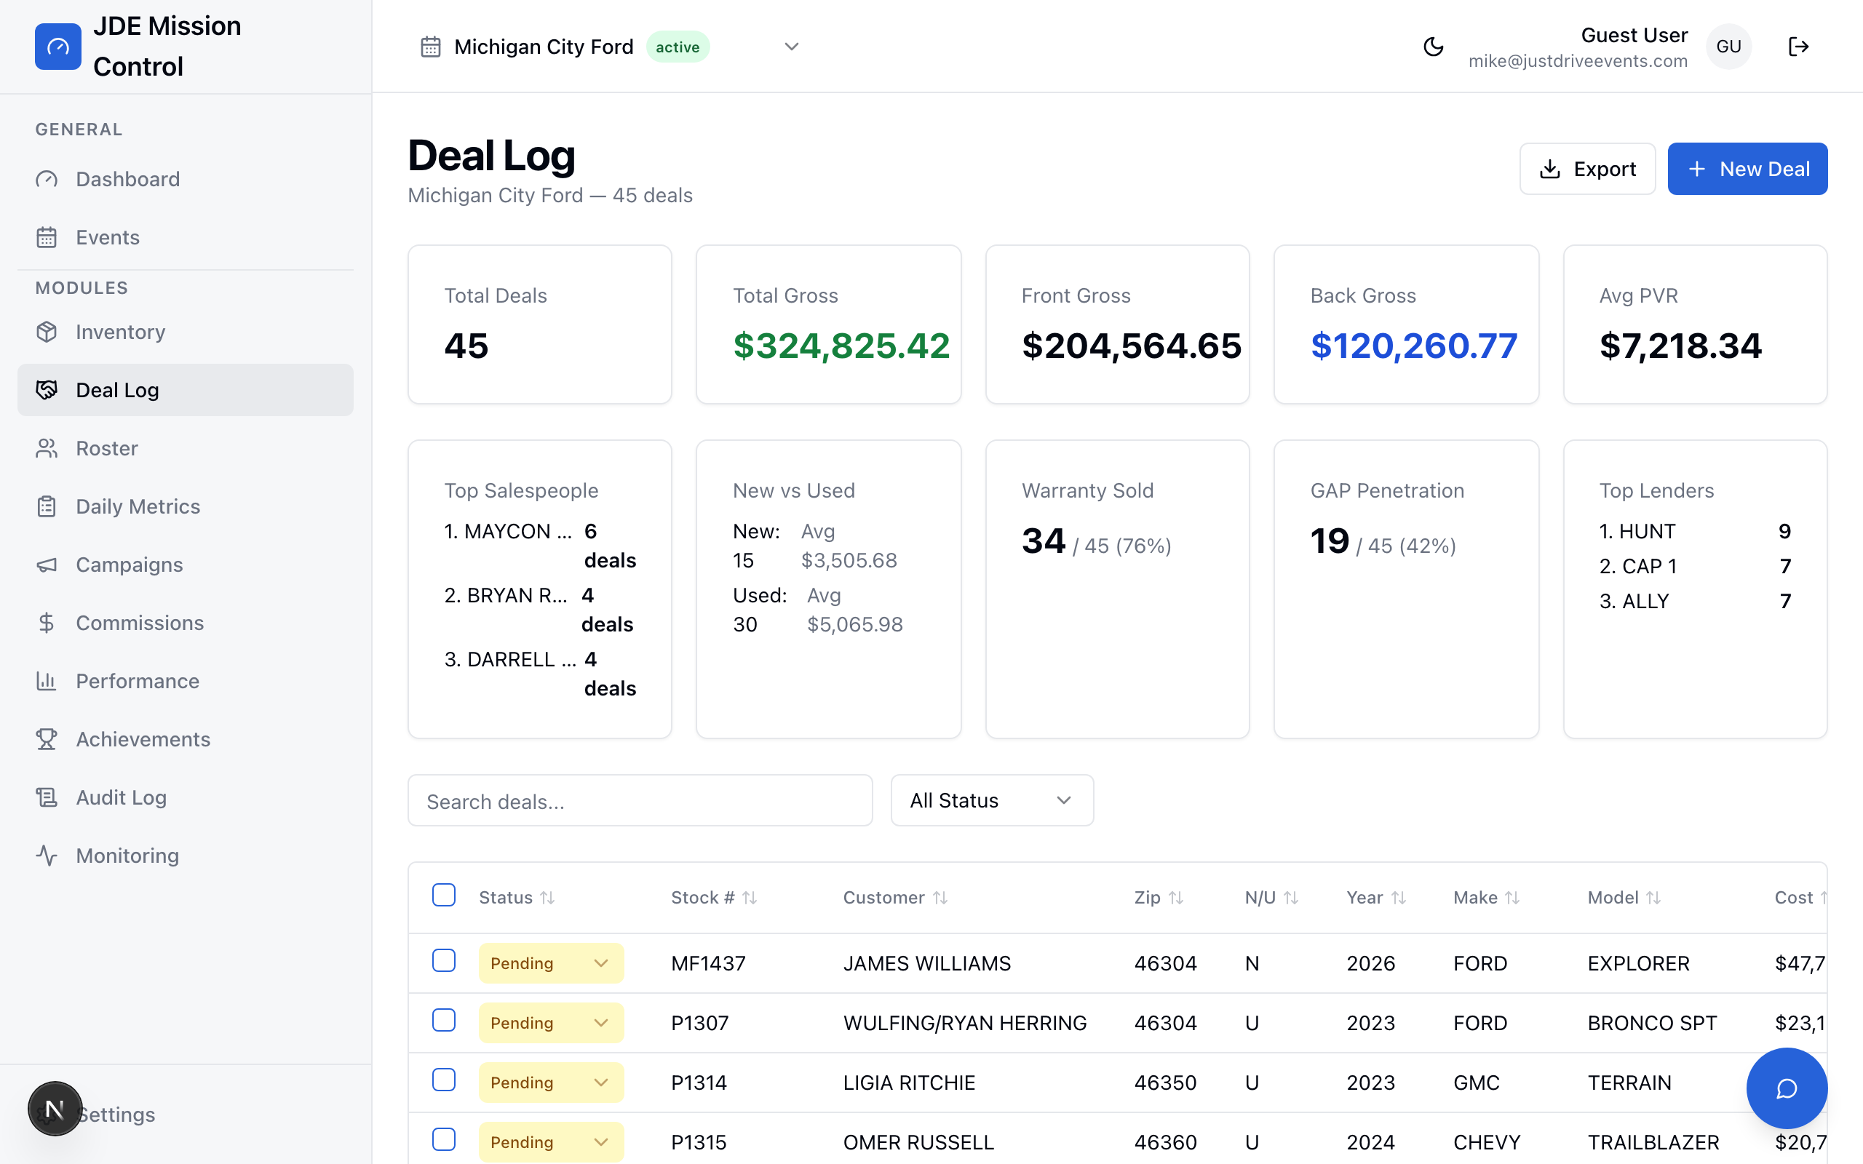
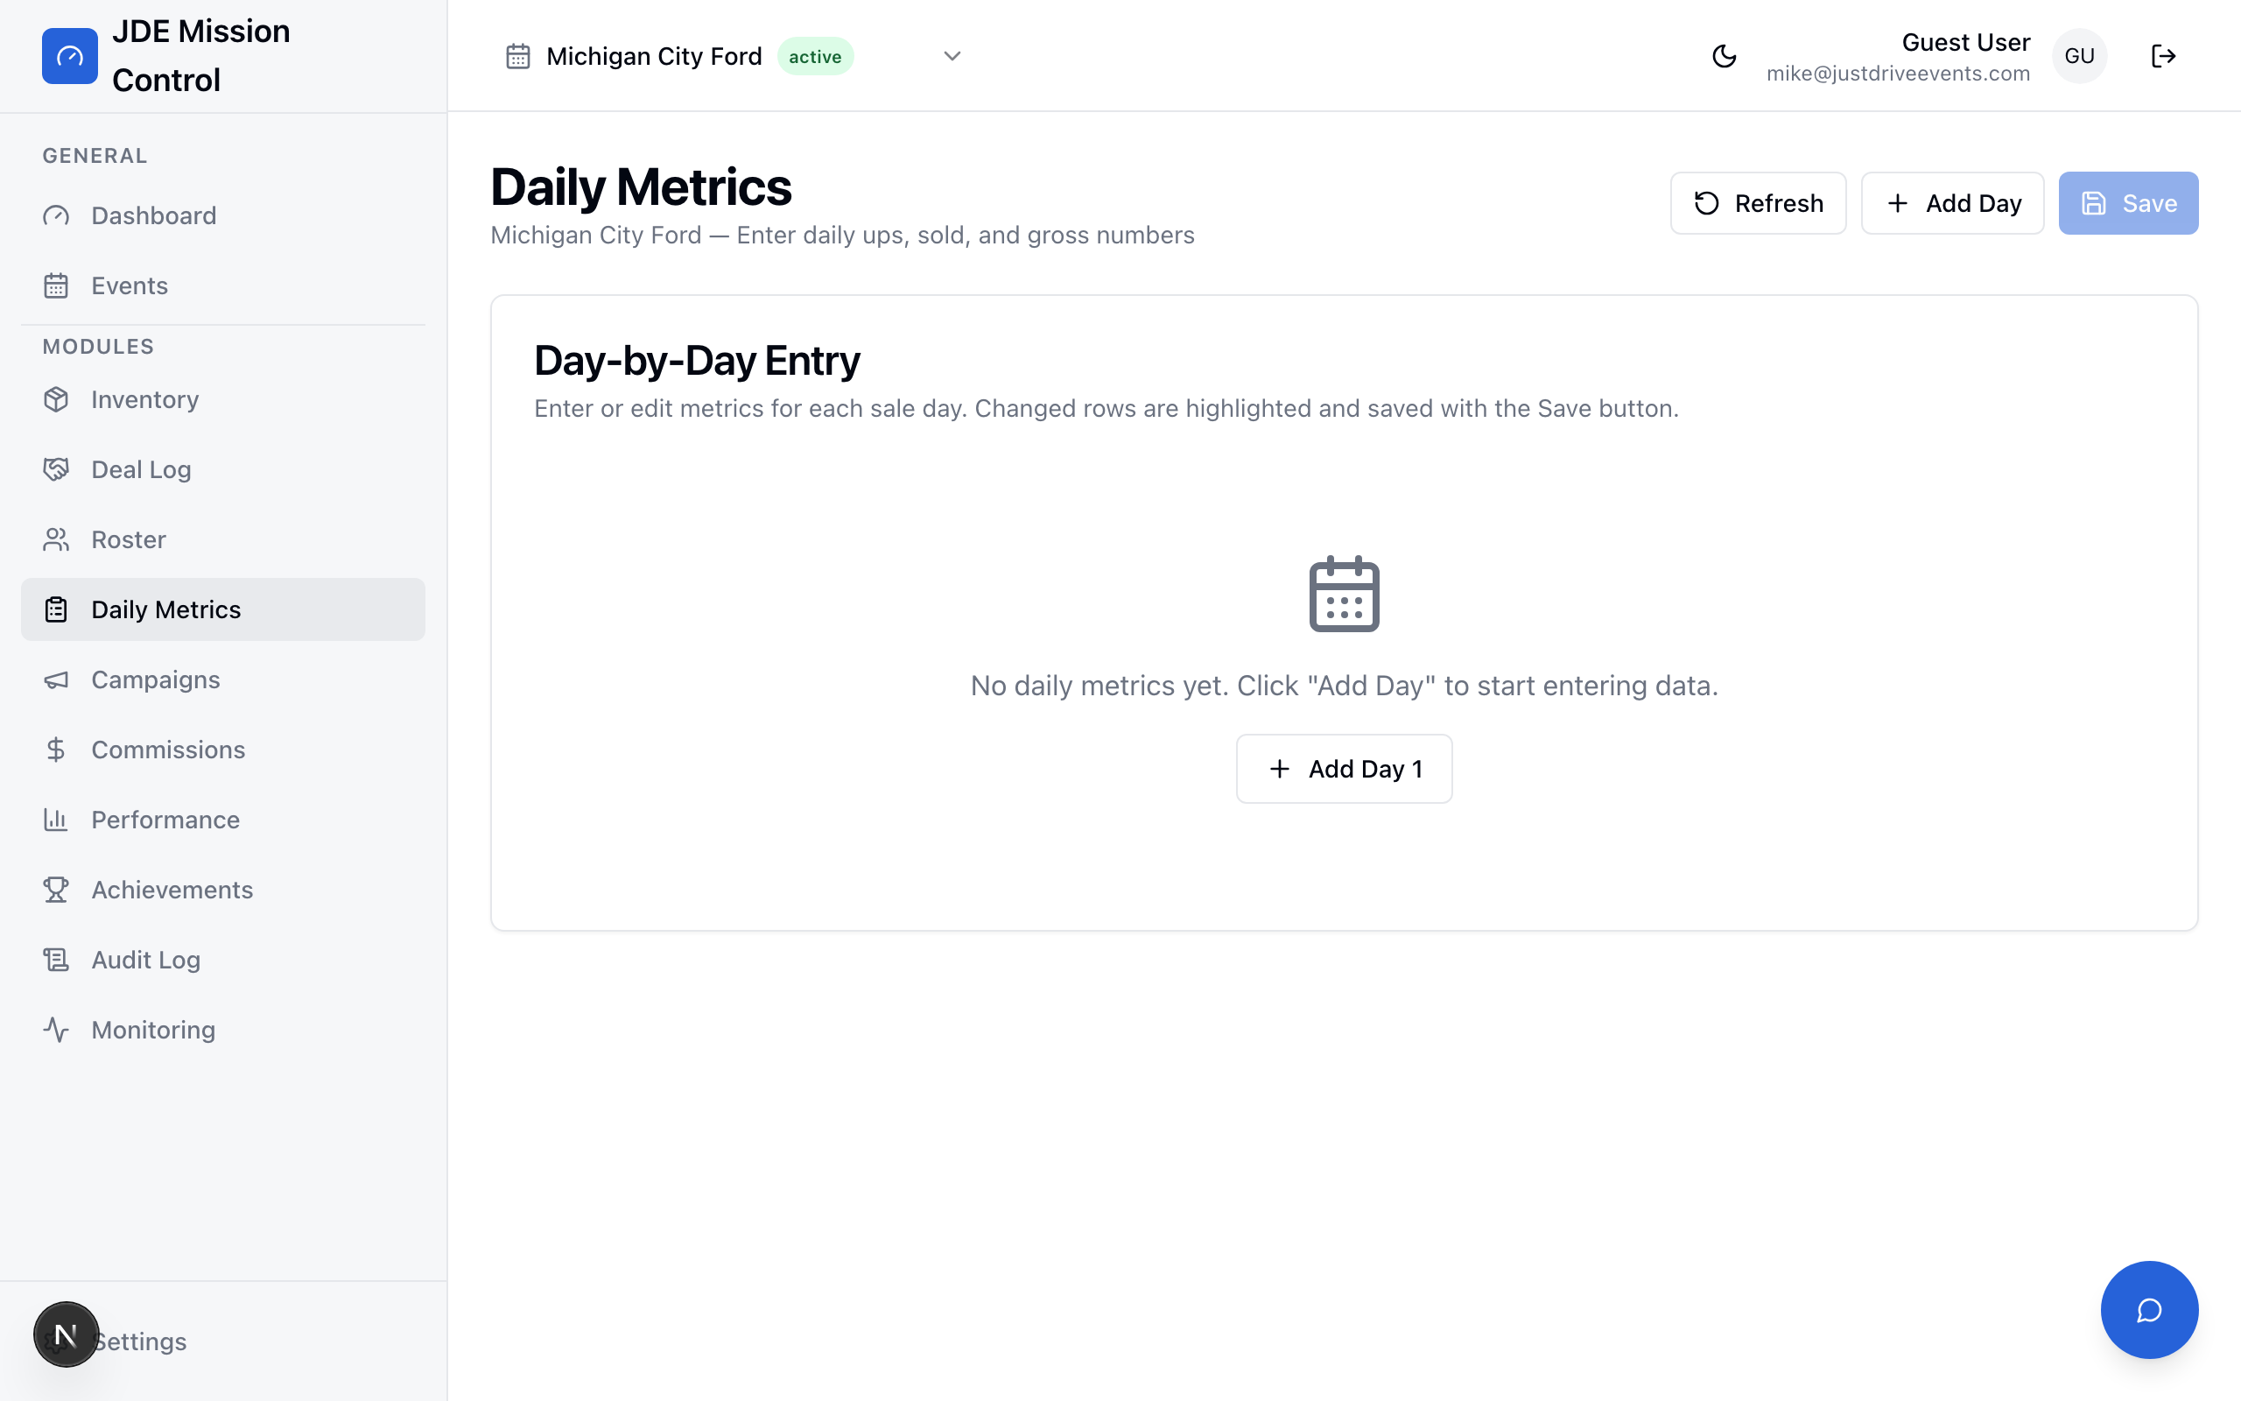
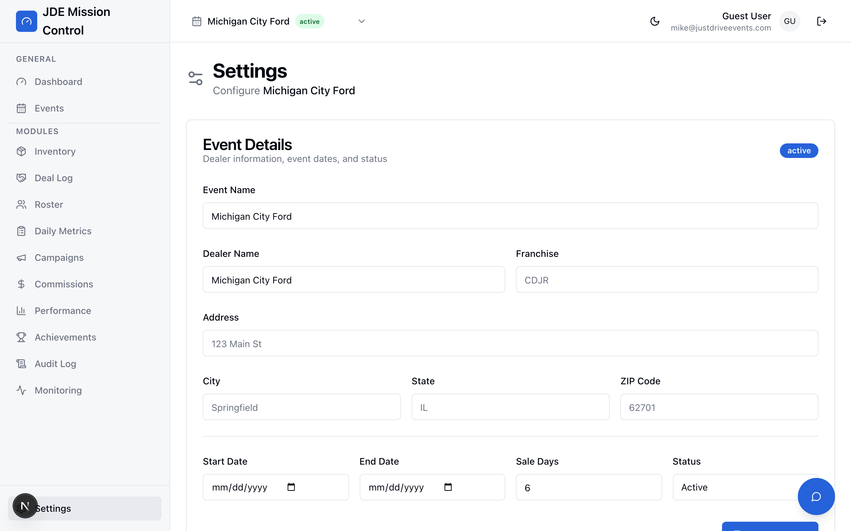
JDE MISSION CONTROL
Built for Live Events
Four core modules that run the show floor.
Inventory
Deal Log
Import vehicles, track status, manage pricing tiers
Log deals with full finance details, TI badges, stat cards
Daily Metrics
Legacy Upload
Track daily ups, appointments, sold units, gross
One-click import from existing Google Sheets
6 / 13
Notes:
These four modules run the show floor. Inventory lets you import vehicles and track what's available versus sold. The Deal Log is where every sale gets recorded — with full finance details, trade-in tracking, and the new TI badges. Daily Metrics captures daily totals. And Legacy Upload lets you import existing Google Sheets data with one click so nothing gets left behind.

Slide 7
JDE MISSION CONTROL
Turning Competition into Results
Badges. Streaks. Leaderboards. Real motivation.
18 Badges
Streak System
Leaderboard
5 categories:
Sales Volume
Gross Profit
Closing Excellence
Streak Milestones
Team Contribution
Earned automatically when
deals are logged.
Track consecutive days
with at least one sale.
Visual flame counter shows
the current streak length.
Badges unlock at 3, 5,
and 7-day milestones.
Ranked by total gross,
deal count, or PVR.
Updates in real-time as
new deals are logged.
Creates friendly competition
that drives performance.
7 / 13
Notes:
This is what makes the dashboard more than just a reporting tool. We built gamification into the DNA. Eighteen badges across five categories — earned automatically when deals are logged. A streak system that tracks consecutive selling days. And a real-time leaderboard that creates friendly competition. The sales team actually gets excited to log deals because they want to see their badge count go up.

Slide 8
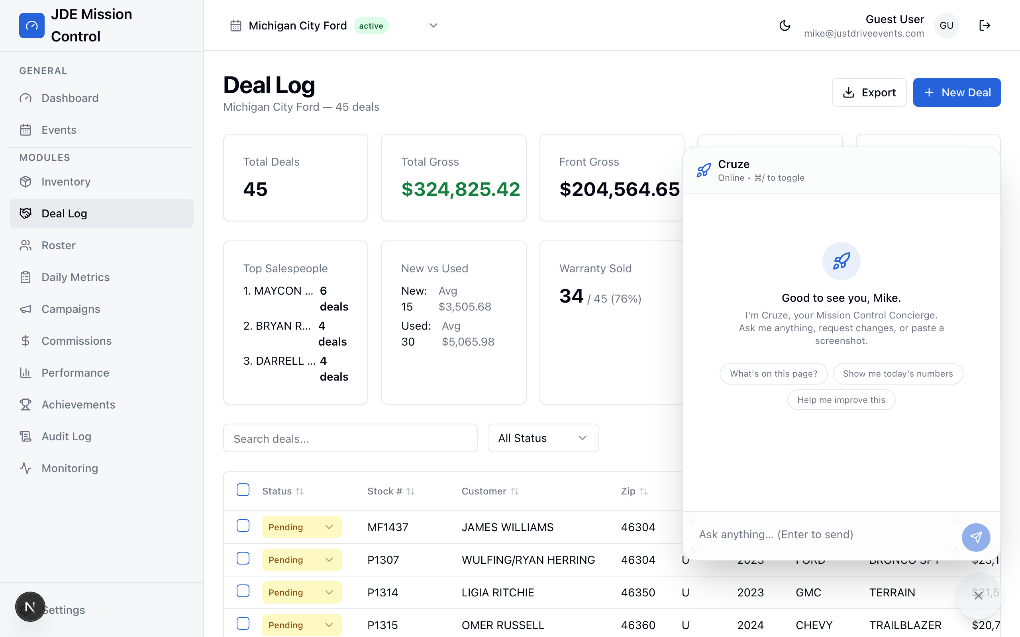
JDE MISSION CONTROL
Meet Cruze
Your Personal Mission Control Concierge
Built with Ritz-Carlton service standards.
Warm authority. Quiet confidence. Genuine care.
Cruze doesn't just answer questions —
he anticipates what you need before you ask.
"I've got this." "Taken care of." "Let's make this better."
3-Tier Intelligence
Context-Aware
Copy Ready Prompts
Haiku → Sonnet → Opus
Auto-routes by complexity
Knows your page, your data,
your event — always
Every suggestion includes a
prompt for Claude Code
8 / 13
Notes:
This is Cruze — the standout feature of Mission Control. He's an AI concierge built directly into the dashboard, modeled after Ritz-Carlton service standards. Warm authority, quiet confidence, genuine care. He uses a three-tier intelligence system — simple requests go to a fast model, moderate changes get previewed first, and complex features get logged as development tasks. Every response includes a copy-ready prompt you can paste into Claude Code to actually build the feature. He knows what page you're on, what data you're looking at, and what event you're managing.

Slide 9
JDE MISSION CONTROL
Cruze in Action
Step 1 — Ask
Step 2 — Preview
Step 3 — Build
"Who's the top salesperson?"
Cruze instantly pulls from
your live deal data and
responds with ranked results.
No searching. No filtering.
Just ask.
"Add a salesperson leaderboard"
Cruze shows a detailed preview
of what he'd build, then waits
for your approval.
→ Apply it
→ Adjust
→ Start over
Every Tier 2 and Tier 3
response includes a
Copy Ready Prompt
for Claude Code
Paste it. Build it. Ship it.
From idea to production
in minutes.
9 / 13
Notes:
Here's how Cruze works in practice. Step one — just ask a question in plain English. He pulls from your live data and gives you real answers with real numbers. Step two — if you want a change, he previews it first and waits for your approval. Step three — every preview includes a copy-ready prompt you can paste into Claude Code to actually implement the feature. The cycle from 'I wish this existed' to 'it exists' is measured in minutes, not weeks.

Slide 10
JDE MISSION CONTROL
Built for Reliability
Next.js 15
Supabase
Google Sheets
Claude AI
React Server Components
App Router
TypeScript throughout
Deployed on Vercel
PostgreSQL database
Row-level security
Real-time subscriptions
Auth & file storage
Legacy data import
Bi-directional sync
Familiar interface for
field team data entry
3-tier routing system
Haiku, Sonnet, Opus
Context-aware responses
Vercel AI SDK streaming
By the Numbers
12 modules • 50+ database tables • Real-time sync < 500ms • 100/100 chatbot test score • Mobile responsive
10 / 13
Notes:
Under the hood, Mission Control runs on a modern, production-grade stack. Next.js 15 with TypeScript for the frontend, deployed on Vercel. Supabase for the database with PostgreSQL, row-level security, and real-time subscriptions. Google Sheets integration for legacy data import. And Claude AI powering Cruze with a three-tier routing system. We ran 100 automated tests on the chatbot — it scored 100 out of 100.

Slide 11
JDE MISSION CONTROL
The Difference We're Seeing
Before — Manual Process
After — Mission Control
24-hour data delay
30+ min daily spreadsheet management
Frequent formula errors
No visibility during live events
No team engagement or motivation
Zero AI assistance
Scattered across 8+ files per event
Real-time data (< 500ms sync)
Zero manual calculation
Automated accuracy — no formula errors
Live visibility from any device
Gamification driving 76% warranty pen.
Cruze AI concierge at your fingertips
One dashboard. One source of truth.
11 / 13
Notes:
The results speak for themselves. We went from 24-hour data delays to real-time sync. From 30 minutes of daily spreadsheet management to zero manual calculation. From constant formula errors to automated accuracy. The team has live visibility from any device during events. Gamification is driving real results — we're seeing 76% warranty penetration at Michigan City Ford. And Cruze gives everyone an AI assistant that actually understands the business.

Slide 12
JDE MISSION CONTROL
Where We're Going Next
The roadmap for whats next
GoHighLevel Integration
Advanced Reporting
Mail Campaign Automation
Mobile App
Multi-Tenant Scaling
Sync leads, appointments,
and follow-ups automatically
Event comparison, trend
analysis, ROI dashboards
Trigger mail drops from
zip code performance data
Dedicated iOS/Android app
for on-the-ground teams
White-label for partner
dealerships to self-serve
12 / 13
Notes:
Looking ahead, the roadmap is focused on integration and scale. Q2 brings GoHighLevel integration for lead sync and advanced reporting for event comparison. Q3 is about automation — triggering mail drops from zip code data and launching a dedicated mobile app. By Q4, we're looking at multi-tenant scaling so partner dealerships can self-serve. Every feature will be Cruze-aware, meaning you can ask the AI about any of these systems once they're connected.

Slide 13
JDE MISSION CONTROL
Thank You
JDE Mission Control — Built by Mike Stopperich
mike@justdriveevents.com
justdriveevents.com
"From Excel chaos to central command — and we're just getting started."
13 / 13
Notes:
Thank you for your time. This is just the beginning. Mission Control is live, Cruze is operational, and we're building new features every week. If you'd like a live demo or want to discuss how this could work for your dealership, reach out anytime. From Excel chaos to central command — and we're just getting started.

