Slide 1
Continuous Integration & Jenkins –part III
DevOps Course

Slide 2
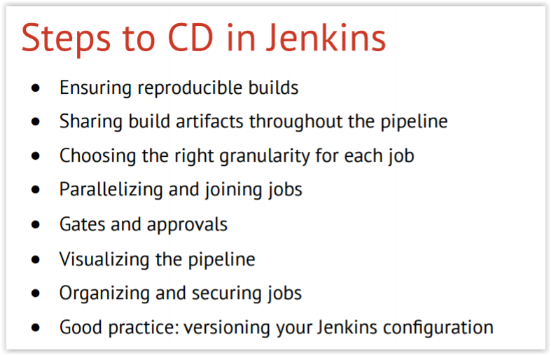
Jenkins Continuous Delivery

Slide 3
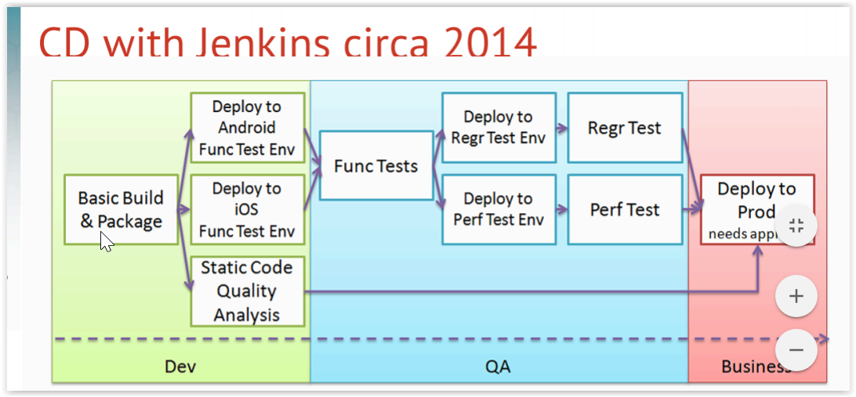
Jenkins Continuous Delivery

Slide 4
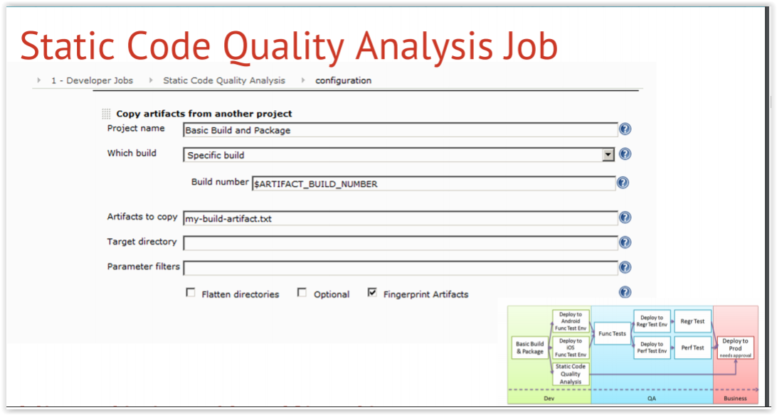
Jenkins Continuous Delivery

Slide 5
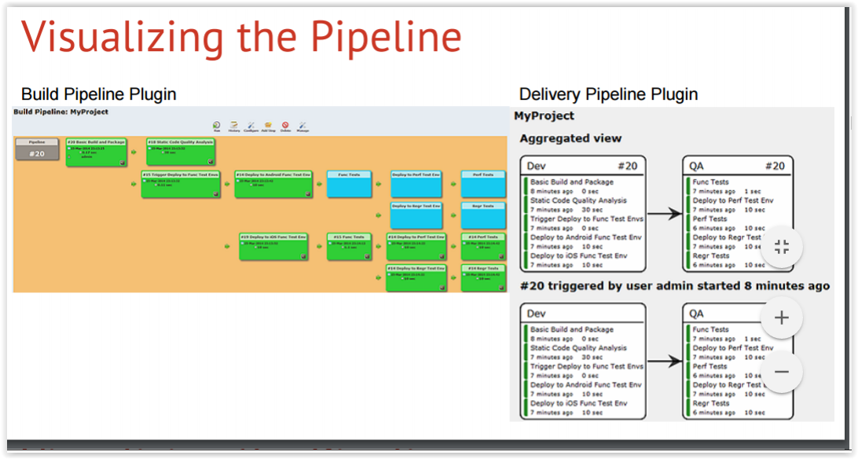
Jenkins Continuous Delivery

Slide 6
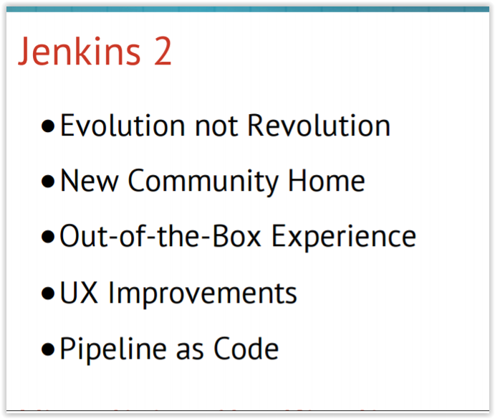
Jenkins 2

Slide 7
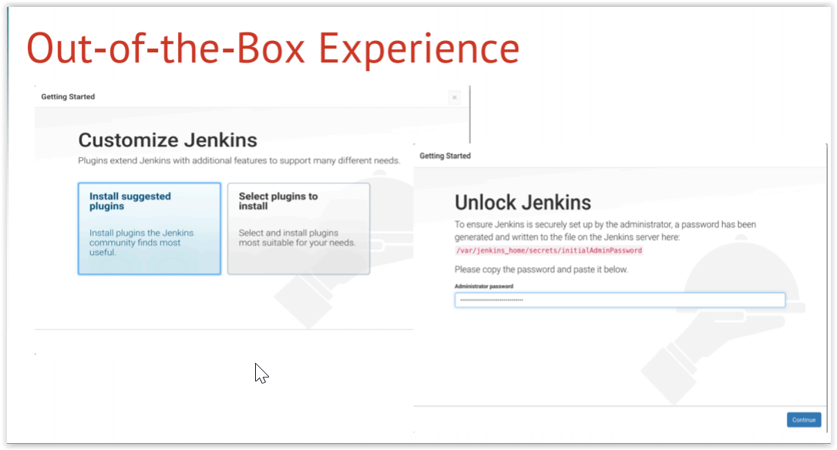
Jenkins 2

Slide 8
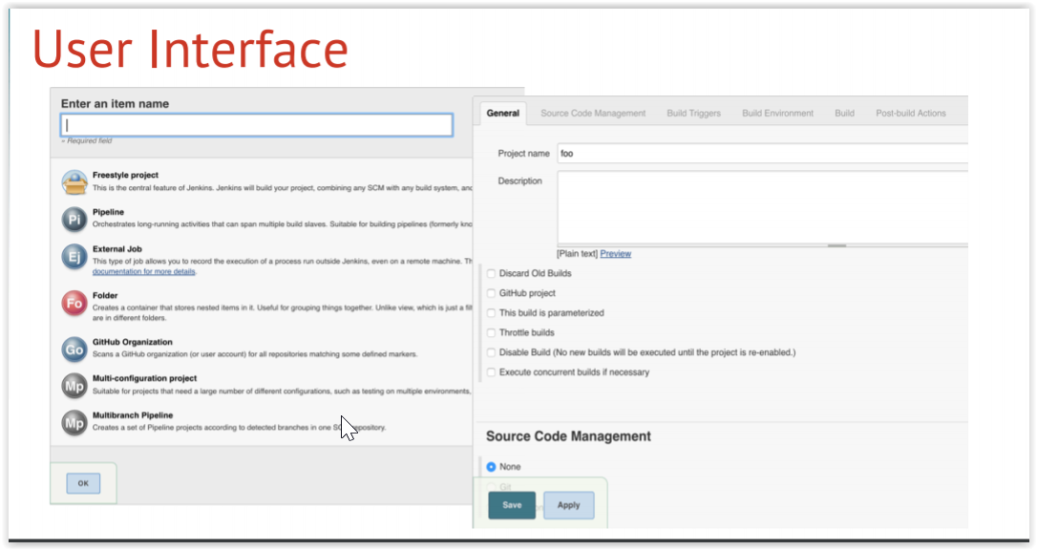
Jenkins 2

Slide 9
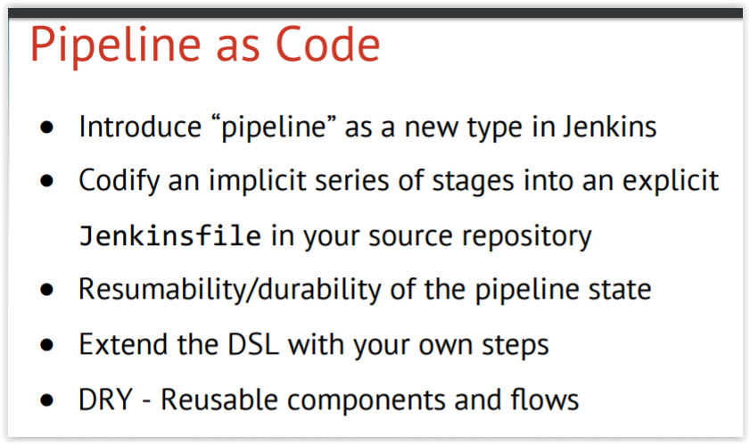
Jenkins 2

Slide 10
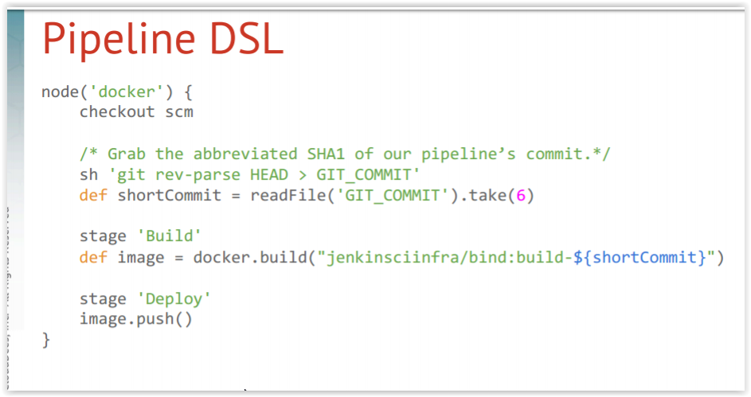
Jenkins 2

Slide 11
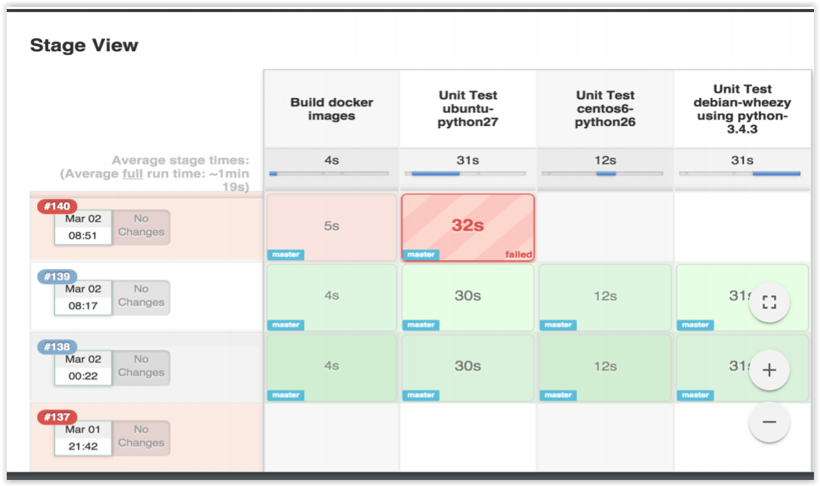
Jenkins 2

Slide 12
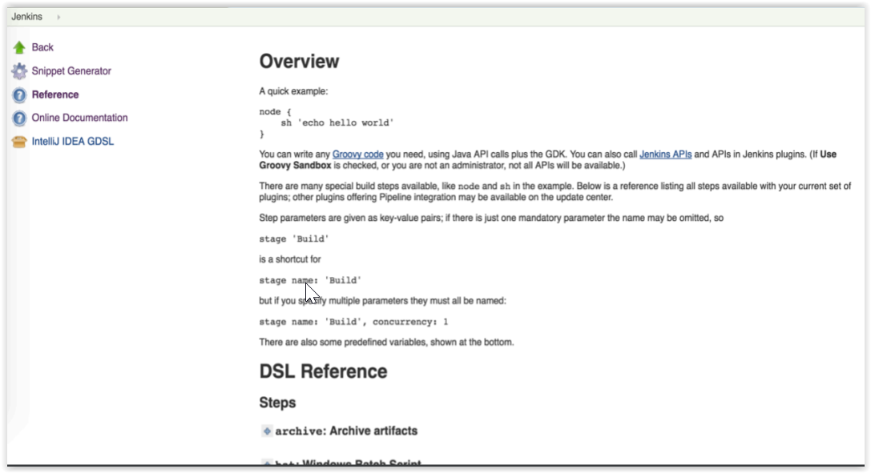
Jenkins 2

Slide 13
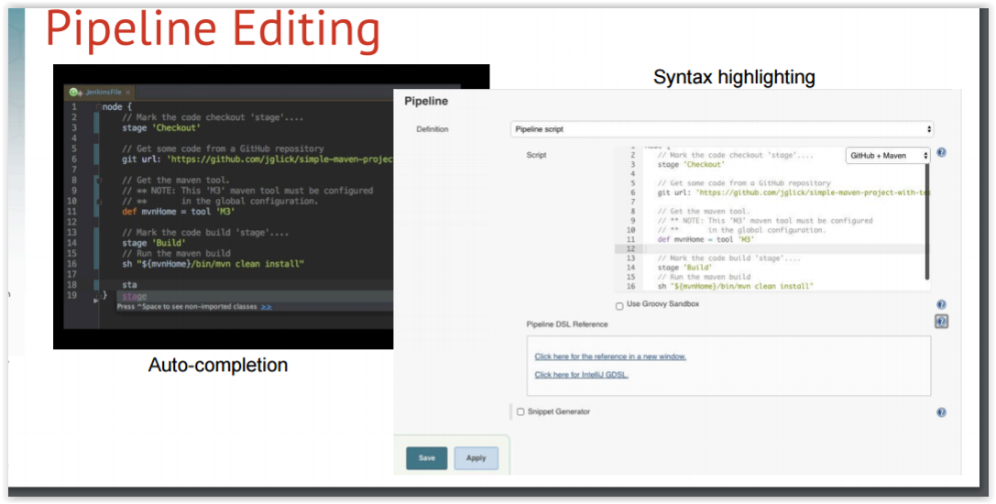
Jenkins 2

Slide 14
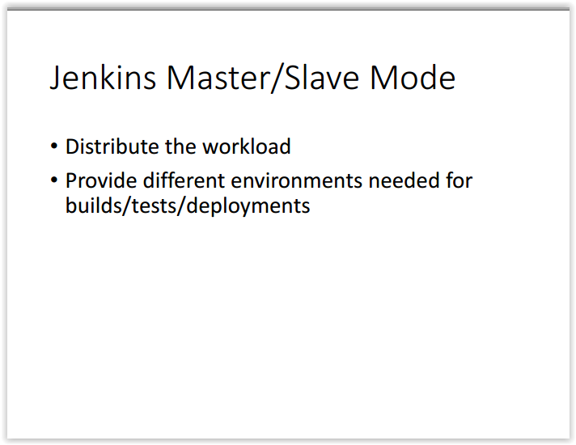
Jenkins 2

Slide 15
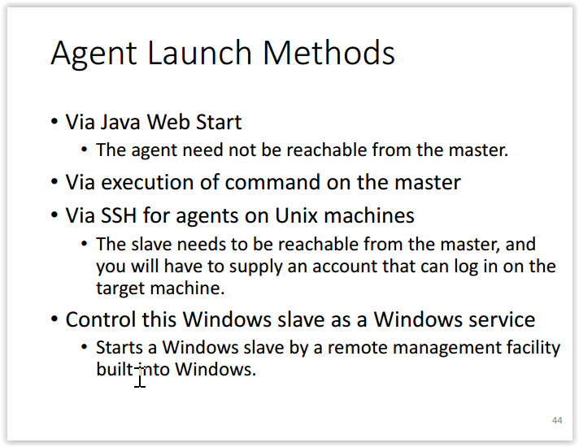
Jenkins 2

Slide 16
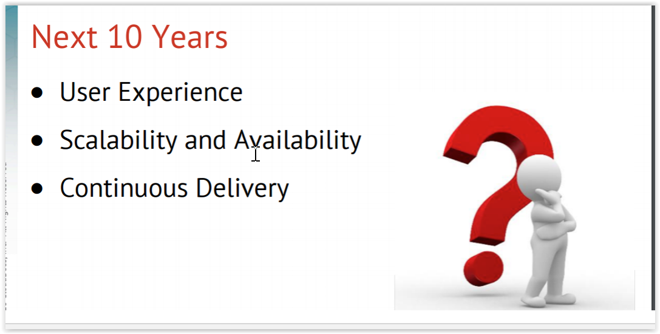
Jenkins 2

