Slide 1
MAHAKIL SMOTE

Slide 2
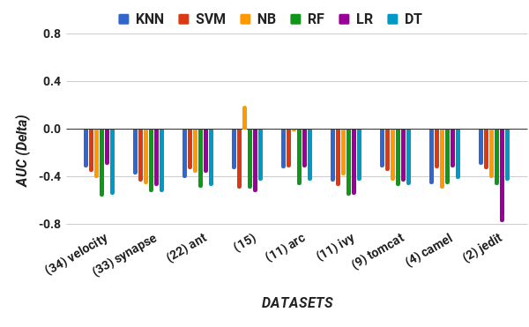
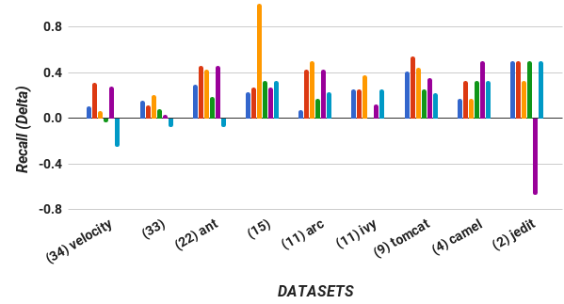

Slide 3
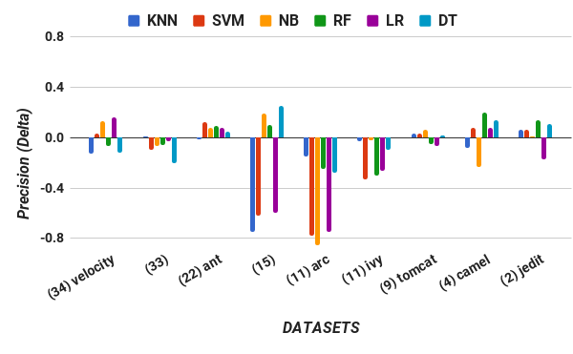
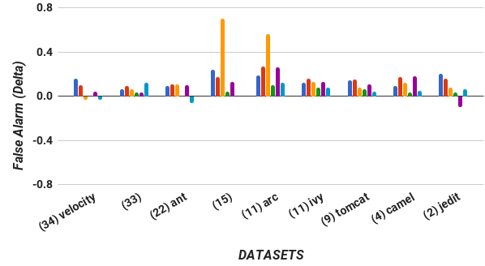

Slide 4
MAHAKIL SMOTUNED

Slide 5
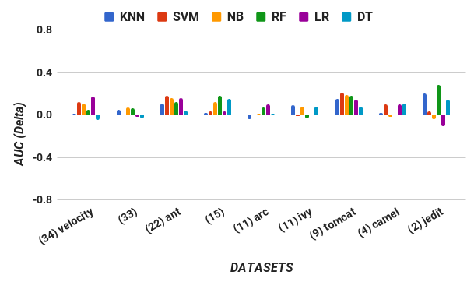
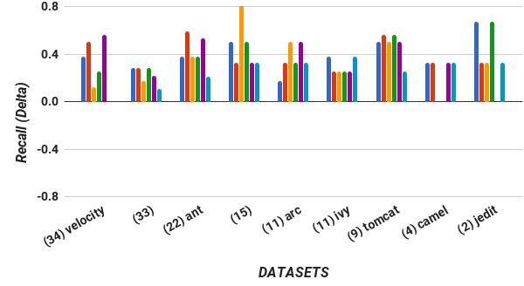

Slide 6
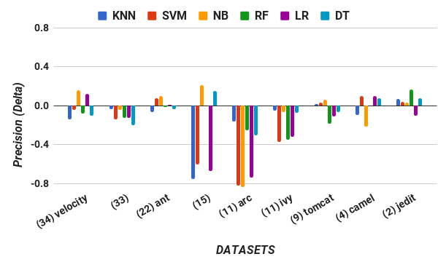
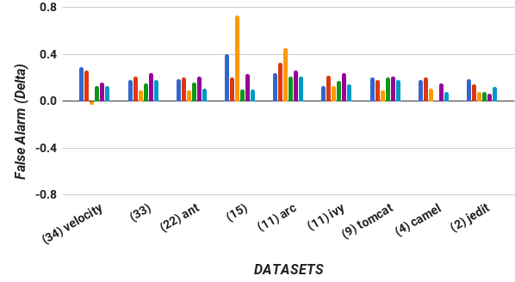

Slide 7
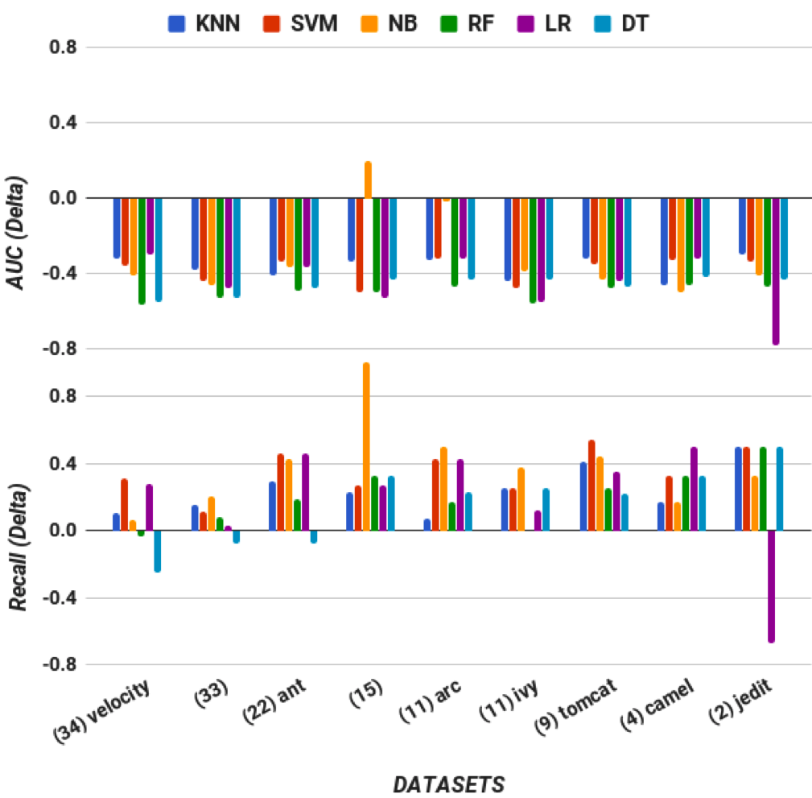
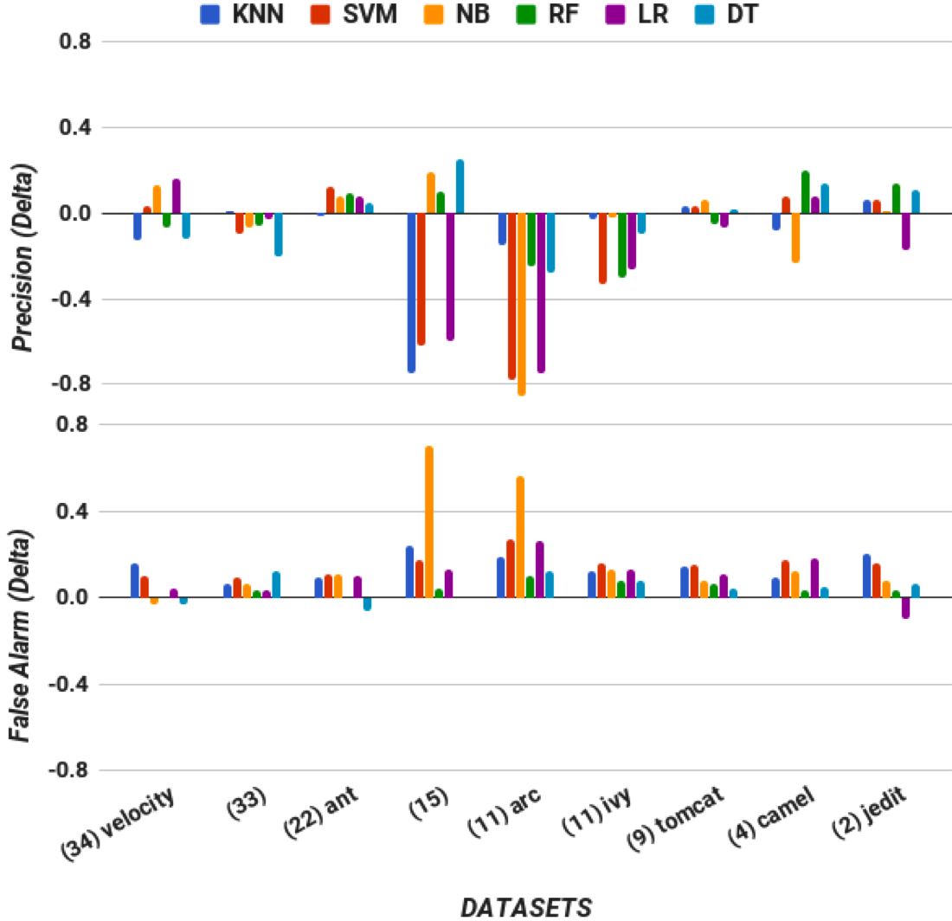
SMOTE improvement over MAHAKIL. For most charts larger values are better, but for false alarm smaller values are better. Note that the corresponding percentage of minority class (in this case, defective class) is written beside each dataset.

Slide 8
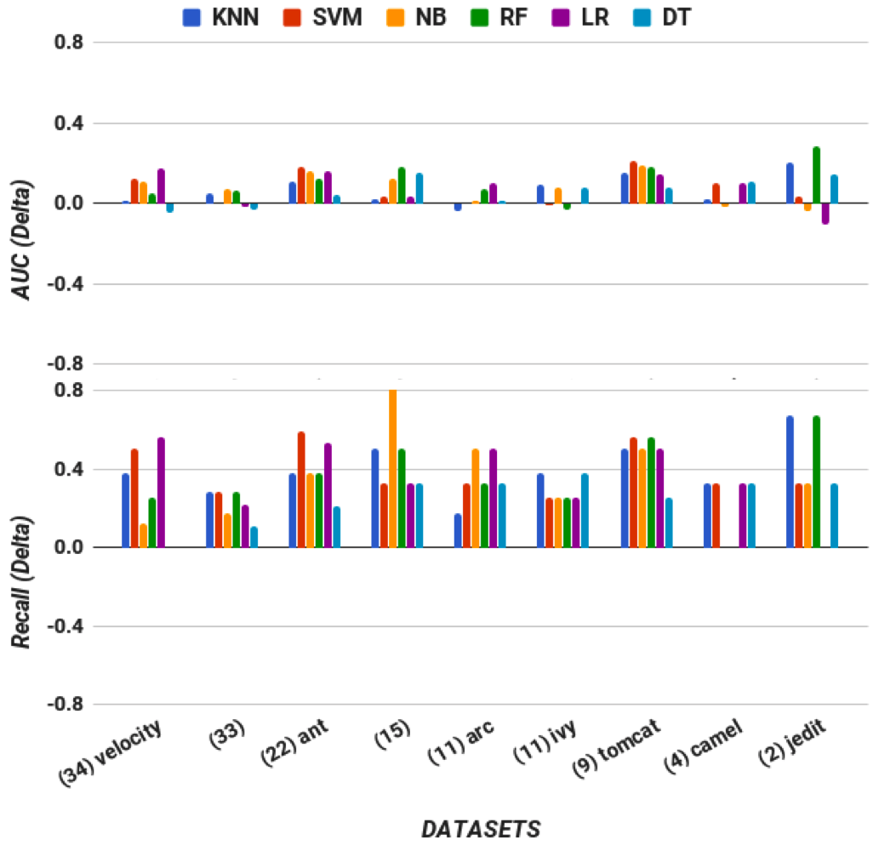
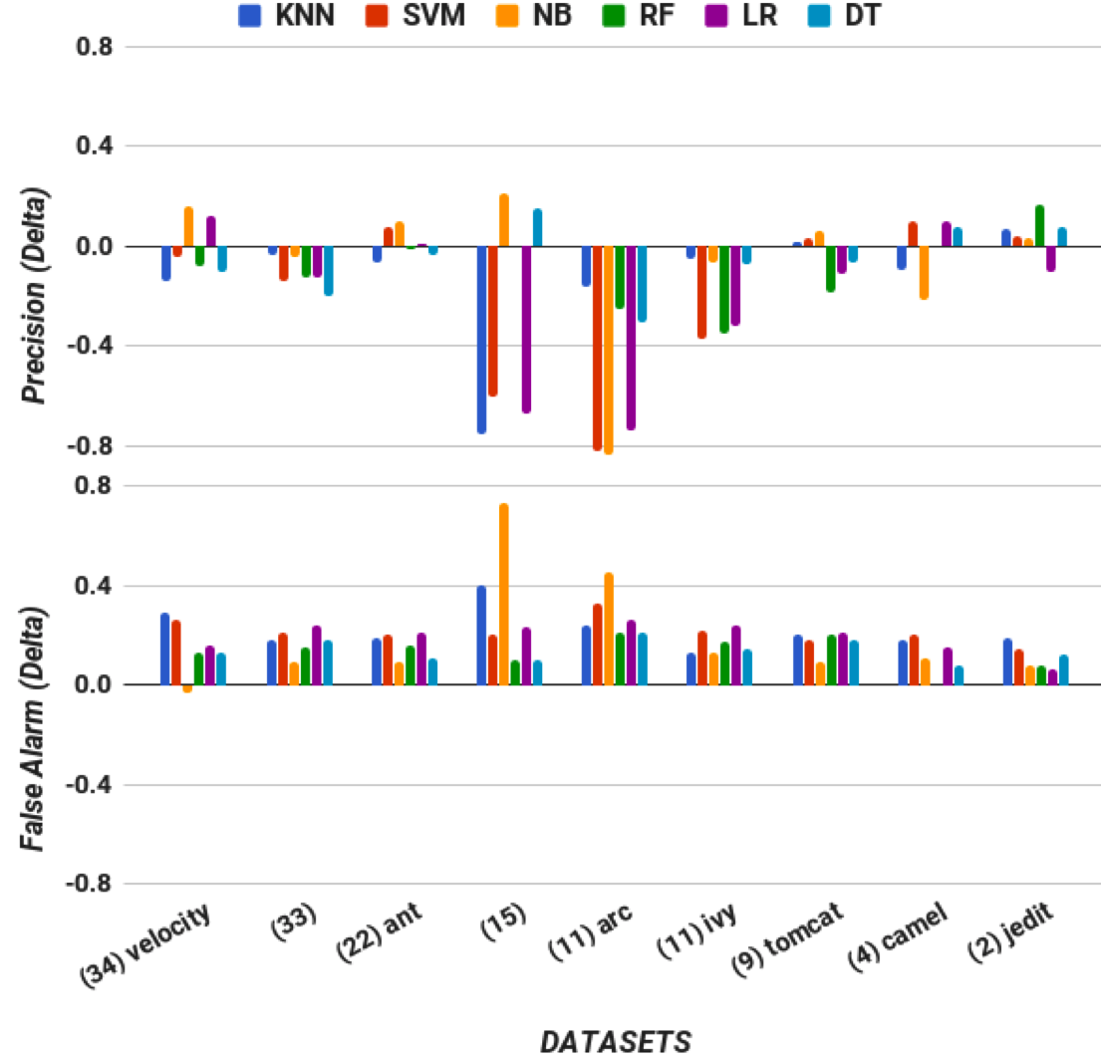
SMOTUNED improvement over MAHAKIL. Within-Measure assessment (i.e., for each of these charts, optimize for performance measure M_{i}, then test for performance measure M_{i}). For most charts larger values are better, but for false alarm smaller values are better. Note that the corresponding percentage of minority class (in this case, defective class) is written beside each dataset.

Slide 9
SMOTUNED withinmeasure

Slide 10
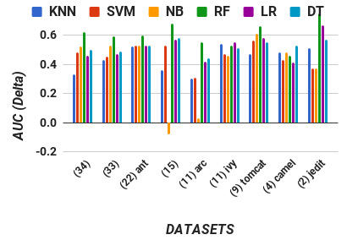
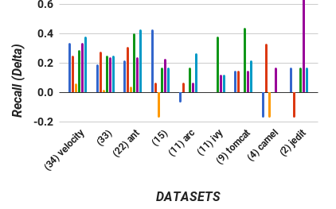

Slide 11
