Slide 1
ONLINE SHOP MOBILE
Class Name: WD04
Group Name: Group 1
Members: Lê Ngọc Xuân
Tạ Văn Ước
Nguyễn Văn Duyệt

Slide 2
Introduction to Project
1.Intending to do the following system:
The online website of selling phones.
2. Purpose:
Building a website to sell phones online, helping customers to choose the suitable phones for their demands instead of going to the stores. With the device has an internet connection, you can choose to buy a phone which is both convenient and cost-effective.
3. Website’s name:
Online Shop Mobile.

Slide 3
Customer Requirements
Website has a beautiful interface and compatible abilities with almost internet-connected devices such as laptop, personal computer, smart phones,…
Website has enough basic functions of online selling website.
Managing easily the product items, configuration of website.

Slide 4
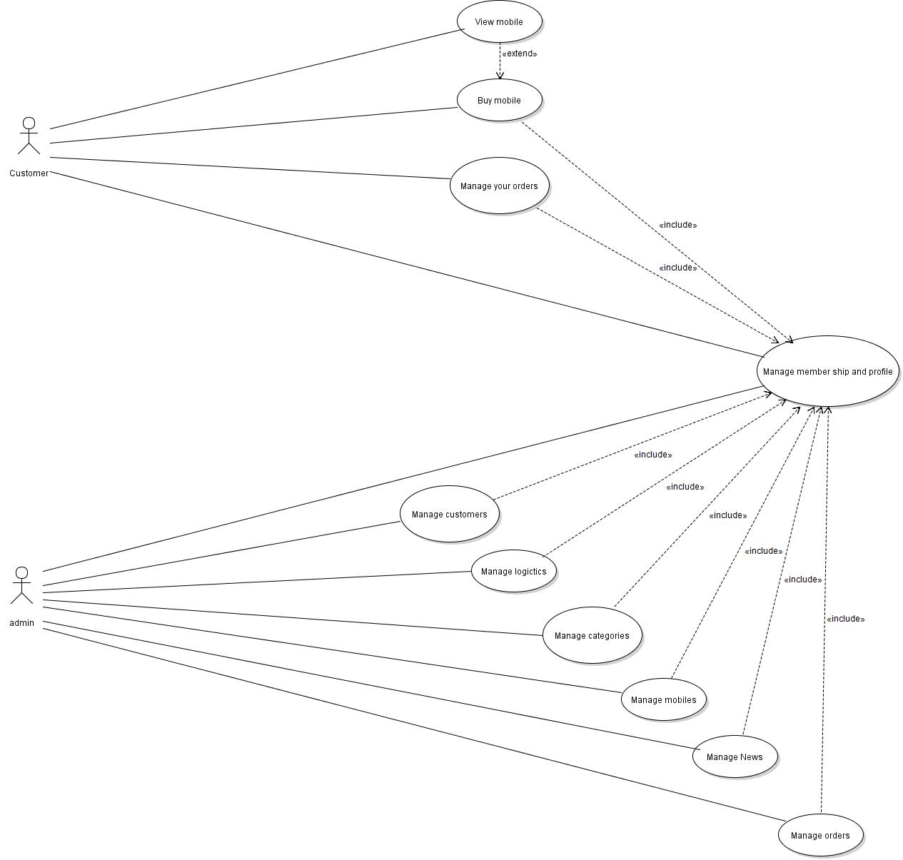
Use Case

Slide 5
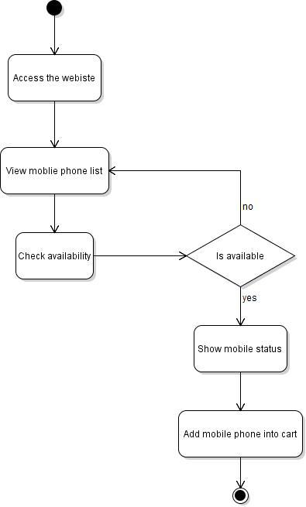
Activity Diagram
Add to cart

Slide 6
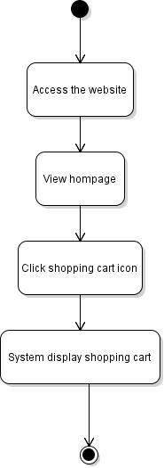
Activity Diagram
View Shopping cart

Slide 7
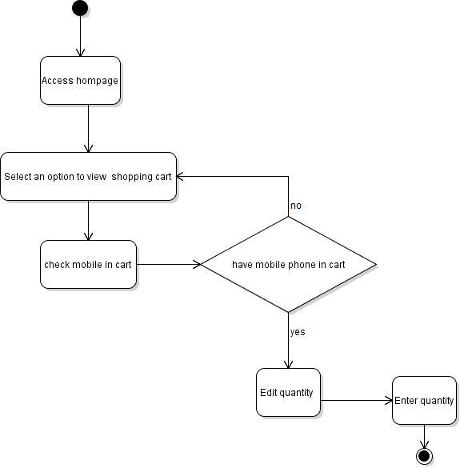
Activity Diagram
Edit shopping cart

Slide 8
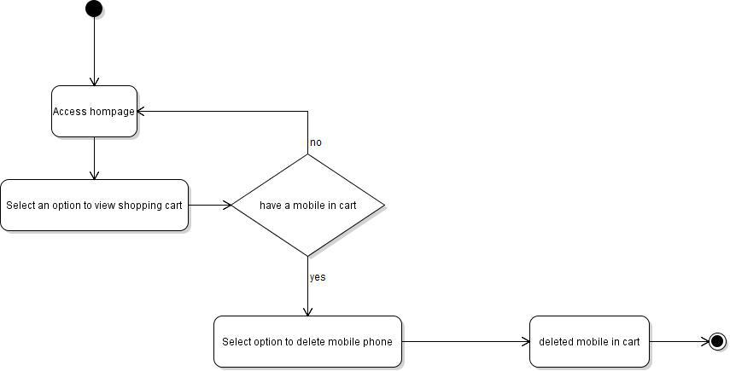
Activity Diagram
Delete shopping cart

Slide 9
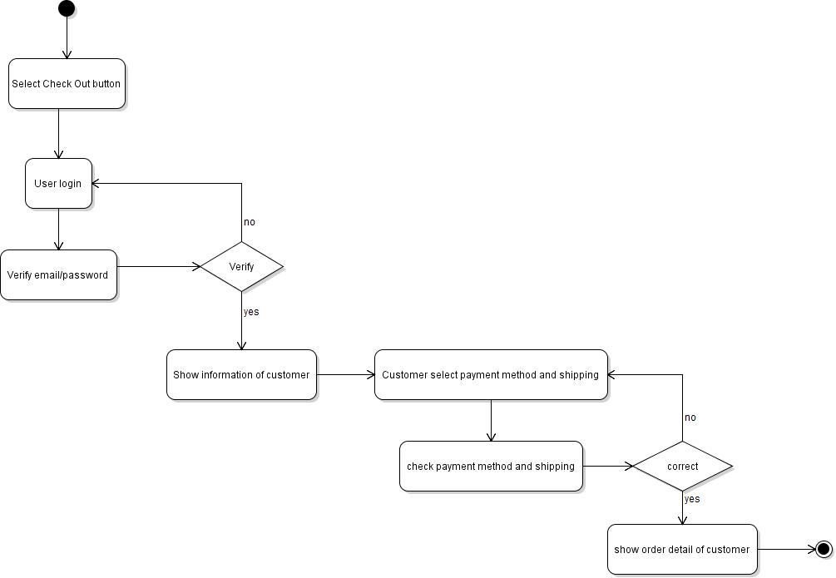
Activity Diagram
Check Out

Slide 10
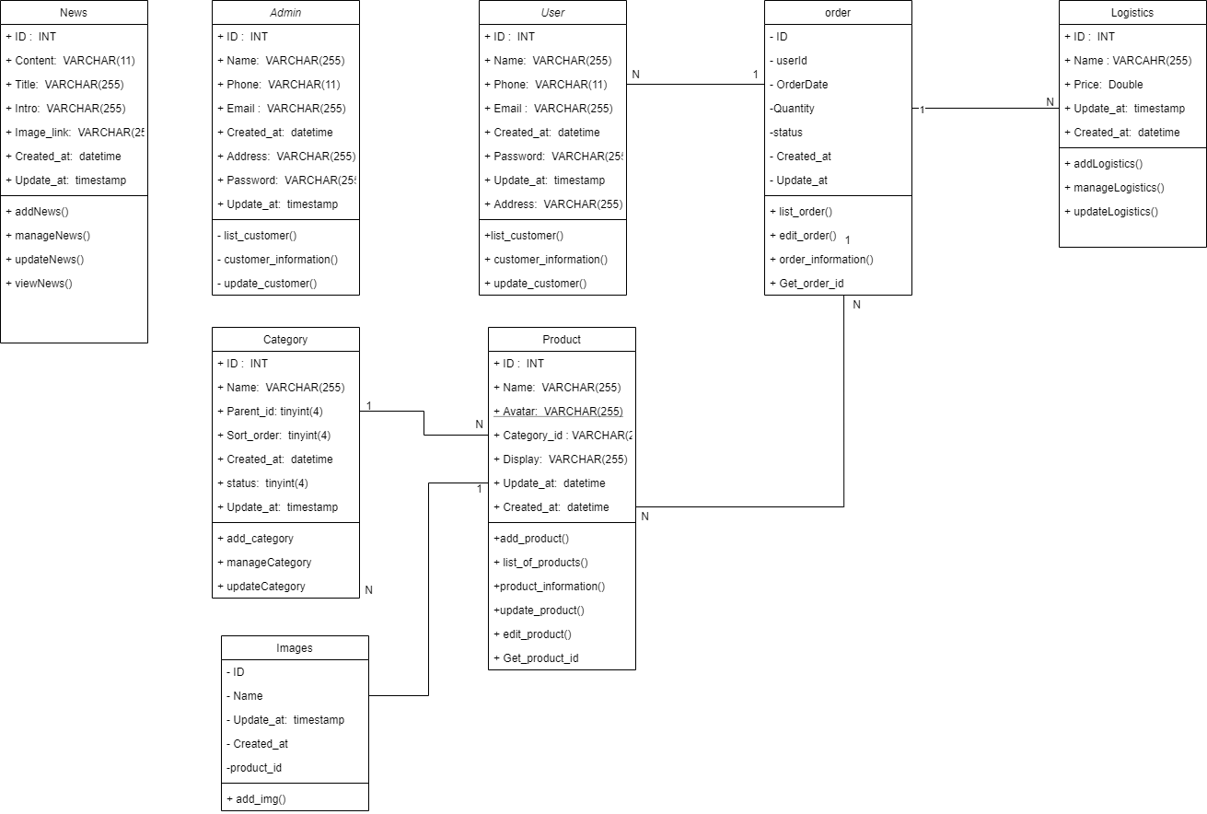
Class Diagram

Slide 11
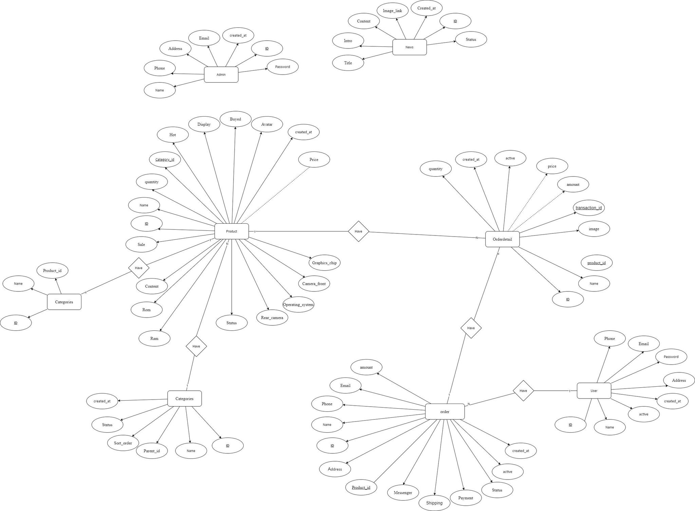
Entity Relationship Diagram

Slide 12
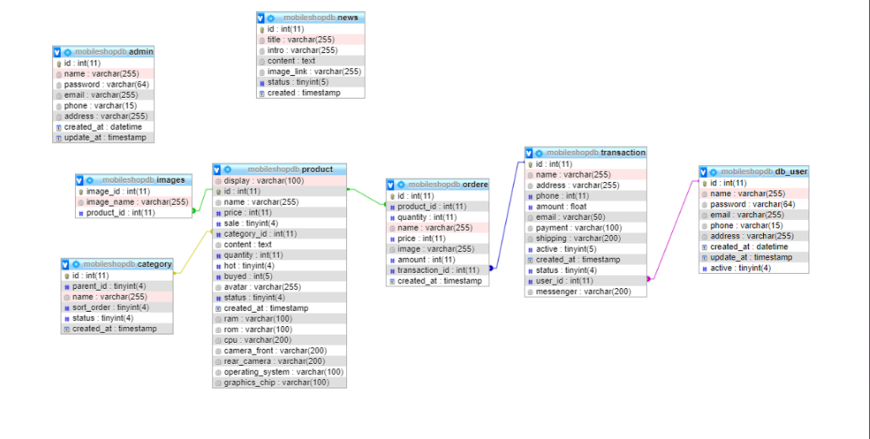
Entity Relationship Diagram

Slide 13
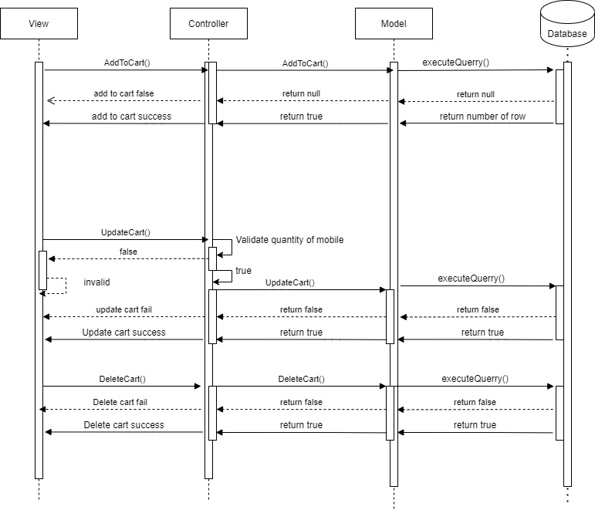
Sequence Diagram
Buy Mobile

Slide 14
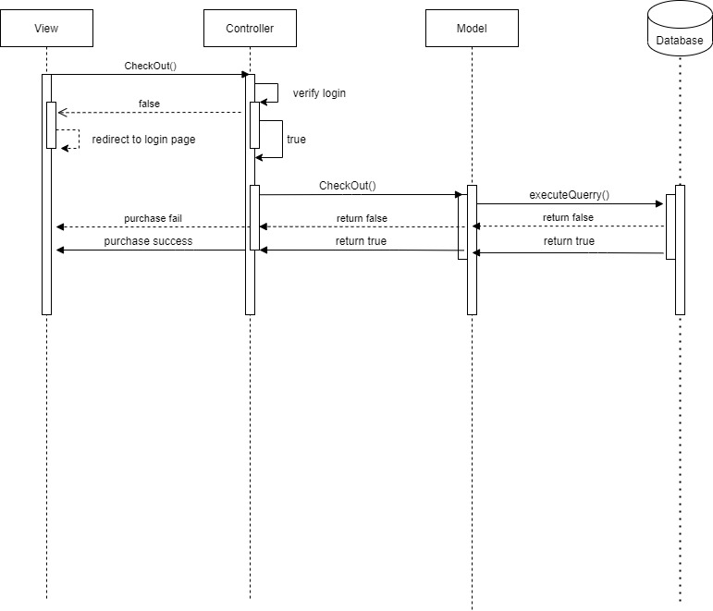
Sequence Diagram
Check Out

Slide 15
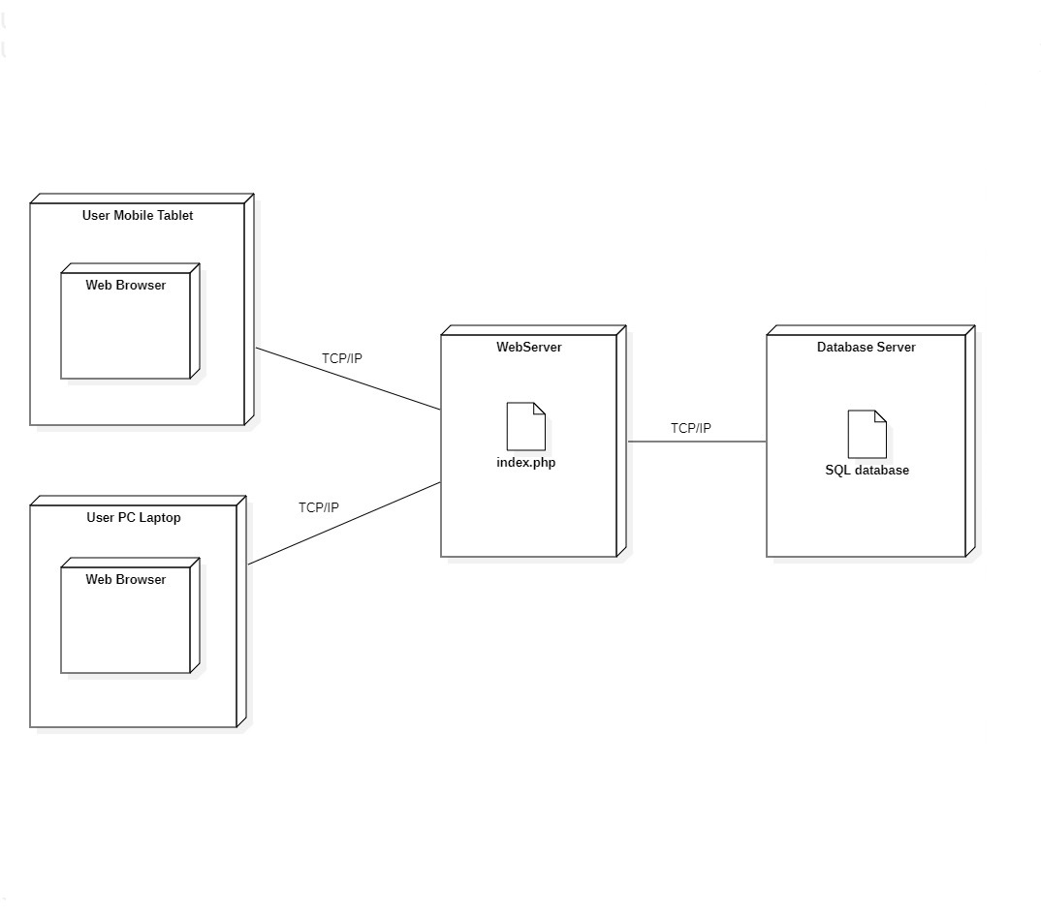
Deployment Diagram

Slide 16
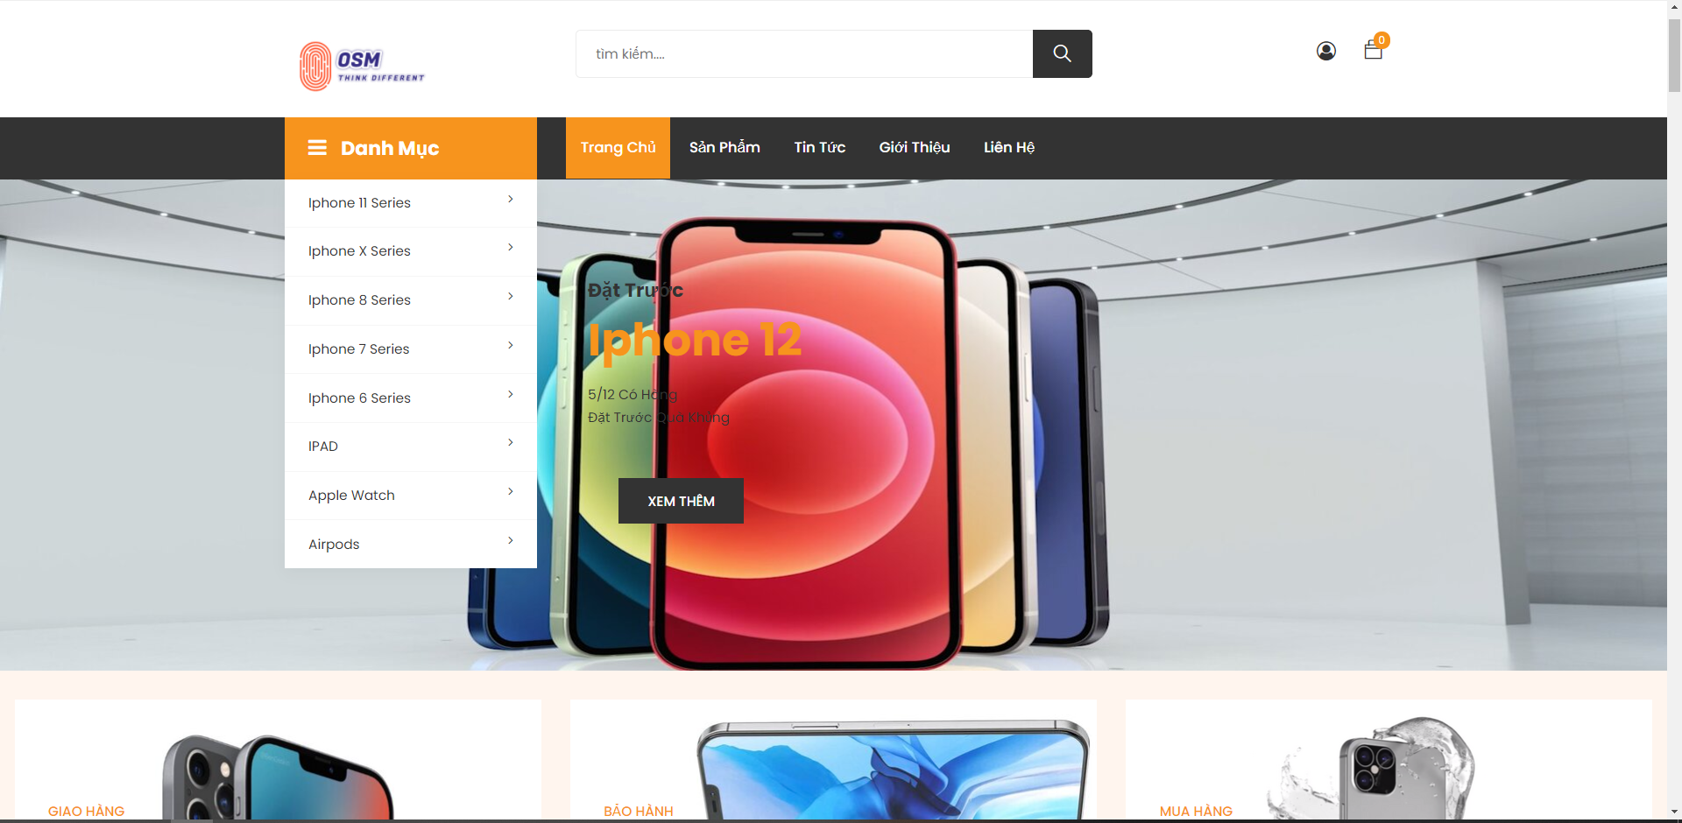
UI/UX Design

Slide 17
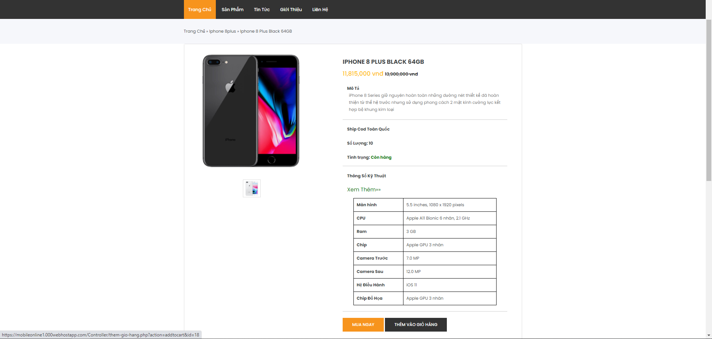
UI/UX Design

Slide 18
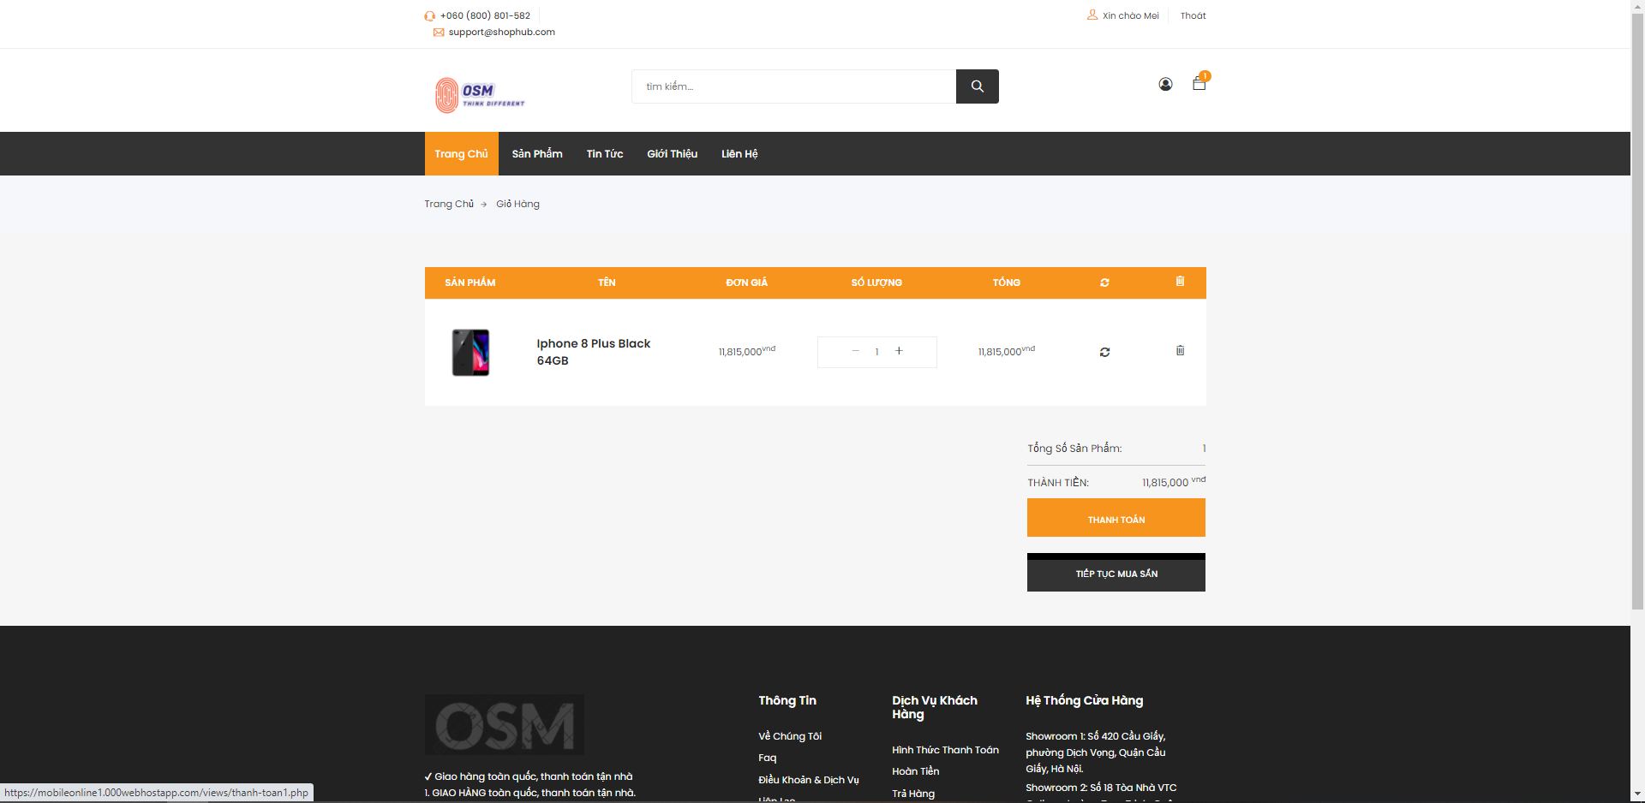
UI/UX Design

Slide 19
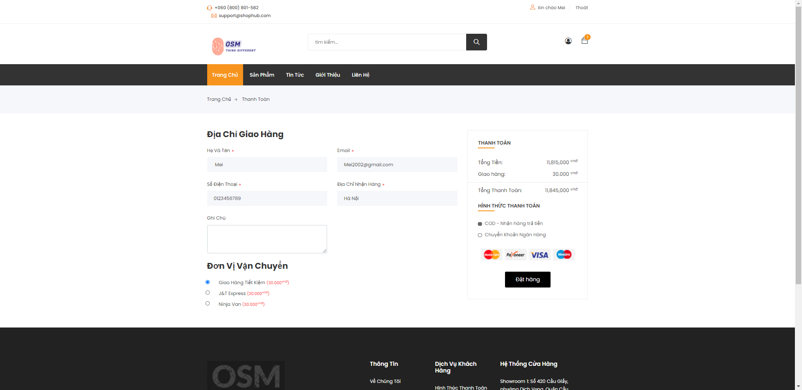
UI/UX Design

Slide 20
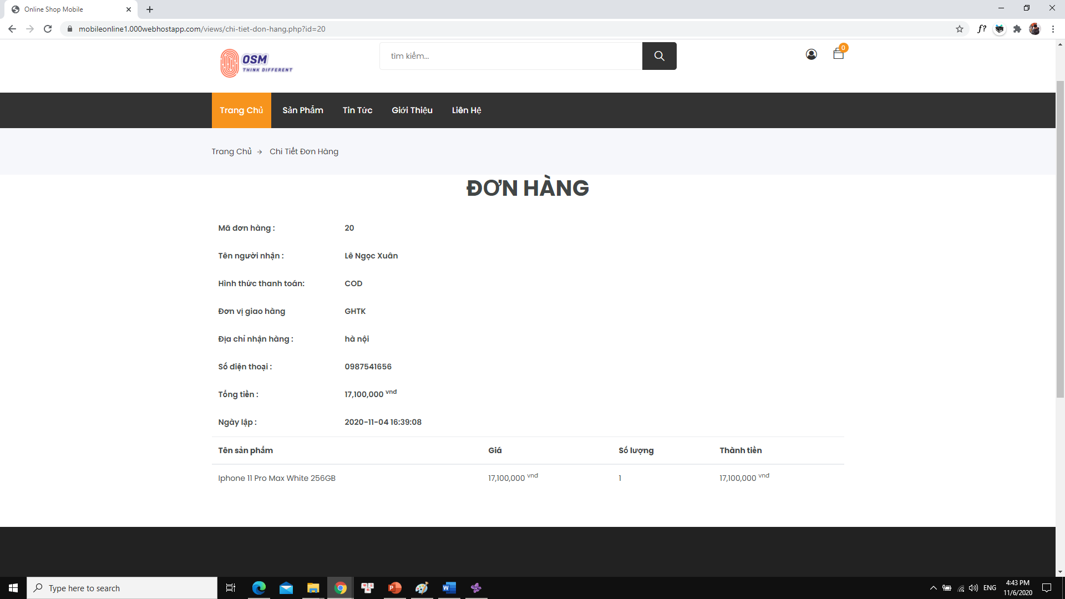
UI/UX Design

Slide 21
Task Assign (to each team member)
Group 1 | Mobile Shop Online
No | Task name | Description | Start Date | End Date | Member | Self assessment
1 | Major Analysis | system analysis | 1/8/2020 | 6/8/2020 | Xuan | 100%
2 | Draw Use Case 1,2,3 | Design Use Case | 9/8/2020 | 15/8/2020 | Xuan | 100%
3 | Draw Use Case 4,5,6 | Design Use Case | 9/8/2020 | 15/8/2020 | Uoc | 100%
4 | Draw Use Case 7,8,9 | Design Use Case | 9/8/2020 | 15/8/2020 | Duyet | 100%
5 | Draw Sequence 1,2,3 | Design Sequence | 9/8/2020 | 15/8/2020 | Xuan | 100%
6 | Draw Sequence 4,5,6 | Design Sequence | 9/8/2020 | 15/8/2020 | Uoc | 100%
7 | Draw Sequence 7,8,9 | Design Sequence | 9/8/2020 | 15/8/2020 | Duyet | 100%
8 | Design Database | Design | 17/8/2020 | 20/8/2020 | Xuan | 100%
9 | Create And Insert database | Code | 22/8/2020 | 27/8/2020 | Uoc, Duyet | 100%
10 | Code Use case 1,2,3 | Code | 31/8/2020 | 20/10/2020 | Xuan | 100%
11 | Code Use case 1,2,3 | Code | 31/8/2020 | 20/10/2020 | Uoc | 100%
12 | Code Use case 1,2,3 | Code | 31/8/2020 | 20/10/2020 | Duyet | 100%
11 | Complete document | Write doc | 21/10/2020 | 4/11/2020 | Duyet | 100%
12 | Complete slide | Write slide | 25/10/2020 | 4/11/2020 | Xuan | 100%

Slide 22
Experience Learned
Developing a great deal of teamwork’s experience.
Learning and capturing knowledge about HTML, CSS, PHP, JQUERY, MYSQL.
Getting experience of Google’s searching.

Slide 23


Slide 24
Q & A

