Slide 1
Python for Data Science
ETEC workshop
June 7-9, 2021
Day 2 materials!
http://github.com/worldbank/Python-for-Data-Science/tree/master/June_2021_ETEC/day_2

Slide 2
Key concepts from Day 1

Slide 3
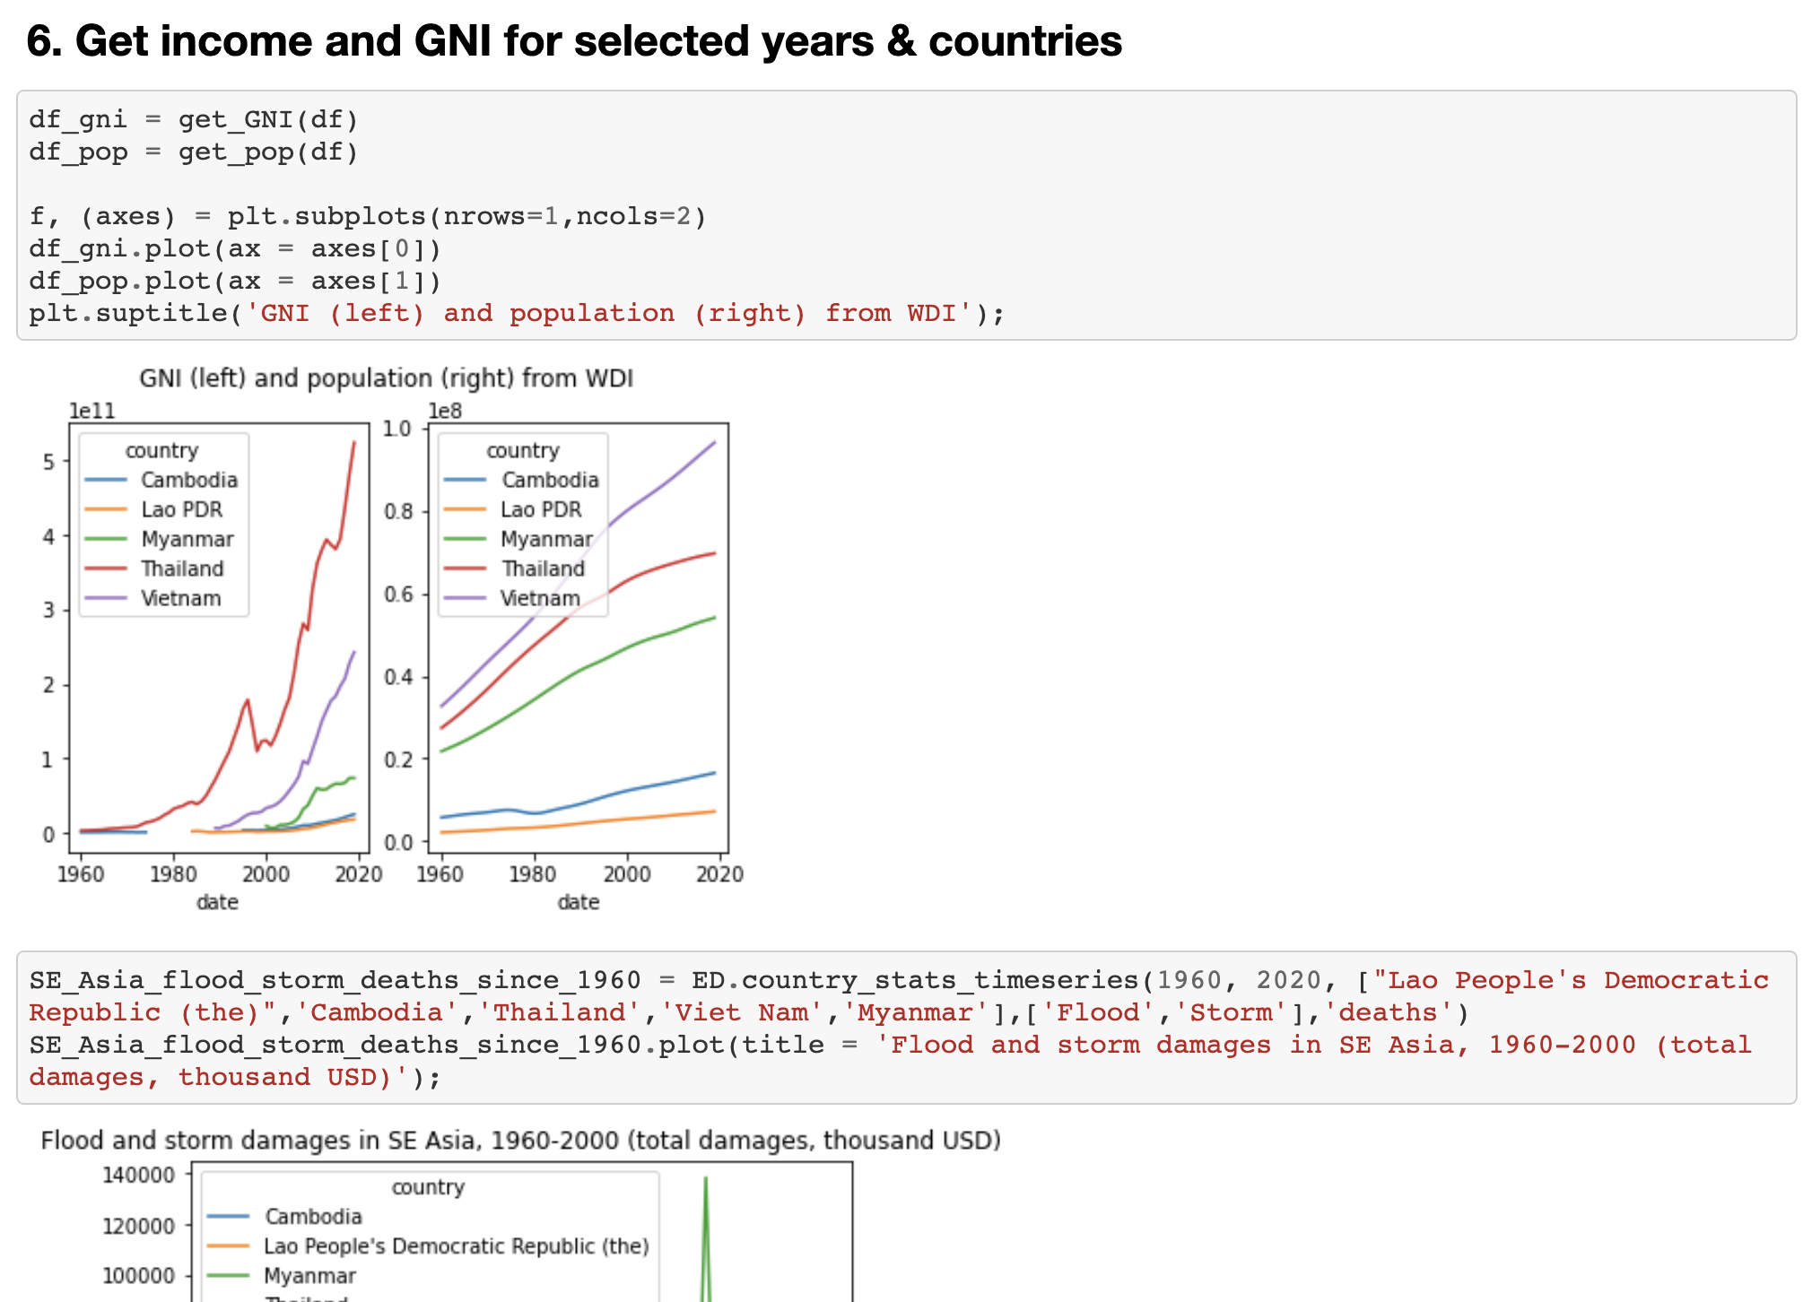

Code notebooks
Documents that combine:
Code
Outputs (eg. charts and tables)
Explanatory text
Individuals or organizations often use an online repository (eg. GitHub) to share their code notebooks.

Slide 4
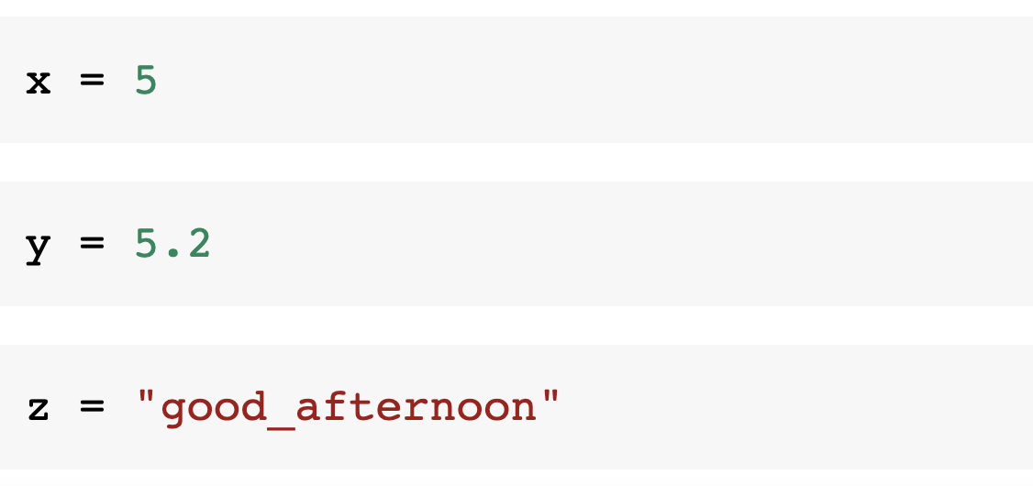
Basic data types: int, float, string

Slide 5
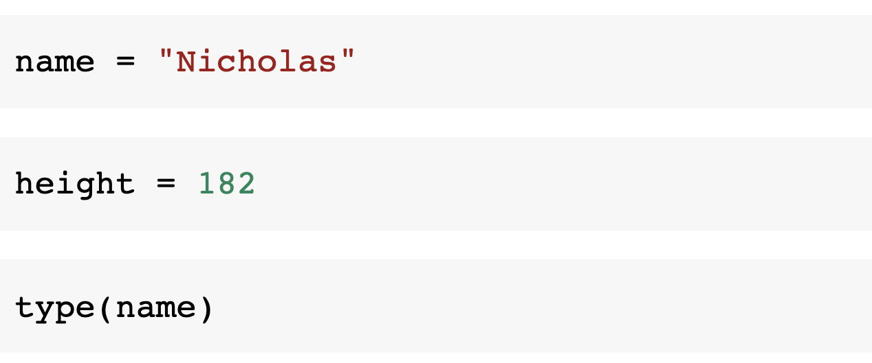
Assigning variables

Slide 6
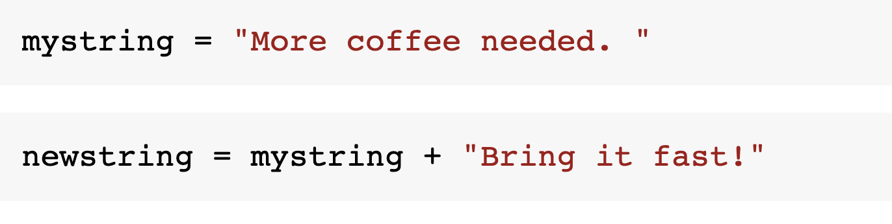
Working with strings

Slide 7
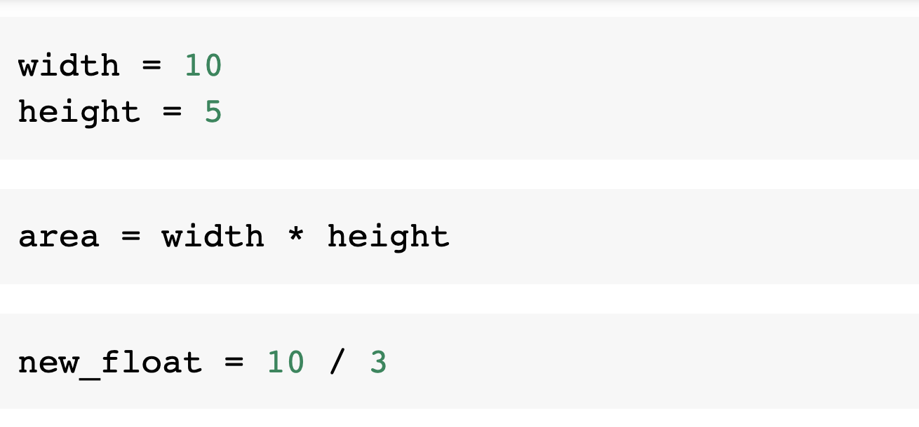
Working with numbers

Slide 8
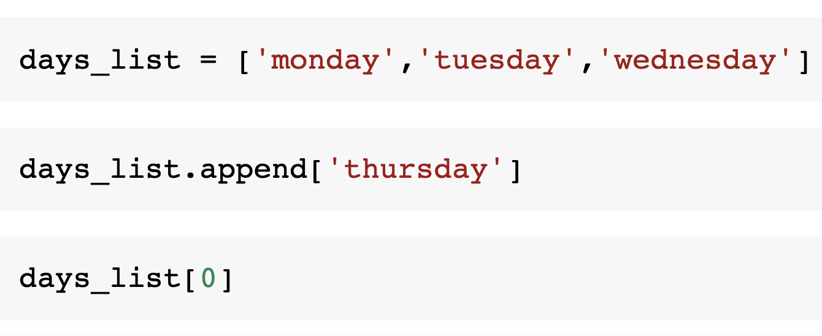
Lists

Slide 9
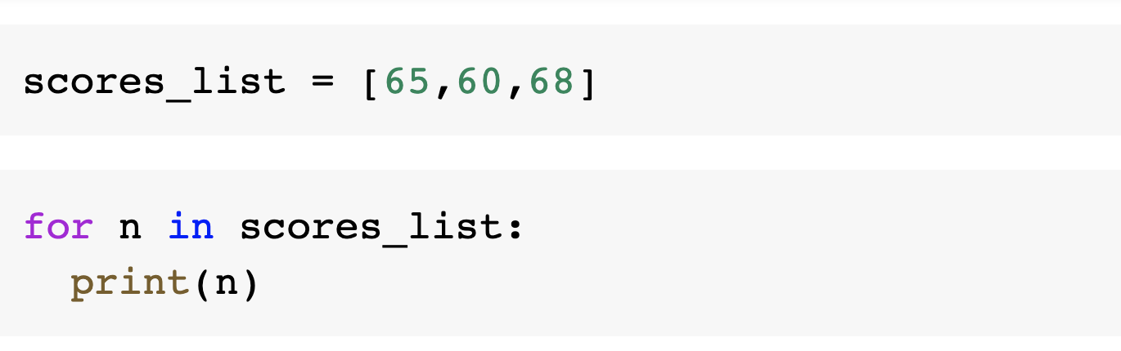
Loops

Slide 10
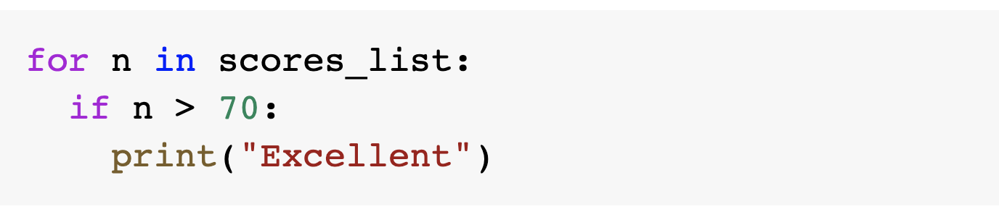
Conditions

Slide 11
To cover today:
Python basics (2): dictionaries, functions, further control flow
Introducing Pandas: data analysis with PISA.
Quiz and Labs (practice makes perfect!)

Slide 12
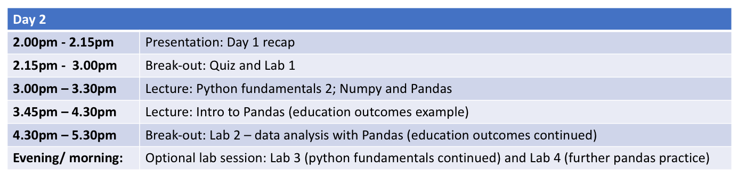
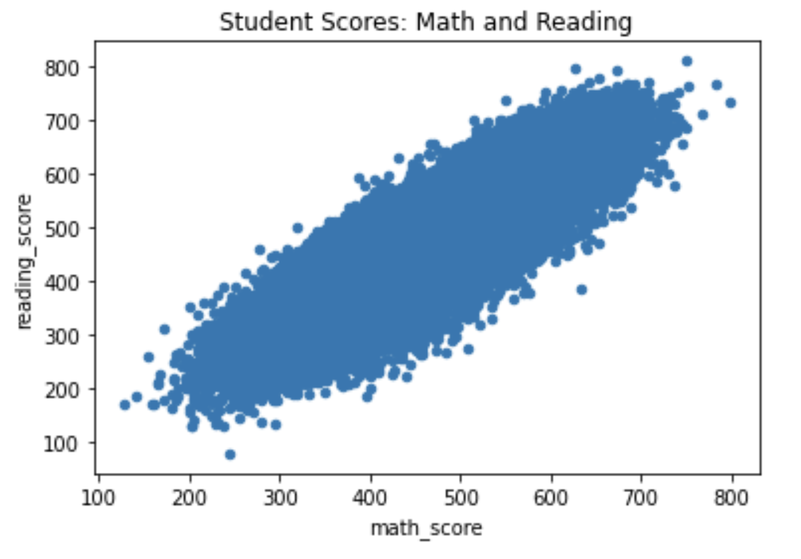
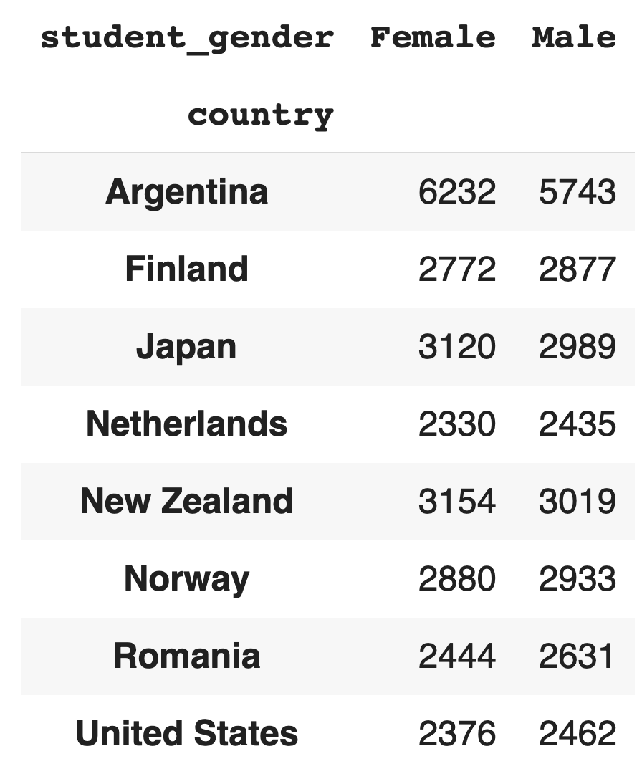
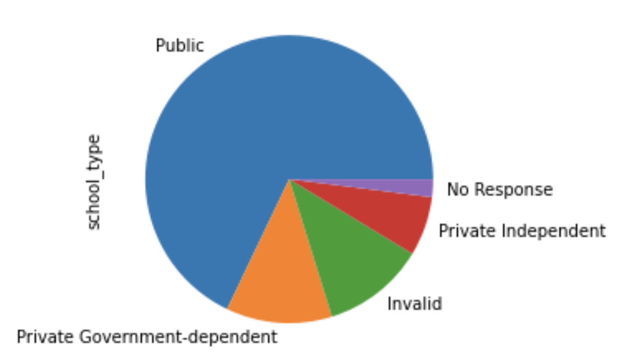
Schedule

Slide 13
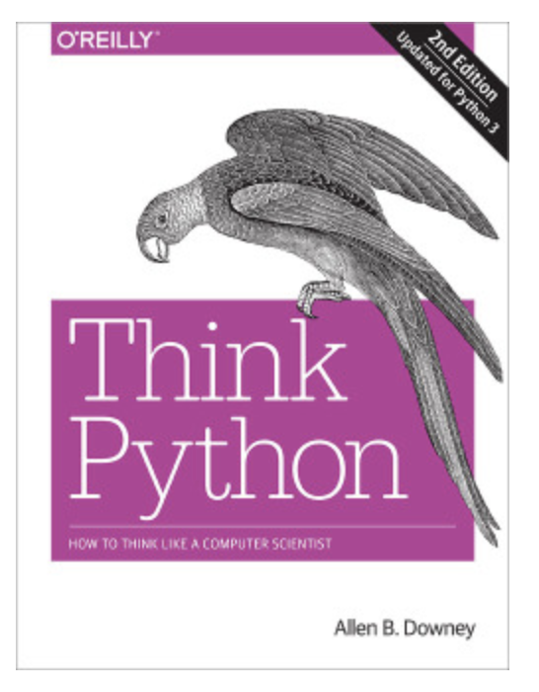

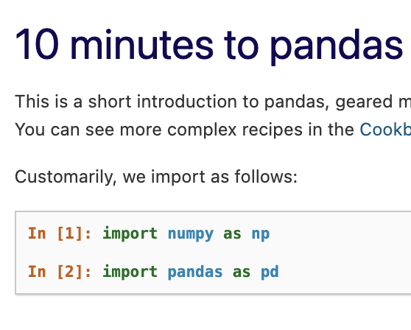
Recommended resources

