Slide 1
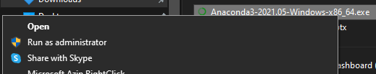
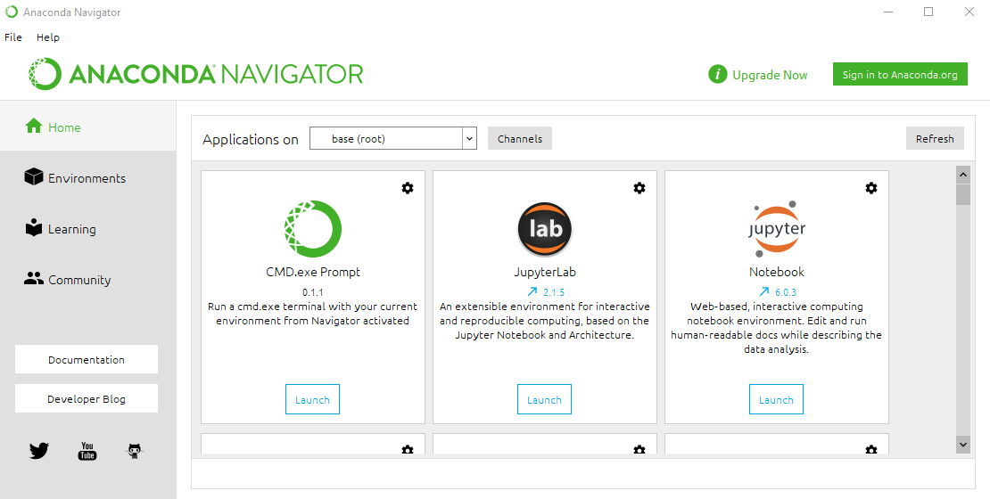
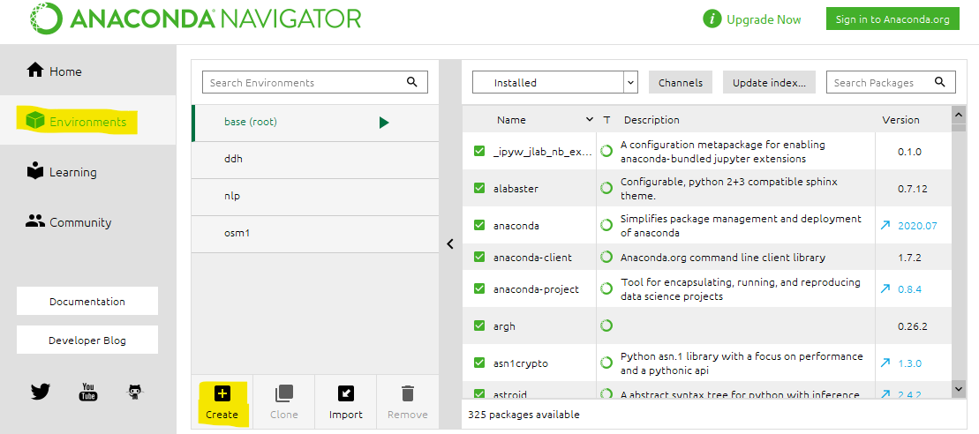
Guide to Install Anaconda (Jupyter Notebook)
1. Visit the website below and download Anaconda for Windows/Mac
Anaconda website: https://www.anaconda.com/products/individual-b
3. After the installation is complete, open Anaconda Navigator from Start Menu
2. For Windows users, right click on .exe file and Run as Administrator
4. Click on Environments tab on the left, and then click on Create

