Slide 1
Python for Data Science
ETEC workshop
June 7-9, 2021
Day 3 materials!
http://github.com/worldbank/Python-for-Data-Science/tree/master/June_2021_ETEC/day_3

Slide 2
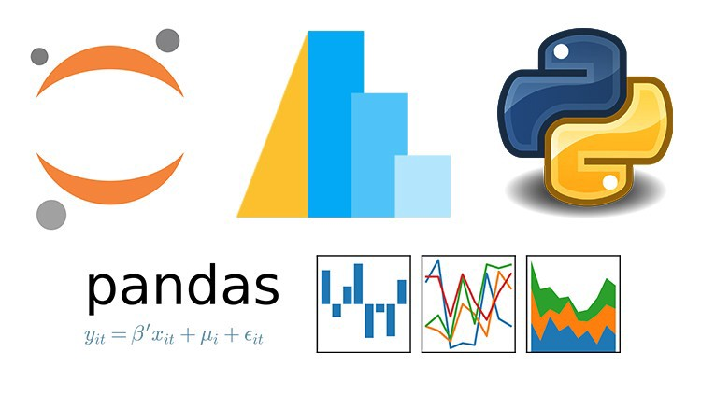
Numpy and Pandas
Numpy array:
Efficient data structures for numerical data
Pandas series and DataFrame:
data cleaning (80% of data science workload), manipulation and visualization.

Slide 3
Key concepts from Day 2

Slide 4
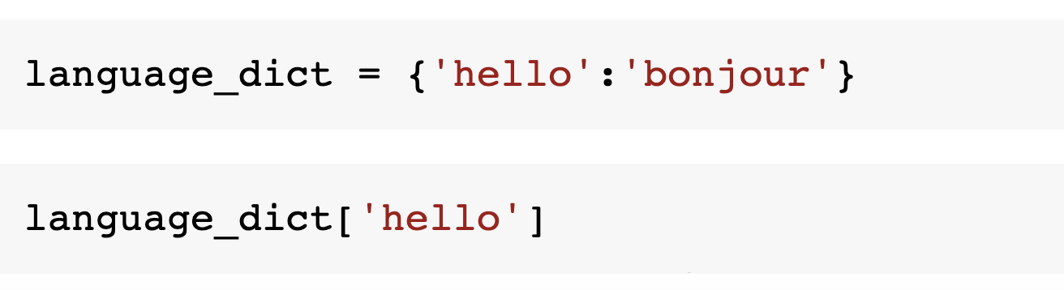
Dictionaries

Slide 5
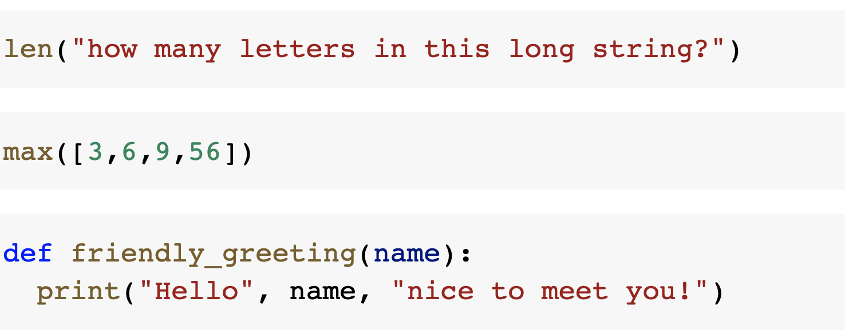
Functions

Slide 6
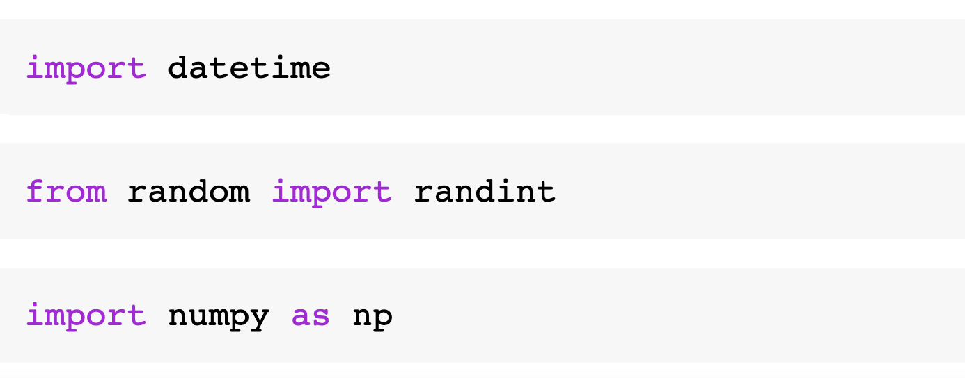
Imports

Slide 7
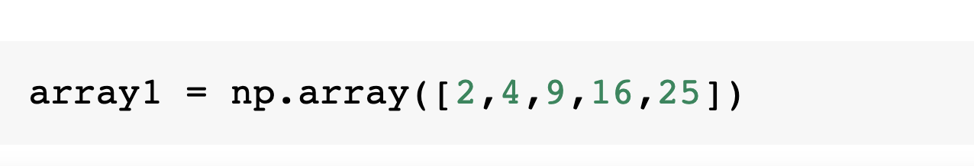
Numpy

Slide 8
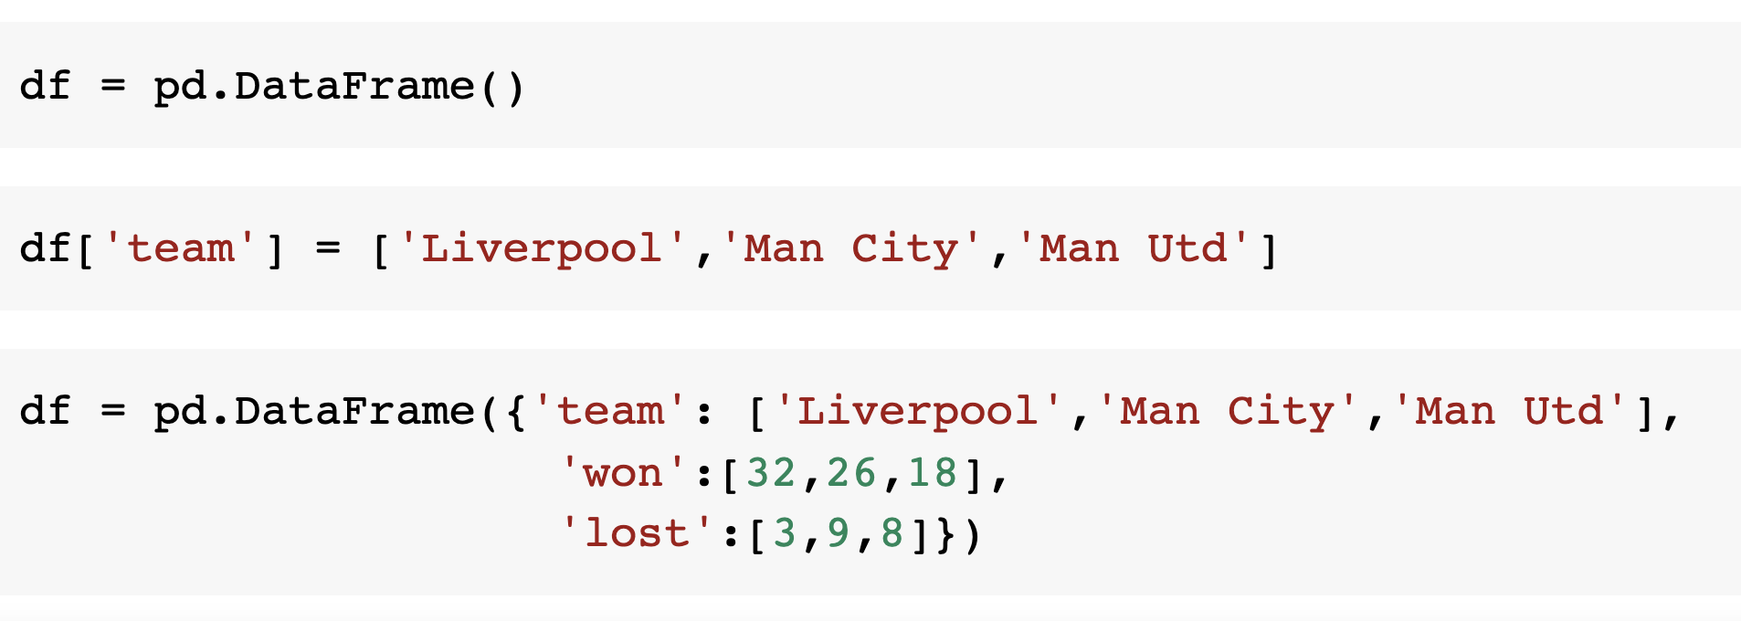
Creating DataFrames

Slide 9
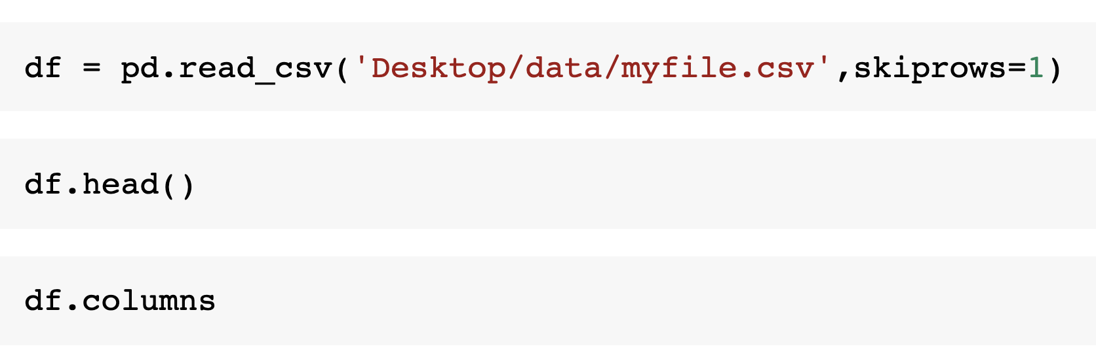
Read and inspect data

Slide 10
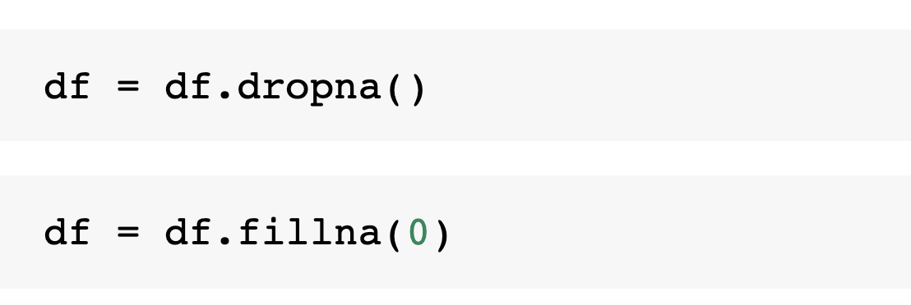
Handle missing values

Slide 11
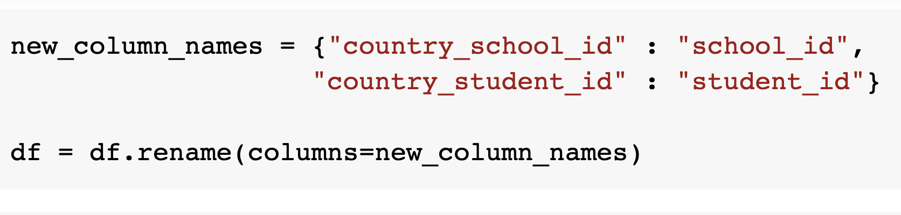
Rename columns

Slide 12
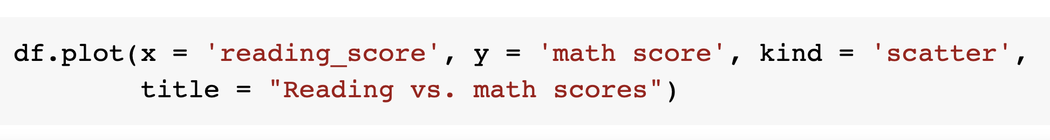
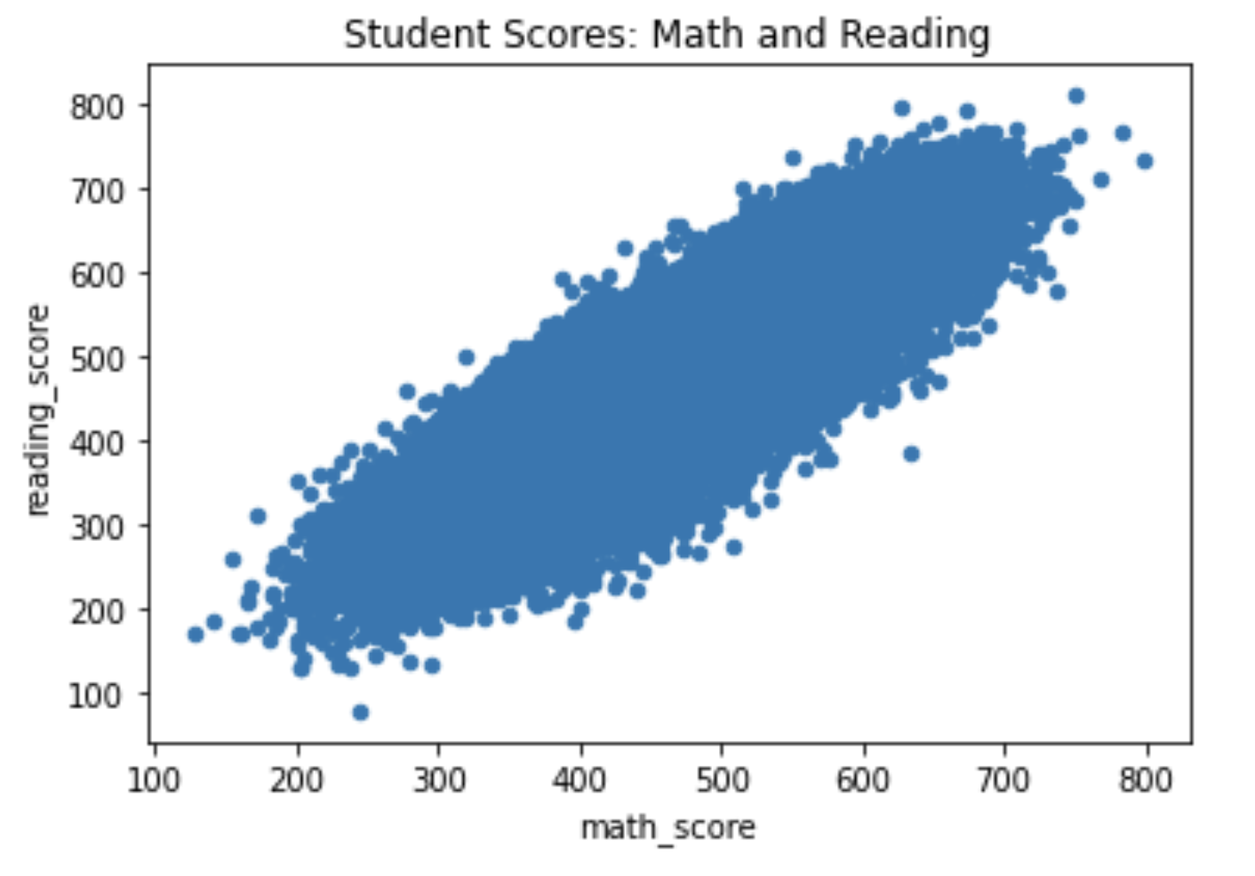
Plot charts

Slide 13
To cover today:
Pandas (2)
Installing Python: the Anaconda distribution
Brief intro to geo-data and machine learning

Slide 14
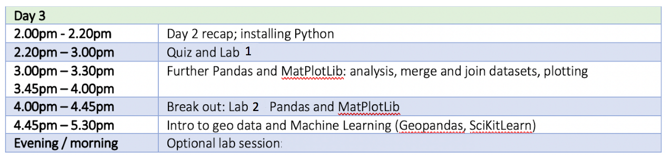
Schedule

