Slide 1

Taproot Lock &
RC(Regulation Compliance) Lock
9/1/2021

Slide 2
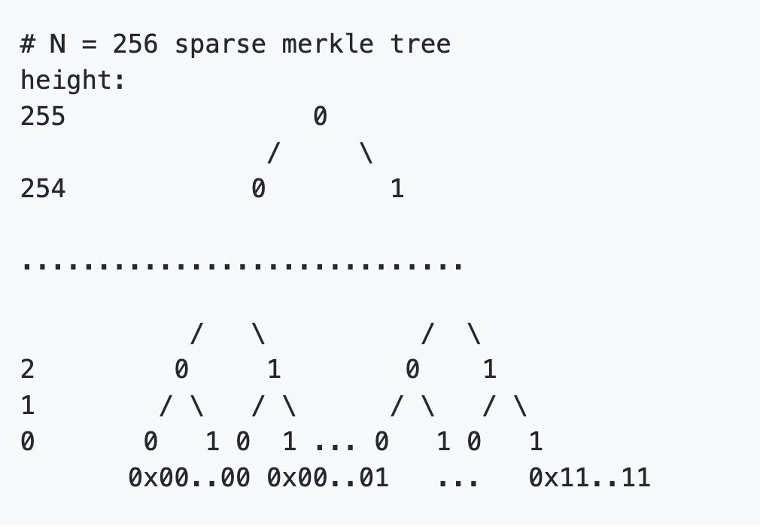
Key point: Sparse Merkle Tree (SMT)
Implementation in C and Rust: SMT

Slide 3
Taproot Background
BIP-0341: Taproot: SegWit version 1 spending rules
BIP-0340: Schnorr Signatures for secp256k1
Unlocked by
Key path spending (traditional way)
Script path spending (new)

Slide 4
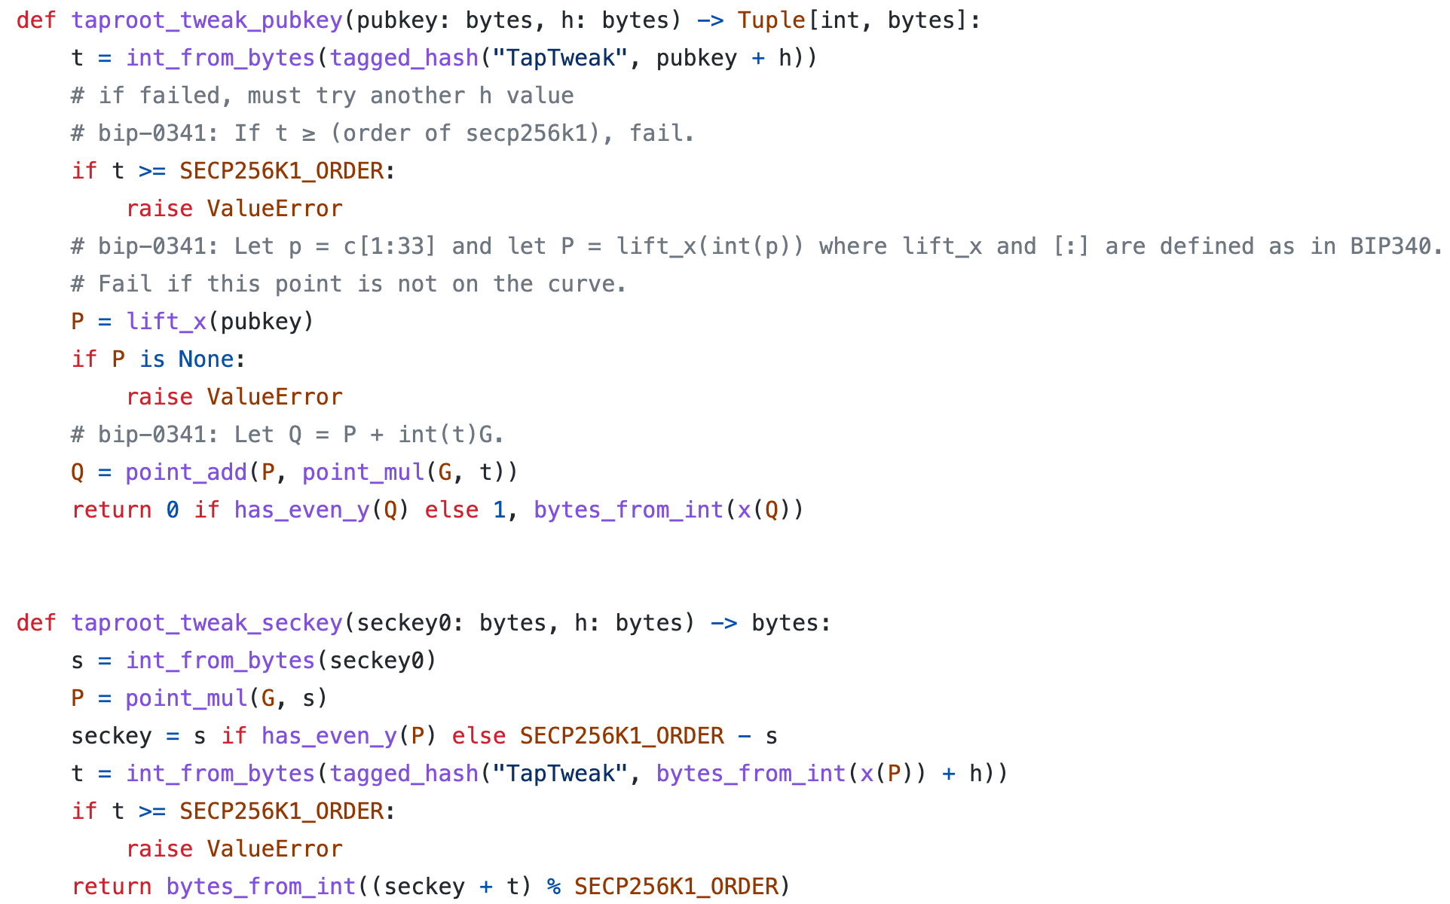
Schnorr Signature
Provable Security
Non-malleablity
Linearity
python demo

Slide 5
RC Lock Overview
RC Lock Spec It can be unlock by:
Owner of the cell
Administrators of the RC lock, typically regulators for a particular xUDT token
Compare to the taproot lock and compare them:
Key path spending (traditional way)
Script path spending (new)

Slide 6
Identity: Common Interface to Signature Verification
flag: 1 byte | identity content: 20 bytes
flag
0x00: CKB (secp256k1)
0x01: Ethereum
0x02: Eos
0x03: Tron
0x04: Bitcoin
0x05: Dogecoin
0x06: Schnorr
...
0xFC: Owner lock
blake160 hash of pubkey, preimage
(code_hash+ hash_type + ...)

Slide 7
RC Lock: 2-phase
Phase 1. Special logic in lock
Phase 2. Identity: signature verification
Special Logic in Lock
(RC)Regular Compliance
Anyone Can Pay
Time Lock
Supply
They can be all turned off, which enables only phase-2: signature verification

Slide 8
RC Lock: Script Args
Identity: 21 bytes | rc lock args: variable length
RC args
ACP args
Time Lock args
Supply args
rc lock flag: 1 byte
masks
RC AdminList Cell's Type ID
Same as in RCE(xUDT)

Slide 9
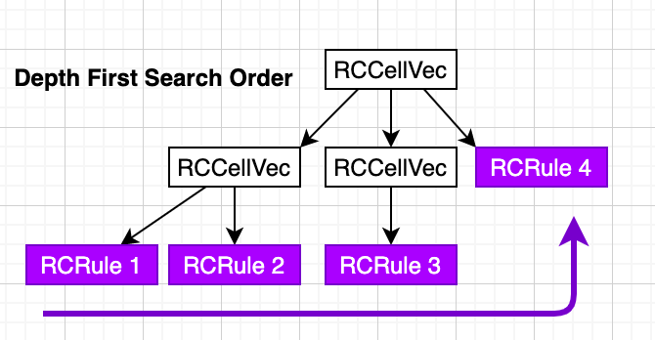
RC Lock: Witness
signature | rc_identity | preimage
RC AdminList Cell's Type ID
identity | proof 1 | proof 2 | proof 3 | proof 4
note: In taproot, there is only one RCRule and one proof

Slide 10
RC Lock: Unlock by Administrator
rc_lock mask is enable (script args)
rc_identity in witness is not empty (witness)
verify identity in rc_identity on white list (witness)
use identity in rc_identity to unlock (witness)

Slide 11
Taproot Lock Overview
Taproot Lock Spec
It follows BIP-0341, replacing MAST(Merkelized Abstract Syntax Tree) with our SMT.

Slide 12

THANKS

