Slide 1

Taproot Lock &
RC(Regulation Compliance) Lock
9/1/2021
Notes:
监管合规:Regulation Compliance

Slide 2
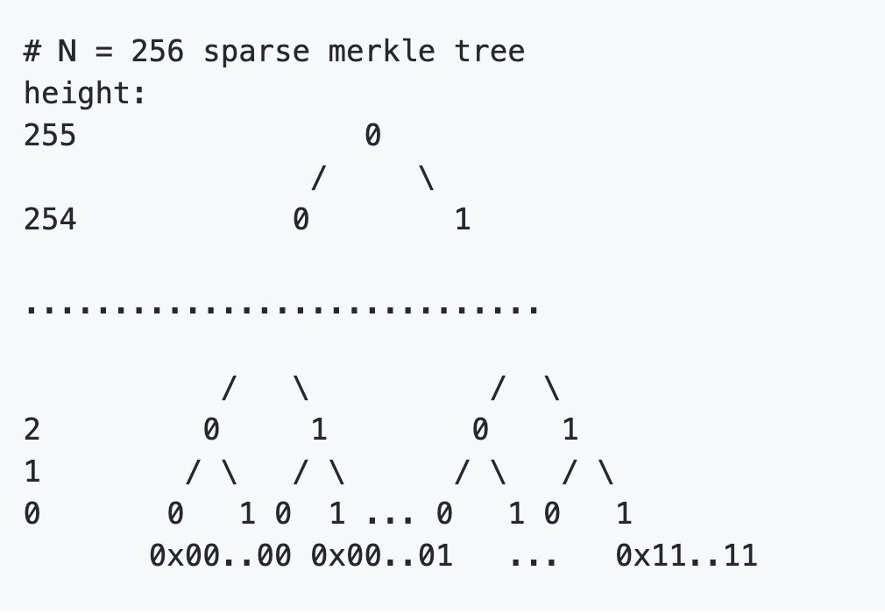
Key Point: Sparse Merkle Tree (SMT)
Implementation in C and Rust: SMT
K/V store with only 32-byte data(SMT Root) on chain.
It can verify a 32-byte key is on (or not on) SMT with proof.
SMT is the key library shared by
Taproot Lock and RC Lock.

Slide 3
Taproot Background
BIP-0341: Taproot: SegWit version 1 spending rules
BIP-0340: Schnorr Signatures for secp256k1
Unlocked by
Key path spending (traditional way)
Script path spending (new)

Slide 4
Schnorr Signature
Provable Security
Non-malleablity
Linearity
python demo
P = s * G
P' = (s + h) *G

Slide 5
RC Lock Overview
RC Lock Spec It can be unlock by:
Owner of the cell
Administrators
Compare to the taproot lock:
Key path spending (traditional way)
Script path spending (new)

Slide 6
Identity: Common Interface to Signature Verification
flag: 1 byte | identity content: 20 bytes
flag
0x00: CKB (secp256k1)
0x01: Ethereum
0x02: Eos
0x03: Tron
0x04: Bitcoin
0x05: Dogecoin
0x06: Schnorr
...
0xFC: Owner lock
blake160 hash of pubkey, preimage
(code_hash+ hash_type + ...)

Slide 7
RC Lock: Two Phases
Phase 1. Special logic in lock
Phase 2. Identity: signature verification
Special Logic in Lock
(RC)Regulation Compliance
Anyone Can Pay
Time Lock
Supply
They can be all turned off, which enables only phase-2: signature verification

Slide 8
RC Lock: Script Args
Identity: 21 bytes | rc lock args: variable length
RC args
ACP args
Time Lock args
Supply args
rc lock flag: 1 byte
masks
RC AdminList Cell's Type ID
Same as in RCE(xUDT)

Slide 9
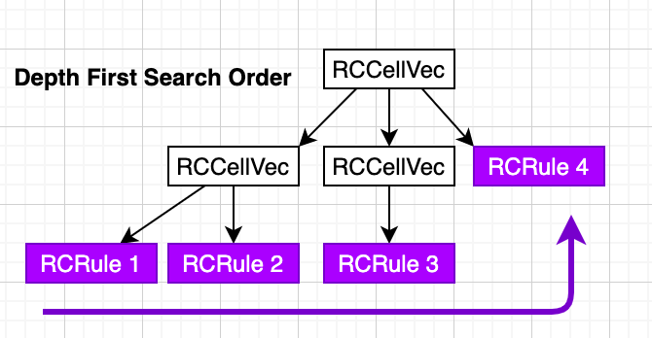
RC Lock: Witness
signature | rc_identity | preimage
RC AdminList Cell's Type ID
(RC Args in script args)
identity | proof 1 | proof 2 | proof 3 | proof 4
note: there is at least one RCRule with white list

Slide 10
RC Lock: Unlock by Administrator
RC args in script args is enable (script args)
rc_identity in witness is not empty (witness)
verify identity in rc_identity on white list/or not on black list (witness)
use identity in rc_identity to unlock: the signature in witness can be also used. (witness)
Unlocking methods
Unlock via owner's public key hash
Unlock via owner's lock script hash
Unlock via administrator's public key hash
Unlock via administrator's lock script hash
Unlock via anyone-can-pay
Unlock via dynamic linking
Unlock via exec
Other method: Unlock by signature when the rc_identity in witness isn't present. It's trivial.

Slide 11
Taproot Lock Overview
Taproot Lock Spec
It follows BIP-0341, replacing MAST(Merkelized Abstract Syntax Tree) with CKB SMT.

Slide 12
Taproot Unlock Method:
Key Path Spending
Identical to unlock method (by signature) widely used in Bitcoin and CKB:
Replacing secp256k1 by Schnorr

Slide 13
Taproot Lock: Script Args
flag: 1 byte | identity content: 20 bytes
blake160 hash of taproot output key

Slide 14
Taproot Lock: Witness
pubkey, 32 bytes | signature, 64 bytes
signature or script_path: choose one
signature | script_path
taproot_ output_ key | taproot_ internal_ key | smt_root | smt_proof | y_parity | exec_script | args2

Slide 15
Taproot Unlock Method:
Script Path Spending
P = s * G
P' = (s + h) *G = s*G + h*G = P+h*G
ckb_tagged_hash(tag, x) = blake2b(tag || x)
def taproot_tweak_pubkey(pubkey, smt_root):
h = int_from_bytes(ckb_tagged_hash("TapTweak", pubkey + smt_root))
P = lift_x(pubkey)
P2 = point_add(P, point_mul(G, h))
return 0 if has_even_y(P2) else 1, bytes_from_int(x(P2))
(y_parity, taproot_output_key) = taproot_tweak_pubkey(taproot_internal_key, smt_root)

Slide 16
Script Path Spending Routine
taproot_output_key and y_parity should be equal to the return values of taproot_tweak_pubkey(taproot_internal_key, smt_root)
smt_verify(blake160(exec_script), VALUES, smt_root, smt_proof)
“ckb_exec_cell” exec_script (code_hash, hash_type, args), with additional args2
taproot_ output_ key | taproot_ internal_ key | smt_root | smt_proof | y_parity | exec_script | args2

Slide 17

THANKS

