Slide 1

BillMap
(https://billmap.govtrack.us/)
Daniel Schuman | Daniel@DemandProgress.org

Slide 2
Problem statement
How might technology assist time-constrained policy staffers by surfacing the critical information they need for legislative decision making?
Notes:
We spoke to dozens of current and former congressional staff, whom we thank for their time. They are overworked, under resourced, and desperate to get a handle on their various and ever-changing issue areas. This website is built specifically around their needs.

Slide 3
Key Findings
Staff need to identify at a glance legislation that contains particular legislative ideas (or “memes”) and to easily access contextual information about those ideas.
This information largely exists but more can be done to aggregate the information, process it, and present it in a way that supports staff work flows.

Slide 4


Slide 5
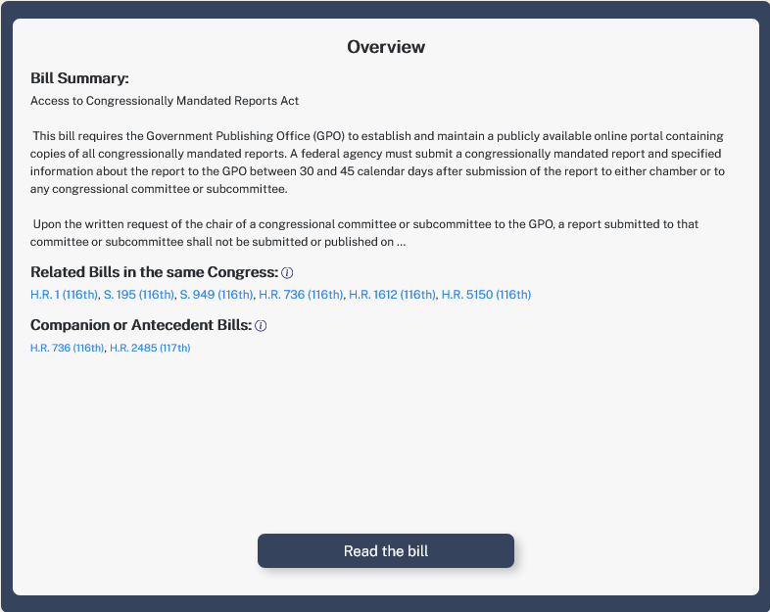
Bill summary
Related bills from the same Congress
Companion or antecedent bills over multiple Congresses
Bill text

Slide 6
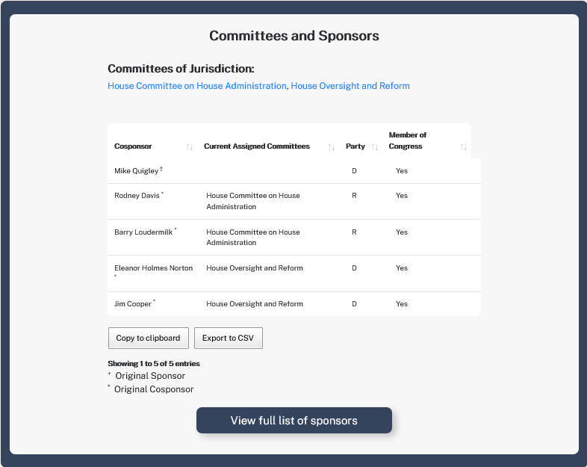
Committees of jurisdiction
Highlighted co-sponsors w/ current cmte assignment + leadership indicator
Download the data as CSV
Committee leadership?

Slide 7
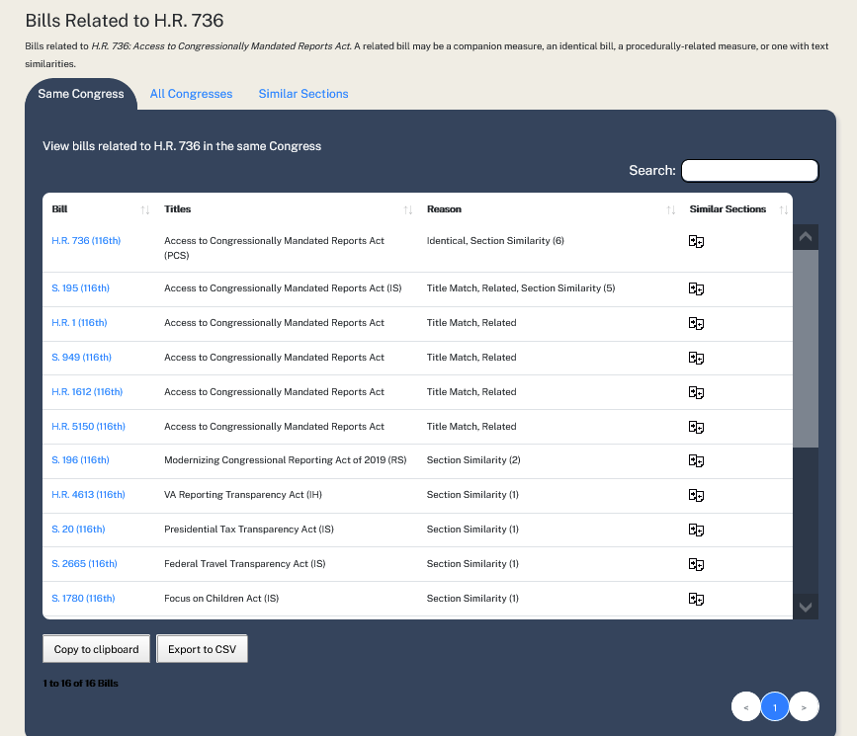
Tabs for related bills for the same congress, all congresses, & identifying bills with similar sections
Filtered search
How the bill is related: identical, related, title match, similar sections (n)
Link to section- by- section comparisons between two bills
Download as csv

Slide 8
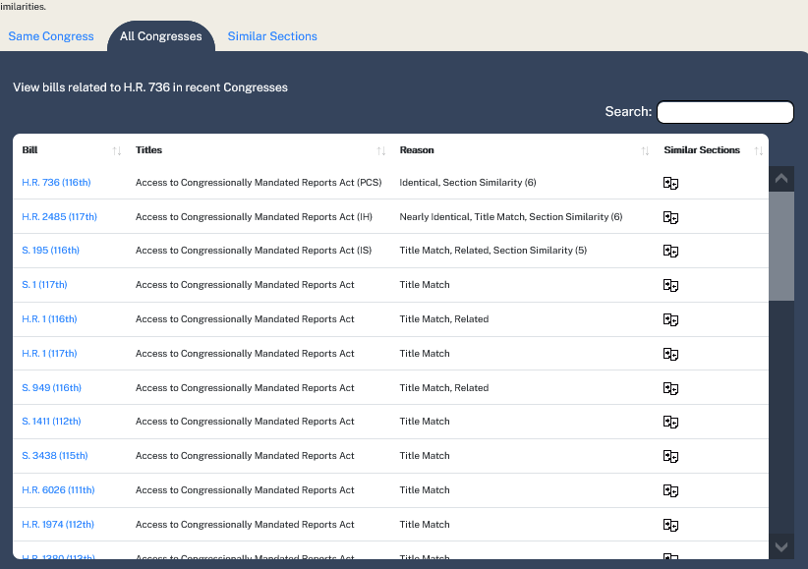
This identifies related bills going back to the 111th Congress — and tells you how we know they’re related

Slide 9
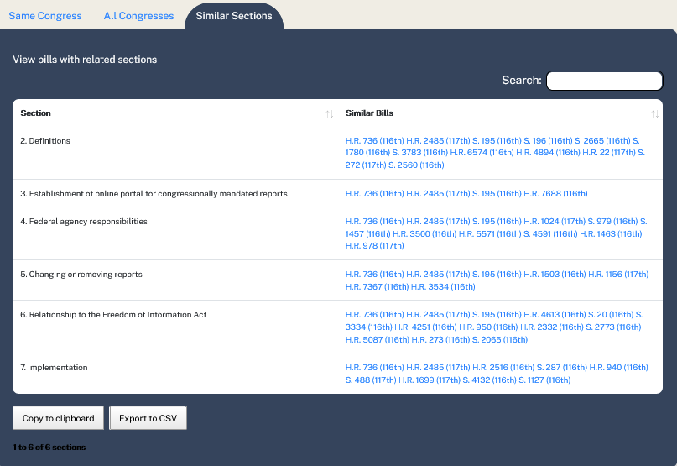
This identifies related sections in bills going back to the 111th

Slide 10
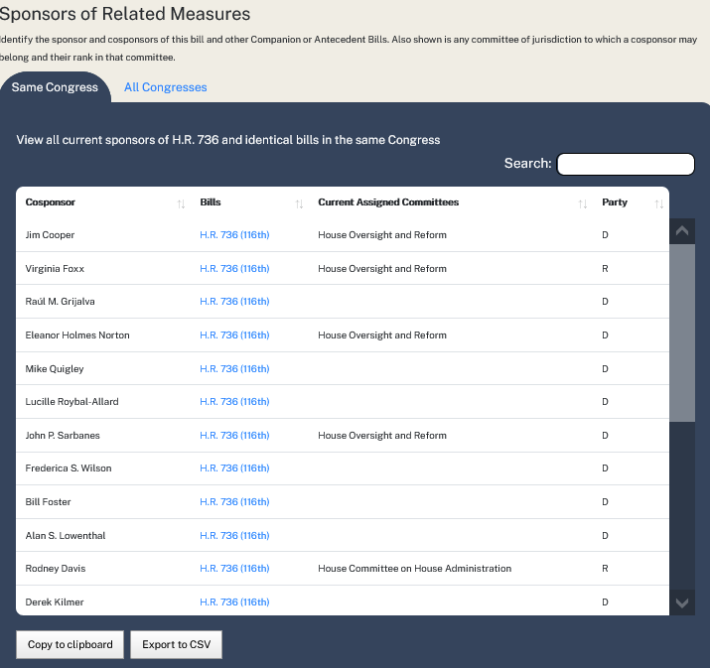
See cosponsors over multiple Congresses (to ID old co-sponsors)
Search filter
Are they on a committee of jurisdiction?
Cosponsors of this bill and nearly identical legislation
CSV download

Slide 11
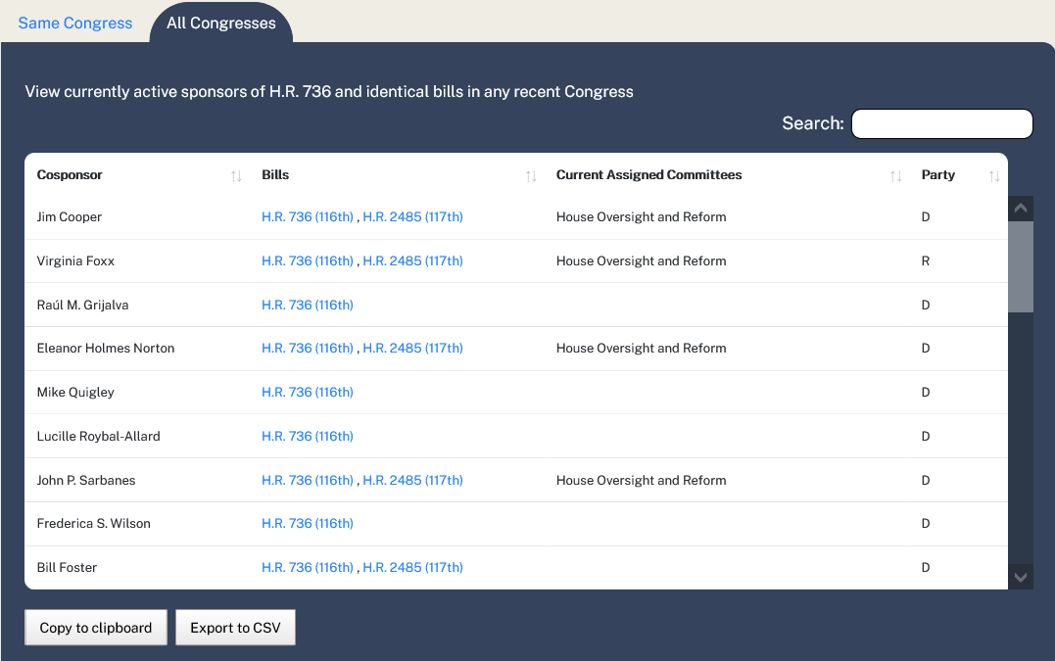
Sort by bill number by typing it into the search
See sponsoring
patterns

Slide 12
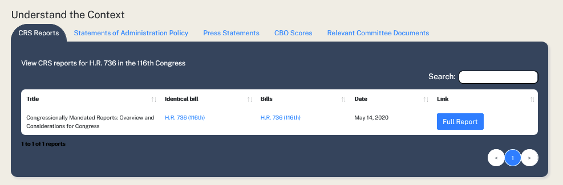
Range of docs: CRS Reports, SAPs, Press Statements, CBO Scores, Relevant Committee Documents
Integrates siloed or outside data connected to current or antecedent legislation: CRS Reports, Statements of Administration Policy, Press Statements

Slide 13
What’s next?
Finish building the website (Sept. 2021) + ensure regular data ingestion.
Integrating some elements into GovTrack.
Writing up what we’ve learned. Share the ideas we were unable to incorporate into the website.
Curious? The code is open source and online.

Slide 14
BillMap
(https://billmap.govtrack.us/)
Daniel Schuman | Daniel@DemandProgress.org

