Slide 1
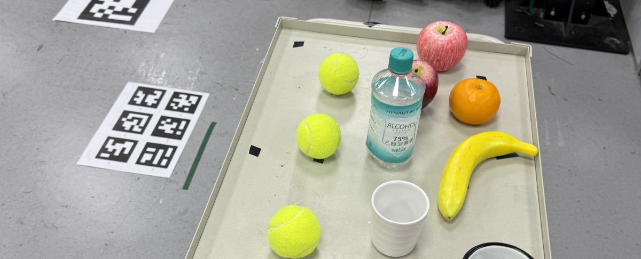
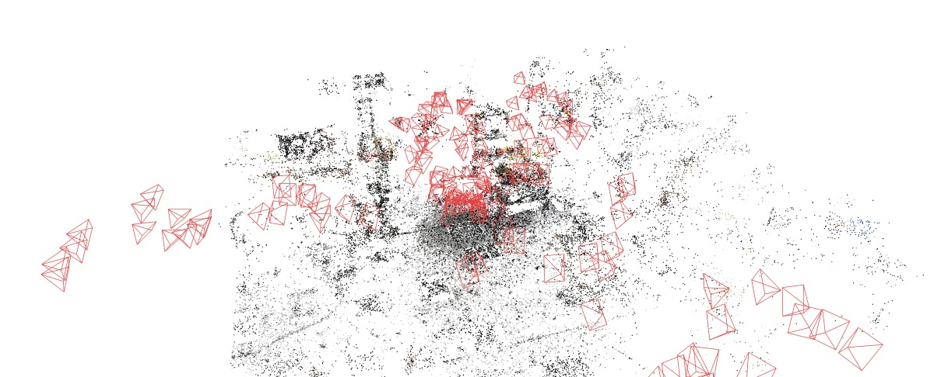
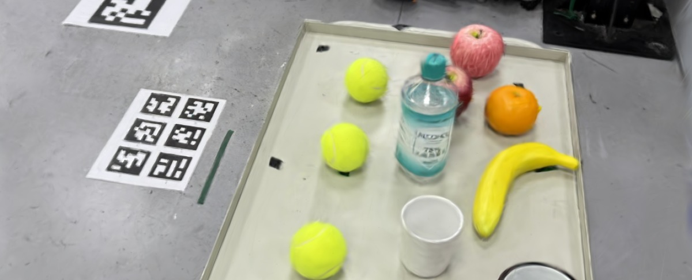
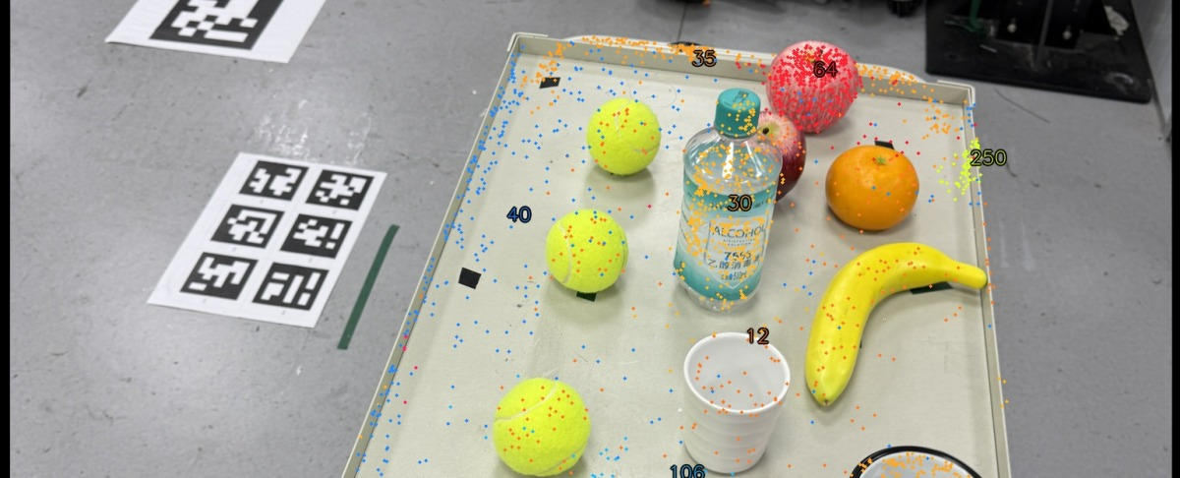
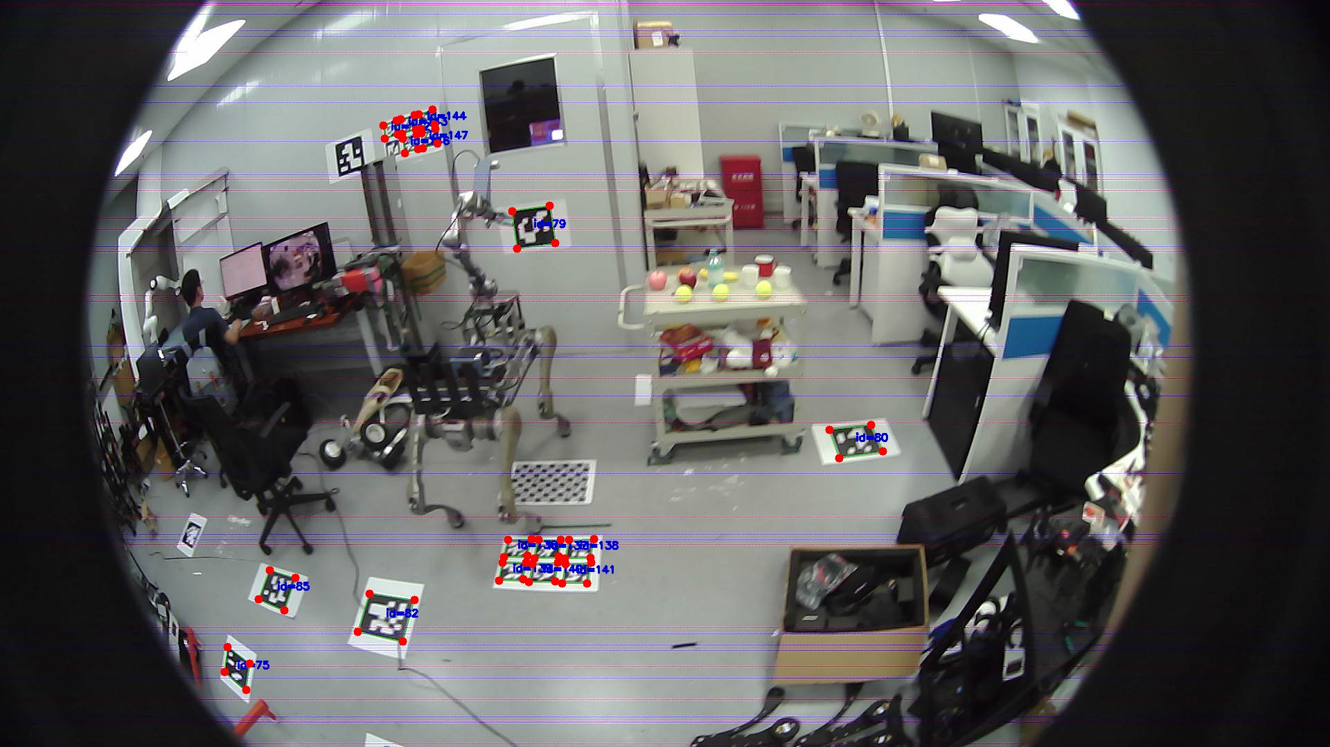
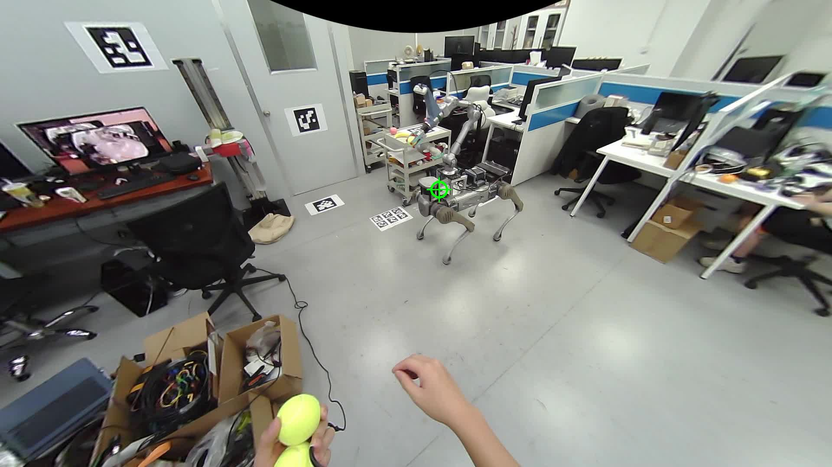
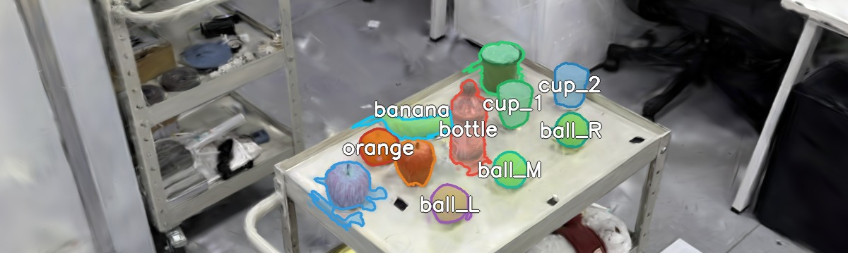
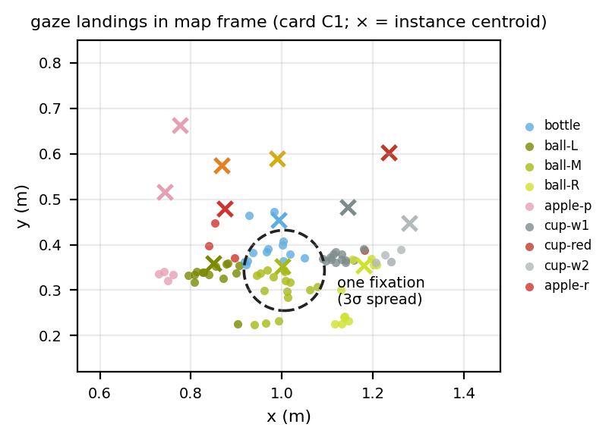
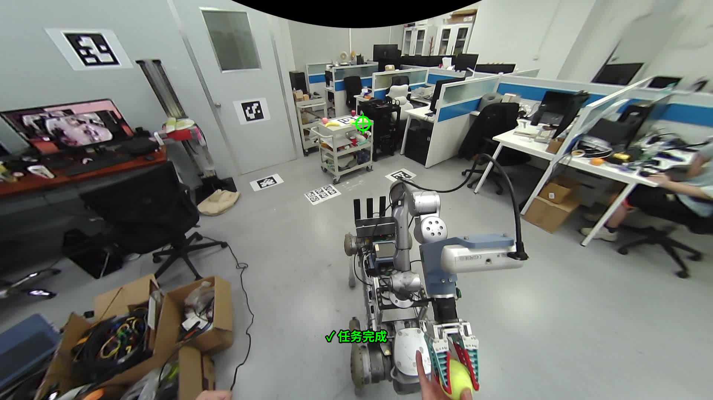
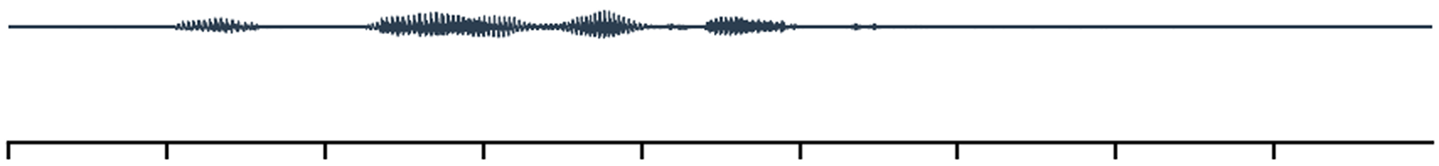
Offline, once: mapping & naming
Phone capture
COLMAP + board alignment
3DGS training (board frame)
SAM → instances
Named registry
259 instances · 15 named
ball_L · ball_M · ball_R
apple ×2 · cup ×3 · banana
orange · bottle · box ×2 · cart
Wearer localization
fisheye ArUco PnP vs. wall tags
Shared 3DGS instance map
one metric frame for human & robot
Robot localization & navigation
same surveyed tags
World-frame fixation clustering
stable while walking
Last-meter disambiguation
hint projected into grasp camera
lastmeter.jpg
Continuous ASR
open mic + energy gate
LLM slot parsing
action + 3 reference slots
Eye–voice binding
-4 s … +0.5 s window
Confirm, then dispatch
refuse rather than guess
Fetch & delivery
grasp + hand-over
“Bring me that ball.”
fetch(object = <that>)
<that> -> ball_2
(draw fixation timeline here)
target: p_obj
approach: d_app
object_hint: c(ball_2)
→ “bring me that one”
gaze channel
speech channel
shared map
robot execution
surveyed tag
dashed = image placeholder — replace with real asset, then delete this legend item

