Slide 1
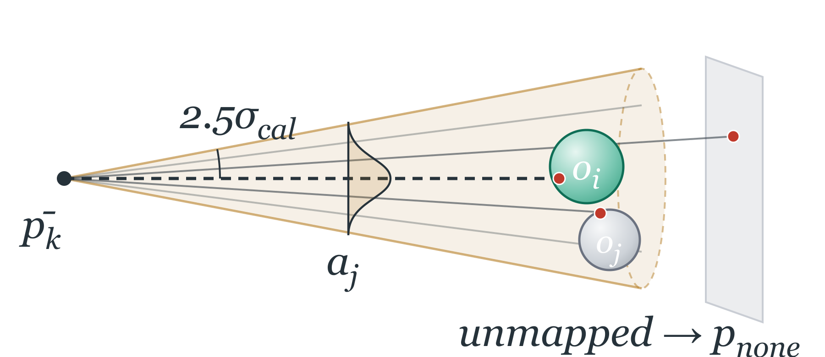
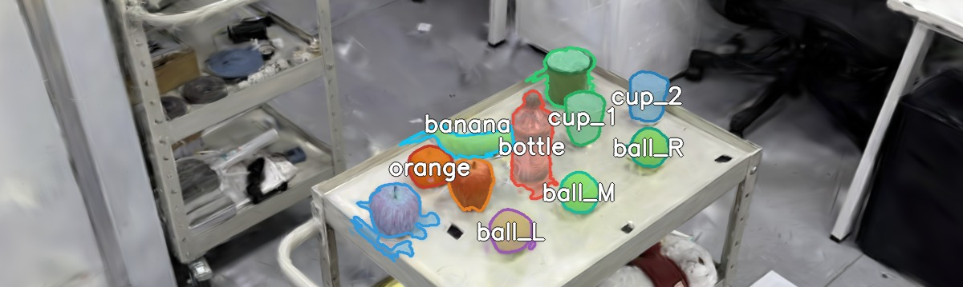
Offline, once: mapping & naming
phone capture
COLMAP + board alignment
3DGS (board frame)
SAM cross-view instances
named registry: 259 instances · 15 named
Wearer gaze →
world fixations
Conical posterior voting
Shared 3DGS instance map
Robot execution
one metric frame for human & robot
LIO-SAM + A* nav
tags → world frame
fisheye ArUco PnP
(wall tags)
move · pick · place
undistort · bias ·
pose → world ray
last-meter: hint → grasp cam
cluster → fixations F_{k}
local depth + opacity inside the cone
a_{j} = exp(−θ_{j}²/2σ_{cal}²), V_{i} = Σ a_{j}α_{j}
persistent instance IDs shared with robot
stable while walking
q_{i} ∝ π_{i}V_{i}, p_{none} = 1 − ΣV_{i}/Z
lastmeter.jpg
q_{i} ≥ τ → ô else reject ∅
Speech → command
streaming ASR
LLM parse: action + slots
deictic word ↔ fixation window
confirm → c = (a, ô, d)

