Slide 1
MCU
MCUlv1
Programmer
Gnd
TOP
Carrier
10k
R10k
Vcc
RST
TX
RX
ADC
RX
TX
10k
R10k
Vcc
Gpio5/SCL
CH_PD/EN
Gnd
RST
Gpio16
Gpio4/SDA
10k
R10k
Gpio0
Vcc
Gpio14
Gpio12
R10k
Gpio2
10k
Vcc
R4.7k
Gnd
Gpio13
Gpio15
4.7k
Vcc
Vcc
Gnd
Gnd
Install resistors through holes, leaving end to MCU loose, on bottom side of board
lay traces leaving end s to MCU loose
Install MCU, wrap mcu end traces and resistors around MCU ‘pins’, fold flat to board (to later solder to headers), solder trace/resistor-to-MCU wrapped junctions
Install header and solder MCU-to-header

Slide 2
MCU
Programmer/v1
Programmer
Carrier
Gnd
TOP
10k
Vcc
RST
TX
DTR
RX
ADC
RX
RX
TX
10k
Vcc
CH_PD/EN
Gpio5/SCL
Gnd
TX
9
Gpio16
Gpio4/SDA
RST
Vcc
10k
Gpio14
Gpio0
CTS
Vcc
Gpio12
Gpio2
Gnd
10k
Vcc
Gpio13
Gpio15
Gnd
4.7k
Vcc
Vcc
Gnd
Gnd
15

Slide 3
MCU
DHT11 Temp & Humidity Carrier/v1
Programmer
Carrier
Gnd
TOP
10k
Vcc
RST
TX
RX
DHT11
ADC
RX
TX
Vcc
10k
DHT11
Vcc
Vcc
Gpio5
Gnd
Data
CH_PD/EN
Data
---
RST
Gpio16
Gpio4
10k
---
Vcc
Gnd
Gpio14
Gpio0
Gpio12
Gnd
10k
Gpio2
Vcc
Gpio13
Gpio15
Gnd
4.7k
Vcc
Vcc
Gnd
Gnd
Gpio4
Gnd
Gpio12

Slide 4
MCU
DHT11 (T&H) & BH1750 (lux)/v1
Programmer
Carrier
TOP
RST
TX
RX
BH1750
TOP
ADC
CH_PD/EN
Gpio5/SCL
DHT11
TOP
Addr
Vcc
Data
Gpio16
Gpio4/SDA
SDA
---
Gpio14
Gpio0
SCL
Gnd
Gpio12
Gpio2
Gnd
Gpio13
Gpio15
Vcc
Vcc
Gnd

Slide 5
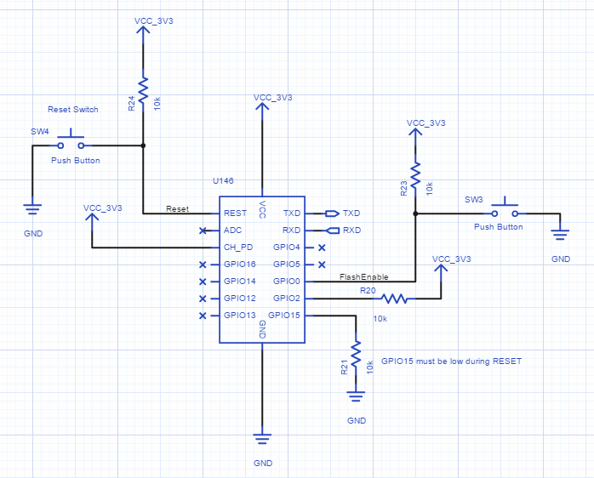
10k
4.7k

Slide 6
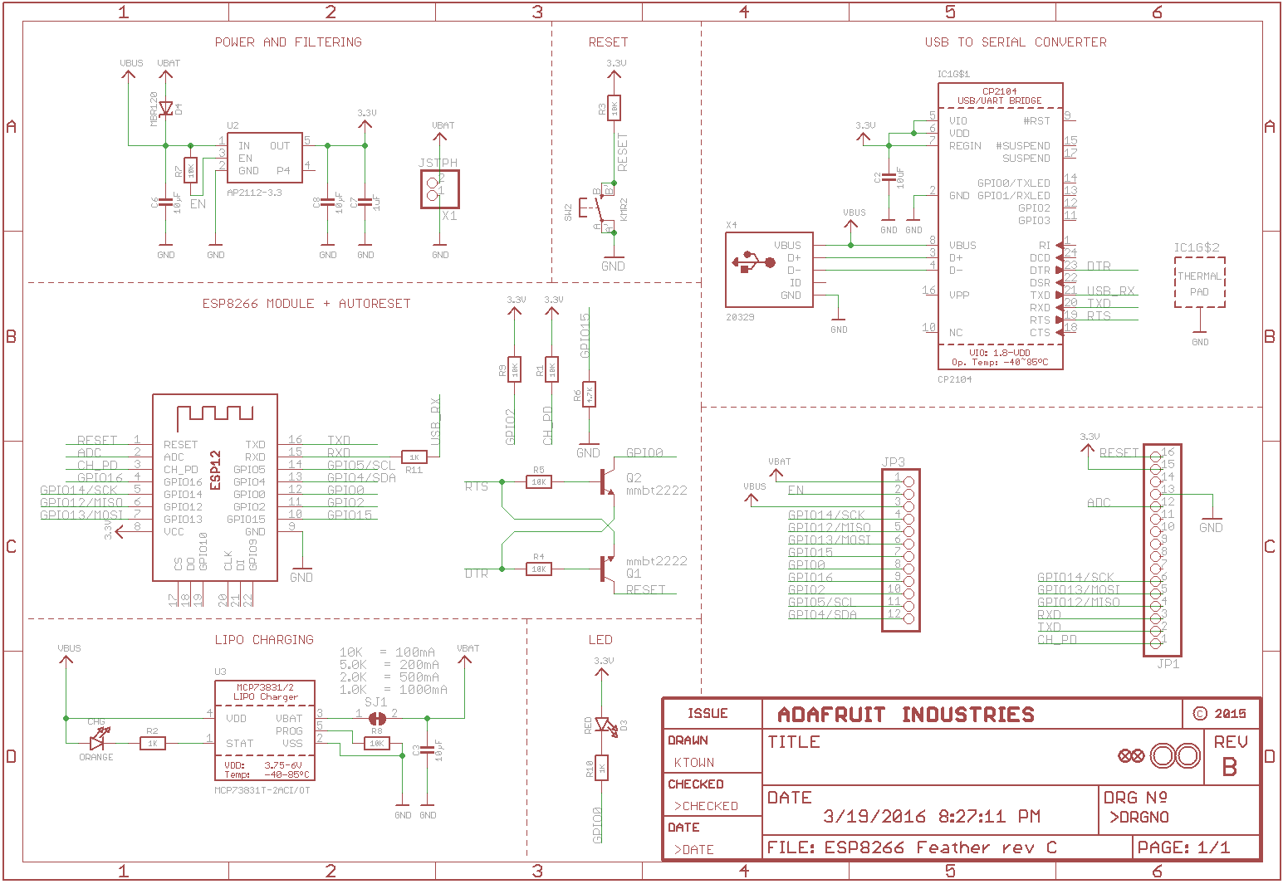

Slide 7
TX
BOTTOM
TOP
RX
DTR
Gpio5
RST
TX
RST
TX
RX
Gpio4
ADC
RX
ADC
RX
TX
Gpio0
EN
Gpio5
EN
Gpio5
Vcc
Gnd
VCC
Gpio2
Gpio16
Gpio4
Gpio16
Gpio4
CTS
Gpio15
Gpio14
Gpio0
Gpio14
Gpio0
Gnd
Gnd
Gpio12
Gpio2
Gpio12
Gpio2
Gpio13
Gpio15
Gpio13
Gpio15
RST
Vcc
Gnd
Vcc
Gnd
ADC
EN
Gpio16
Gpio14
R10k
Gpio12
Gpio13
Vcc

