Slide 1
EMD Step by Step
2024.05.07
judewang@zju.edu.cn

Slide 2
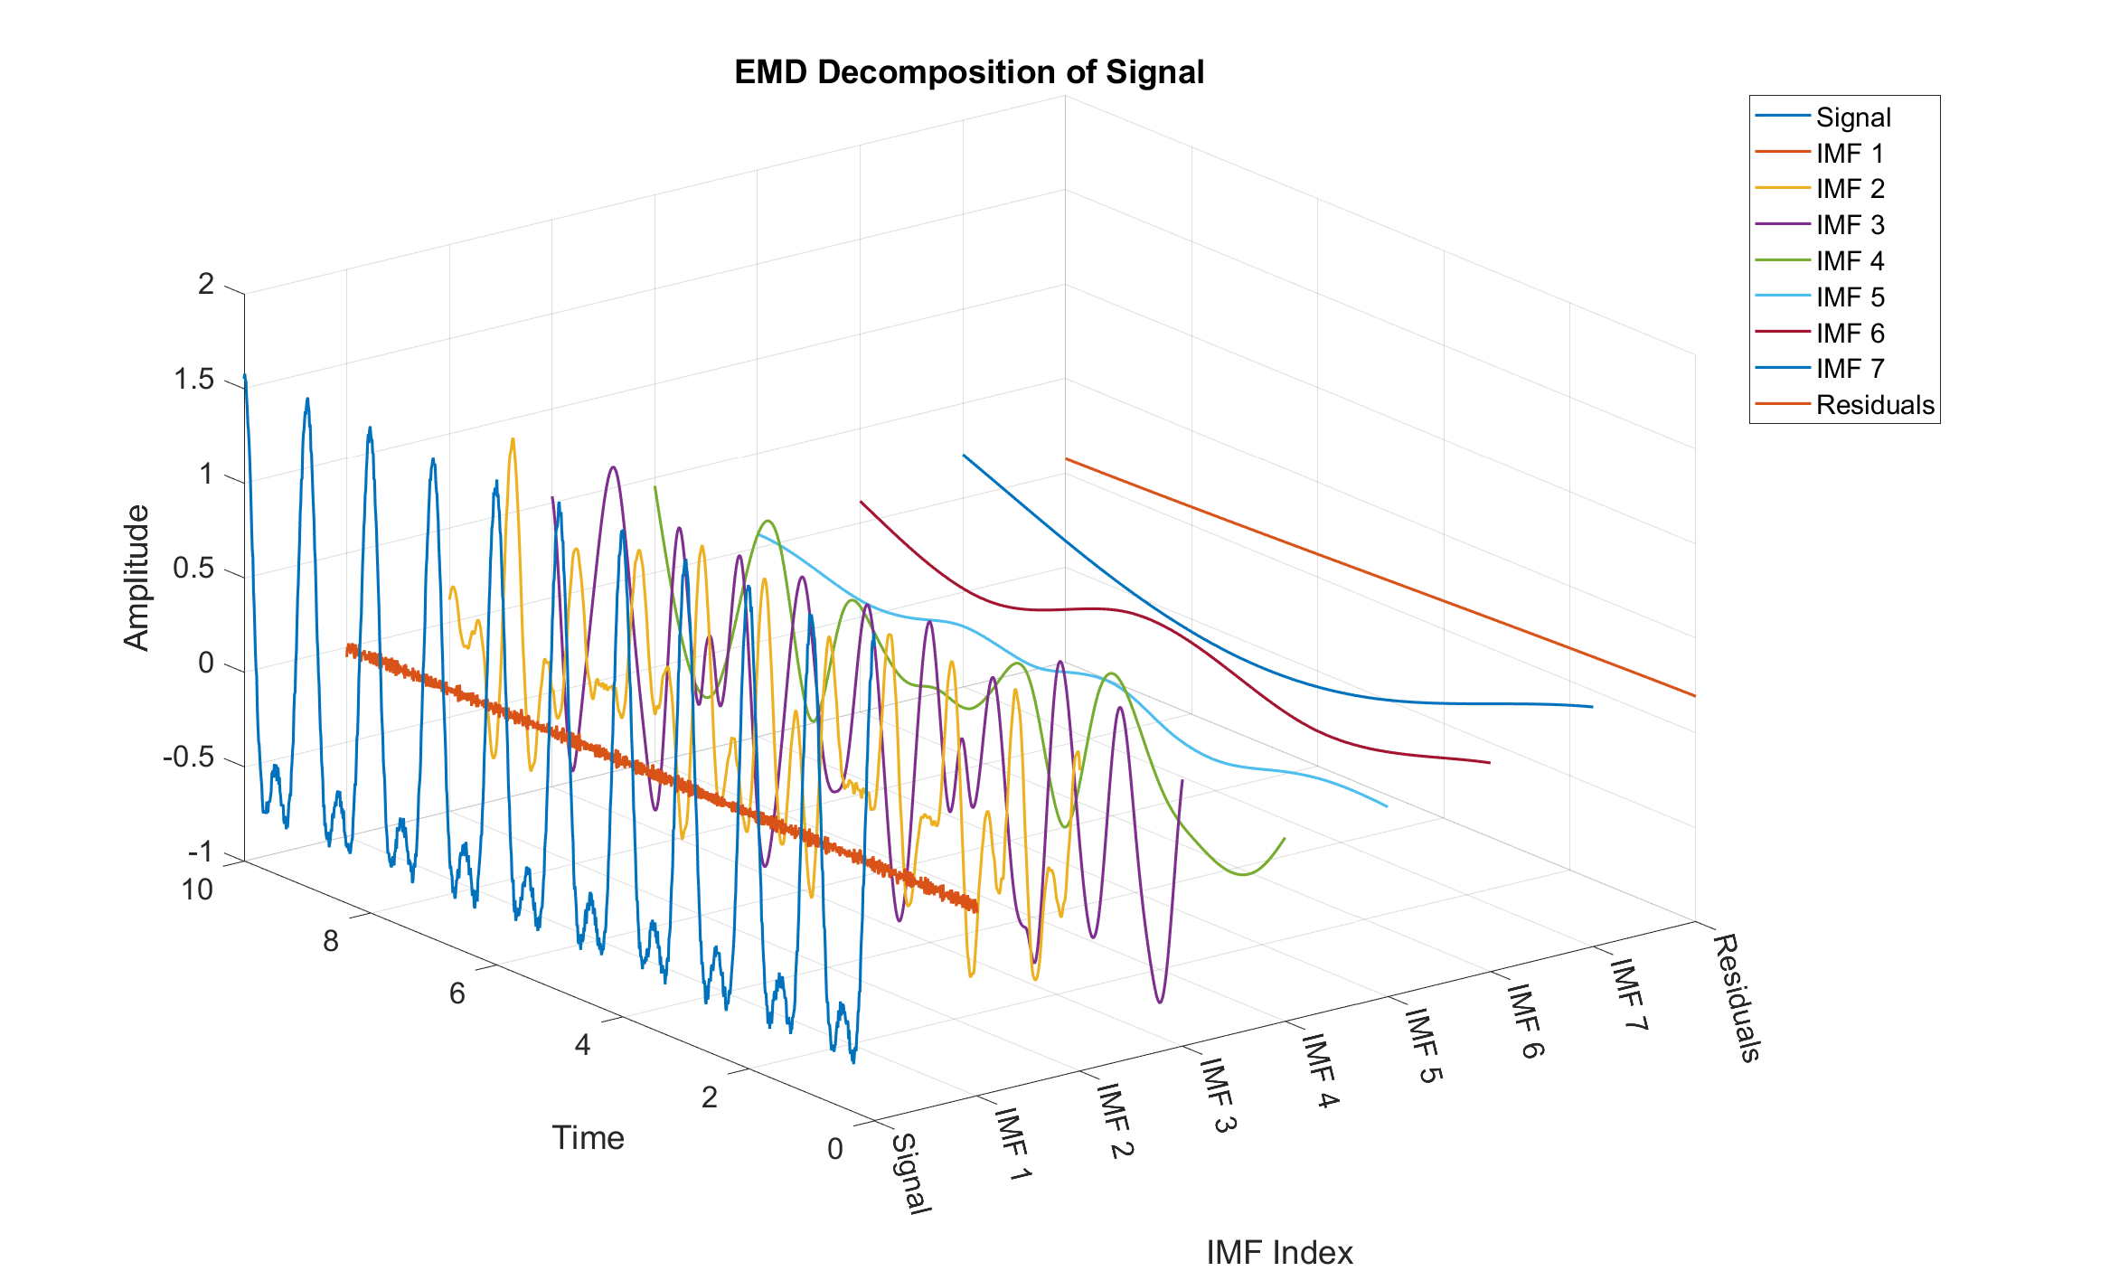
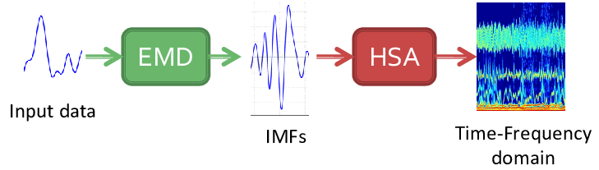
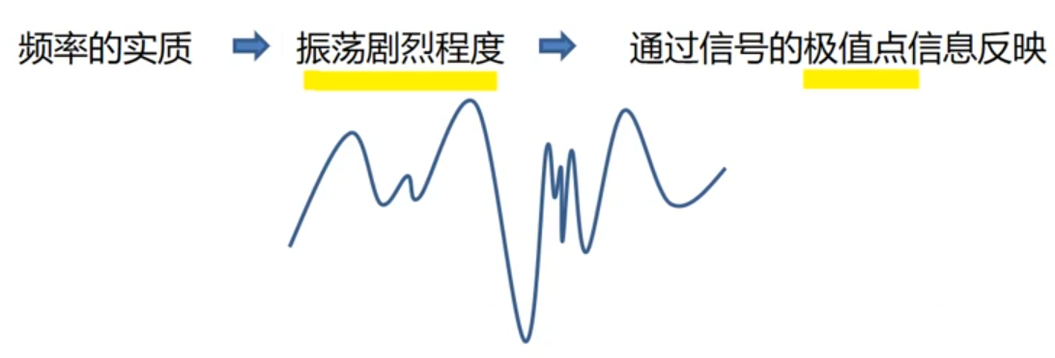
Introduction
(Empirical Mode Decomposition, EMD)经验模态分解用于非平稳非线性信号处理
EMD中，认为频率的实质是通过极值点反映的振荡的激烈程度，并通过这种瞬时频率将信号分解为若干本征模态函数（IMF: Intrinsic Mode Function）
相较于STFT，小波变换等非平稳信号频谱分析工具，EMD不存在人为设定参数，一切基于信号的数据，因此被称为Empirical
EMD是HHT的一部分，也可以单独来使用

Slide 3
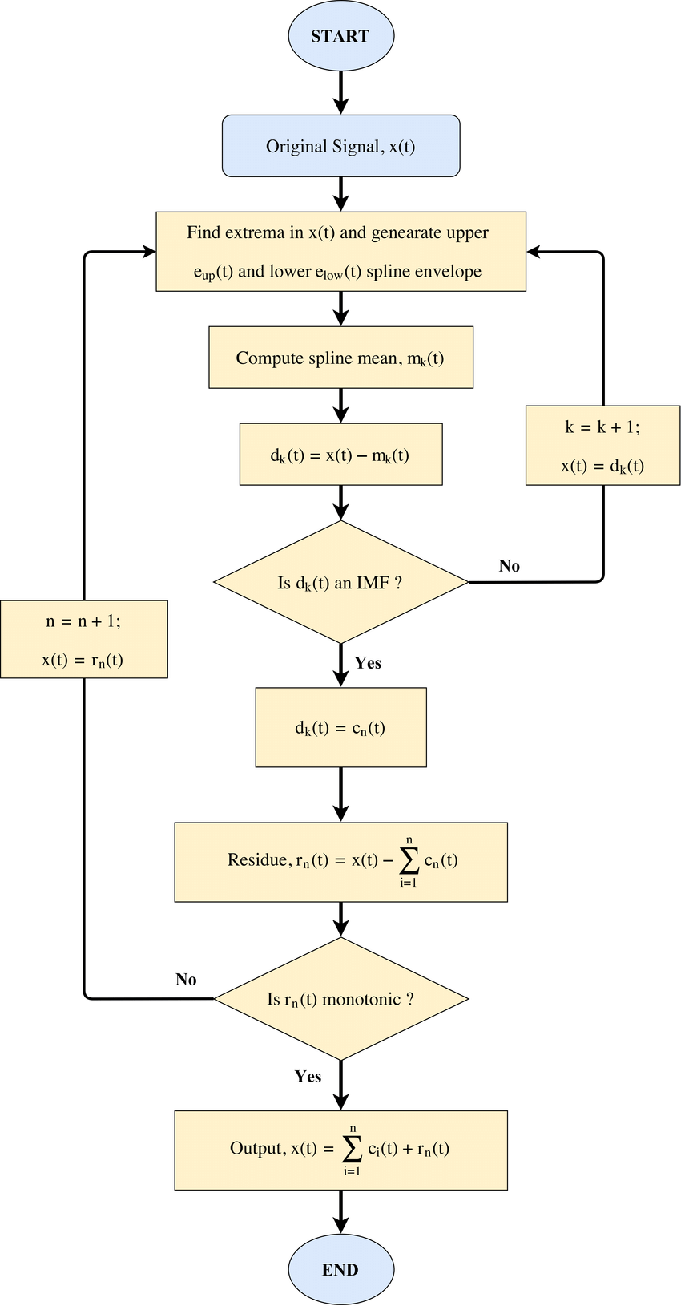
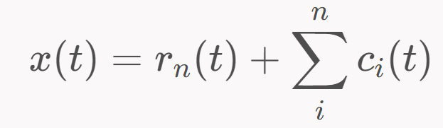
EMD Step by Step
Identify all extrema of x(t)
Create an envelope of minima and maxima from the array of minima and maxima.
Interpolate the value of minima and maxima to create an envelope of minima and maxima using a cubic spline.
maxima envelope: emax​(t)
minima envelope: emin​(t)
Compute the mean from the envelope of minima and maxima m(t)=2emax​(t)+emin​(t)​
Extract the detail c(t)=x(t)−m(t)
Iterate 1-4 with x(t)←c(t) until c(t) is zero-mean
or some stopping criteria
The resulting c(t) is the intrinsic mode function (IMF)
Iterate 1-5 on the residue m(t)=x(t)−∑ci​(t)
Until some stopping criteria
Peak Frequency is low
Residuum signal is just a constant, monotonic, or just have 1 extremum

Slide 4
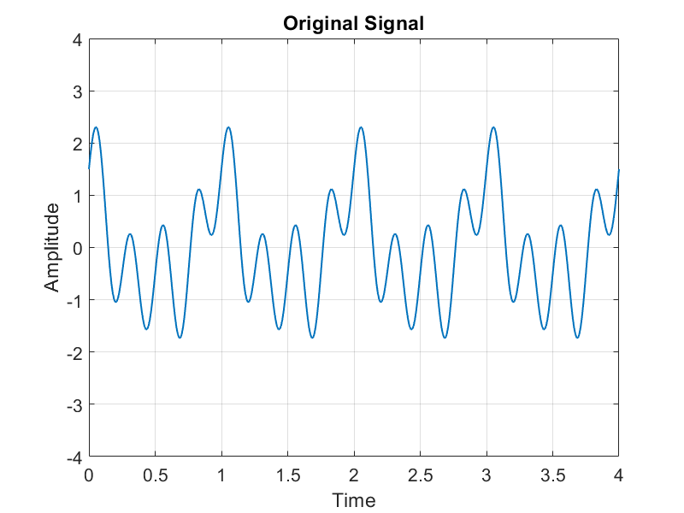
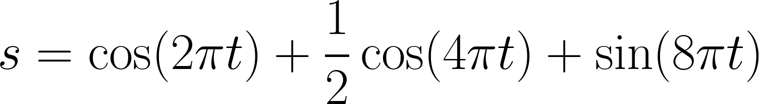
EMD Step by Step
a). Signal Input

Slide 5
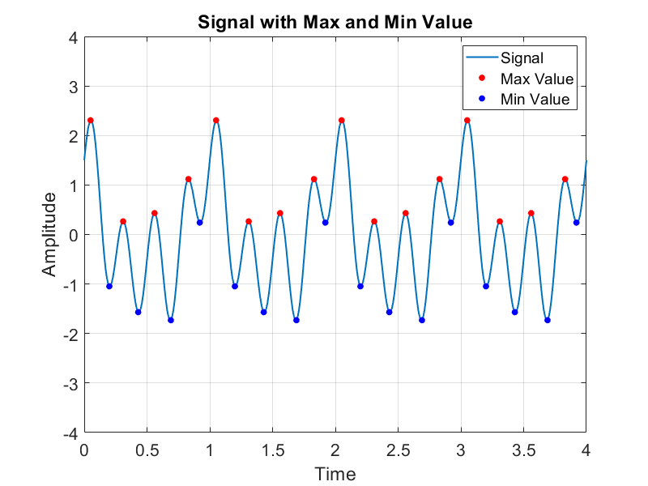
EMD Step by Step
b). Identify all extrema of x(t)

Slide 6
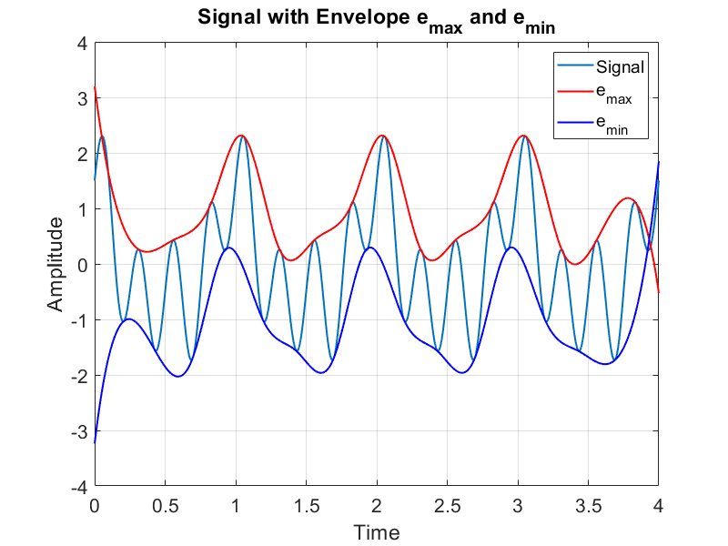
EMD Step by Step
c). Create an envelope of minima and maxima from the array of minima and maxima.
Interpolate the value of minima and maxima to create an envelope of minima and maxima using a cubic spline.
maxima envelope: emax​(t)
minima envelope: emin​(t)

Slide 7
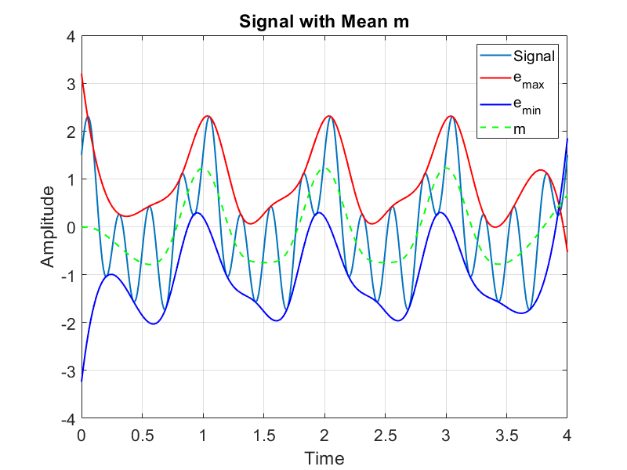
EMD Step by Step
d). Compute the mean from the envelope of minima and maxima m(t)=2emax​(t)+emin​(t)​

Slide 8
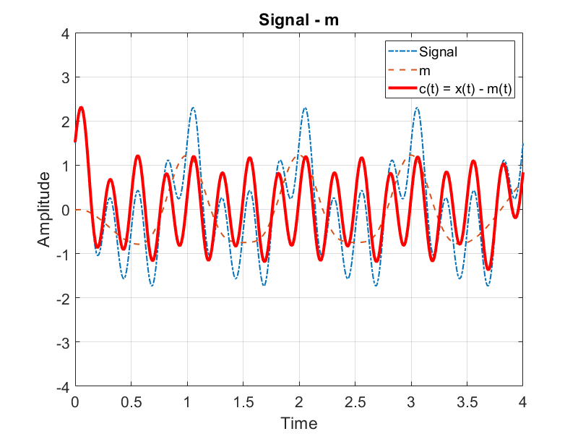
EMD Step by Step
d). Extract the detail c(t)=x(t)−m(t)
e). Iterate a-d step with x(t)←c(t) until c(t) is zero-mean
or some stopping criteria
The resulting c(t) is the intrinsic mode function (IMF)

Slide 9
EMD Step by Step
d). Extract the detail c(t)=x(t)−m(t)
e). Iterate a-d step with x(t)←c(t) until c(t) is zero-mean
or some stopping criteria
The resulting c(t) is the intrinsic mode function (IMF)

Slide 10
EMD Step by Step
d). Extract the detail c(t)=x(t)−m(t)
e). Iterate a-d step with x(t)←c(t) until c(t) is zero-mean
or some stopping criteria
The resulting c(t) is the intrinsic mode function (IMF)

Slide 11
EMD Step by Step
e). Iterate above steps on the residue m(t)=x(t)−∑ci​(t)
Until some stopping criteria
Peak Frequency is low
Residuum signal is just a constant, monotonic, or just have 1 extremum

Slide 12
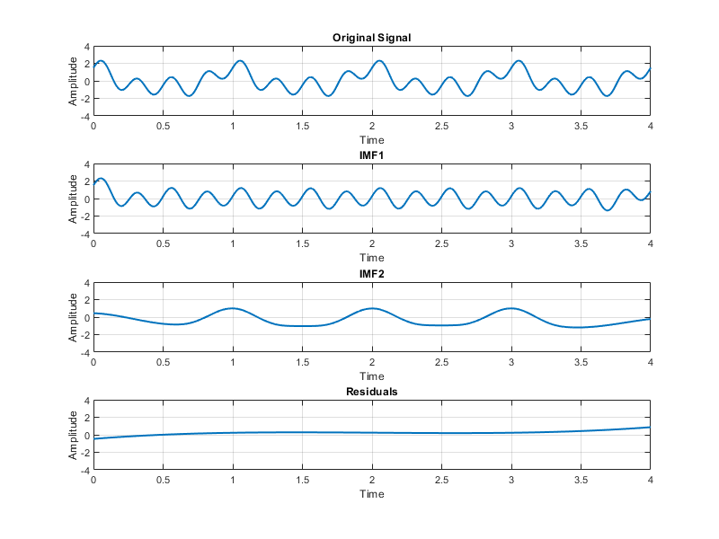
EMD Step by Step

