Slide 1
GCP Enterprise Data Platform
MVP demo — end-to-end pipeline, live
60-minute session · a single change followed from commit to curated data
100%
0
3
4
Infrastructure as code
Console access
Governed zones
Source views, parallel
Notes:
Good morning everyone, and thanks for joining. Today I'll walk you through the MVP we've built for the GCP Enterprise Data Platform. Quick framing before we start: not long ago this environment was at design stage — manual steps, Google-default encryption, nothing running end to end. What you'll see today is the opposite of that: a working pipeline where a single change flows all the way from a commit to curated, consumable data. It's deliberately a thin slice — four source views — because the goal was to prove the whole chain works together, not to build every feature yet. The whole thing is infrastructure-as-code, there's zero console access, and it runs across three governed data zones.

Slide 2
Agenda
60-minute session
1
Welcome & context — where the programme stands and what this MVP proves
3 min
2
What's new & what to expect — capabilities delivered; what's live vs in development
4 min
3
Architecture walkthrough — the end-to-end platform at a glance
3 min
4
Live demo: commit → curated — a single change, followed through the full pipeline
37 min
5
What's next — new workstreams beyond the MVP
5 min
6
Q&A & discussion — open floor
8 min
Notes:
Here's how I'll use the hour. I'll spend the first ten minutes or so on context — what's new, what you'll see live versus what's still in development, and a quick look at the architecture. Then the bulk of the session, around 37 minutes, is the live demo itself — I'll take one change and follow it the whole way through. I'll close with where we're headed next, and leave a good chunk of time for your questions. If we run short anywhere, I'll protect the demo block — that's the part worth seeing.

Slide 3
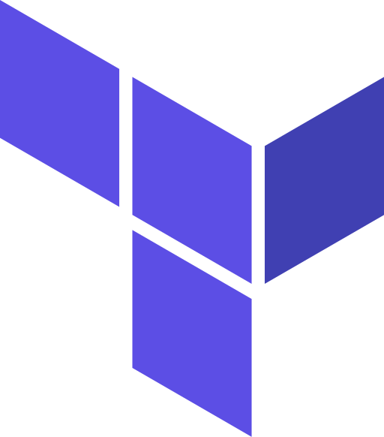
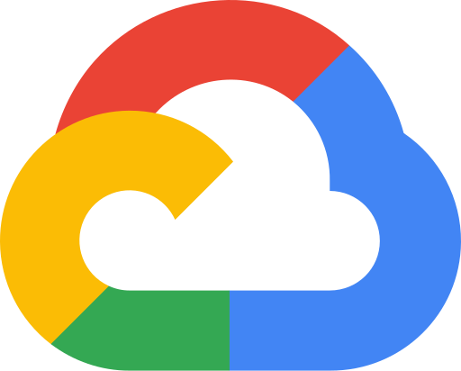



What's new in the GCP environment
Capabilities delivered in this MVP — from design-stage to a working end-to-end pipeline.
In scope: the pipeline spine, proven end to end. Not in this MVP: full source coverage · production hardening · legacy decommission.
Standardised Terraform foundation
EKM encryption everywhere
Automated CI/CD delivery
One reusable infrastructure-as-code baseline for every service.
Externally-held keys (Cloud EKM) across BigQuery, GCS and Composer.
Pull request to production via GitHub Actions, JFrog and Terraform — no console.
Parallel ingestion with fail-safe
Governed three-zone model
Operations & observability
Concurrent source-to-raw loads; a single failure halts the run.
raw → staging → curated, with full dbt lineage.
Centralised orchestration, logging, monitoring and alerting.
Notes:
So what's actually new here — six things, and they're all live. We've got a standardised Terraform foundation: one reusable baseline instead of bespoke setups per service. Encryption uses our own external keys, not Google's defaults, across BigQuery, GCS and Composer. Deployment is fully automated — a pull request goes all the way to production through CI/CD, with nobody touching a console. Ingestion runs in parallel with a fail-safe I'll show you shortly. Transformations run through a governed three-zone model with full lineage. And it's all observable — orchestrated, logged, monitored and alerted. The bar at the top matters: this MVP proves the spine end to end. It deliberately does not cover every source, production hardening, or the legacy decommission — those come later, and I'll be clear about that line throughout.

Slide 4
What to expect today
What's running live in this demo — and what's in active development.
Live & demoed today
CI/CD deploy · parallel ingestion → raw · dbt raw→staging→curated · Composer orchestration · logging, monitoring, alerting, lineage
In continuation — in active development & integration; described today, not part of the live demo
Control-plane DAGs
Schema-drift detection
dbt versioning
Standardised, reusable pipeline control pattern across sources.
Catch dropped or changed source columns before they break loads.
Versioned dbt models and controlled releases.
Data-quality alerting
Data freshness
Automated alerts on dbt data-quality test failures.
Freshness tracking and SLAs surfaced to consumers.
Notes:
Quick expectation-setting so nobody's surprised. Everything in the green bar is live, and I'll demo all of it today — the CI/CD deploy, parallel ingestion, the dbt transforms, Composer orchestration, and the observability. The amber items below are in active development and integration right now — control-plane DAGs, schema-drift detection, dbt versioning, data-quality alerting and freshness tracking. I'll talk about those and where they're going, but they're not part of today's live run. I wanted to draw that line clearly so you know exactly what you're looking at, and what's still coming.

Slide 5
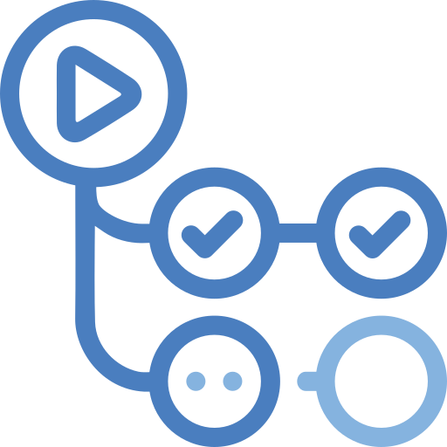
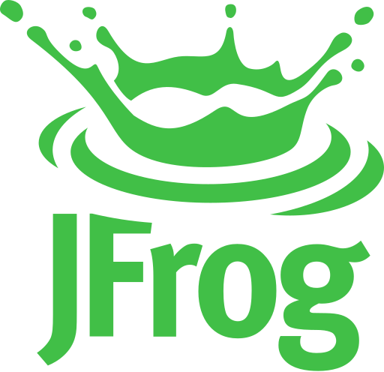
End-to-end platform — commit to curated
VPC Service Controls perimeter
Orchestration: Cloud Composer · Airflow
Sources
upstream
Ingestion
parallel
Raw
Staging
Curated
serving
Consumers
BI & apps
Secret Manager
Oracle credentials
dbt transform · Airflow BashOperator
provisions & deploys all platform infra
GitHub
PR · merge
GitHub Actions
self-hosted
JFrog
private PyPI
Terraform
deploy
Observability Structured logs (correlation_id) · monitoring · actionable alerting · dbt lineage
New / improved in this MVP
Existing / external
Notes:
This is the whole platform on one slide. Read it left to right along the top: data comes from our sources, gets ingested in parallel into the raw zone, dbt moves it through staging into curated, and curated serves our BI tools and apps. The teal is everything we built; the grey at the two ends is the world either side that we connect to. A few things worth pointing at. Ingestion pulls its Oracle credentials from Secret Manager at runtime — nothing's hard-coded. dbt currently runs through an Airflow BashOperator. The whole platform sits inside a VPC Service Controls perimeter, so nothing leaves the boundary. And down at the bottom, that CI/CD lane is what provisions and deploys everything you see above it, with observability running underneath all of it.

Slide 6
What you'll see — live
One change, followed from commit to curated data.
1
Commit & merge A small change goes up as a pull request and merges to main.
2
Build & deploy GitHub Actions pulls from JFrog; Terraform provisions and deploys — no console access.
3
Orchestrate Composer picks up the change and triggers the DAG.
4
Ingest in parallel Source extracts load concurrently into raw; Oracle credentials pulled from Secret Manager.
5
Transform dbt runs raw → staging → curated via BashOperator; lineage is captured.
6
Observe Structured logs (correlation_id), monitoring, alerting and lineage confirm the run.
Watch for: a deliberate source failure — the alert fires and dbt does not run, so no partial data reaches consumers.
Notes:
Now the main event. I'm going to make one small change and we'll follow it the whole way through. It starts as a pull request that merges to main. CI/CD picks it up — pulls packages from JFrog, Terraform deploys it, no console anywhere. Composer then triggers the pipeline. We'll watch the sources ingest in parallel into raw, with credentials coming from Secret Manager, and then dbt transforms raw to staging to curated, capturing lineage as it goes. Finally we'll confirm the run in the logs, monitoring and alerting. The one thing I really want you to watch for is the fail-safe: I'll deliberately break one source, and you'll see the alert fire and dbt simply not run — so no partial or wrong data ever reaches the dashboards. In a regulated environment, that's the behaviour that matters most. (Presenter cue: trigger the fresh run live to show it works, then cut to the pre-baked completed run for the downstream steps so we're not waiting on it.)

Slide 7
What's next
New workstreams beyond this MVP.
Source interfaces
SQL Server → BigQuery migration
Build ingestion interfaces for the remaining source systems.
Migrate the SQL Server estate into BigQuery.
UAT landing-zone provisioning
dbt on Cloud Run
Initiate provisioning of the UAT landing zone.
Move dbt execution from Airflow BashOperator to the Cloud Run operator.
Notes:
Beyond this MVP, there are four bigger workstreams ahead. We'll build ingestion interfaces for the remaining source systems. We'll take on the SQL Server to BigQuery migration. We'll stand up the UAT landing zone. And we'll move dbt execution off the BashOperator onto the Cloud Run operator, for better isolation and scaling. These are the larger pieces of work coming — separate from the in-flight items I showed earlier, which are already underway.

Slide 8
Questions & discussion
GCP Enterprise Data Platform · MVP delivered end-to-end
Notes:
That's the MVP — a working, governed pipeline from a commit all the way to curated, consumable data. I'd love your questions. Happy to take the business and scope questions first, then go as deep on the technical side as you'd like. And for anything that's more of a deep architecture discussion, we can pick it up in the architecture-team session.

